Slide 1
Draft Outdoor Advertising
July 2019
Land Use Planning and Transport

Slide 2
Outdoor Advertising locations
Zone 1: This zone consists of the most sensitive areas and primarily relates to Architectural Conservation Areas (ACA) which contain places, areas and groups of structures that exhibit unique, distinct character and qualities. There is a strong presumption against large outdoor advertisements within these areas. Smaller advertisements may be considered subject to sensitive design and siting.
Zone 2: This zone consists of urban centres that comprise retail and commercial uses. Outdoor advertisements may be permitted here subject to special development management measures.
Zone 3: This zone consists of the main transport corridors into, out of and within the county including the primary road network and Luas lines. There is an opportunity for the managed provision of outdoor advertising on these corridors in the public domain. Subject to compliance with the development management standards, compliance with road and transport safety requirements as set by TII and SDCC as set out in Section 7, the development of outdoor advertising in this zone will be open for consideration. (Further discussion with TII is required to inform this that may result in some changes, however, this will take place in advance of the policy variation going on public display in September).
Zone 4: This zone consists of existing and potential high amenity areas including the Grand Canal corridor, the Liffey Valley, the Dodder Valley, the Dublin Mountains and upland rural areas. There is a strong presumption against outdoor advertising in this zone.
Zone 5: This zone consists of significant developing areas where advertising could form an integral part of newly created streetscapes. This zone relates to certain strategic developments, regeneration areas or new residential communities where advertising may form part of new streetscapes, having regard to the need to protect residential amenities. Subject to compliance with development management, the development of outdoor advertising in this zone will be open for consideration.
Zone 6: This zone consists of predominantly existing residential areas where outdoor advertisements would generally be visually inappropriate. Within this zone, there are large areas of separate robust character and may have the potential to accommodate outdoor advertising.

Slide 3
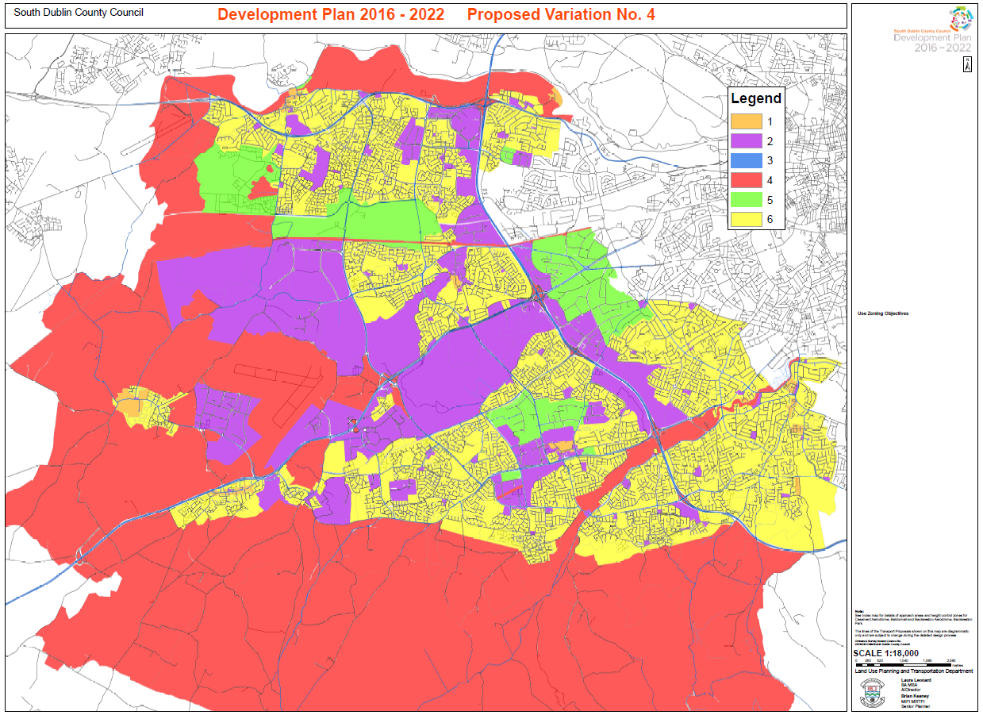
Outdoor Advertising locations

Slide 4
Process
July 2019: Notify Council of intention to vary the County Development Plan
September 2019: Public consultation on the proposed variation
Q1 2020: Brief Land Use Planning Transport SPC
Q1 2020: Council to consider and decide on final proposed variation

