Slide 2
Draft Scheme of Priority for Affordable Dwelling
Purchase Arrangements
7th May 2019

Slide 3
Context
Master Planning Large Council Owned Housing Sites
Affordable Housing in tenure mix for sites at Killinarden, Rathcoole & Clonburris
Terms of Affordable Schemes to be confirmed by DHPLG (Income/Eligiblity; Discount; Conditions;)
Legislative Requirement for Scheme of Priorities for Eligible Applicants to be adopted by Council by 18th June 2019 – can be amended subsequently

Slide 4
Context
Order of priority largely prescribed by legislation
Areas for consideration by elected members:
Define “Adequate accommodation”
Match household sizes with accommodation types
Decide distance (in kms) within which priority given to:
Household member working locally
Household member in full-time education locally

Slide 5
Scheme of Priority
S.85, Part V, Housing (Misc. Provisions) Act, 2009, 2018 Commencement Order & 2019 Regulations
In accordance with legislation and commencement of the relevant Part, each Housing Authority must make Scheme of Priority by 18th June 2019
Scheme must be considered by the Council and sent to Minister for approval.
Special Housing SPC held on 24th April 2019

Slide 6
Class A- Adequate Accommodation
Dwelling Type | To Meet Accommodation Needs of:
One-bedroom | One or two person household
Two- bedroom* | Two to Four person household (in the first instance, but also one or more person households where availability/supply exceeds demand)
Three/Four bedroom** | Three or more person household (in the first instance, but also one or more person households where availability/supply exceeds demand)
*Allocation of dwelling types will be prioritised in accordance with the table above but having regard to ensuring that overcrowding is not facilitated.
** Allocation of larger homes to smaller households will be facilitated where demand allows (concern about a young couple not being able to purchase a three-bed home)

Slide 7
Order of Priority
Priority Rating | Eligible* | Affordable Home Suited to Household Needs | Member of Household Living in County for 12 Months | Member of Household in Local Education** | Member of Household Working Locally**
1. “Class E” | ü | ü | ü | ü | ü
2. “Class C” | ü | ü | ü | ü
3. “Class D” | ü | ü | ü |  | ü
4. “Class B” | ü | ü | ü
5. “Class A” | ü | ü
*Eligibility criteria in relation to income to be confirmed by DHPLG
**Applicable distances to be set at the discretion of the Council
+Where number of “Class E” households exceeds number of available homes, “Time on List” will determine priority.

Slide 8
Considerations
Having regard for context of South Dublin:
Small administrative area
Large % of commuters out of County
Avoids arbitrary setting of distance which may exclude certain workers
Very challenging to cover all education types with one distance
Set both distances at 0 kms effectively giving no priority to either employment or education categories?

Slide 9
Considerations
DHPLG guidance:
0 kms distance conflicts with & negates legislative intent for local priority
Actual distance must be set to reflect priority;
Cannot cast net so wide to include everybody effectively removing priority
Education can be defined as primary & secondary only if desired;
Advice from Law Dept.:
Council required to adopt by 18th June – avoid potential challenges to a scheme that is first adopted post 18th June 2019
Set a limit now and review as and when necessary in future

Slide 10
Considerations
CSO data
Average straight line distance of worker commute:
Nationally 15km / South Dublin 8kms;
Only 7% of workers nationally commute >50kms to work
40% of students walk to school in South Dublin
Other LAs:
Range from 5-100kms for Education & 30-100kms for Employment
One has recommended 300kms for both – will not be allowed.

Slide 11
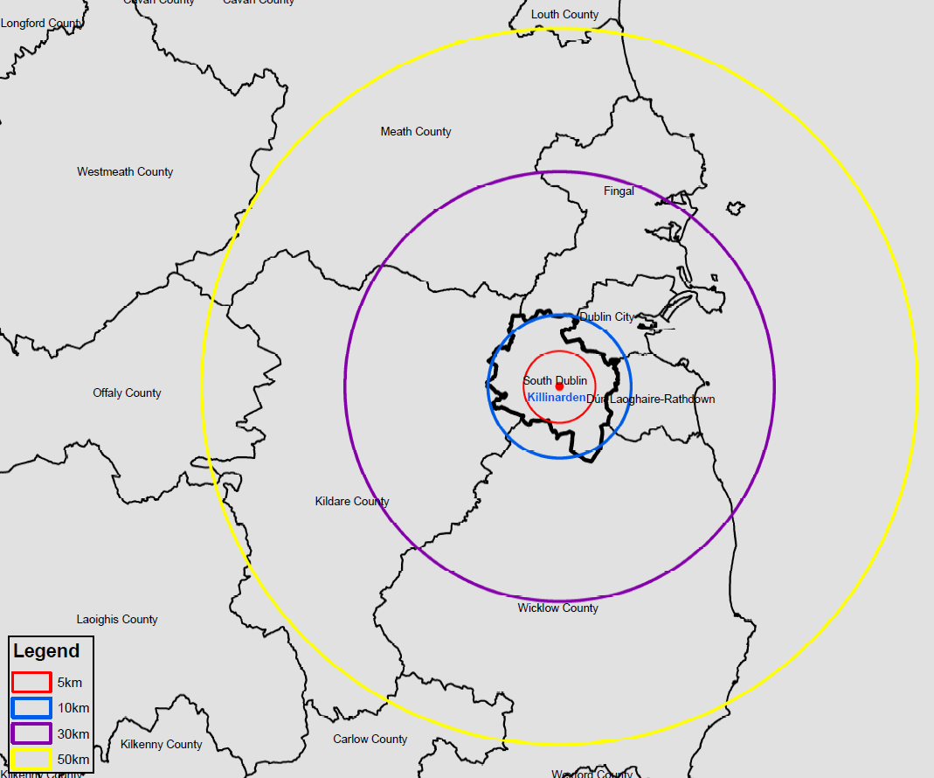

Slide 12
Recommendation:
Adopt draft scheme now with:
10kms distance for education (excluding third-level education)
30kms distance for employment
Meets the immediate legislative requirement
Further analysis on commuting and places of work & education by SPC in new Council term as required
Amend scheme as necessary in accordance with Members views before any affordable home delivery in the County

