Slide 1
River Poddle Flood Alleviation Scheme Update Presentation to SDCC Council Meeting May 7th 2019

Slide 2
Proposed Scheme
Increase storage at Tymon Lakes to reduce outflow downstream with a 200m long embankment.
Create additional flood storage at Wainsfort/Manor Green and Ravensdale Park (DCC)
Build flood defence embankments and flood walls along river course at vulnerable locations
Embankments to include 500mm freeboard, flood walls: 300mm
Clear trees and vegetation where defences are being installed
Upgrade culvert screens and screen maintenance mechanisms
Rehabilitate existing flood defence walls, structural assessment and replacement as required of existing walls along river route
Develop Asset register of River Poddle Flood Defences for SDCC/DCC Development Plan
Estimated flood defence lengths greater than 2,100m

Slide 3
Proposed Scheme Layouts – Tymon Park Lakes

Slide 4
Proposed Scheme Layouts – River Realignment at Rear of Grosvenor Court

Slide 5
Proposed Scheme Layouts – Wainsfort Manor

Slide 6
Proposed Scheme Layouts – Poddle Park

Slide 7
Schematic Layouts – Proposed Tymon Park Embankment

Slide 8
Schematic Layouts – Proposed Realignment Rear of Grosvenor Court

Slide 9
Schematic Layouts – Proposed Realignment of Poddle Park

Slide 10
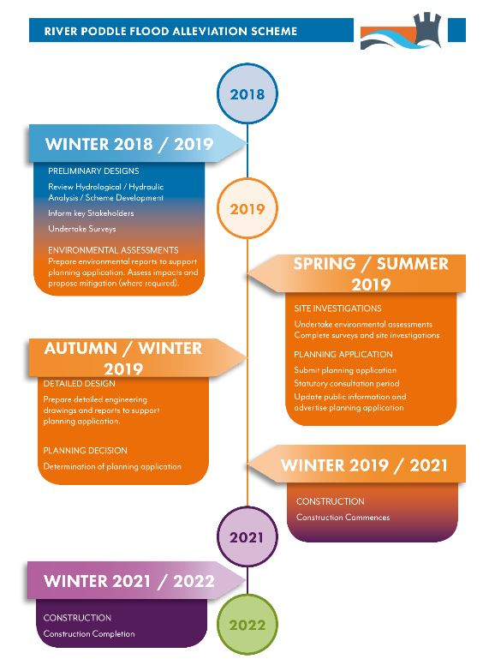
Future

