Slide 1
Dublin Agglomeration Environmental Noise Action Plan 2018-2023

Slide 2
What is Noise
Noise can be characterised as “unwanted sound” or “sound that is loud, unpleasant or unexpected”

Slide 3
Burden of disease
At least 100 million people in the EU are affected by road traffic noise above the assessment threshold specified in the Environmental Noise Directive (55dB Lden)
Over 83 million Europeans are exposed to harmful levels of noise from night-time road traffic (above 50 dB Lnight)
At least 1.6 million healthy years of life are lost due to road traffic noise in Western Europe
Source: WHO/JRC, 2011; EEA, 2017

Slide 4
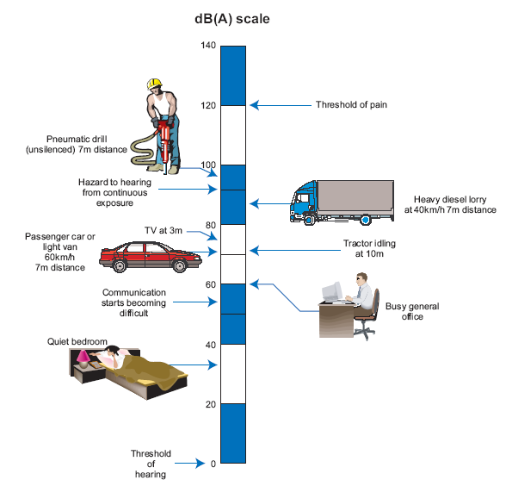
Levels of Typical Common Sounds on the dB(A) Scale

Slide 5
Objective of the Noise Plan The key objective of the Noise Action Plan is to avoid, prevent and reduce, where necessary, on a prioritised basis the harmful effects, including annoyance, due to long term exposure to environmental noise.

Slide 6
Background to the Plan
Environmental Noise Directive 2002/49/EC and the Europe Communities Environmental Noise Regulations (S.I. No. 549 of 2018)
The directive is commonly referred to as the END Directive
The Directive aims to identify an EU common approach aimed at avoiding, preventing or reducing the negative and harmful effects of the exposure to environmental noise

Slide 7
Traffic is the dominant environmental noise source in Ireland and throughout Europe.
Noise from railway and LUAS does not have a major impact in overall noise levels in Dublin.
Noise from industrial sources does not have a major impact
The noise modelling statistics for South Dublin show an improvement in overall noise levels since round two.

Slide 8
What scenarios require Noise Action Plans
An agglomeration with more than 100,000 inhabitants. This includes Dublin, Cork City and Cork County. The next round of noise action plans will incorporate Limerick City.
Any major road with more than 3 million vehicle passages per year (approximately 8,220 per day).
Any major railway with more than 30,000 train passages per year (approximately 82 per day); and
Any major airport with more than 50,000 aircraft take-off or landing movements per year (approximately 137 per day).

Slide 9
Designated Noise Action Planning Bodies
The Dublin agglomeration is made up of the 4 Local Authorities: Dublin City Council, Dún Laoghaire/Rathdown Council, Fingal Council and South Dublin County Council
Each Local Authority developed its own Noise Action Plan and it is added to the agglomeration as a Volume i.e. South Dublin is Volume 4.
A short summary of the key points of all 4 Noise Action Plans was then added to the noise action plan.

Slide 10
Designated Noise Action Planning Bodies cont.…
Transport Infrastructure Ireland(TII) is responsible for the development of strategic noise maps for all national roads carrying in excess of 3 million vehicles a year and for light rail lines (i.e. the Luas network) which has more than 30,000 passages per year.
Iarnród Éireann is responsible for the development of Strategic Noise Maps along specific sections of the rail network, ie within Agglomeration Areas and/or where the operational rail traffic exceeds 30,000 vehicle passages per annum.
Fingal County Council is the designated Action Planning Authority with responsibility for preparing a Noise Action Plan for Dublin Airport.

Slide 11
The EPA is the national authority for overseeing the implementation of the Regulations. This role includes supervisory, advisory and coordination functions in relation to both noise mapping and action planning.
The EPA’s Role in the Noise Mapping Process
The EPA is also responsible for reporting to the European Environment Agency (EEA) to meet the various requirements for noise mapping and action planning.

Slide 12
The Department of Communications, Climate Action and Environment (DCCAE)
The DCCAE are the lead authority in relation to policy issues.

Slide 13
Environmental Noise Indicators
L_{den} is an A-weighted average sound pressure level, measured over a 24 hour period, with a 10dB penalty for night and a 5dB penalty for evening. The den is an acronym for Day, Evening, Night.
L_{night} is an A-weighted average sound pressure level measured over an 8 hour period during night time, between the hours of 23:00 and 07:00.

Slide 14
Desirable and Undesirable Sound Levels
The following are the target values for desirable low and undesirable high sound levels in the Noise Action Plan 2018-2023:
Desirable Low Sound levels
< 50 dB(A) Lnight
< 55 dB(A) Lday
Undesirable High Sound levels
> 55 dB(A) Lnight
> 70 dB(A) Lday
Also, it is proposed to use the following absolute values as a criterion for defining a Quiet Area:
< 45 dB(A) Lnight
< 55 dB(A) Lday
< 55 dB(A) Lden

Slide 15
What is a Noise Map
A strategic noise map is designed to assess noise exposure in a given area, resulting from particular noise sources for major roads, major rail, major airports, & agglomerations.
These maps are normally prepared using computer modelling techniques know as noise predictor software.
Such techniques calculate the noise level at specific points resulting from the sound emanating from the source being studied, in this case road traffic, and the attenuation of the sound during propagation between the source and the receiver.
The modelling software uses source data such as traffic flow, type of road and rail, types of vehicles and speeds etc. plus terrain data such as contour lines, ground cover, building heights and locations, barriers and bridges.

Slide 16
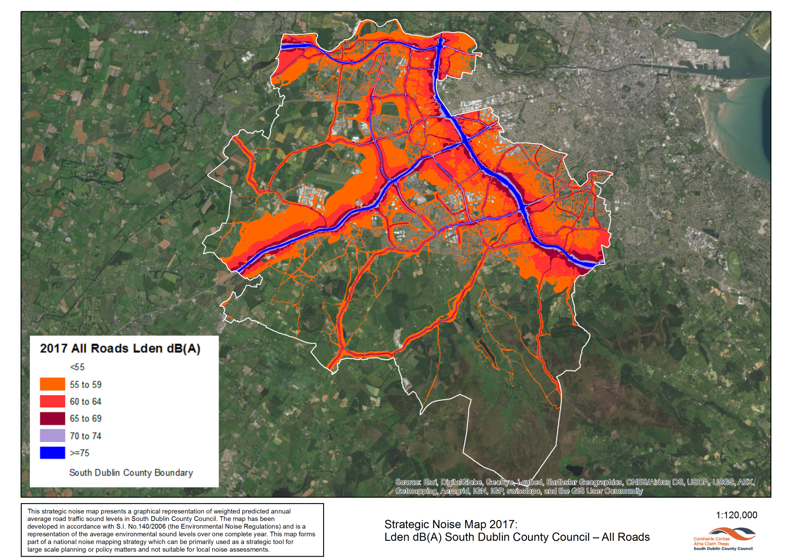

Slide 17
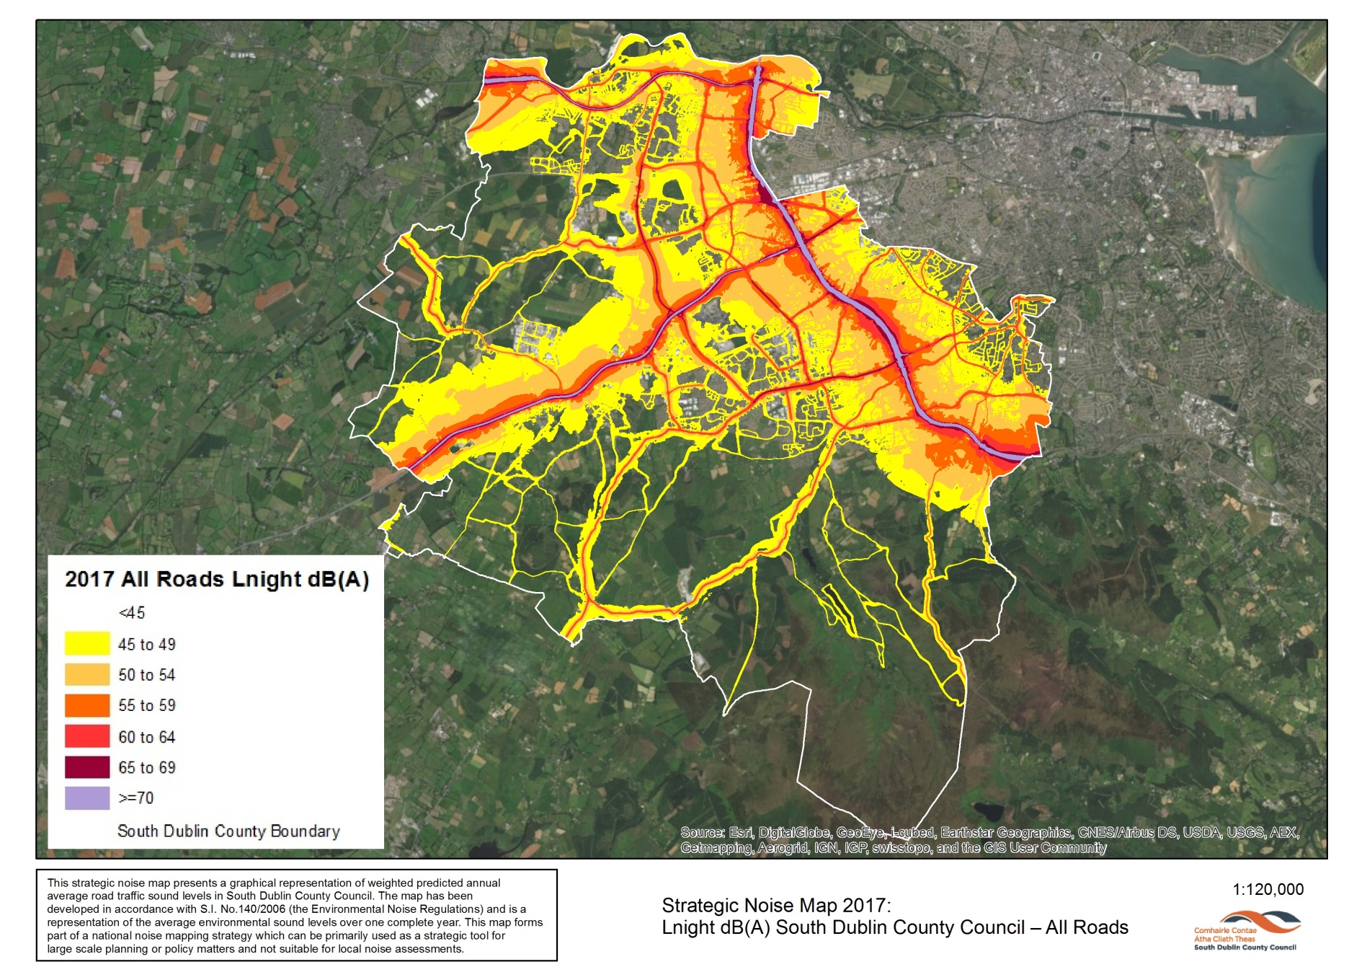

Slide 18
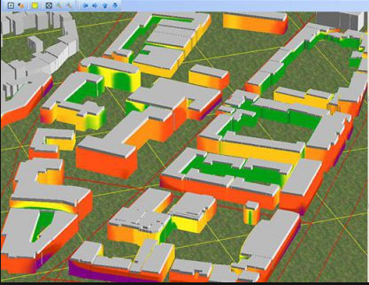
Noise Exposure
In order to identify how many people are exposed to environmental traffic noise using the predictor software all the dwellings within South Dublin County Council were mapped.
The 2016 CSO population data was then used to estimate the number of people exposed by simply dividing the postal addresses by the population.

Slide 19
Noise exposure levels – SDCC
Noise exposure levels from all roads – SDCC 2017
Decibels dB(A) | Lden number people Exposed 2017 | Lden % people Exposed 2017 | Lden number people Exposed 2012 | Lden % people Exposed 2012
<55 | 142800 | 51% | 67900 | 26%
55-59 | 81500 | 29% | 86100 | 32%
60-64 | 34700 | 13% | 58900 | 22%
65-69 | 16400 | 6% | 27800 | 10%
70-74 | 3200 | 1% | 18300 | 7%
>75 | 200 | 0% | 6300 | 2%
 | 278800 |  | 265300

Slide 20
Night Time Exposure Levels
Table 5.2 Lnight exposure levels from all roads – SDCC 2017
Decibels dB(A) | Lnight number people Exposed 2017 | Lnight % people Exposed 2017 | Lnight number people Exposed 2012 | Lnight % people Exposed 2012
<50 | 194600 | 70% | 110000 | 41%
50-55 | 51300 | 18% | 76900 | 29%
55-59 | 27100 | 10% | 43800 | 16%
60-65 | 4900 | 2% | 20900 | 8%
65-69 | 900 | 0% | 11900 | 4%
>70 | 0 | 0% | 1800 | 1%
 | 278800 | 100% | 265100 | 100%

Slide 21
Summary of Results
Of the 278,800 people living in the SDCC Area in 2017, the % of people exposed to noise levels greater than 55 dB(A) Lden, has halved from 58% in 2012 to 30% in 2017.
The number of people exposed to undesirable night time levels of above 55dB(A) has reduced from 29% in 2012 to 12% in 2017.
There were no persons exposed to night time sound levels above 70 dB(A).

Slide 22
Proposed Action Plan Measures A number of measures are proposed as part of this plan to prevent noise and reduce, avoid or relocate the various types of noise source. These measures focus mainly on road traffic sound emissions and include:
The Identifying of Priority Areas
Including a Noise Plan and mitigation measures where housing developments could be affected by Major Road traffic noise
Traffic noise reduction and prevention measures
Strategic Cycle Plan
Public Transport
Protecting ‘Quiet Areas’
Traffic Noise Complaint Investigation and Control procedures

Slide 23
Noise in the Planning Process
In addition to the measures outlined in the previous slide the Planning system has the potential to have a major influence on the control of future exposure to environmental noise.
The pre planning process gives the local authority scope to liaise with Developers to provide measures that will limit the impacts of noise from nearby roads. Such measures can include:
Overall site configuration and layout
Internal design of residences
Boundary treatment

Slide 24
Thank you.

