Slide 1

March 2019
Strategic Housing Development Update

Slide 2
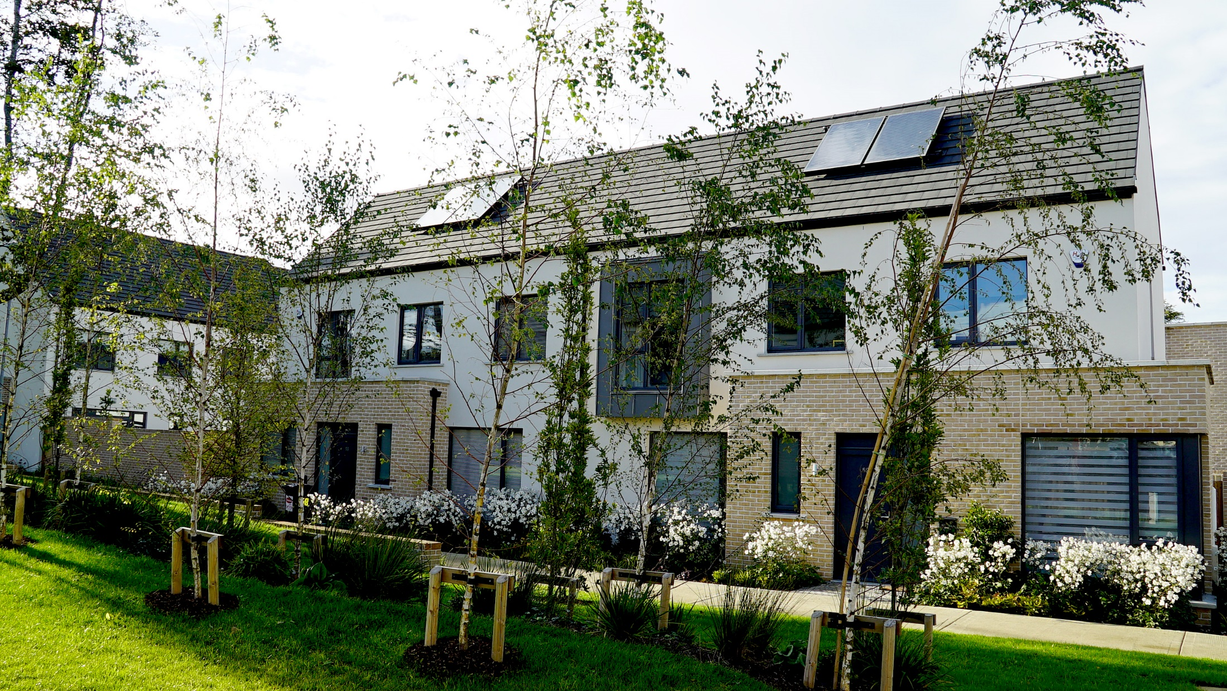

SHD Analysis Summary Highlights
Tallaght: 7
11,458Units
403 Student Bedspaces
500 Units Under Construction
26 SHD Sites
8,591
Apartments
2 Grants of Permission: 983 Units
2,271
Houses
193 Shared Bedspaces
1 Application
Refused:
303 Units
Saggart/Fortunestown: 6

Slide 3
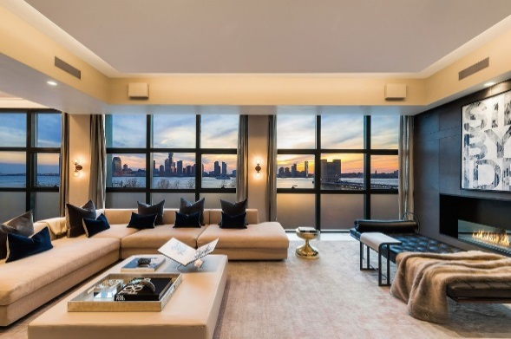
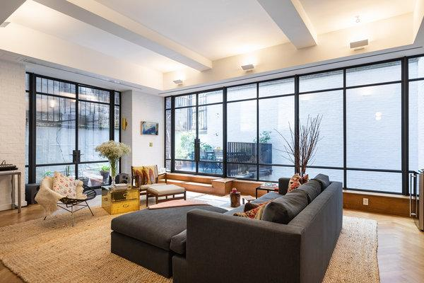
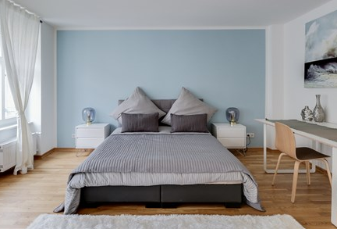
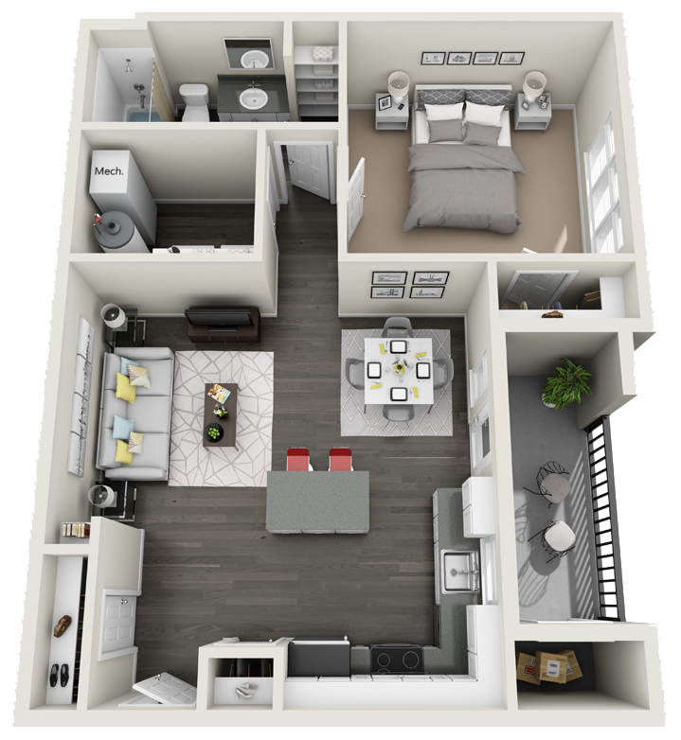
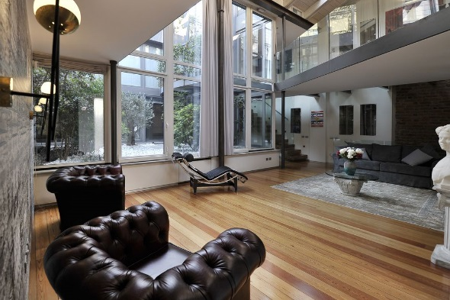
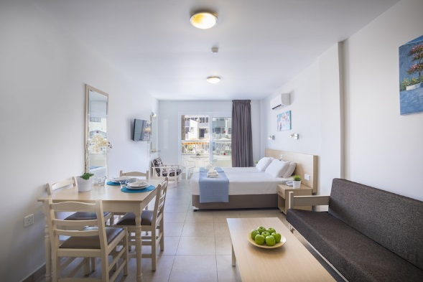
SHD Residential Mix
Total No. of Residential Units: 11,458
5 Bed Unit
4 Bed Unit
2 Bed Unit
10 Units / <1% of all SHD Units
514 Units / 5% of all SHD Units
4,315 Units / 40% of all SHD Units
3 Bed Unit
Studio Apartment
1 Bed Unit
2,382 Units / 22% of all SHD Units
478 Units / 4% of all SHD Units
2,314 Units / 21% of all SHD Units
*849no. units have not been specified at this stage

Slide 4
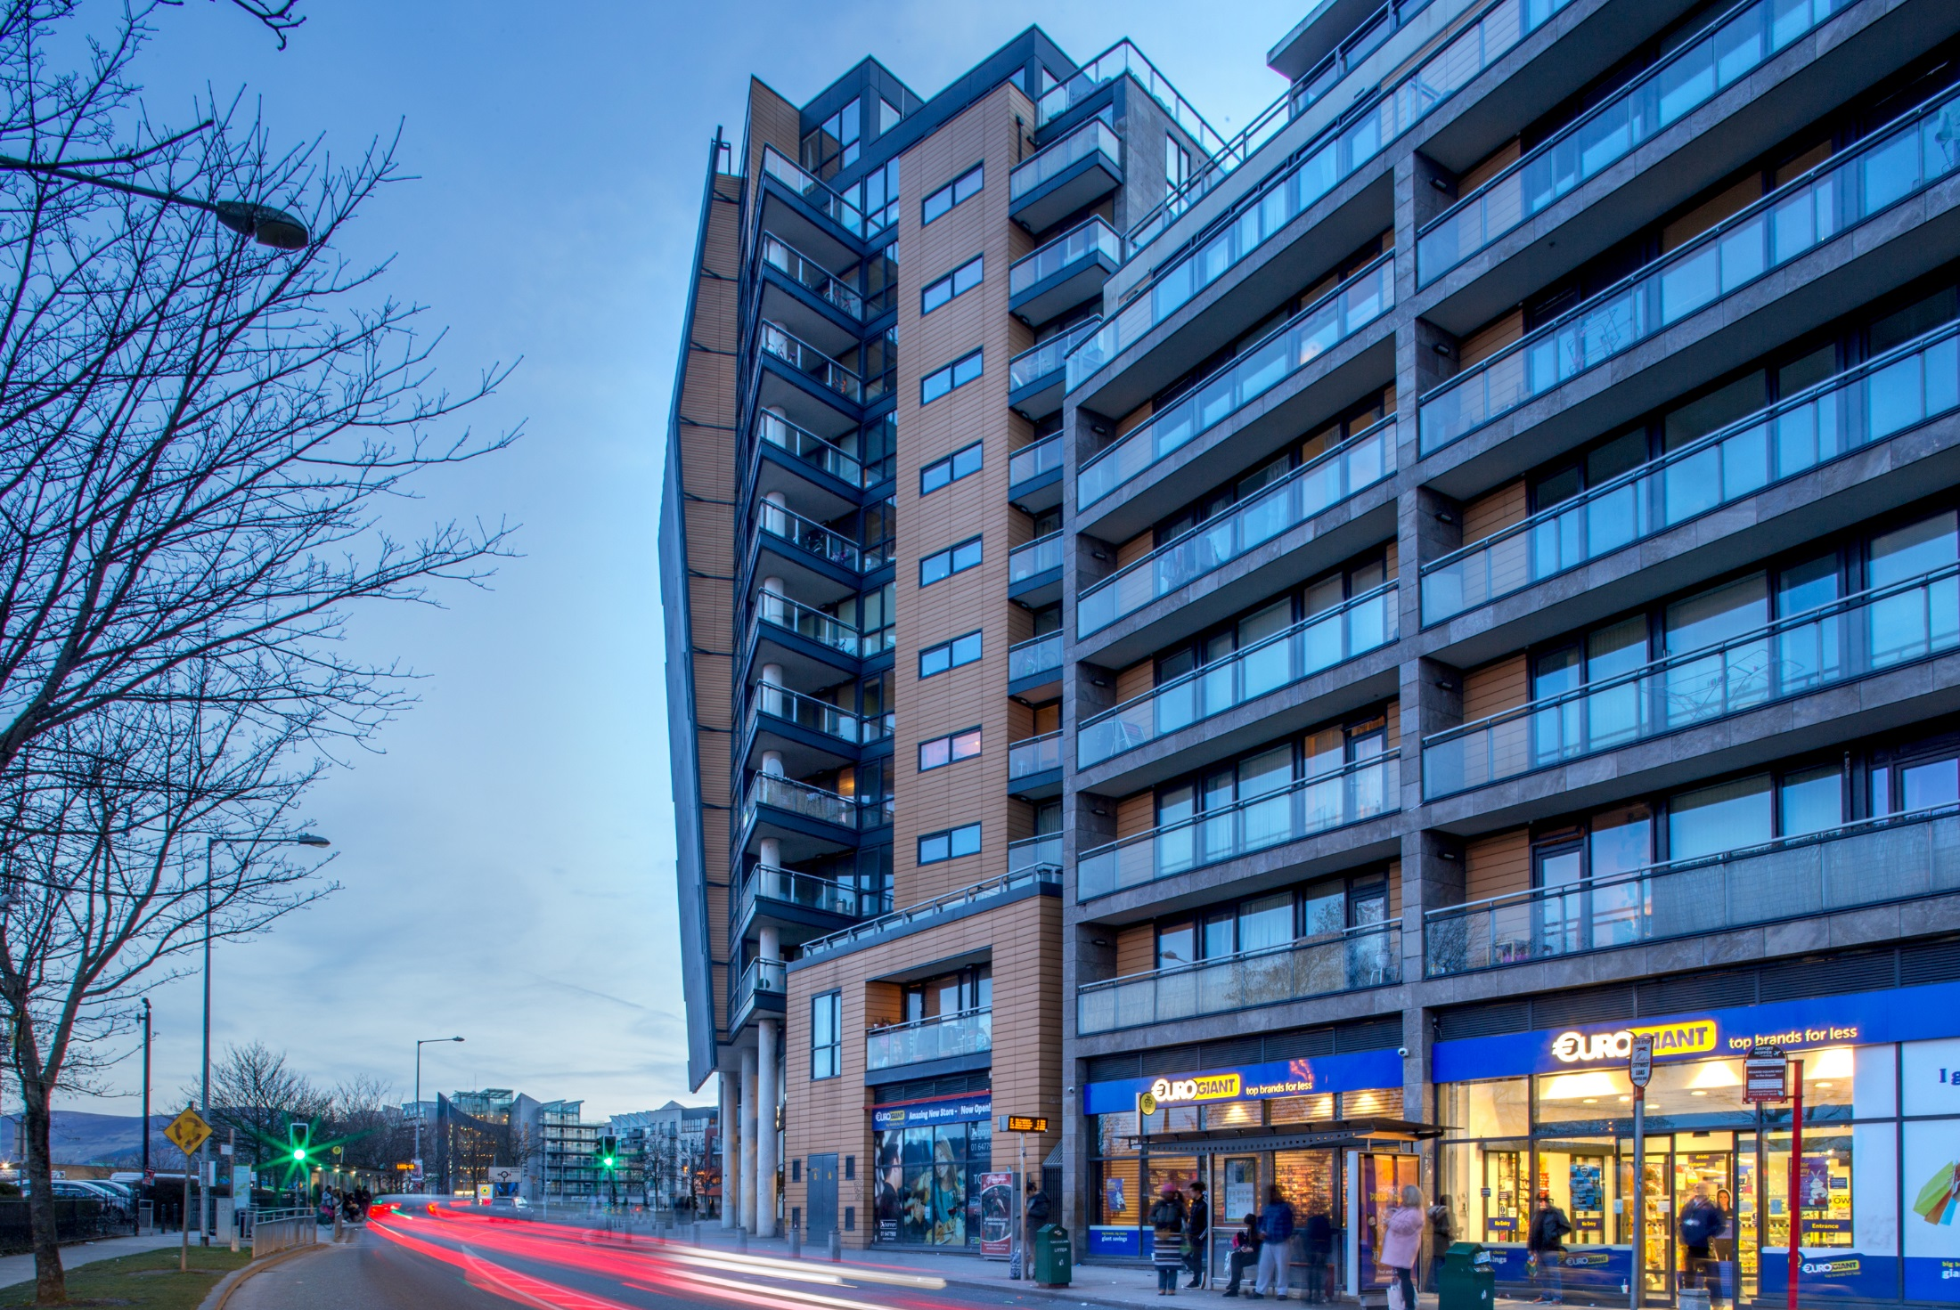
SHD Stage Status
SDCC Pre-Application Consultation
14 Proposals
6,094 Residential Units
Stage 1
SDCC Pre-Application Consultation
7 Proposals
3,041 Residential Units
Stage 2
ABP Formal Application
2 Applications
1,037 Residential Units
Stage 3
ABP Decision
3 Application Decisions
983 Residential Units Granted
Stage 4

Slide 5
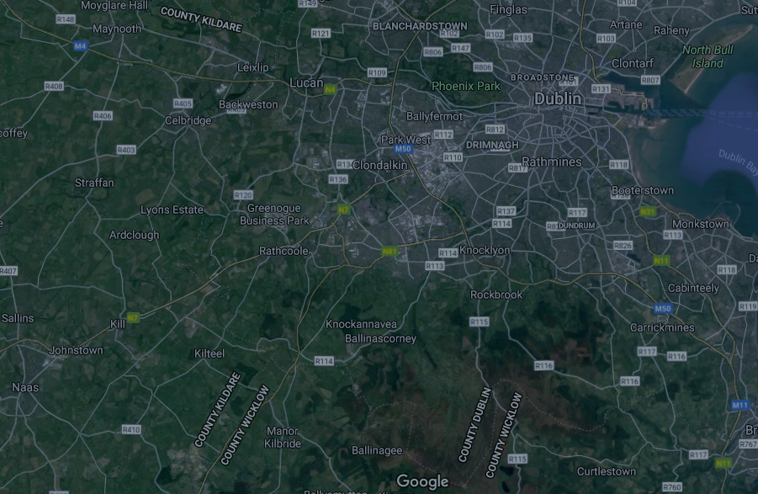
SHD Locations & Proposed No. of Units
Clondalkin
Newcastle
2,047
1,684
Rest of County*
537
Tallaght
2,860
Tallaght
Rathcoole
323
3,035
376
Saggart/Citywest
Ballycullen/Oldcourt
Total: 10,862 Residential Units**
*Rest of County includes areas within M50 & Lucan
**Not including 403 student bedspaces and 193 shared living bedspaces

Slide 6
Application Examples

Slide 7
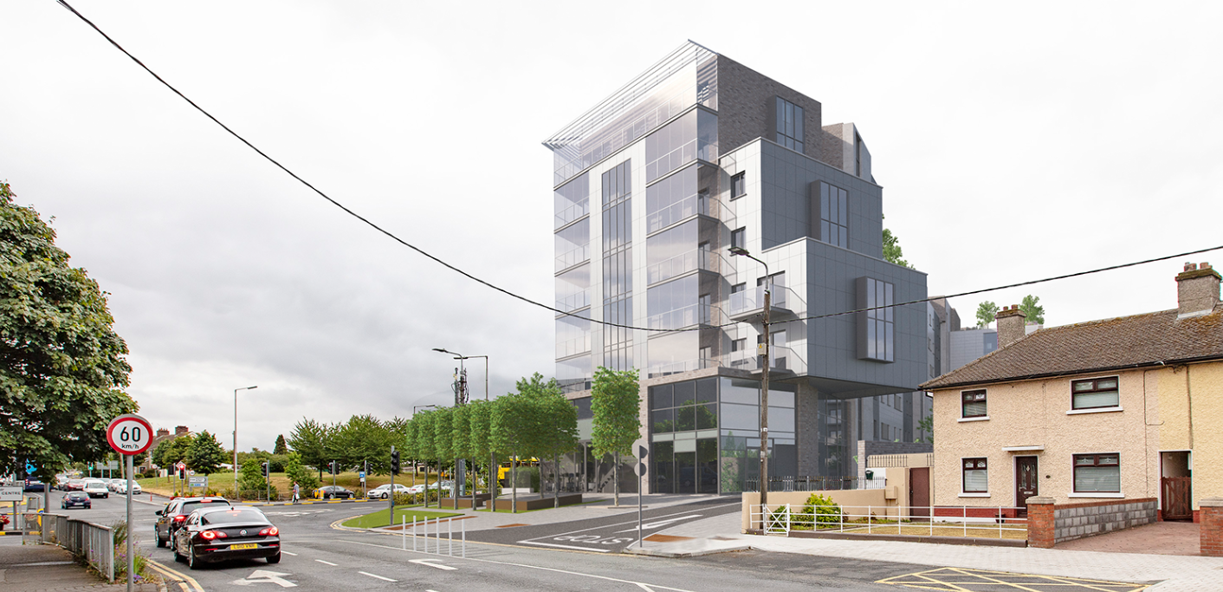
Kennelsfort Road Lower
303 Apartments
274 Car-parking
Creche
Site Area: 1.27ha
Site Coverage: 0.34
Density: 238 units per ha.

Slide 8
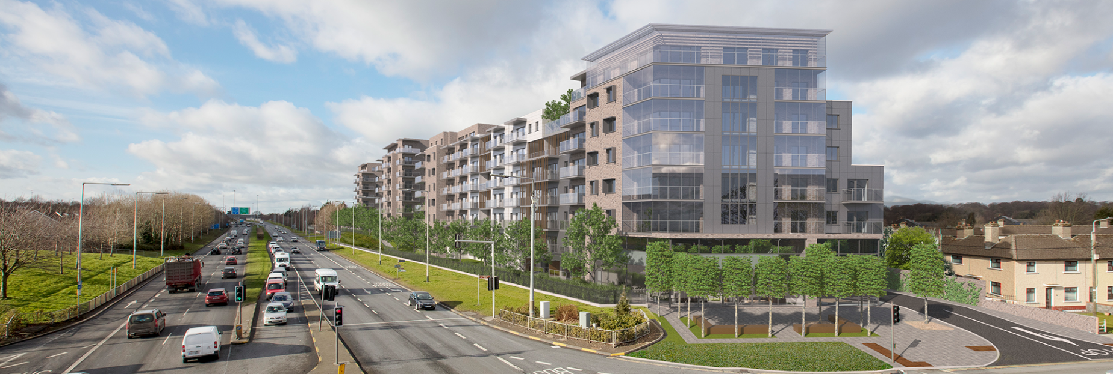
Kennelsfort Road Lower
Refusal
Design; overdevelopment of the site; overbearing & overshadowing impact;
Access & Traffic;
Application premature pending the preparation of a masterplan for the site;
Information relating to surface water insufficient.

Slide 9
Cooldown Commons
459 dwellings
294 Apartments
123 Houses
1,830 sq.m Open Space
4 storeys
Site Area: 7.49ha
Creche & Play Area
Site Coverage: 0.38
5/6 storeys
Density: 83 units per ha.
5/6 storeys
1,810 sq.m Open Space
1,275 sq.m Open Space
5/6 storeys
3 storeys

Slide 10
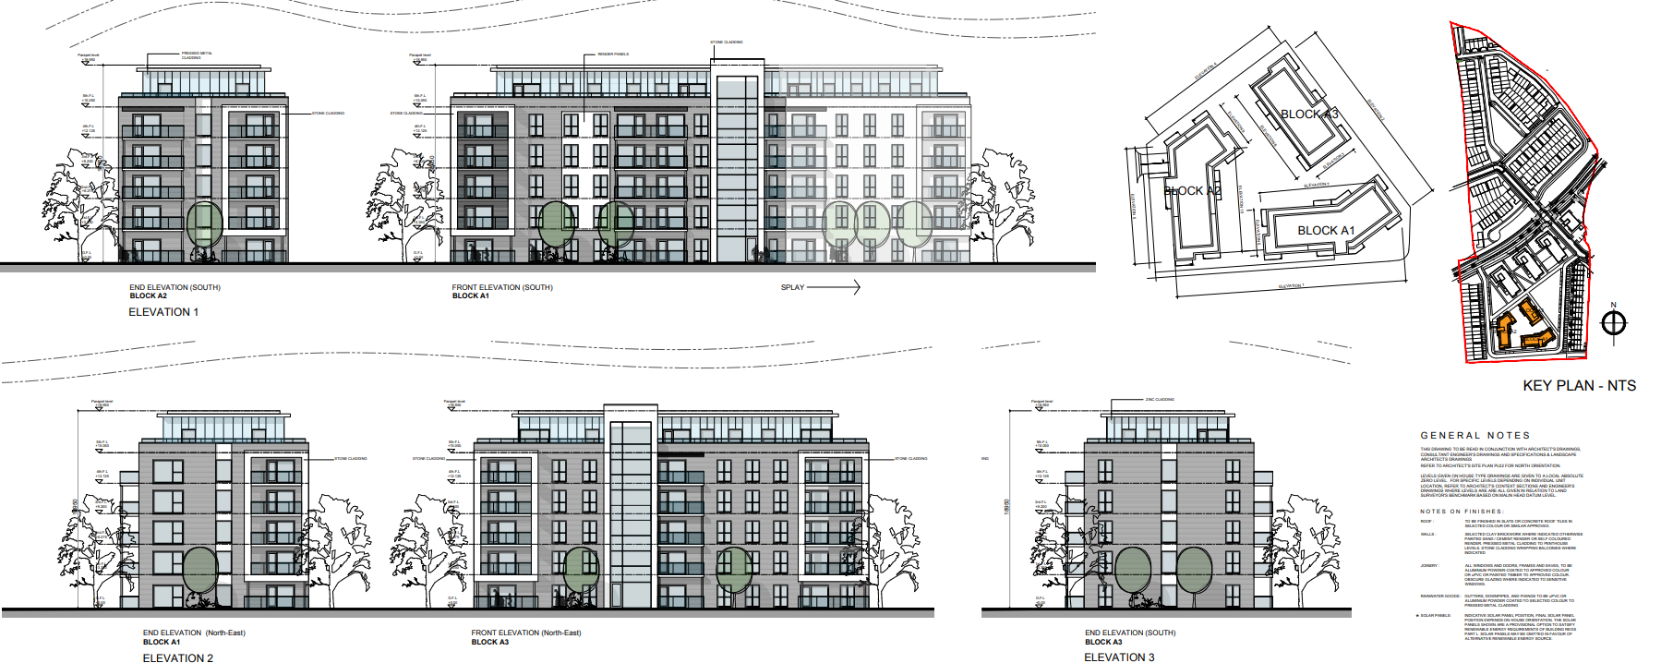
Cooldown Commons

Slide 11
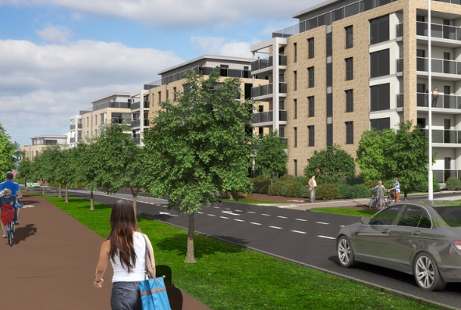
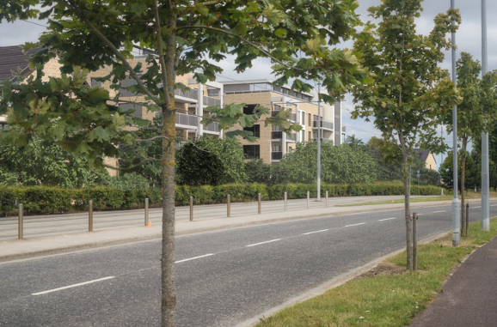
Cooldown Commons

Slide 12
Thank You

