Slide 1
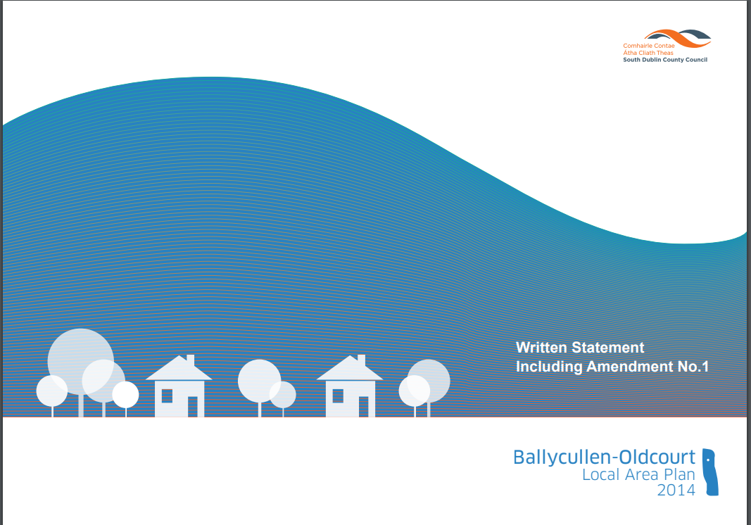

Ballycullen-Oldcourt LAP 2014 Extension of Time
Land Use Planning & Transportation
Strategic Policy Committee
14th March 2019

Slide 2
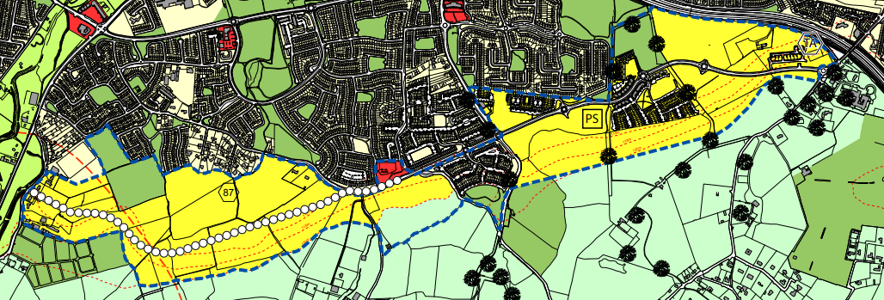
BALLYCULLEN-OLDCOURT LAP 2014
Ballycullen-Oldcourt LAP was adopted 6th of May 2014.
Will remain in force for 6 years from its adoption until 2020.
Section 12 of the Planning and Development Act 2010 gives the Council the option to extend the LAP to May 2024 provided the Planning Authority resolve to do this before 27th June 2019.

Slide 3
POLICY CONTEXT
Planning and Development Act 2000 (as amended)
Section 19 of the Planning and Development Acts 2000-2015.
Planning Authority can resolve to extend the life of a Local Area Plan following receipt from the Chief Executive of:
  (i) an opinion that the Local Area Plan remains consistent with the objectives and core strategy of the relevant development plan,
  (ii) an opinion that the objectives of the LAP have not been substantially secured, and
  (iii) confirmation that the sending and publishing of notices to commence the review of the LAP may be deferred and the period for which they may be deferred.
Plan can be extended by up to 5 years.
Resolution to extend must take place within 5 years of adoption of LAP (by 2019).
Ballycullen-Oldcourt LAP adopted 14th May 2014.
Planning Authority has until 27th June 2019 to extend life of Plan.

Slide 4

SOUTH DUBLIN COUNTY DEVELOPMENT PLAN 2016-2022
The vision for Ballycullen-Oldcourt is consistent with the County Development Plan policy and objectives which include the following:
Identified as a key growth node.
Identified as Consolidation Areas with opportunities to strengthen and consolidate through infill and brownfield redevelopment.
To develop based on the capacity of the public transport network and social infrastructure.
To facilitate the provision of additional post primary schools in the Ballycullen area.
To form a strategic street network providing access to the Ballycullen-Oldcourt LAP lands.

Slide 5
SOUTH DUBLIN COUNTY DEVELOPMENT PLAN 2016-2022
CDP Policy and Objectives relevant to Ballycullen-Oldcourt LAP:
Quality of life, with an emphasis on key economic, environmental, social and cultural indicators;
Prosperity, with an emphasis on contributing to a competitive business environment that supports economic development, job creation and prosperity for all;
Sustainability, with an emphasis on making better use of key resources such as land, buildings, water, energy, waste and transport infrastructure;
Health and wellbeing, by facilitating active and healthy lifestyles with increased opportunities for walking, cycling and active sport and recreation;
Social inclusion, with an emphasis on creating socially and physically inclusive neighbourhoods, taking account of the recommendations of The National Disability Strategy Implementation Plan 2013-2015 and Inclusion Ireland’s Changing Places campaign; and
Climate change adaptation, with increased emphasis on reducing climate change at a local level through settlement and travel patterns, energy use and protection of green infrastructure.

Slide 6
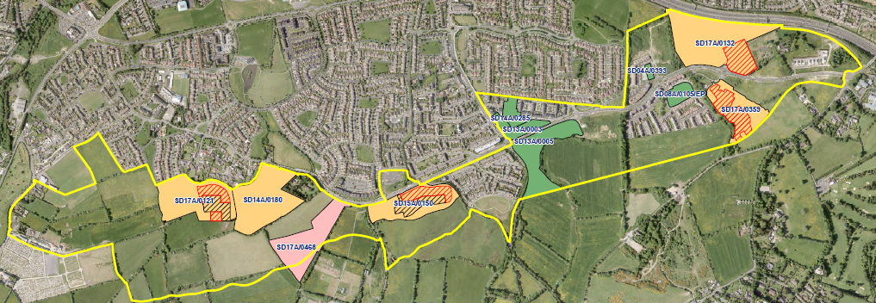
KEY OUTCOMES TO DATE
LAP area constitutes approximately 125 hectares;
Approximately 23.4 hectares is under construction;
6 hectares is completed (i.e. 864 units granted; 506 units completed; 154 units under construction);
4 hectares has planning permission but has not commenced.

Slide 7
Ballycullen-Oldcourt LAP 2014
Adopted 6th May 2014
SDCC adopted Amendment 1 of LAP
Adopted 8th May 2017
Option to Extend LAP until 2024
Resolve to do this by 27th June 2019
Consideration of Members to Extend LAP
Publish Notice in Newspaper no later than 2 weeks after resolution
Ballycullen-Oldcourt LAP extended until 2024
TIMELINE FOR LAP EXTENSION
Report considered at April Council Meeting and resolution made to extend LAP
Notice of resolution available for inspection by members of public

Slide 8
EXTENSION OF BALLYCULLEN-OLDCOURT LAP
Timeframe for Extension of Plan
Planning authority may extend the life of the LAP, which is normally 6 years, for a further 4 years i.e. up to a total of 10 years from adoption.
Proposed resolution:
“That this Council approve the procedure to defer the sending of a notice under section 20(3)(a)(i) of the Planning and Development Act 2000 -2010 i.e. notices for making, amending or revoking the Local Area Plans in accordance with Section 19(1)(d) of the Planning and Development Acts 2000-2015 for the Ballycullen-Oldcourt Local Area Plan for a further period of 5 years."
Ballycullen-Oldcourt LAP would be extended up to May 2024.

