Slide 1
County Development Plan
Variation No. 3 (and Proposed Material Alteration) – Amend Zoning at Ballymount / Naas Road
Land Use Planning & Transportation
Strategic Policy Committee
March 2019
14th March 2019

Slide 2
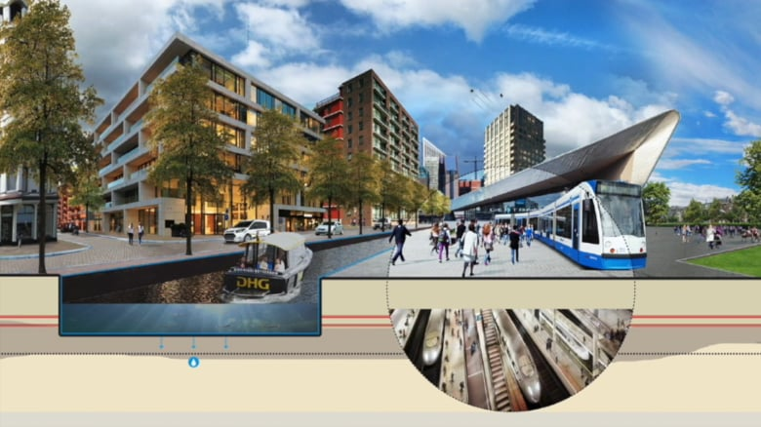
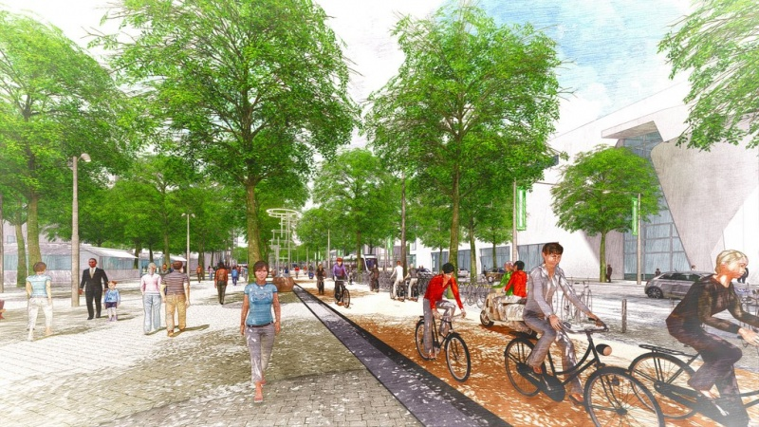
Development Plan Variation No. 3
At the Council Meeting on 11th February 2019, Members agreed to make Variation No. 3 of the Development Plan (with a proposed Material Alteration).
Variation No. 3 changes the zoning of lands at Ballymount/Naas Road from ‘EE’ (Enterprise and Employment) to ‘REGEN’ (Enterprise and/or Residential-led Regeneration).
Previous restrictions are relaxed on uses including Residential, Restaurant/Café, Hotel/Hostel, and Offices over 100sqm.
‘REGEN’ Zone allows for a wider range of uses to facilitate regeneration and the creation of a vibrant mixed-use urban quarter for people to live, work and enjoy.

Slide 3
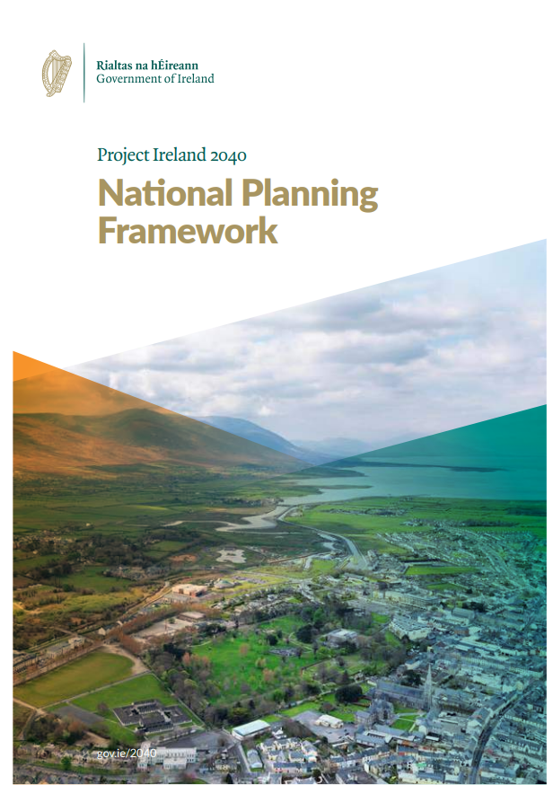
Variation No. 3: Policy Context
New National & Regional Policy:
National Planning Framework (NPF) – Achieve National Strategic Outcome No.1 Compact Growth.
Eastern and Midlands Assembly Draft Regional Spatial and Economic Strategy (RSES).

Slide 4
Variation No. 3: Rationale
Gateway to Dublin City Centre; inside M50.
Served by Luas; potential for new stop.
Underutilised brownfield lands.
Existing ‘REGEN’ lands not redeveloped to date.
Opportunity to achieve compact growth.
Successful Urban Regeneration Development Fund (URDF) bid.
Potential for further cooperation with
Dublin City Council.

Slide 5
Variation No. 3: Process
Planning and Development Act 2000 (As Amended)
Chief Executive Report on Submissions
CE Report with Members 21st January 2019.
Consideration of CE Report by Members
Maximum of 6 weeks from date CE Report received (4th March 2019).
Variation made with proposed Material Alteration at February Council Meeting.
Public Consultation
Commenced on Tuesday 20th November 2018 for 4 weeks.
Closing Date Tuesday 18th December 2018.
A total of 14 submissions were received.

Slide 6
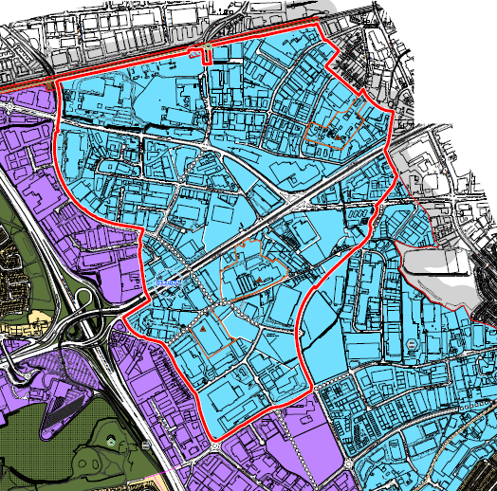
Variation No. 3: Development Plan Amendments
1 | Change Land Use Zoning Map from ‘EE’ to ‘REGEN’ REGEN objective – ‘To facilitate enterprise and/or residential-led development’.
2 | Amend Core Strategy Tables Additional strategic landbank for residential units; No additional units forecast in life of CDP 2016-2022.
3 | Amend existing Specific Local Objective (CS6 SLO1) to state: CS6 SLO 1 To initiate a plan led approach to the sustainable regeneration of the brownfield lands in the Naas Road / Ballymount REGEN zoned lands. The plan led approach will include the preparation of a masterplan in 2019 with a view to preparing a Local Area Plan or other appropriate mechanism for the REGEN and LC zoned lands. The Naas Road Framework Plan (2010) to be taken into consideration during the preparation of the masterplan.

Slide 7
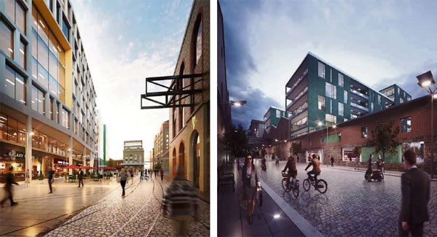
Proposed Material Alteration to Variation No. 3
The proposed Material Alteration would further amend Specific Local Objective, CS6 SLO 1 (previously amended as part of Variation No. 3) contained in Chapter 1, Introduction and Core Strategy, by inserting a new sentence as follows:
Q3/Q4 2019
Procured Design Consultants for all stages, up to and including construction handover
Complete construction works
“That no planning applications for residential use of these lands be approved prior to the passing of a Local Area Plan for these lands.”

Slide 8
Timeline for Proposed Material Alteration to Variation No. 3
Step 1 (CURRENT STAGE) | Public Consultation / Display Period for proposed Material Alteration (MA) Friday 1st March to Friday 29th March (4 weeks)
Step 2 | Preparation of Chief Executive (CE) Report on Submissions CE Report completion approx. end of April (furnished to Members).
Step 3 | May Council Meeting Consideration of MA and resolution to make/not to make the Material Alteration to Variation No. 3.

Slide 9
Thank you

