Slide 1
Delivering Housing Solutions
SDCC SPC
14th February 2019

Slide 2
About Respond
Not-for-profit housing association.
36 years of experience & proven track record.
Nationwide – homes in 26 counties.
€493 million invested to date in social housing.
Own & manage 4,502 homes accommodating 8,965 people.

Slide 3
Respond Vision
Every family and individual in Ireland will have high-quality housing as part of a vibrant & caring community

Slide 4
The Approved Housing Body Sector (AHB’s)
Partners in the delivery of social housing
Uniquely placed to support Central & Local Govt in social housing delivery.
Strong record in delivery & management of social housing – 32,000 homes in management, exceptional void, arrears & management performances.
Independent & not for profit.
Well regulated & professionally managed.
Solely focused on the relief of housing need.
Central & committed to meeting Rebuilding Ireland targets.

Slide 5
Working with Local Authorities
We can achieve nothing without the support of each Local Authority
Our first step is to seek support from the Local Authority for each development in terms of:
Development plan.
Planning.
Funding.
Assessments.
Allocations.

Slide 6
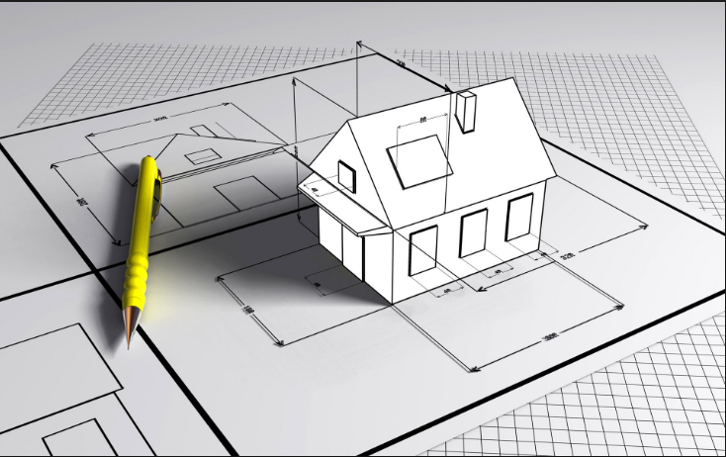
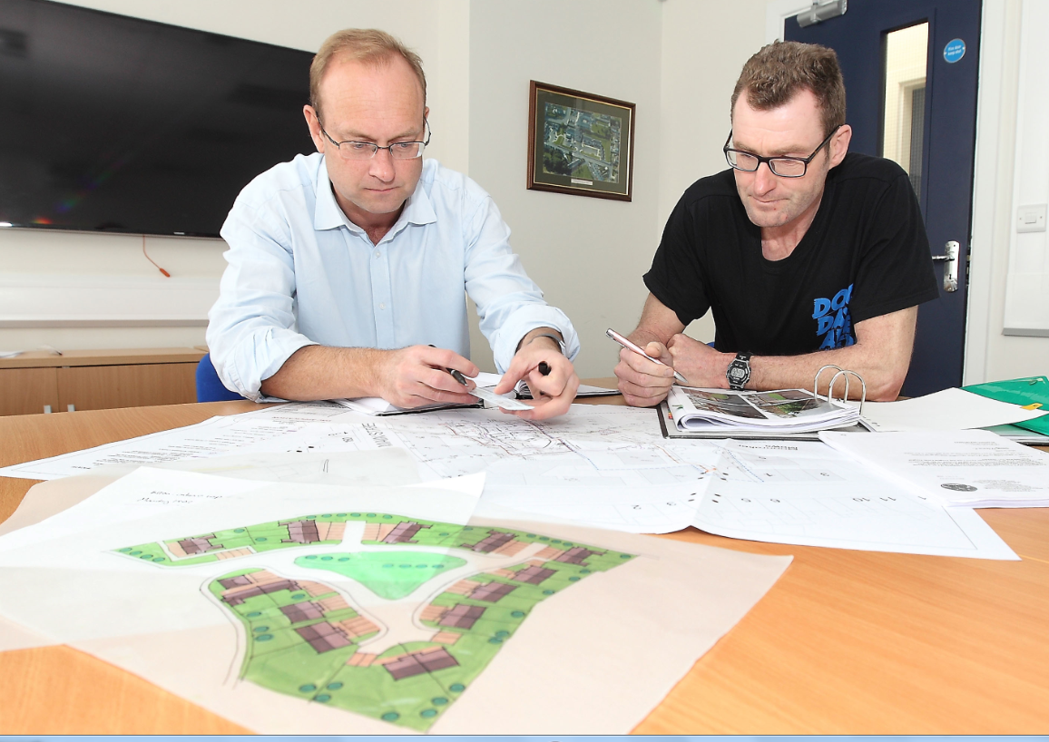
Respond’s In-House Design Capacity
Respond’s In-house Design Capacity
Architects
Quantity Surveyors
Planners
Technical Service Officers
Legal Team of Solicitors
Information Technology Staff
Customer Service Centre

Slide 7
Snapshot of Key Statistics
2,500
Respond Strategic Plan - Delivery 2019 – 2023
3,776
Number of Homes in Current Risk rated Development Pipeline
305
Homes built 154 with 151 due for acquisition
676
Construction of 676 new homes have commenced on various sites 2018
267
New homes being appraised for acquisition & delivery in various LA jurisdictions

Slide 8
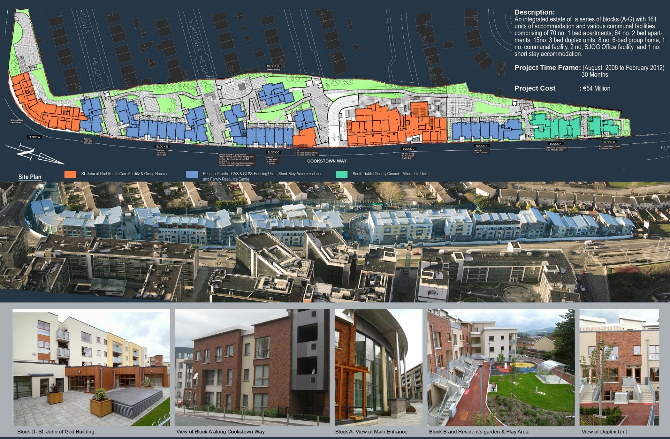
Gleann na hEorna, Tallaght, Dublin 24: 161 completed units
Integrated Development
General Needs, housing for people with disabilities, emergency accommodation, group home and St John of God offices, Community building, and Affordable housing funded through CAS and CLSS

Slide 9
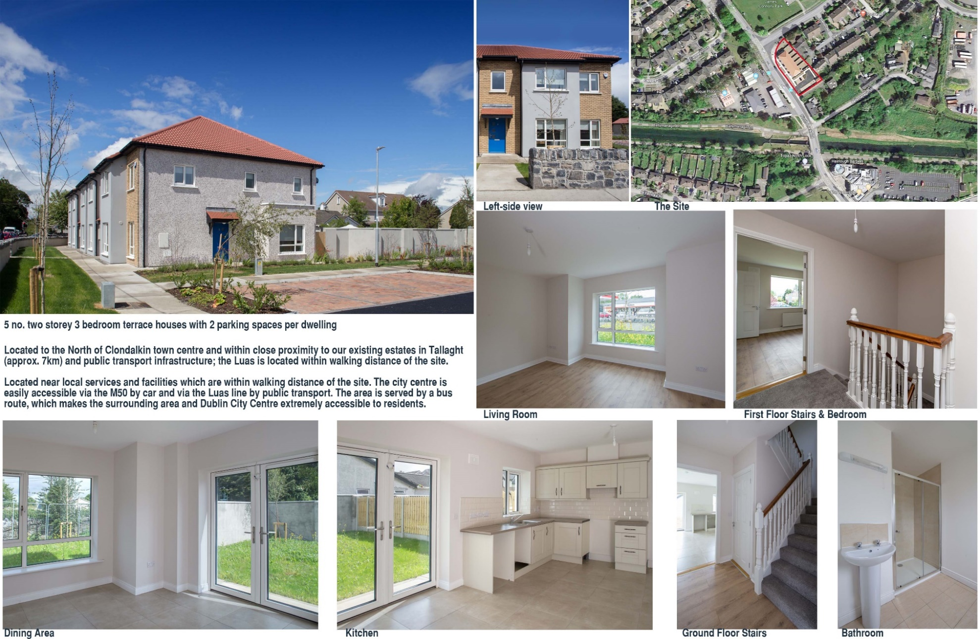
Station Road, Clondalkin, Dublin 22: 5 completed units
Social Housing Development
General Needs Housing of 3 bed homes funded through CALF and PAA

Slide 10
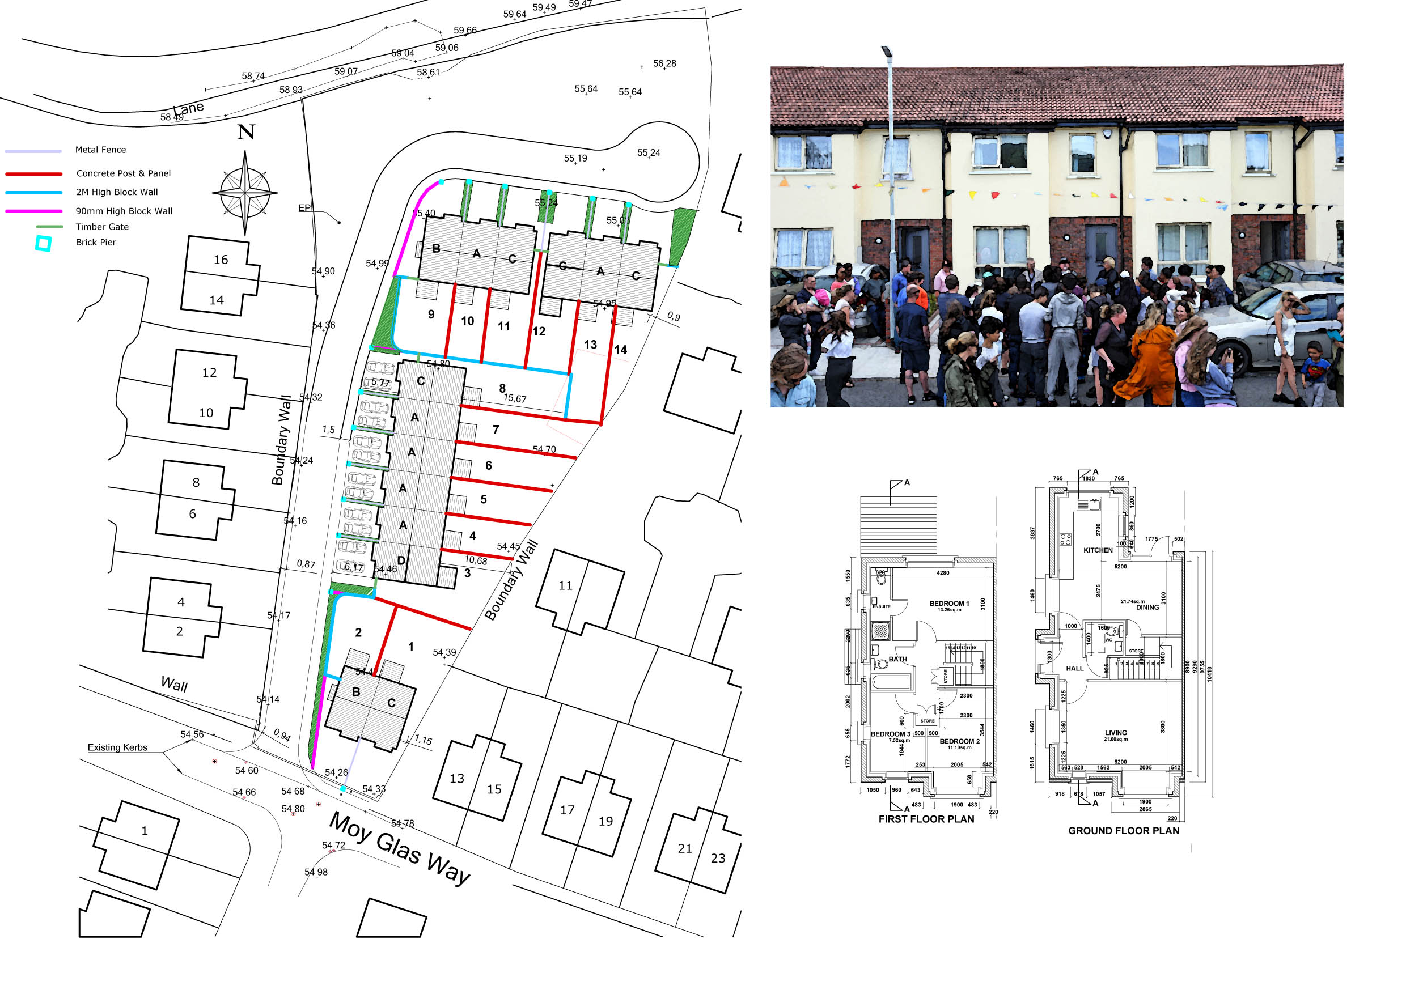
Moy Glas Glade, Lucan, Co. Dublin:14 completed units
Social Housing Development
General Needs Housing of 3 bed homes funded through CALF and PAA

Slide 11
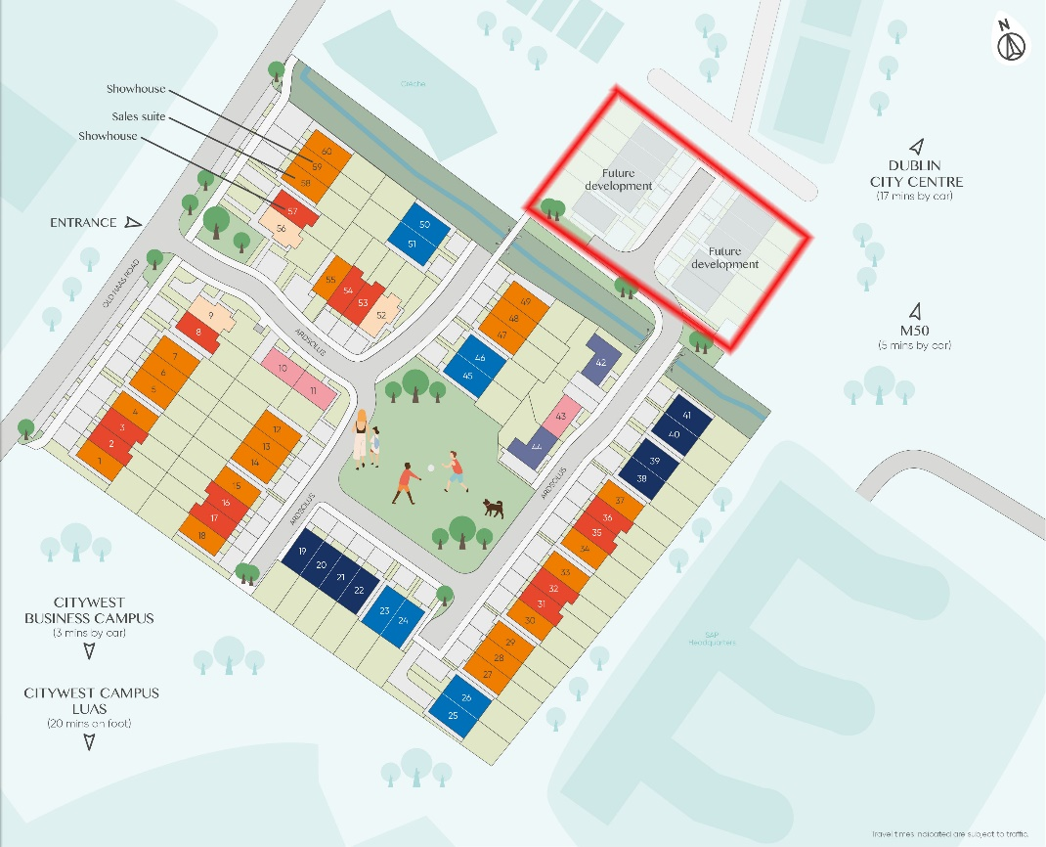
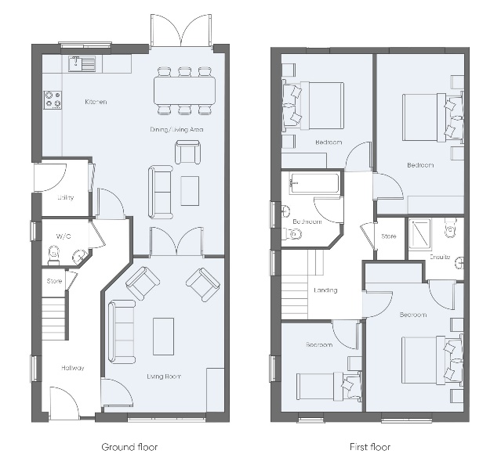
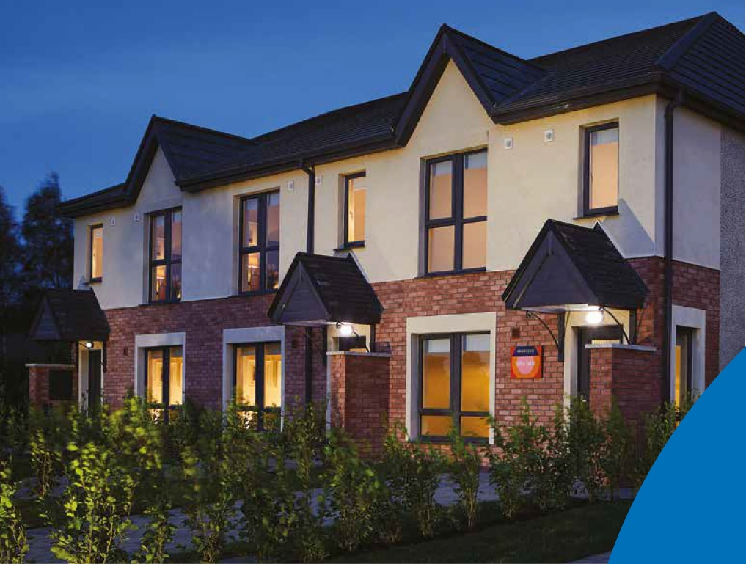
Ardsolus, Brownsbarn, Tallaght – 10 Homes under Construction
Ardsolas, Brownsbarn, Tallaght: 10 homes under construction
Integrated Development
General Needs – 3 Bed homes to be funded through CALF and PAA

Slide 12
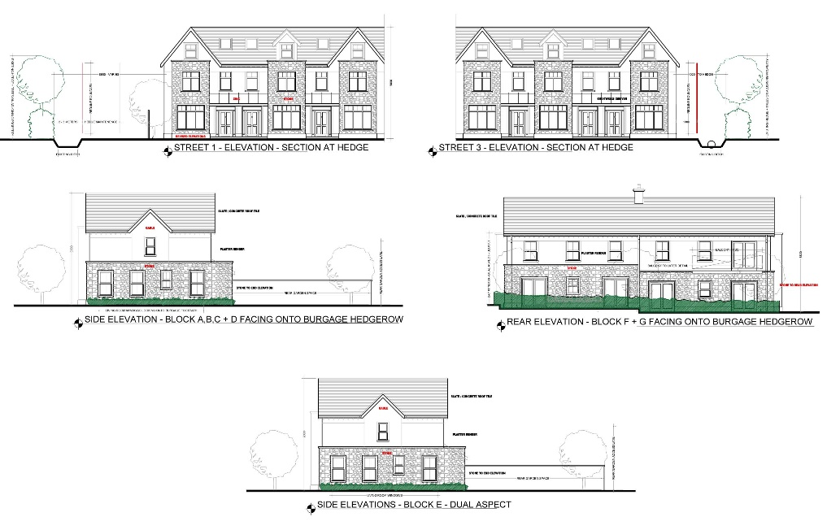
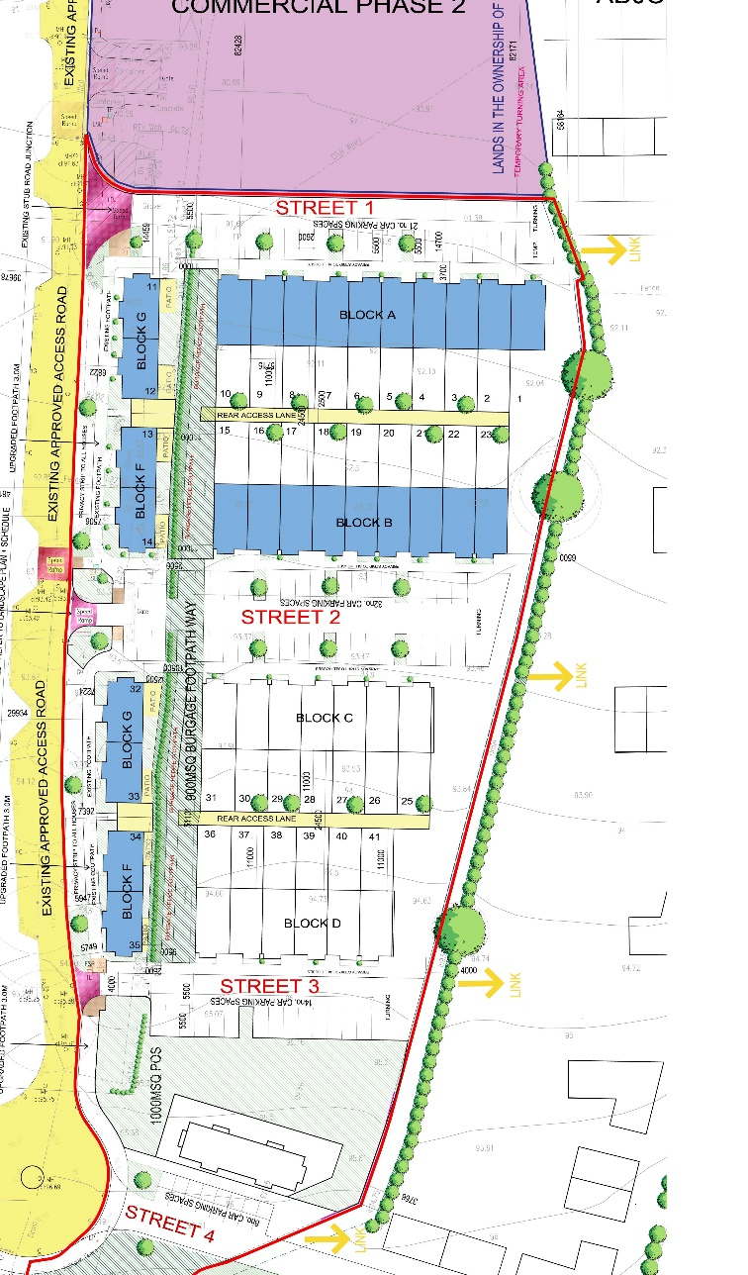
Newcastle, Dublin 22: 40 Homes to commence on site
Social Housing Development
General Needs Housing funded through CALF and PAA
- Mix of 36 no. 3 bed and 4 no. 2 bed homes

Slide 13
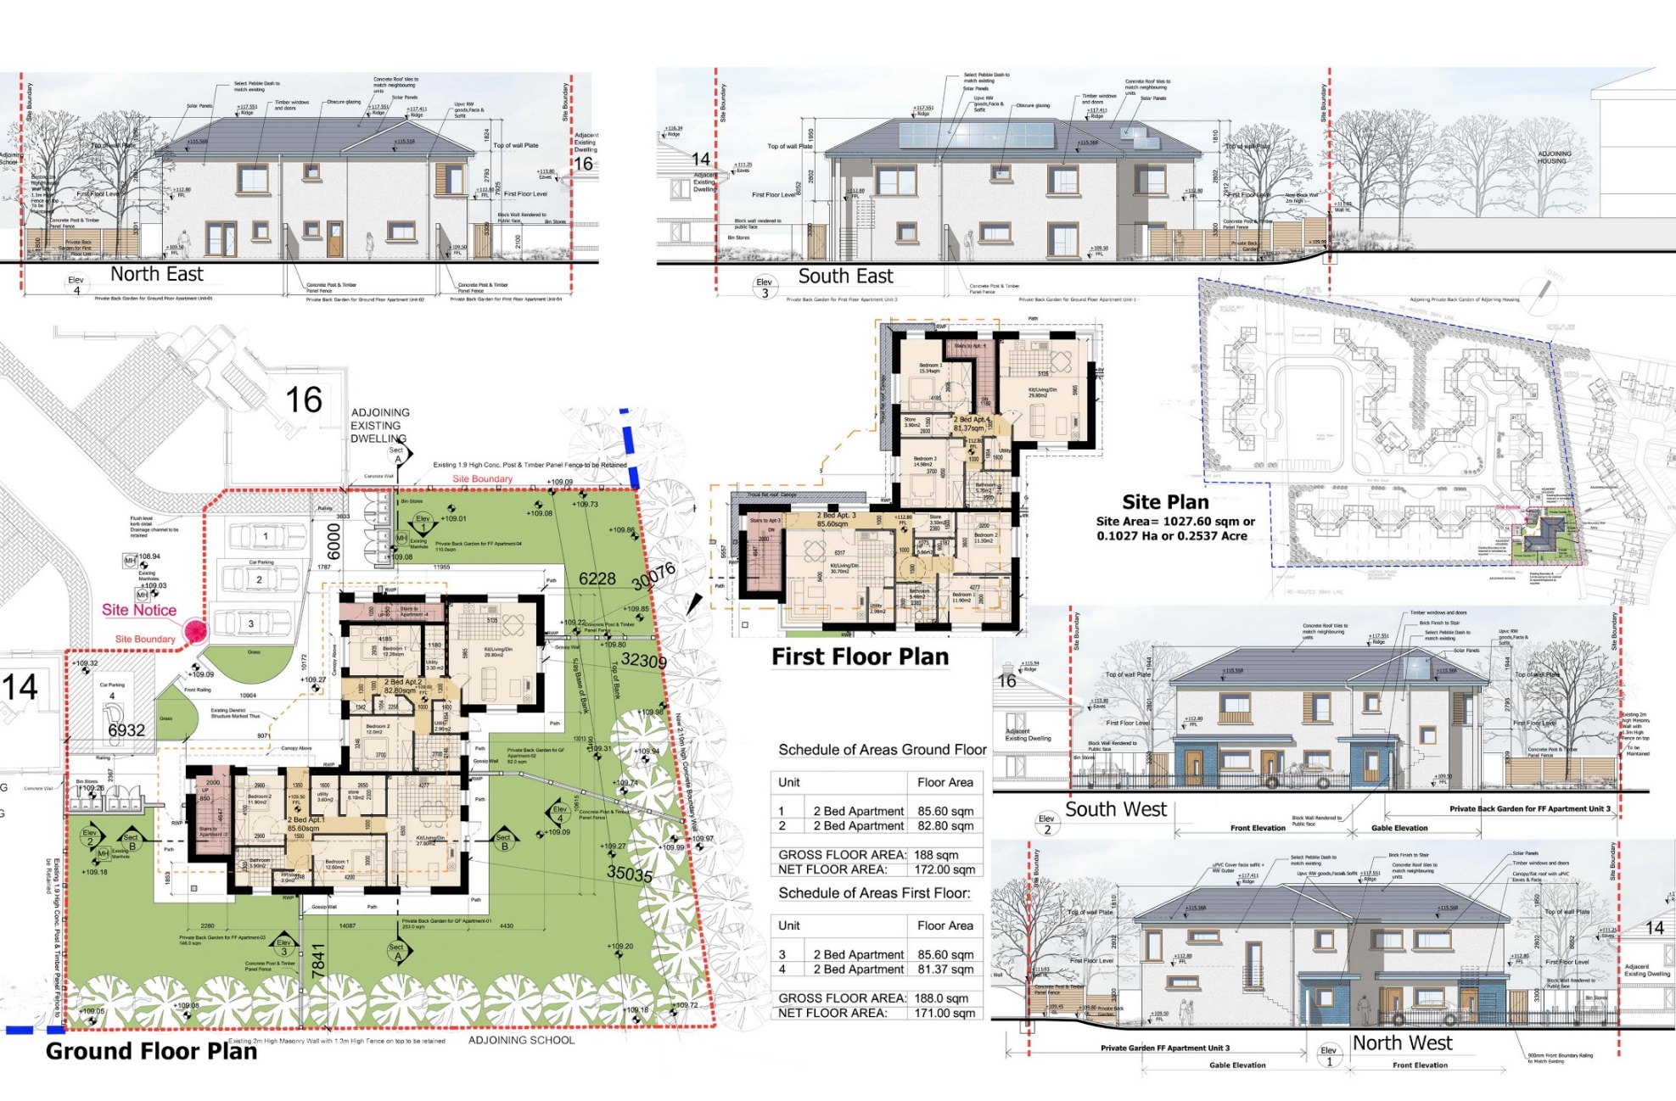
Àrd Mor Court, Tallaght, Dublin 24: 4 Units to be constructed
Social Housing Development
General Needs Housing of 2 bed apartments funded through CALF and PAA

Slide 14
Àrd Mor Fire
July 2018.
Two properties badly damaged & substantial work needed.
One tenant rehoused through another AHB. One tenant temporarily rehoused in Gleann na hEorna.
Discussions ongoing with the Insurance company.

Slide 15
Asset Management
Annual budget of €7m +.
Upgraded 2,017 homes.
Total investment of approx. €24 million with the assistance of SEAI funding of €8.5 million.
Reactive /Cyclical /Planned /Void Work.
Framework of contractors in each County.

Slide 16
Respond’s Reponse to Homelessness
New model of emergency accommodation for homeless families.
Goal to support as many families as possible to move into secure homes as quickly as possible working in partnership with LA’s.
Short term intervention while families await long-term homes.
Better alternative to commercial hotels & B&B’s.
Wraparound services using a housing led approach.

Slide 17
Respond’s Reponse to Homelessness
This involves a holistic, person centred model of care working with people at their own pace, using key working & care planning to support them in their pathway out of homelessness.
Supports & Outreach Services BOTH during & after stay.
5 Family Hubs - 4 located in Dublin & 1 in Limerick.
Average duration of stay is 7 months.

Slide 18
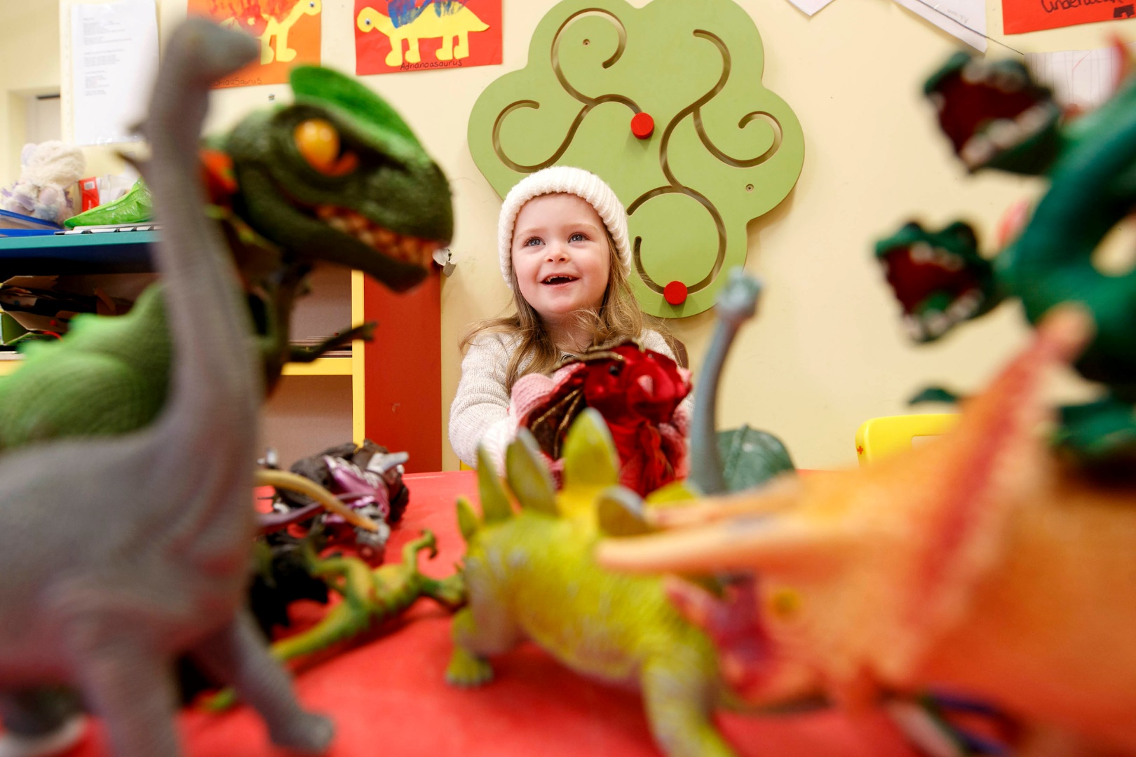
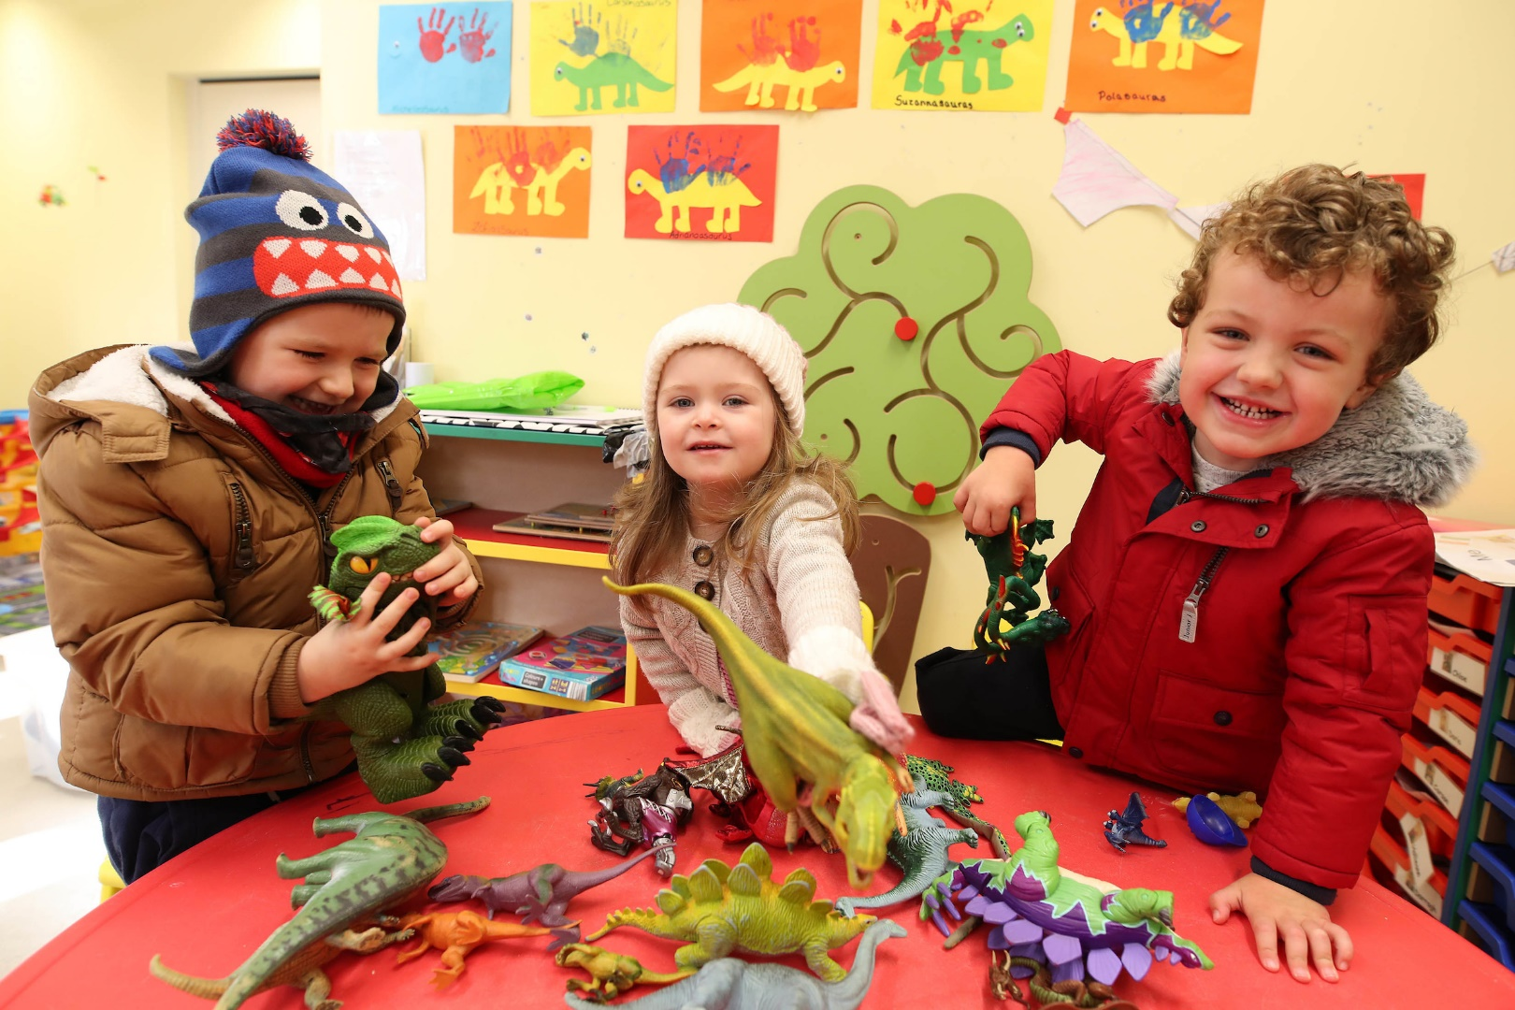
Springfield Family Hub
Some of our residents

Slide 19
Springfield Family Hub
Our Springfield family hub opened in December 2016.
7 two bed own door units.2 single rooms with shared kitchen internal unit.
Capacity for 9 families.
Currently 1 family is residing there who have high medical needs so KPI returns are based on 8 units for the moment.
Child & Youth Development room & a Children’s Play area on the rooftop.
Total intake 37 families since operating.
Family move-on’s: 27 to ABH & 10 to HHAP properties.

Slide 20
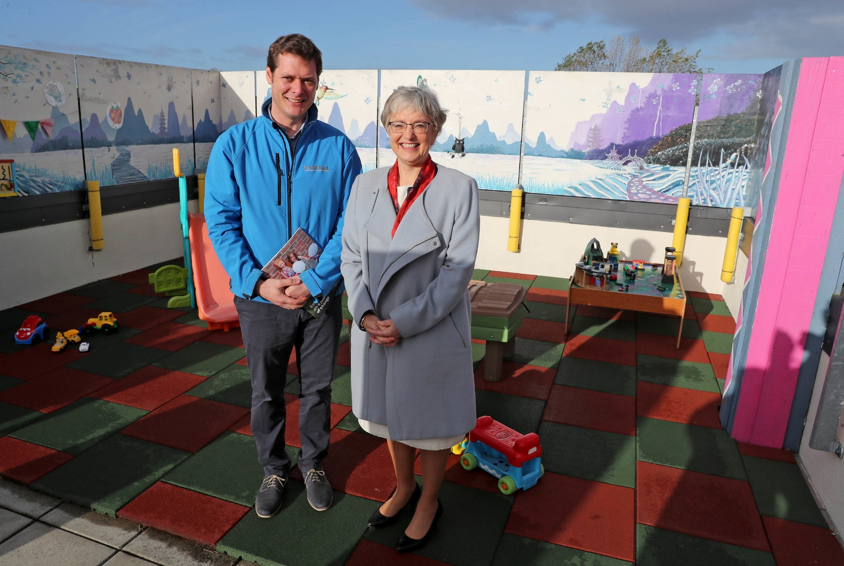
Springfield Family Hub
Roof top play area
Kitchen in one apartment

Slide 21
Firhouse Family Hub
Our Firhouse Family Hub opened in December 2019.
Capacity for 20 families once works are completed.
Currently 7 families residing in the hub.

Slide 22
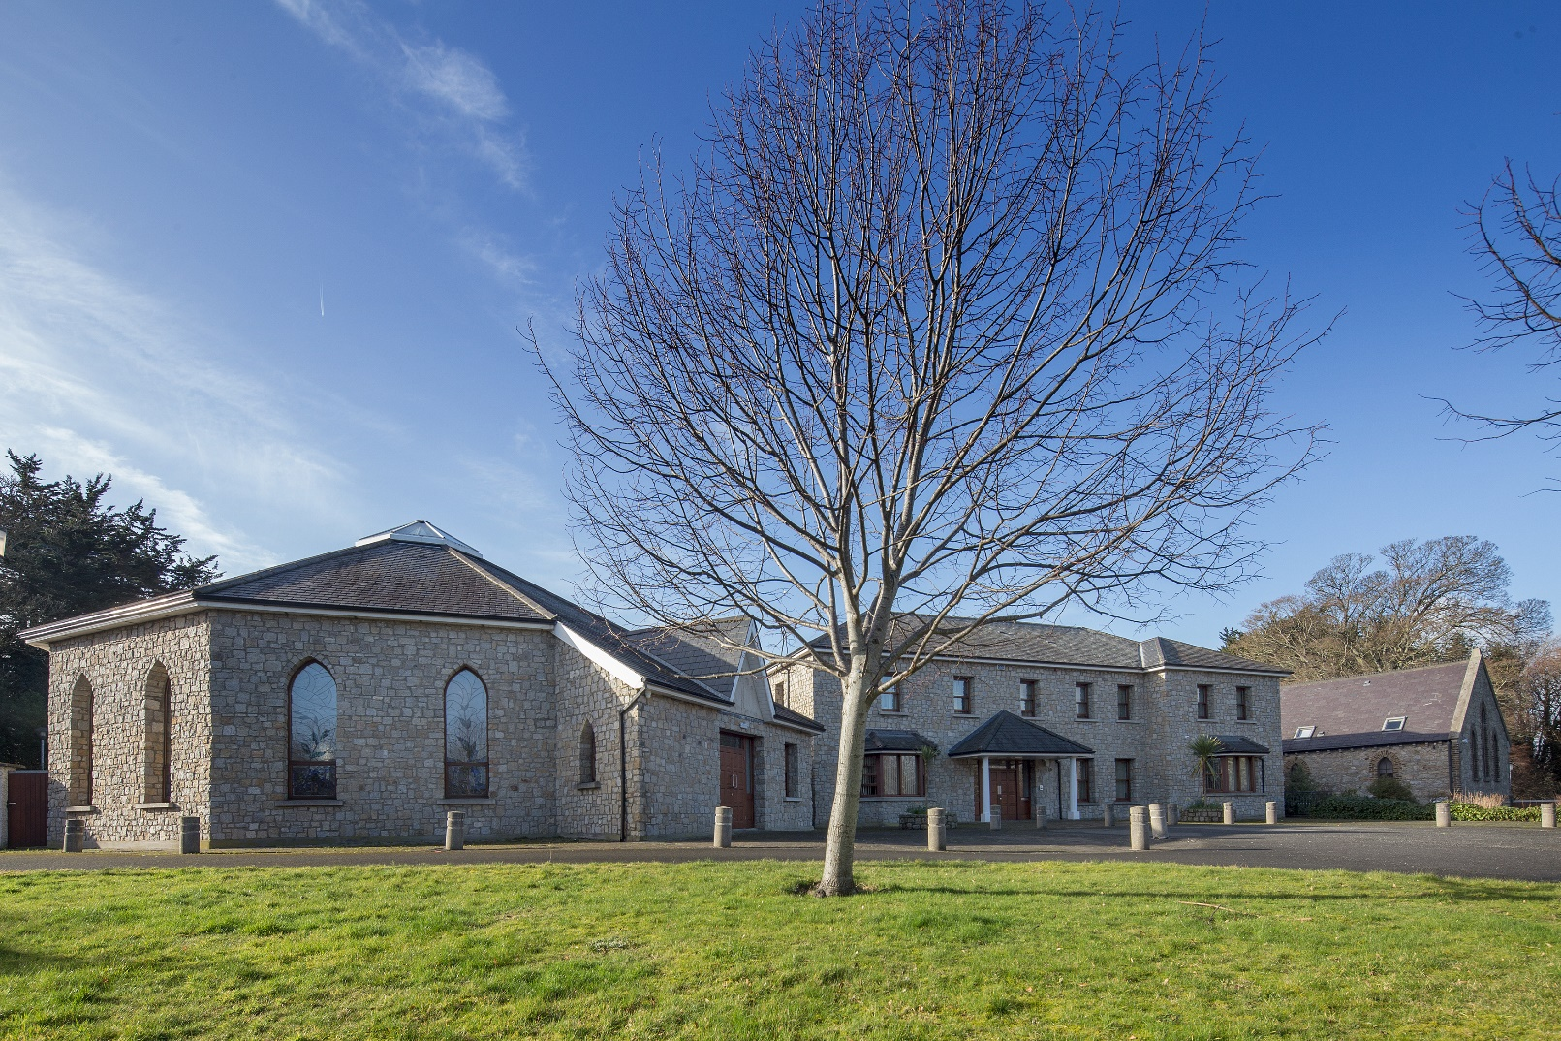
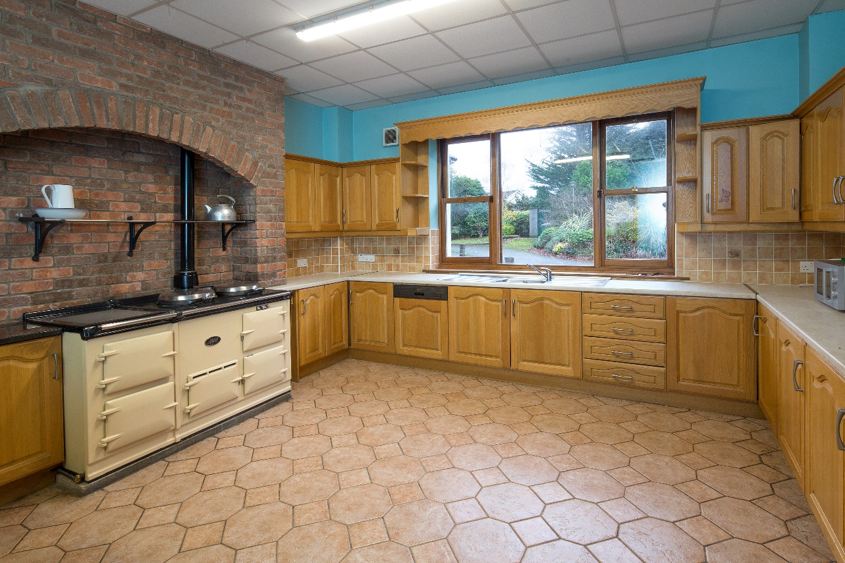
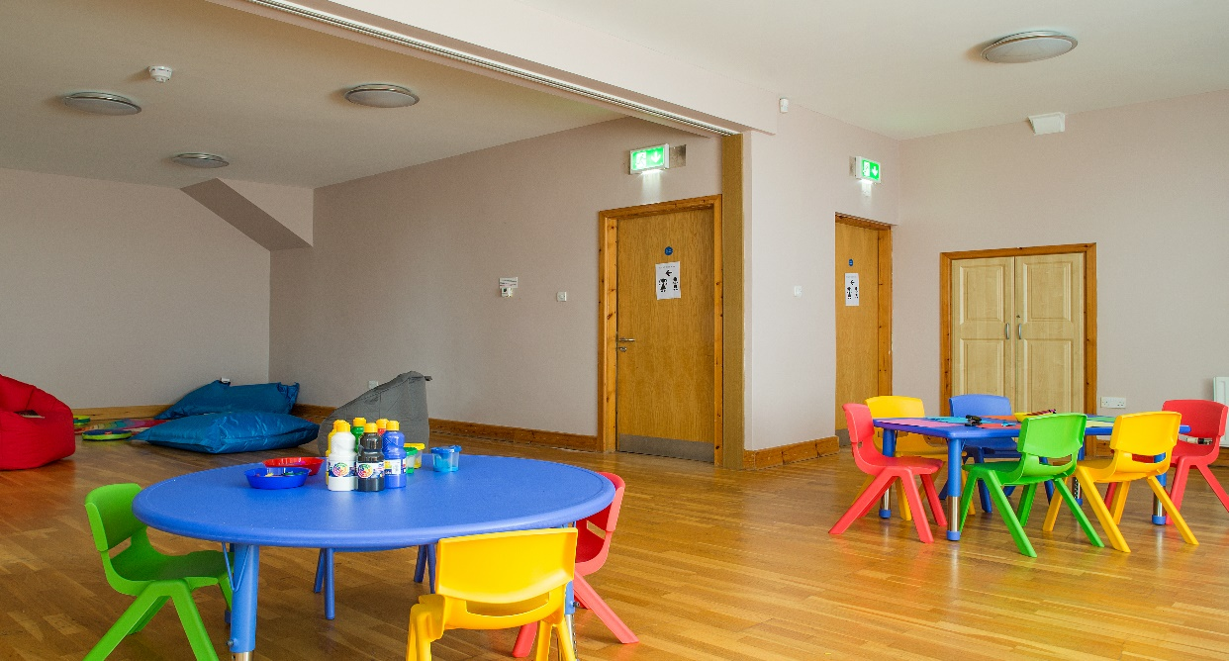
Firhouse Family Hub
Outside the building
One kitchen above right
Children’s Education & Play Room

Slide 23
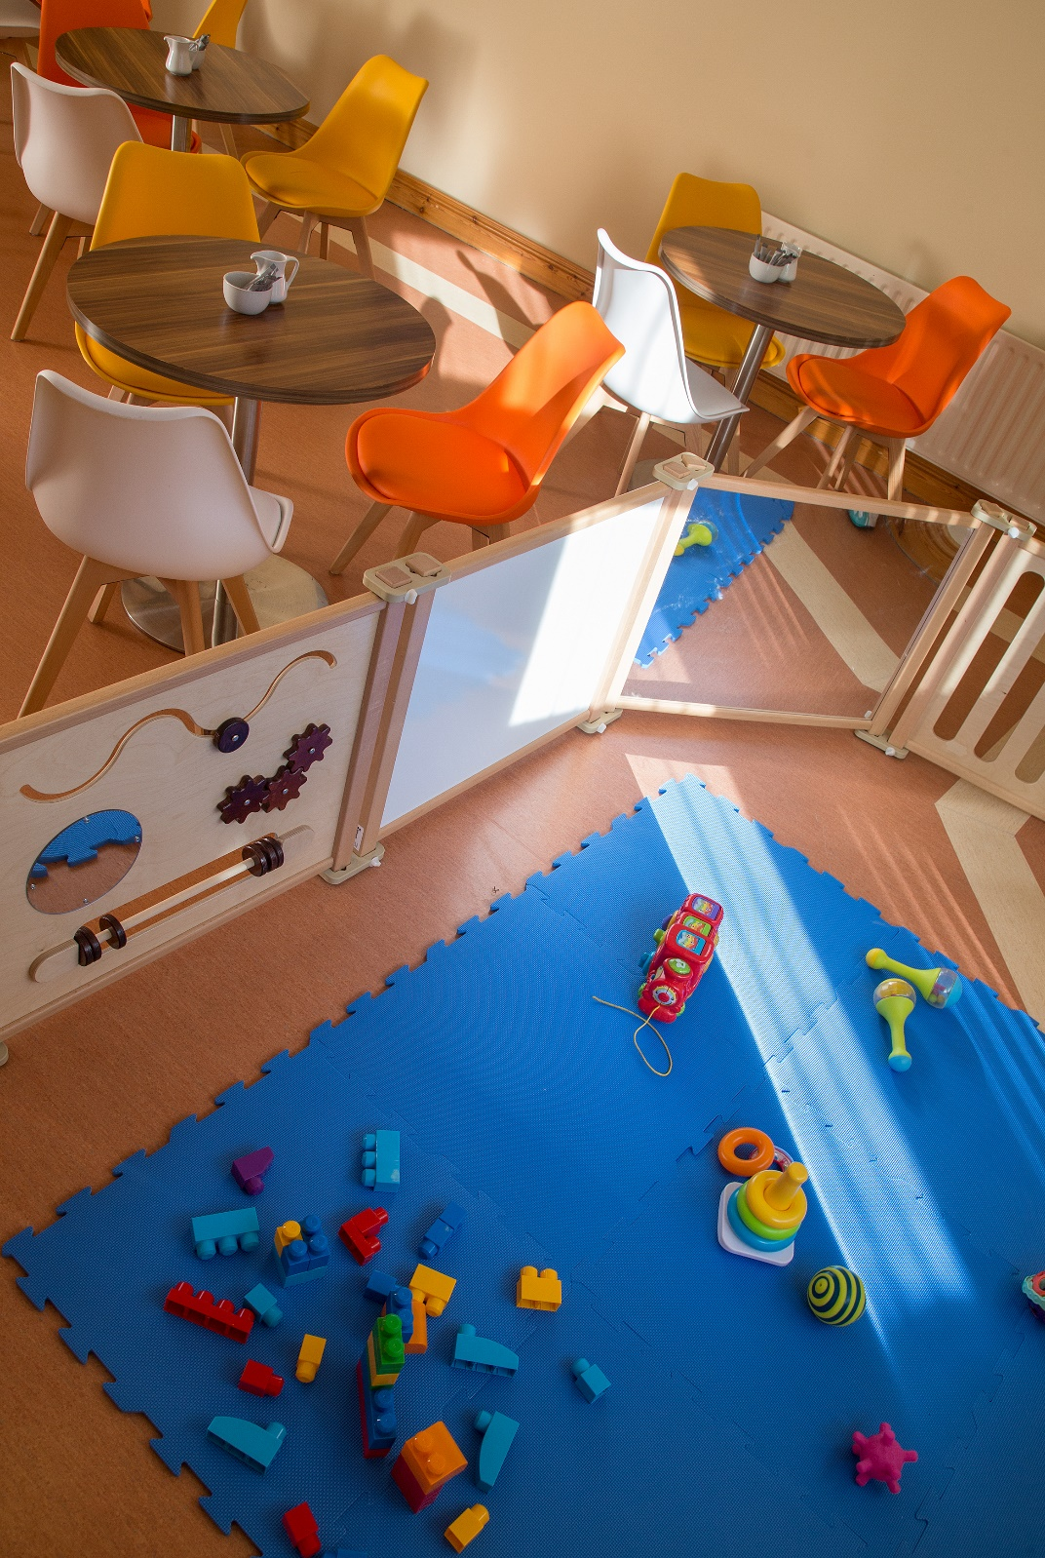
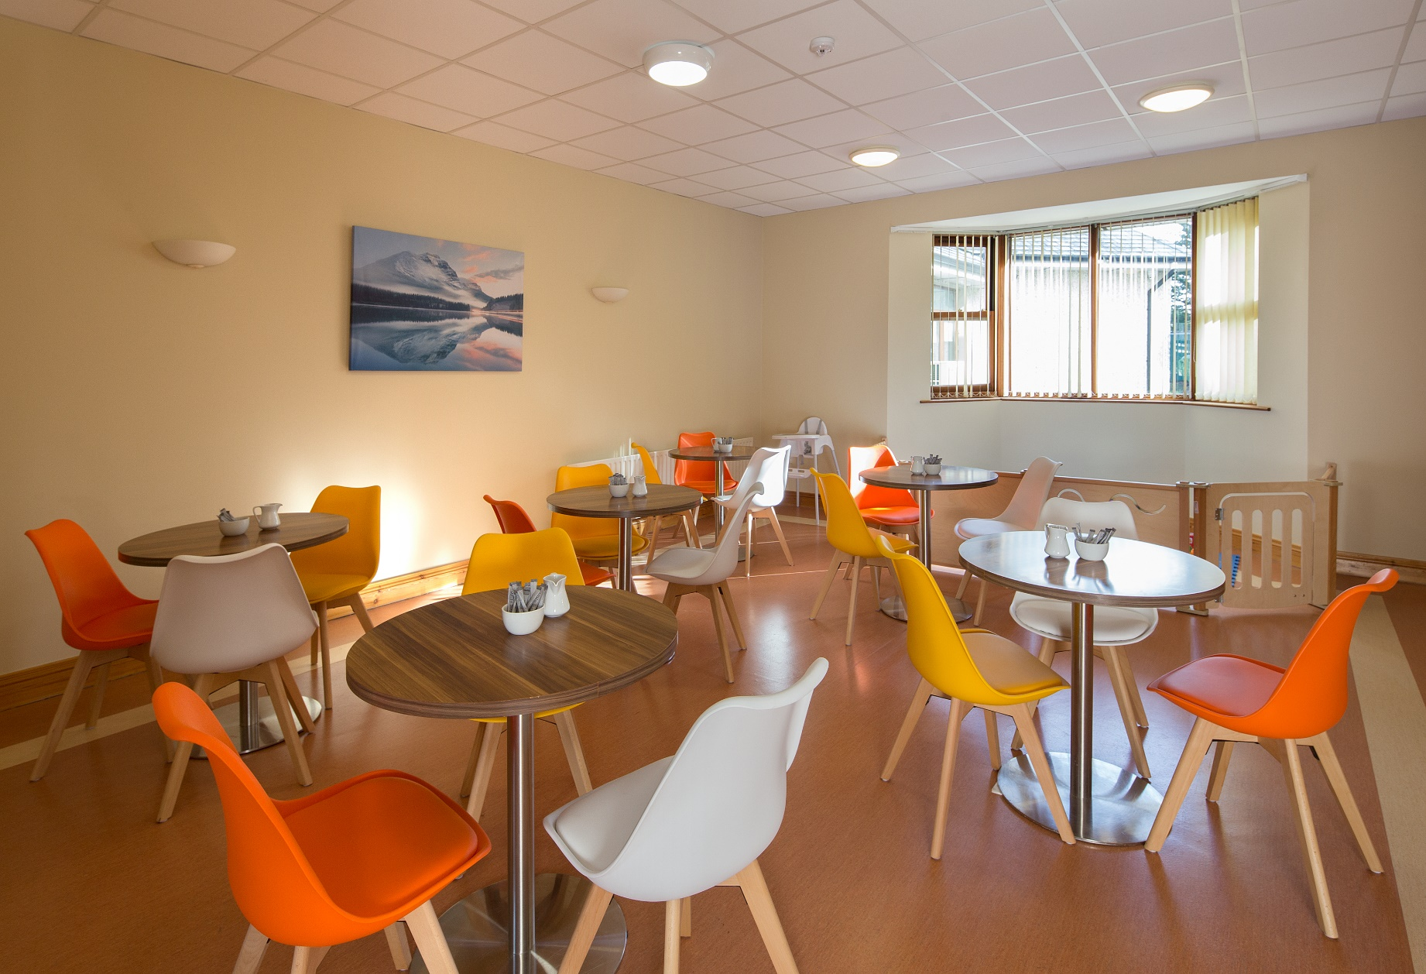
Firhouse Family Hub
One Dining room and play area

Slide 24
Affordable Housing
Priority for Respond.
Intermediate housing.
For those who don’t qualify for social housing or mortgages.
Cities cannot operate without housing for key workers.
Affordable purchase.
Cost Rental.
Cannot have subsidised housing without a subsidy.

Slide 26
Thank You for listening

