Slide 1
RATHFARNHAM/TEMPLEOGUE/TERENURE
AREA COMMITTEE MEETING

Slide 2
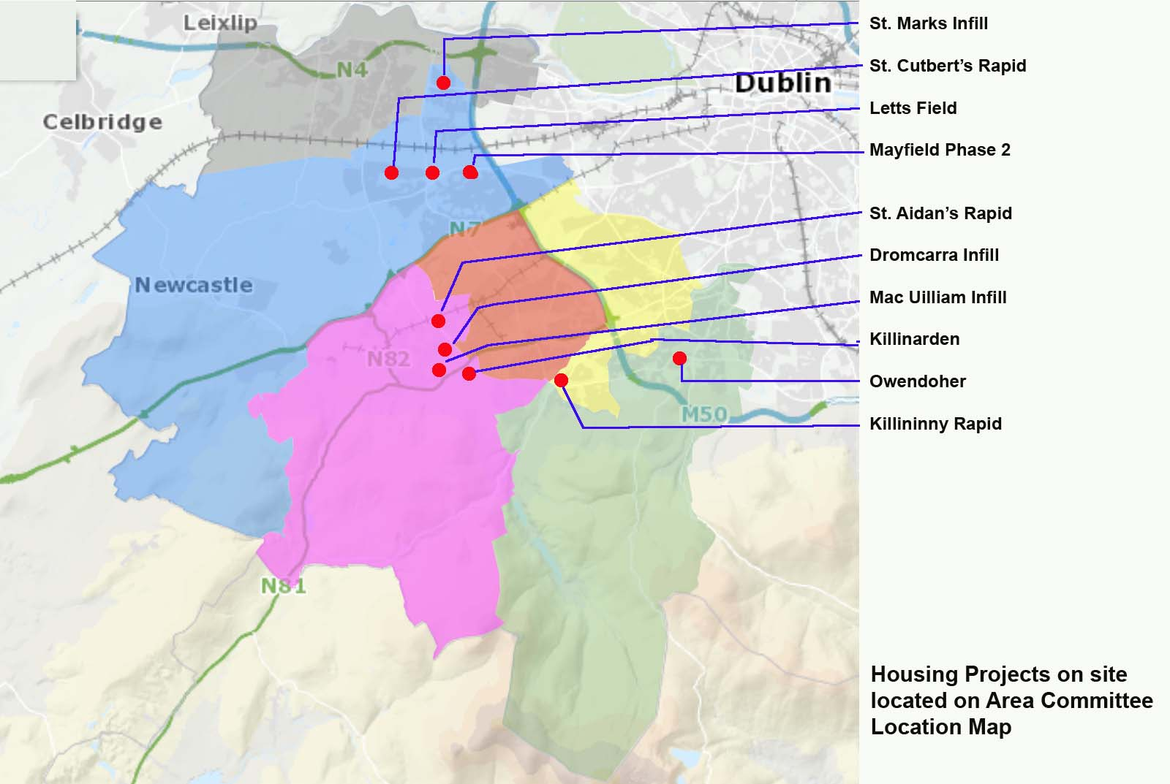
AREA LEGEND:
Lucan
Clondalkin
Templeogue-Terenure
Tallaght Central
Tallaght South
Rathfarnham
Electoral Areas 2014 (1986 Act)-NTS & Proposed Site Locations

Slide 3
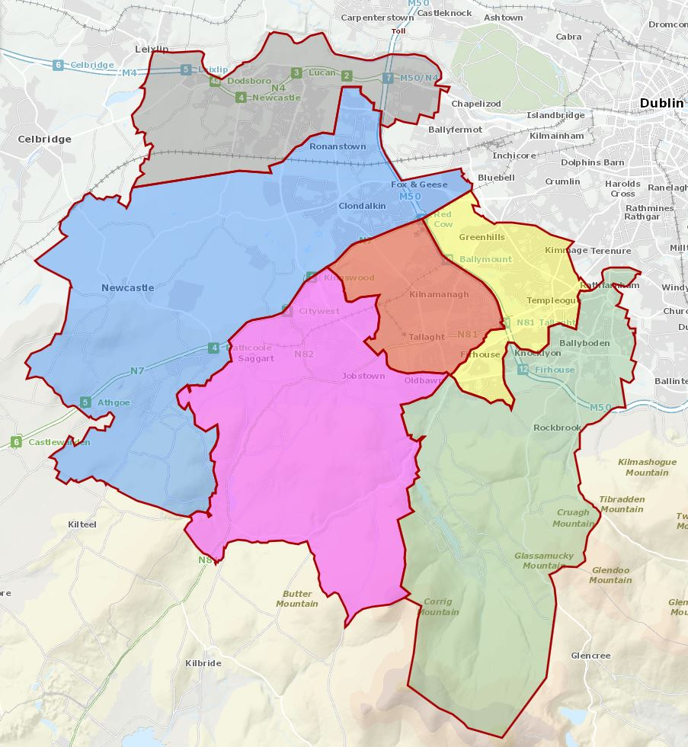
SITE 1
AREA LEGEND:
SITE 2
Lucan
SITE 3
Clondalkin
SITE 4
Templeogue-Terenure
SITE 5
Tallaght Central
Tallaght South
SITE 6
Rathfarnham
SITE 7
SITE 8
SITE 9
SITE 10
SITE 11
Electoral Areas 2014 (1986 Act)-NTS & Proposed Site Locations

Slide 4
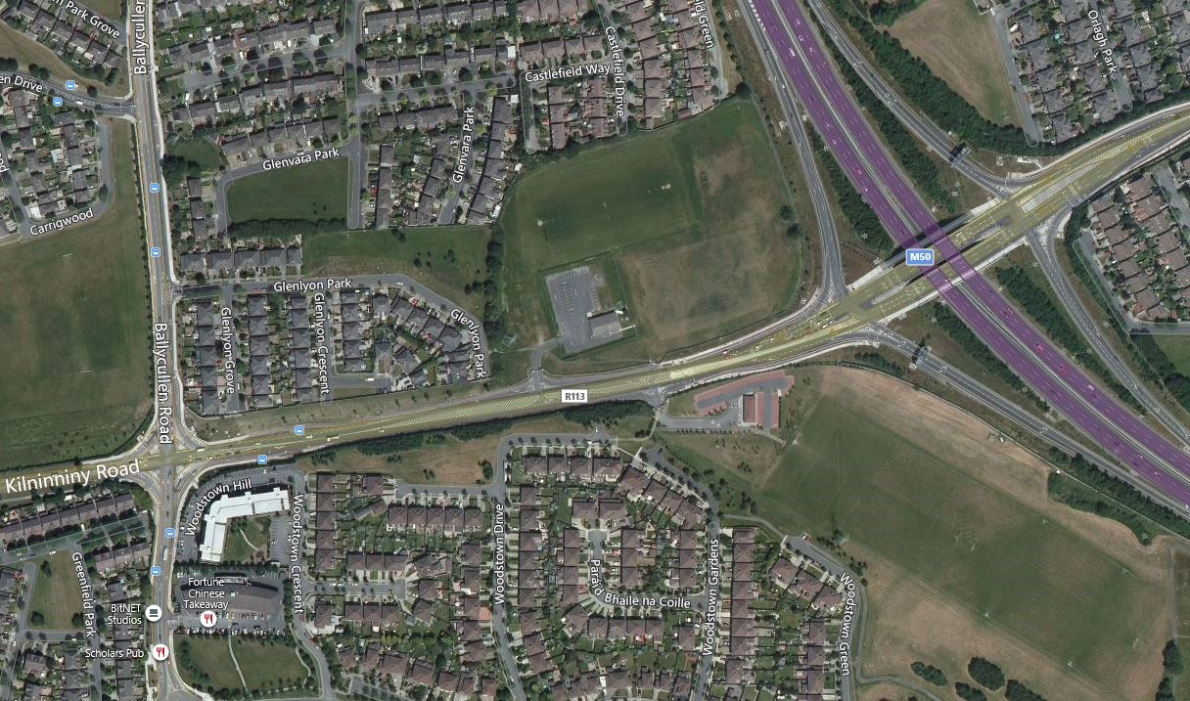
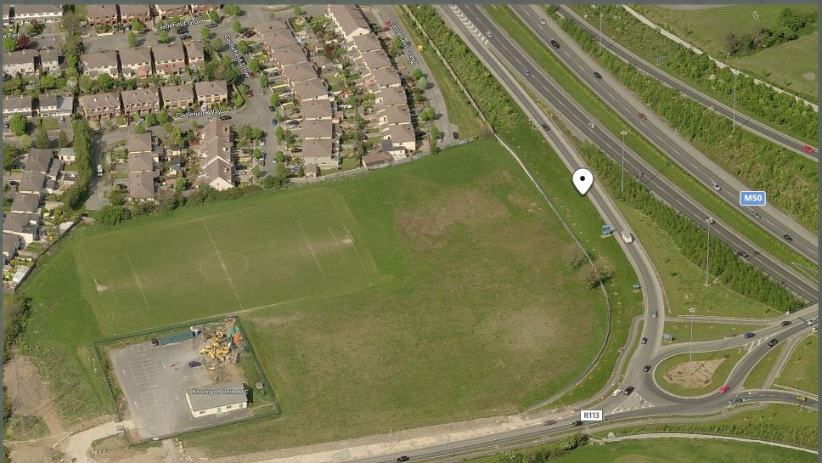
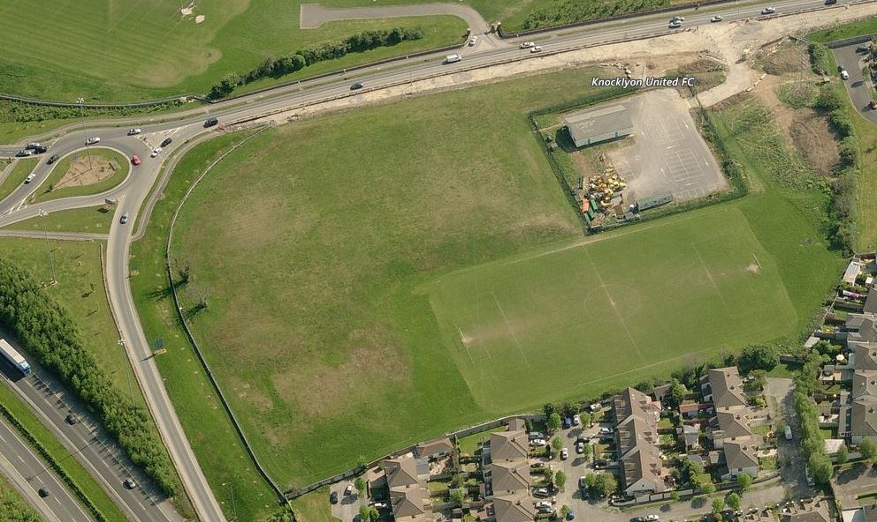
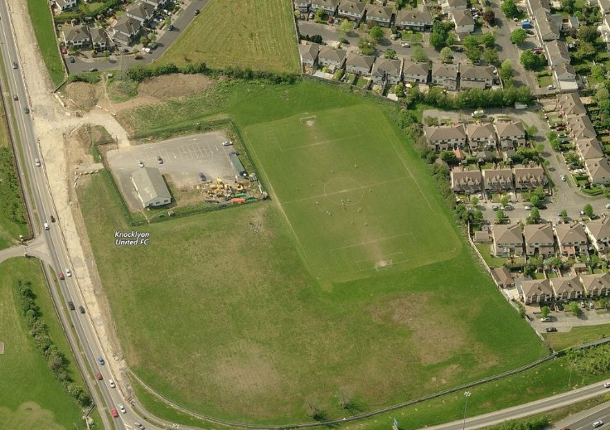
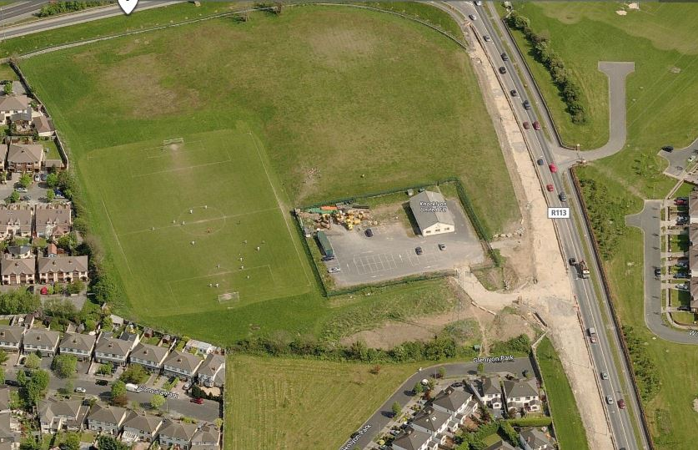
KNOCKLYON
SITE IMAGES-EXISTING

Slide 5
KNOCKLYON
EXISTING SITE
SITE CONSTRAINTS

Slide 6
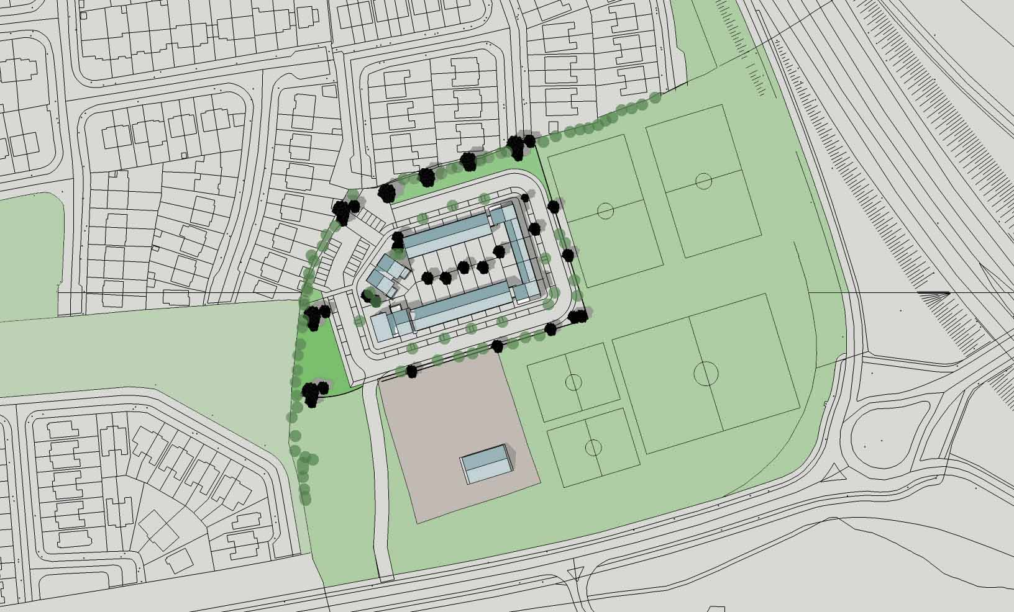
PROPOSED MASSING

Slide 7
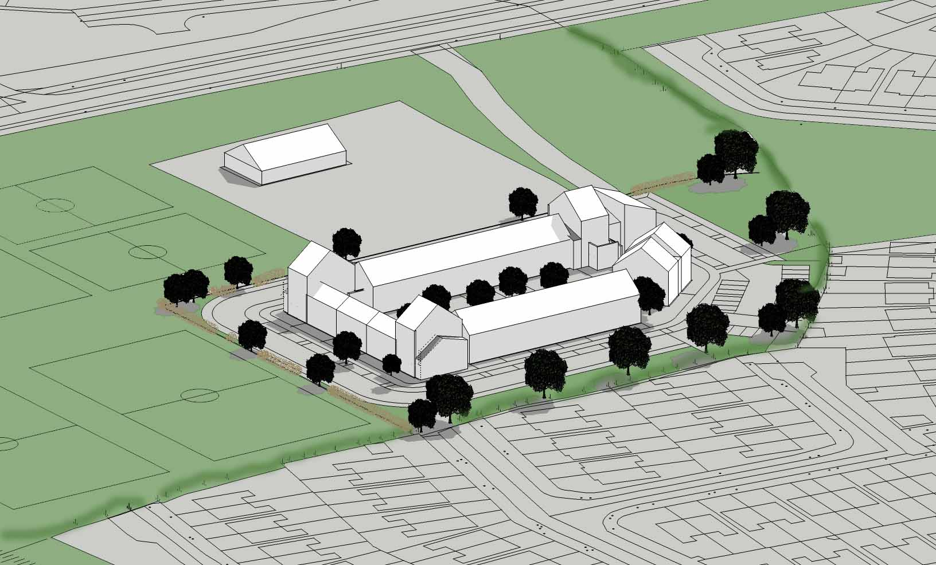
PROPOSED MASSING

