Slide 1
Proposed permeability schemes
Lucan

Slide 2
Proposed locations

Slide 3
Esker Project In the Esker project, it is proposed to construct a pedestrian and cycle link along the line of the Esker, a route which is used as an existing pedestrian shortcut. The project will provide a connection between Griffeen Road and Ballyowen Road (R136). The route will greatly reduce the walking and cycling distance to the Ballyowen local centre, Griffeen local centre and local amenities for households in the area. In 2012, South Dublin County Council passed an amended Part 8 permission for the project, the outcome of which has been submitted to the NTA. The NTA however will not approve funding for the scheme as the amendments to the ‘Part 8’ Submission are not acceptable to them. The Council can submit this to the NTA again but it is unlikely that funding will be made available unless the approved Part 8 (with the amendments) is revised. 1 Run Part 8 again with original plans. 2 Revised plan such as one shown with new opening where the Esker joins the R136 or separately at Moy Glas and Castle Riada. 3 Open a section of wall between the bus stop and the Esker at Moy Glas Lawn. 4 Do none of the above.

Slide 6
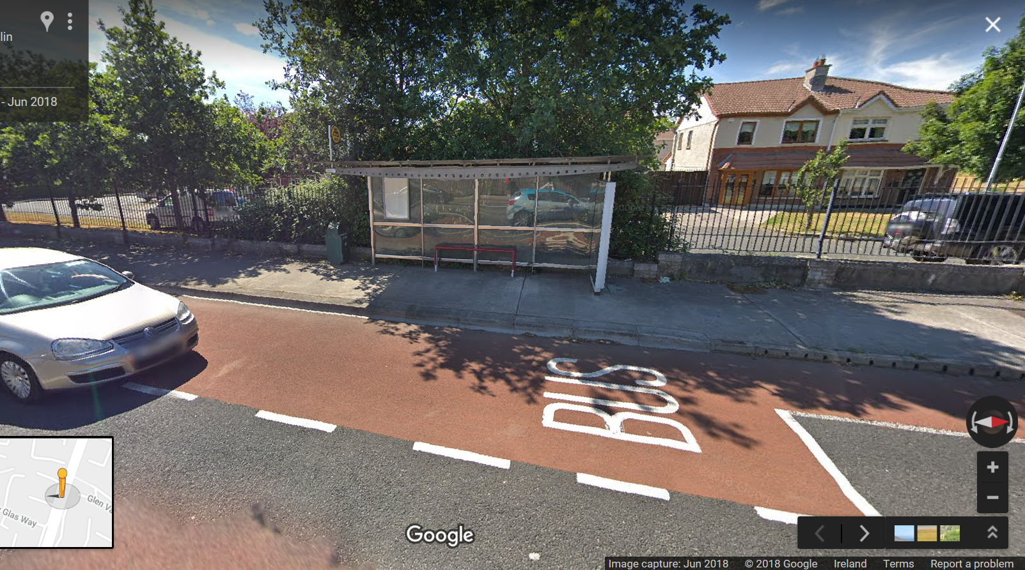
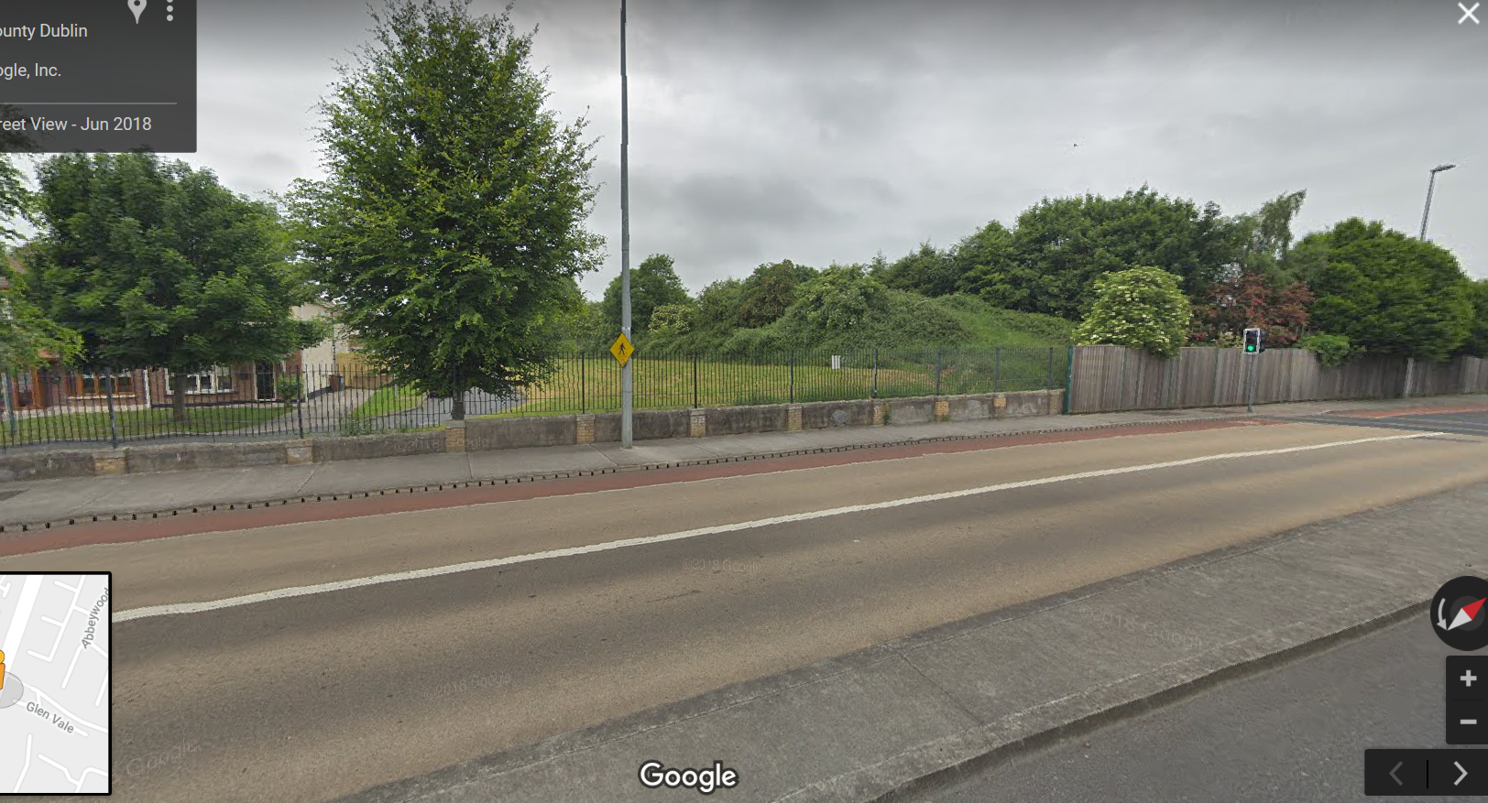

Slide 7
The Paddocks to Hillcrest A fence was erected as promised between the estates in the Jan 2018 but was removed, presumably by locals, within 24 hours. We feel it map be best to carry out a public consultation exercise in 2019 to look at gauging public opinion and determining a new route.

