Slide 1
Proposed permeability schemes
Clondalkin

Slide 2
Proposed locations

Slide 3
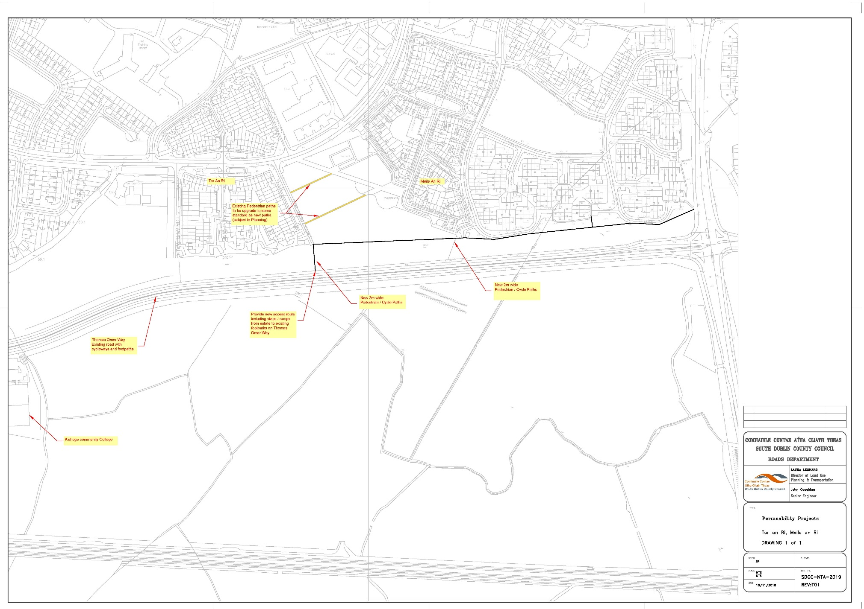
Foxdene, Miele an Ri, Tor an Ri

Slide 4
Bawnogue Rd to Fonthill Rd
Part 8 has been agreed, we have received agreement from the NTA that we can commence this scheme.
We are currently producing tender documents and should have a contractor on site March 2019.
The scheme should take 4 months to be completed.

