Slide 1
Timelines for Delivery of New Traveller Accommodation Programme 2019 – 2024
Housing Strategic Policy Committee Meeting
19th November 2018

Slide 2
Key Dates for Implementation of TAP 2019-24
Date | Summary of Action
August 2018 | Notification issued to adjoining local authorities, HSE, LTACC, AHB’s and Community bodies
September 2018 | Closing Date: 6 submissions received Clondalkin Traveller Development Group Minceirs Whiden National Traveller MABS Parish of the Travelling People Tallaght Traveller Development Group Traveller Health Unit, HSE
Nov/Dec 2018 | Needs Assessment and Annual Traveller Count

Slide 3
Key Dates for Implementation of TAP 2019-24
Date | Summary of Action
Jan/Mar 2019 | Preparation of Draft Traveller Accommodation Programme
1st April 2019 | Publish notice in newspapers- draft programme available for inspection
31st May 2019 | Latest date for receipt of submissions
1st July 2019 | Submission of draft to Council members for adoption
30th Sept 2019 | Latest date for adoption of programme

Slide 4
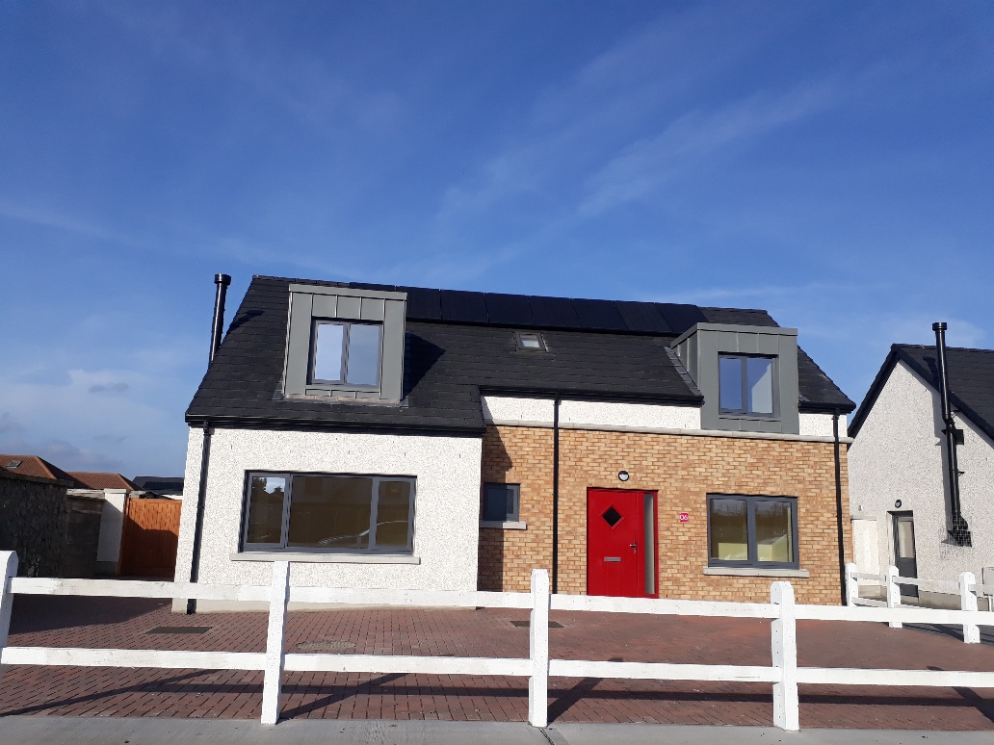
St. Aidan’s Group Housing Scheme 2018

