Slide 1
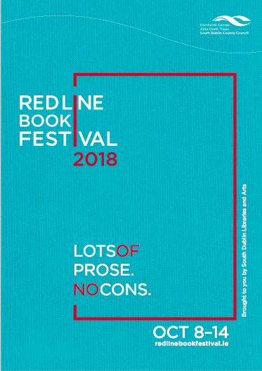
Post Festival Report for Arts SPC
November 2018
Notes:
New design and colours
Website revamped also

Slide 2
Post Event Report
7 Days: Monday 8th October – Sunday 14th October 2018
14 Venues across South Dublin County –57 events.
90+ authors/speakers/actors/storytellers/facilitators
38 Free Events
19 Paid Events
Poetry and Short Story competitions.
Notes:
Authors of note:
Irish language events
History events:

Slide 3
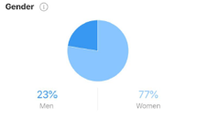
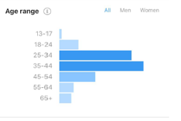
Audience attendance of 3,495
(attendance rate of 75%, increase of 16% attendance from 2017)

Slide 4
Pictures speak a thousand words…….
Just a few highlights

Slide 5
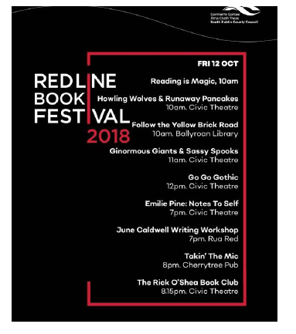
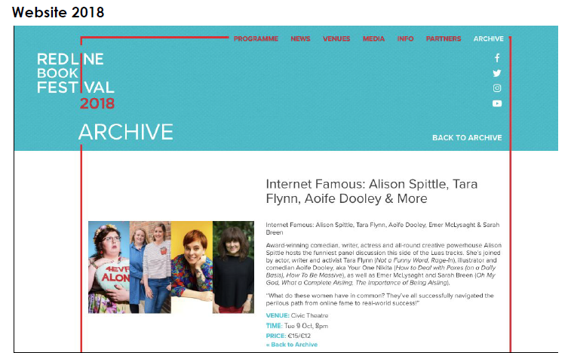
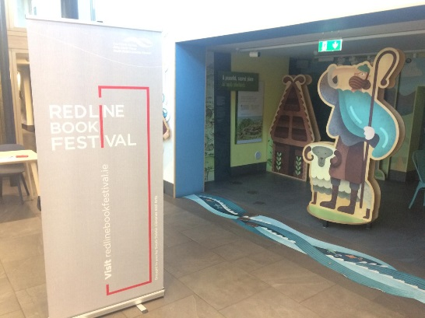
New designs for new image
Social Media Twitter and Instagram
Brochure, posters, pop-ups and bookmarks

Slide 6
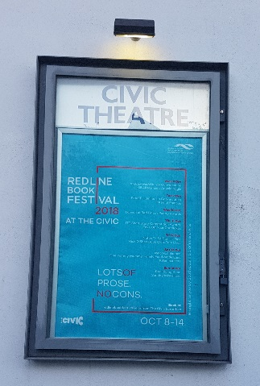
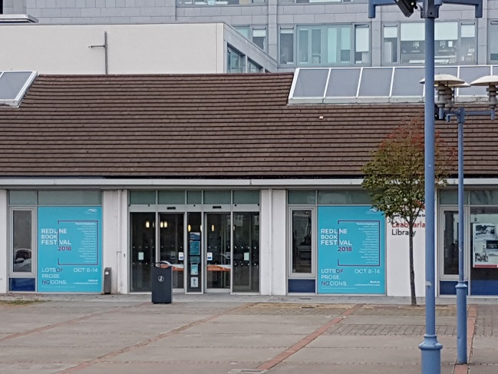
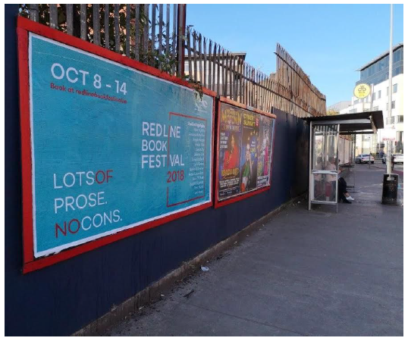
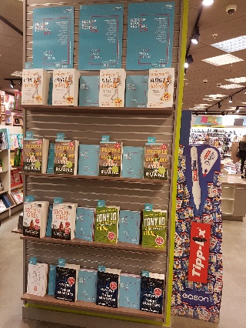
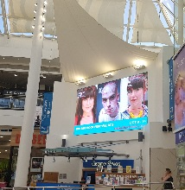
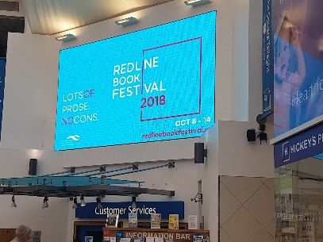
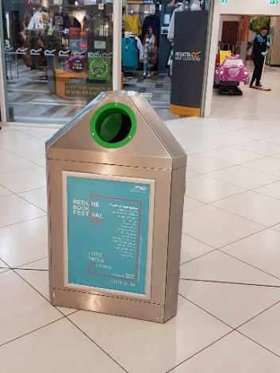
Advertising and Publicity

Slide 7
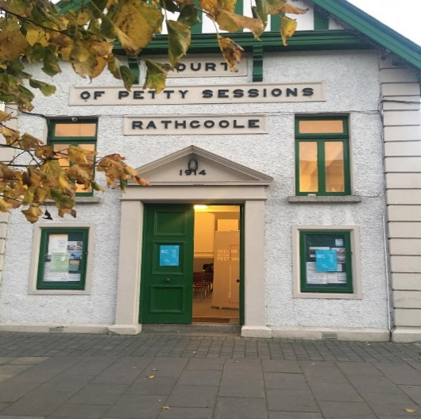
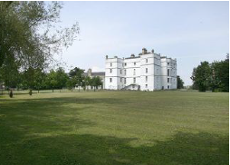
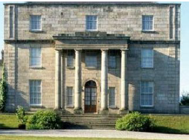
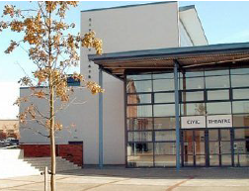
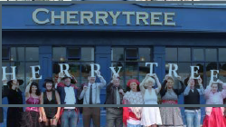
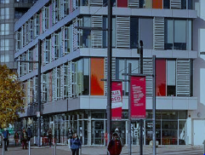
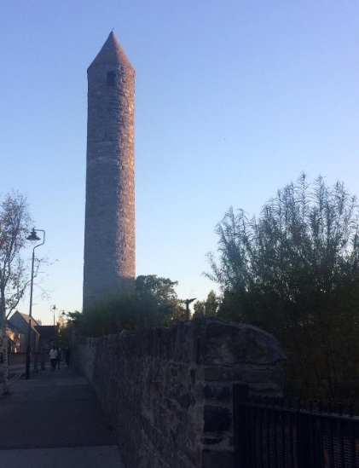
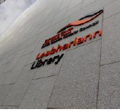
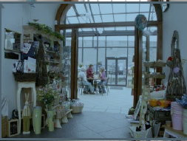
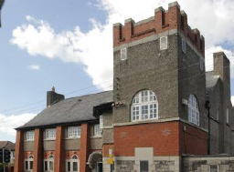
The Venues

Slide 8
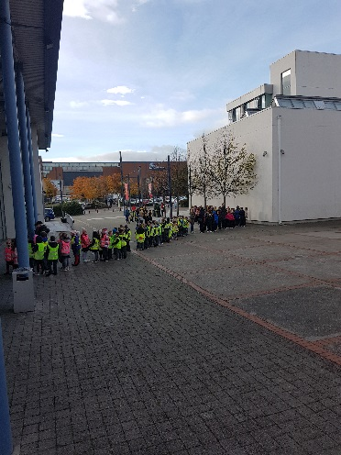
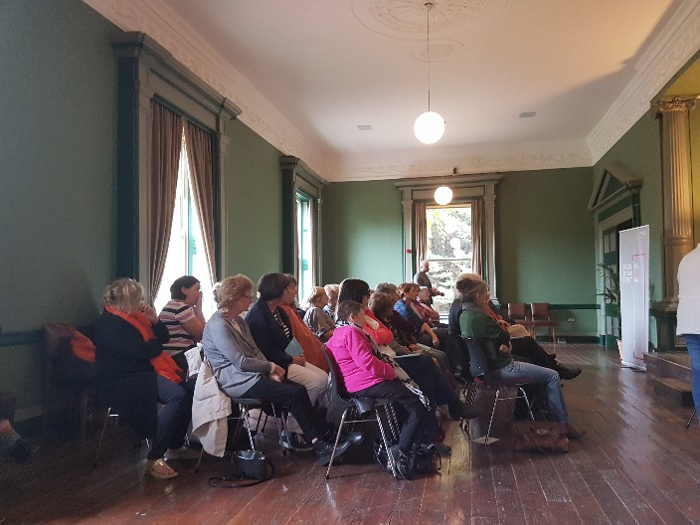
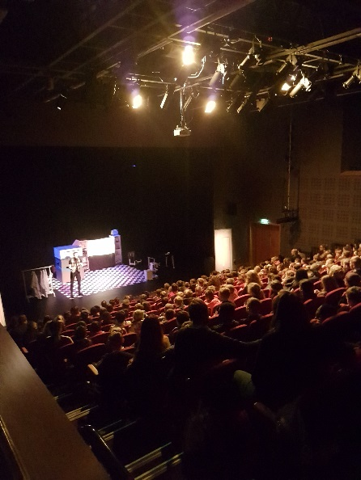
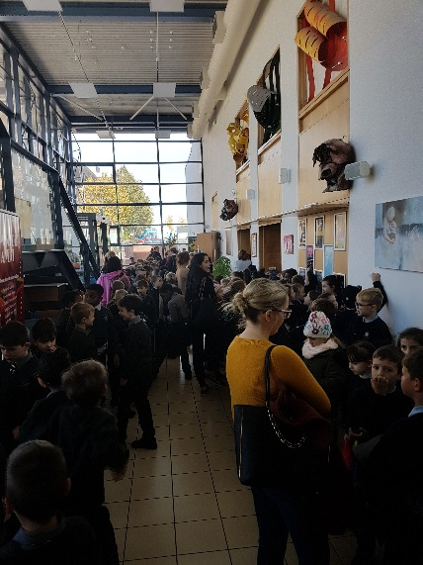
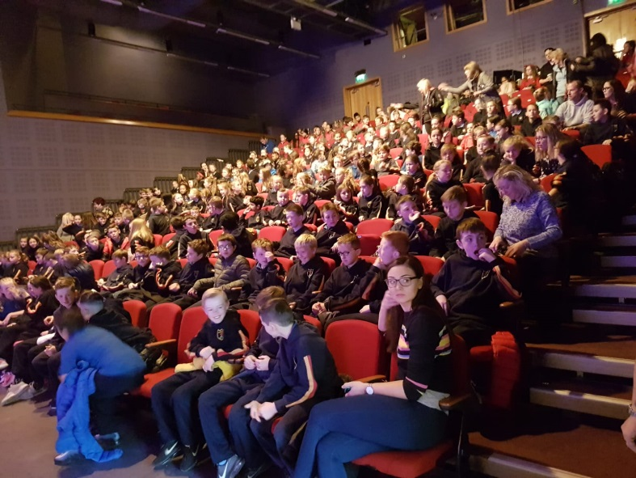
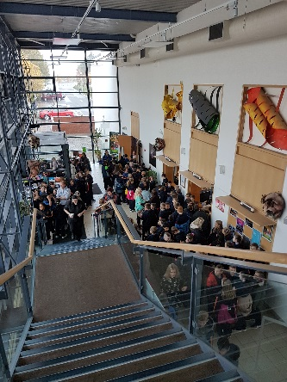
The Crowds

Slide 9
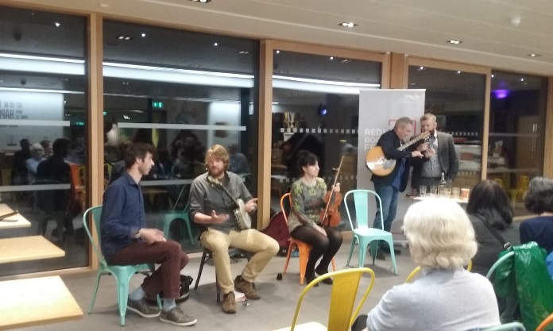
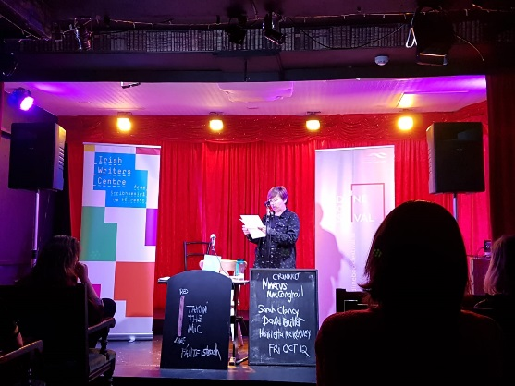
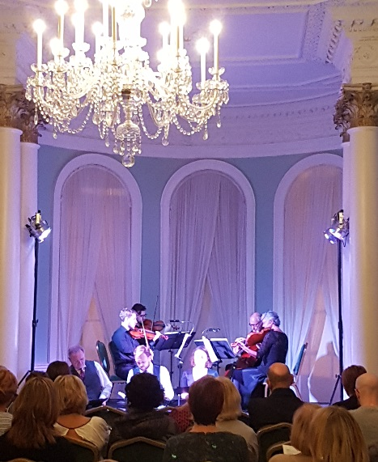
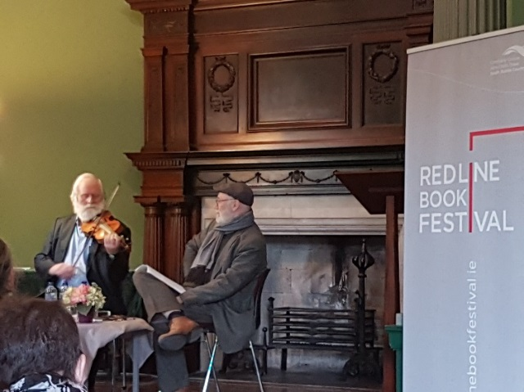
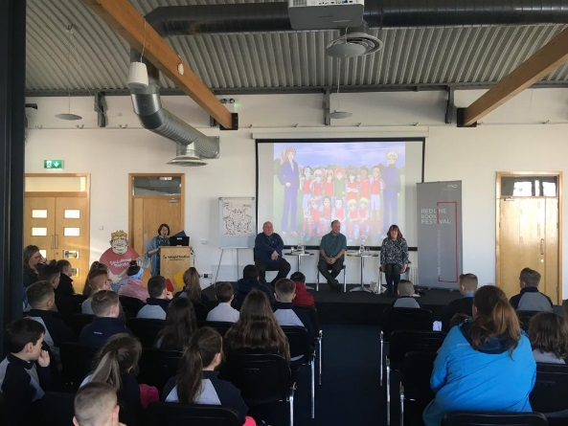
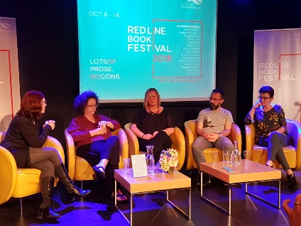
Taking the Mic
In the Cherrytree
Anam an Náisiúin
Ceol agus craic and poetry Clondalkin Round Tower Centre
Magic in My Eyes
Hardy’s Poems of Love and Loss
Rathfarnham Castle
The Events
Killer Instinct
The Studio in The Civic
Booked! Sports fiction for Children Tallaght Stadium
Dermot Bolger in Conversation Pearse Museum

Slide 10
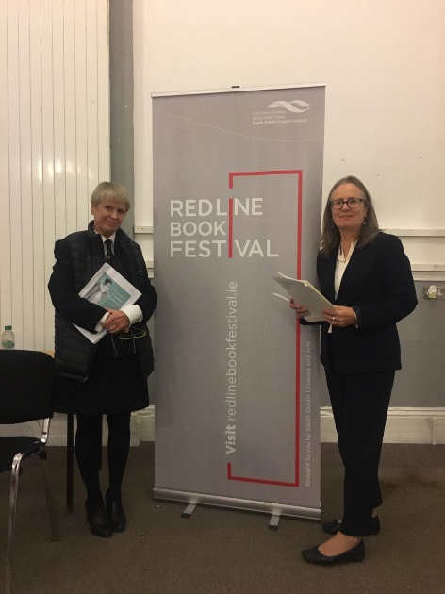
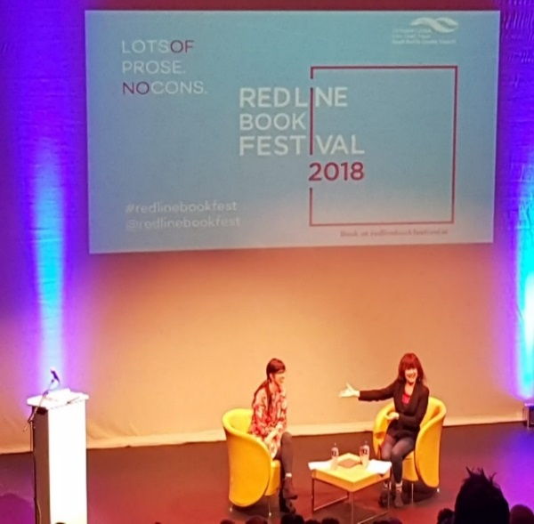
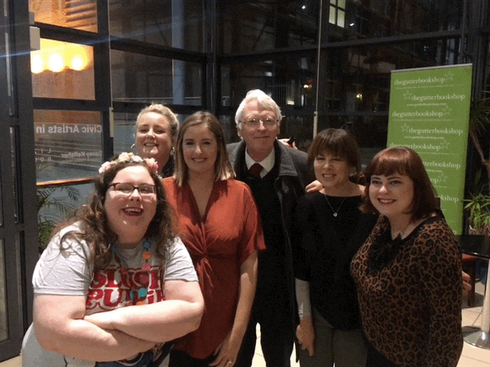
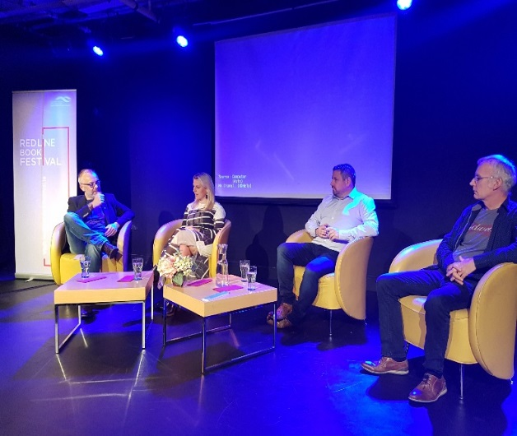
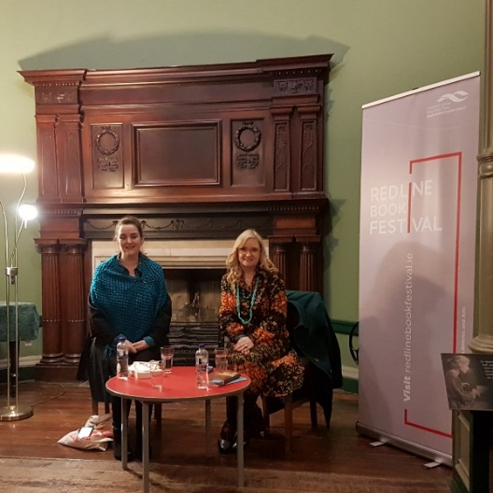
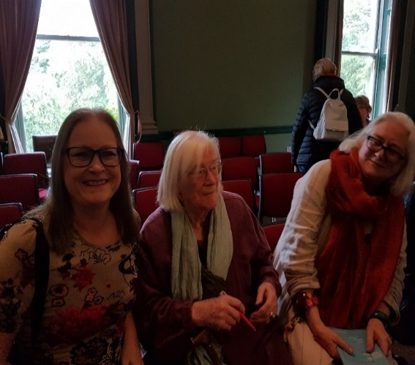
Mná and the Law
Justice Marie baker and Constance Cassidy SC Court of Petty Session, Rathcoole
Emily Pine
Internet Famous
Alison Spittle, Aoife Dooley, Sarah Breen and Aoife McLysaght
The Events
Rick O‘Shea Book Club
with Senator Lynn Rouane, Tony
O’ Reilly and Declan Lynch
Victorian Mavericks
Pearse Museum
Jennifer Johnston in conversation
Pearse Museum

Slide 11
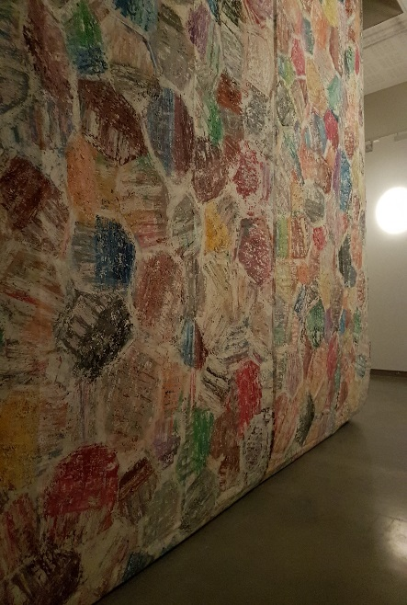
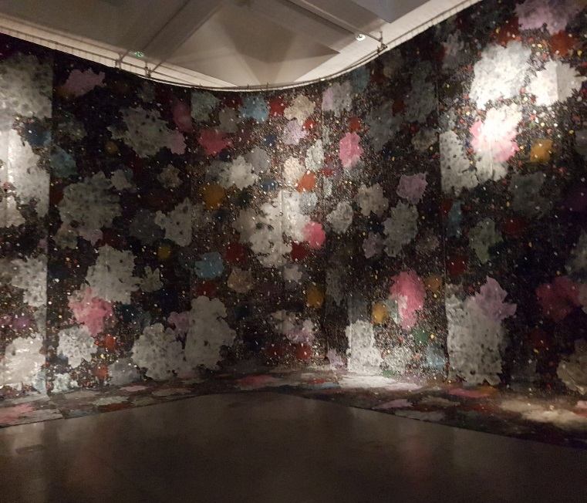
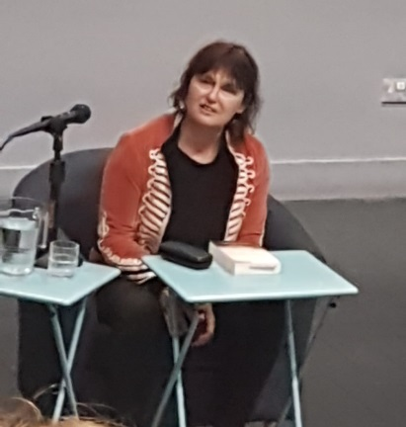
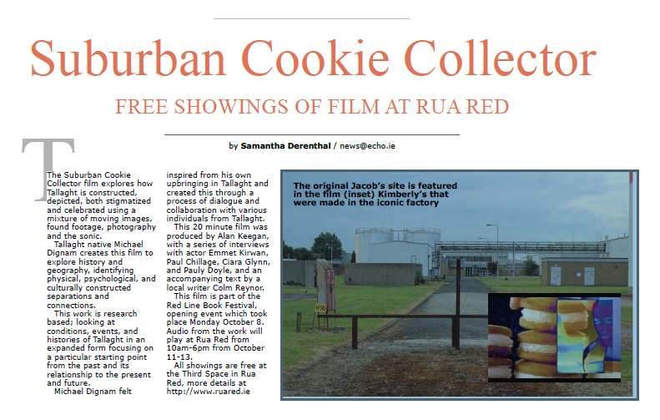
Rua Red Events

Slide 12
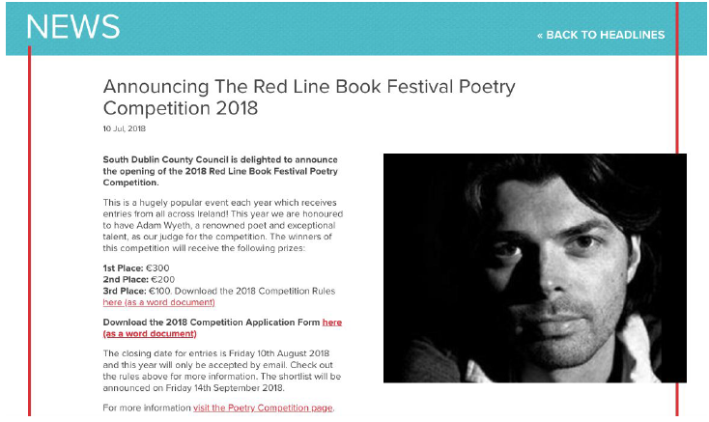
Writing Awards and Tools of the Trade Workshops
Eight FREE Workshops with well respected poets and authors:
Mary O Donnell, Jane Robinson, Rob Doyle, Eileen Casey, Lisa Harding, Mark Granier, June Caldwell and Colm Reynor
More than 100 people got involved in the 2018 workshops
RLBF Poetry Awards Ceremony 2018 and Launch of “Red Lines” Poetry Book
300 Poems from 168 Poets in Ireland
Tallaght IT awards for Short Story Competition 2018
200 entries from 17 Countries worldwide
Notes:
Workshops – Tools of the Trade
Eight workshops for adults and young adults in various venues.
ITT - Short Story
Number of entries: 240 from all around the World
Prizes: 1st place €500, 2nd €250, 3rd €150.
Awards Thursday 11th^{th} October 2018 The Studio, Civic Theatre
SD Libraries Poetry
Number of entries: 300 from all around Ireland
Prizes: 1st place €300, 2nd €200, 3rd €100.
Awards Wednesday 10th October 2018 as part of Poetry evening at the Civic Theatre
Launch of Poetry book – Red Lines

Slide 13
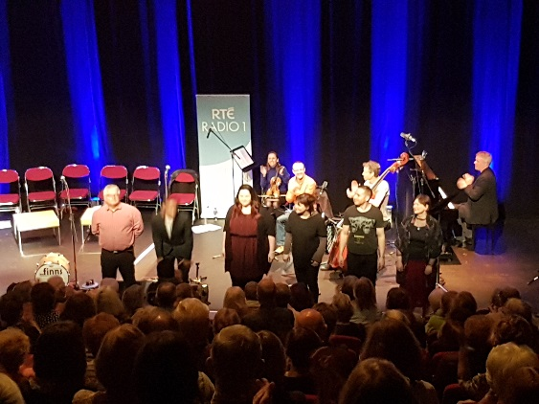
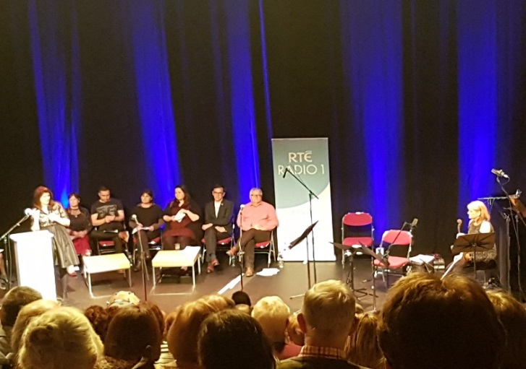
Red Line Book Festival team secured 100% radio support for the 2018 festival from RTÉ Supporting the Arts . Adverts ran from Oct 1st - 7th on RTÉ Radio 1 and highlighted the 2018 programme twice a day for the week. (The value of this campaign equates to €13,377)
The Finale
RTÉ Sunday Miscellany live recording at the Civic Theatre for the 3rd year running.

Slide 14
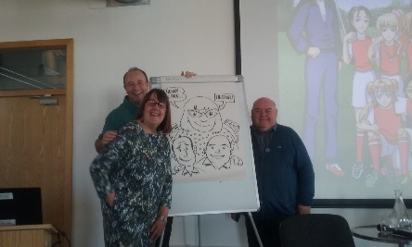
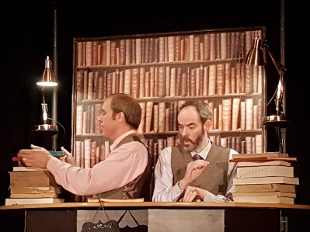
Recommendations and Conclusions
Contact with more local publishers
More paid events at weekend
Nominal fee for workshops
Pop-up events in Square
Invite more media persons to chair events
Allow volunteers
More contact with the LUAS
Entice audiences out from the city
Take off your Cornflakes
Civic Theatre
This Voice
Writing and the working class
Rua Red
Mná na hEireann
- Historical Heroines
Civic Theatre

