Slide 1
River Poddle Flood Alleviation Scheme Presentation to Rathfarnham/Templeogue-Terenure Area Committee 9th October by David Grant, Project Resident Engineer

Slide 2
Route 6km in length Rises in Tallaght flowing through Tymon Park, KCR, Harold's Cross, Blackpitts and discharges at Wellington Quay

Slide 3
History
Associated with the naming of Dublin
Main Water Supply for Dublin up to 13th Century
Played a major role in the social and economic growth of Dublin where it served unto 52 Mills and Commercial Enterprises along its route
15 other Watercourses associated with its network
Heavily urbanised watercourse

Slide 4
Recent Flood Events
24/10/2011 – 90mm of rainfall in 6 hour period – Major flooding in Kimmage, Harold's Cross, Mount Argus, Mount Jerome and Gandon Close. Over 50 properties flooded. One loss of life.
05/09/2008 – 58mm of rainfall over 11 hour period in Kimmage area
06/11/2000 – 103mm of rainfall in 48hr period. Banks broken in Kimmage area
25/08/1986 – Hurricane Charlie – 80 Households and 5 Commercial Properties affected

Slide 5
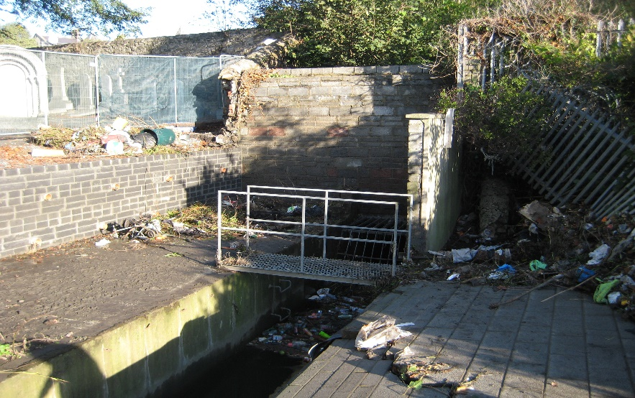
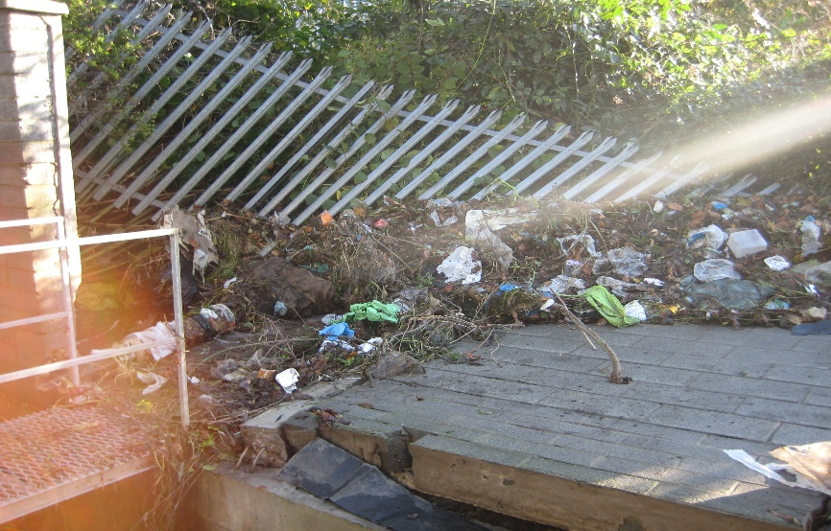
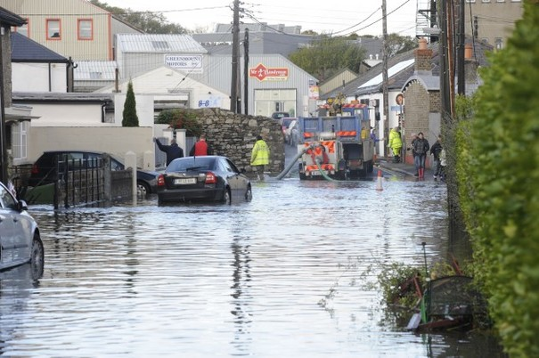
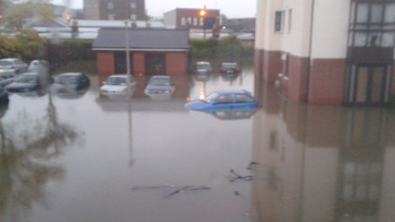
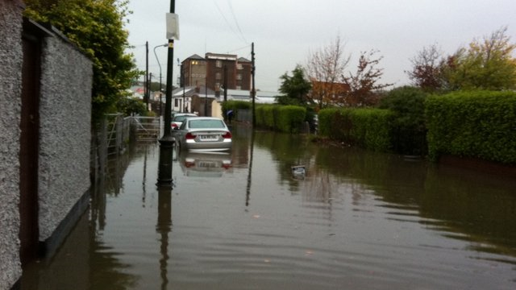
Photos 2011 Flood Event

Slide 6
River Poddle Flood Alleviation Scheme
Devised from 2011 Eastern CFRAM Study
Tri-Agency Input – OPW, DCC and SDCC
Consultant Appointed in March 2018 – Nicholas O’Dywer Ltd
Containment of water upstream of City

Slide 7
Proposed Scope of Scheme
Main intervention area from Tymon Park to Harold’s Cross
Combination of raised Earth Embankments and Hard Defences
Some re-alignment of River Channel
Non Return Flap Valves
Assessment of Drainage Networks
Manhole Sealing
Culvert Cleaning
Upgrading of access to Grand Canal Siphon
Replacement of Weirs and Review of Culvert Screens
Maintenance Plan

Slide 8
Main Elements of Proposed Works
Earth Embankments:
127m along the river at Tymon Castle
284m around Tymon Lake in Tymon Park
135m along river at Whitehall Park and Glendale Park
Hard Defences:
453m between Limekiln Rd and Wellington Lane
367m between Wellington Park and Wainsfort Manor
245m between Glendale Park and Kimmage Manor
255m at Ravensdale Park
223m at Poddle Park
291m between Bangor Rd and Mount Argus

Slide 9
Current Milestone Dates
Preliminary Design – 27/10/2018
Public Exhibitions – 03-14/12/2018
Submit Part 10 Documents to ABP – 25/01/2019
Planning Period – 28/01/2019 to 12/07/2019
Detailed Design – 03/12/2019 – 01/07/2019
Tender Stage – 23/09/2019 – 20/12/2019
Construction Stage – 26/03/2020 – 26/03/2022
Handover Date – 23/07/2022
ALL DATES FROM JANUARY 2019 ARE SUBJECT TO PLANNING APPROVAL FROM ABP

Slide 10
Current Status
Hydraulic Modelling and Hydrological Analysis completed
Selected CCTV and Manhole Surveys completed
Rainfall and Flow Monitoring Surveys completed
Structural Condition Surveys completed
Project Website Live www.poddlefas.ie
Environmental Screening and Assessment commenced
Topography and Threshold Surveys to start October 2018
Site Investigation Surveys to commence Oct/Nov 2018
Proposed Scheme Launch Date October 24th

Slide 11
Thank You
Any Questions?

