Slide 1
Draft WASTE MANAGEMENT (STORAGE, PRESENTATION AND SEGREGATION OF HOUSEHOLD AND COMMERCIAL WASTE) BYE-LAWS 2018
South Dublin County Council
October Council Meeting
8th October 2018

Slide 2
Why New Bye-Laws?
South Dublin County Council previously made Household Waste Presentation Bye Laws in 2012 and Commercial Waste Bye Laws in 2007
Existing ByeLaws out of date due to changes in legislation and requirements in terms of food waste presentation

Slide 3
Why New Bye-Laws?
Specific requirement of each of the Regional Waste Plans 2015-2021 which has an objectives to :
…..Review/introduce presentation of waste ByeLaws across the region, to maximise the quantity and quality of recyclable waste collected and amend /replace/introduce new ByeLaws if appropriate.

Slide 4
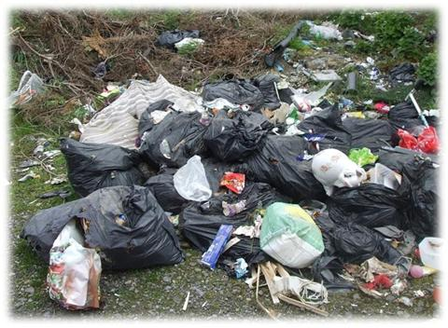
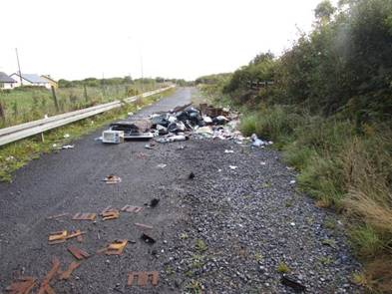
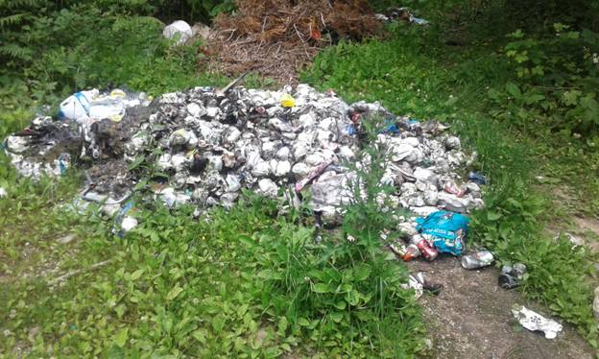
Waste Bye-Laws - Why

Slide 5
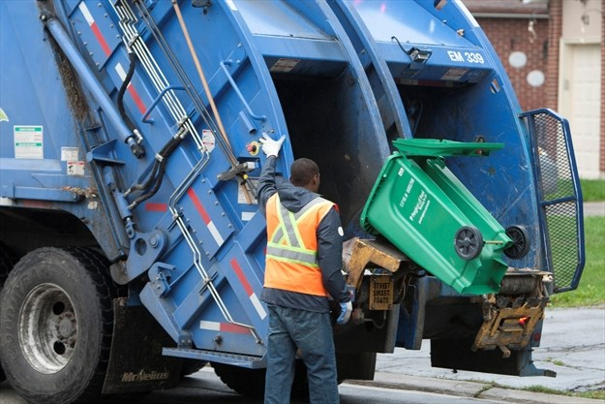
Why New Bye-Laws? Greater Participation in Waste Collection Services

Slide 6
Making Bye-Law Statutory Process
Bye-law making powers in Part 19 of the LGA 2001 Section 199 – Reserved Function
Content is determined by powers under Section 35 of the WMA 1996
Section 21 of the Litter Pollution Act 1997 (if necessary)
Once made, obligation to formally publish in the newspaper circulating in the area and in Iris Oifigiúil
Issue to the appropriate Minister(s) and Superintendent of Garda Divisions.
Effective no less that 30 days after the Bye-Laws are made.

Slide 7
Waste Presentation ByeLaw Adoption
Agree Draft ByeLaw Text
Newspaper
Notice
Copy to Minister & Superintendents of Garda Districts
Two Months
Consideration of Submissions
Incorporation of Amendments
Approval by Members
Finalised Bye-Law Text
Newspaper Notice
Notice in Iris Oifigiuil
Minister & Superintendents of Garda Districts

Slide 8
Waste Presentation ByeLaw Template
Interpretation and Definitions
Obligation to Participate in a Waste Collection Service
Maintenance and Management of Waste Containers
Location for Container Storage
Use of Waste Containers on Collection Day
Collection Times and Container Removal
Prohibited Waste Types
Segregation of Household Waste and Contamination Prevention
Additional Provisions for Householders not availing of a Kerbside Collection Service
Provisions affecting Multi-User Buildings, Apartment Blocks, etc
Interference with Orderly Waste Collection
Additional Provisions for Commercial Waste
Enforcement Provisions/Fixed Payment Notices.
Notes:
This is a quick resume od the various byelaws and what specific areas are covered.

Slide 9
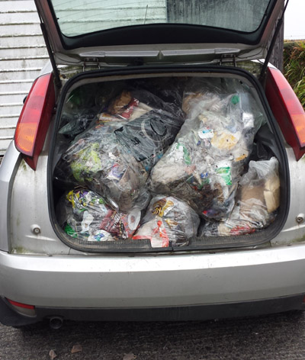
Obligation to Participate in a Waste Collection Service
Bin Sharing with consent of householder
Deliver directly to an authorised site
Authorised Collector
Notes:
Obliges holder of household waste to have at all times a contract with an authorised collector –they can bin share subject to contract being in place and consent of other householder-they can also deliver to authorised sites . Authorised persons can request documentary evidence of contract.
642,546 households or 81% of EMR availing of a waste collection service in 2012 but % in other regions significantly lower

Slide 10
Waste ByeLaws Additional Tool for Enforcement
Key point: Ask the householder?
How did you manage your household waste last month, or for the last 12 months?
Notes:
The key question for LA to ask of householders

Slide 11
Maintenance and Management of Waste Containers

Slide 12
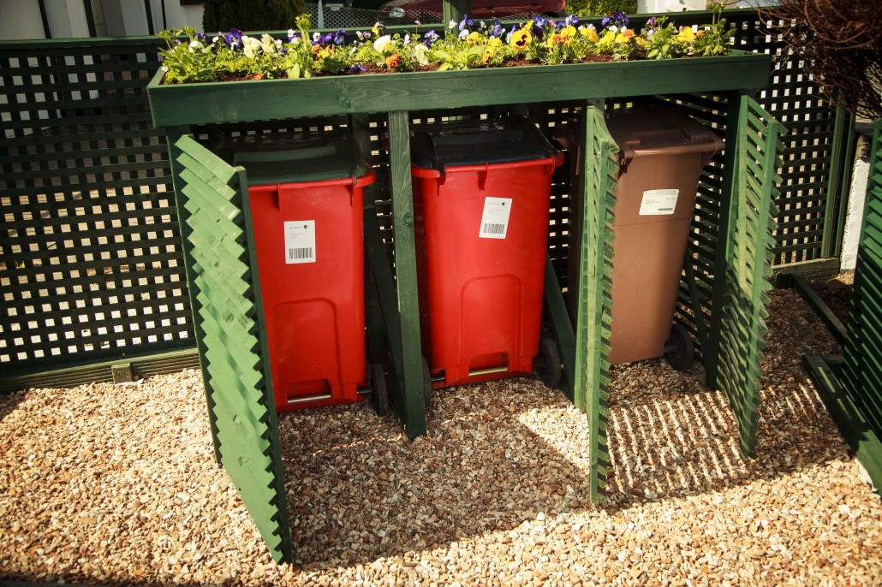
Location for Container Storage
Notes:
Other than on the day before and the designated waste collection day, containers used for the presentation of kerbside waste shall be held within the curtilage of the premises where the waste is produced. They shall not be stored on a roadway, footway, footpath
A question being asked around - Should we be specifying in planning permissions that provisions be made for a three bin storage area within curtilage of terraced houses

Slide 13
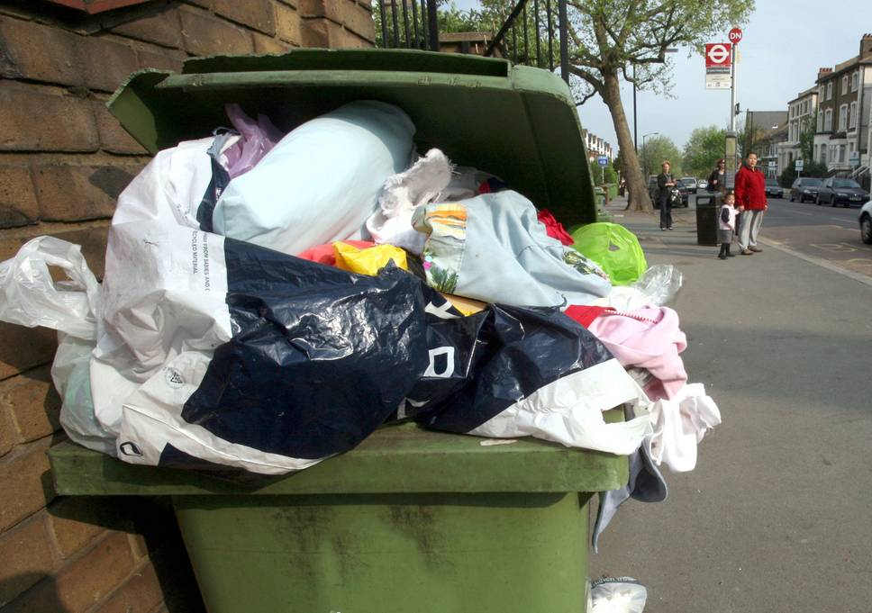
Use of Containers on Collection Day
.
Notes:
Kerbside waste to be presented in an appropriate waste container – bags are only in designated area – no such designated areas in SDCC

Slide 14
Collection Time & Container Removal
Please Take Me In
Notes:
Specifies time that a waste container can be presented for collection and latest time by which containers are to be removed from the public place.
SDCC draft specified as follows:
Kerbside waste presented for collection shall not be presented for collection earlier than 8.00 pm on the day immediately proceeding the designated waste collection day.
All containers used for the presentation of kerbside waste and any uncollected waste shall be removed from any roadway, footway, footpath or any other public place no later than 8:00am on the day following the designated waste collection day.

Slide 15
What Goes in Your Recycling Bin

Slide 16
Prohibited Waste Types
Notes:
Very clear prohibitions – absolutely no hazardous / electronic / batteries

Slide 17
Segregation
Segregation of Household Waste and Contamination Prevention
Notes:
Residual and household recyclable

Slide 18
Provisions affecting Multi-user Buildings, Apartment Blocks, etc
Multi-user buildings, apartment blocks etc. Duty of persons with responsibility to provide:
Adequate receptacles
Information to tenants
Retention of documentation proving contract with an authorised waste collector
Adequate access and egress for RCVs.

Slide 19
Orderly Collection
No interference with collection workers
No Interference with collection vehicles

Slide 20
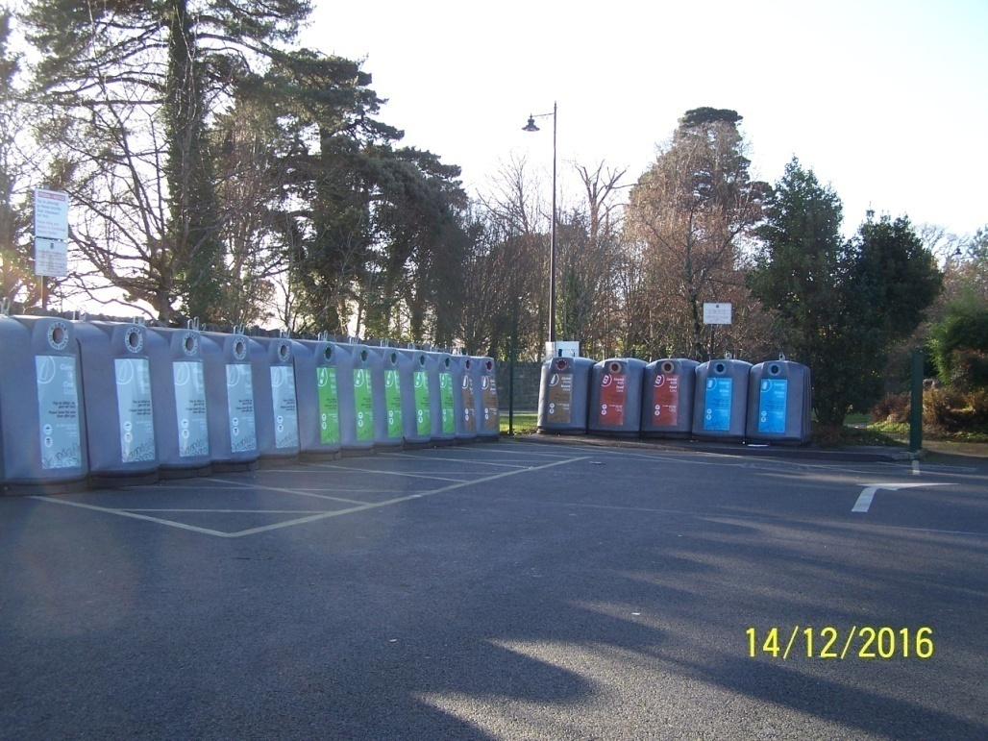
Additional Provisions for Commercial Waste
No Commercial Waste at Bring Facilities
Notes:
MCC proposing to re-advertise Operation of 3 Civic Amenity Sites by year end and will seek to promote such sites as additional option to Kerbside Collection ( €3 - loss making

Slide 21
Waste Presentation Bye-Law Enforcement
Key points:
Enforcement for the discretion of each local authority
FPNs can be used Max €75
Max fine is €2,500. Discretion to vary penalties (downwards).
Bye-Laws cannot circumvent the basic legal principles that govern criminal justice & the waste enforcement process

Slide 22
Conclusion
Draft Bye-Laws as proposed have undergone examination and consideration by the RWMP Offices , Senior Counsel, practitioners on the ground etc.
The proposed Bye-Laws are expected to assist as part of a wider suite of measures including extensive education/awareness initiatives in ensuring lasting behavioural change in how we as citizens manage our waste.

Slide 23
Conclusion
They will provide a consistent set of Bye-Laws across the Region (and country) which will assist Local Authorities in the enforcement of waste storage, presentation and collection.
There is a need to be positive here, acknowledge the very real constraints that apply and, within that envelope, produce Bye-Laws that are (a) useful, (b) workable, (c) enforceable and (d) politically acceptable
Recommendation from EPR&CC SPC that SDCC formally approve the making of these Bye-Laws

