Slide 1
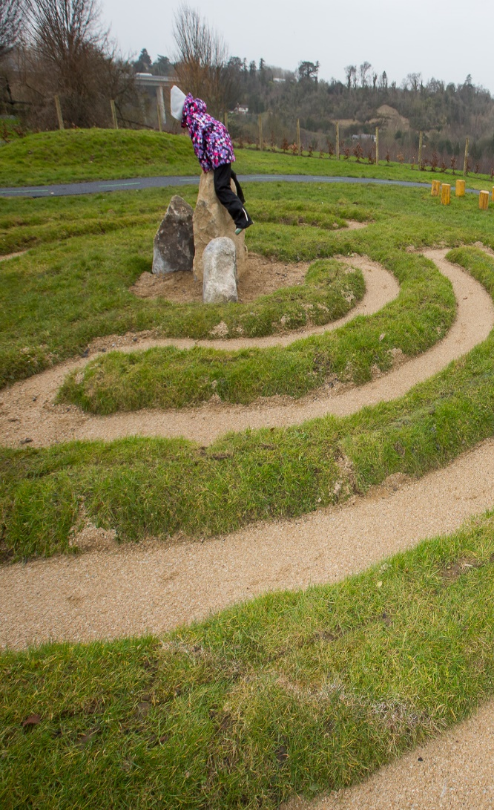
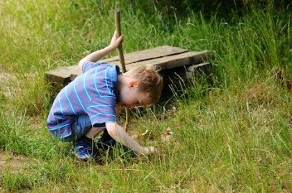
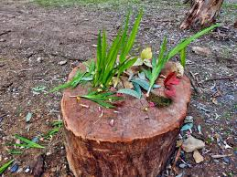

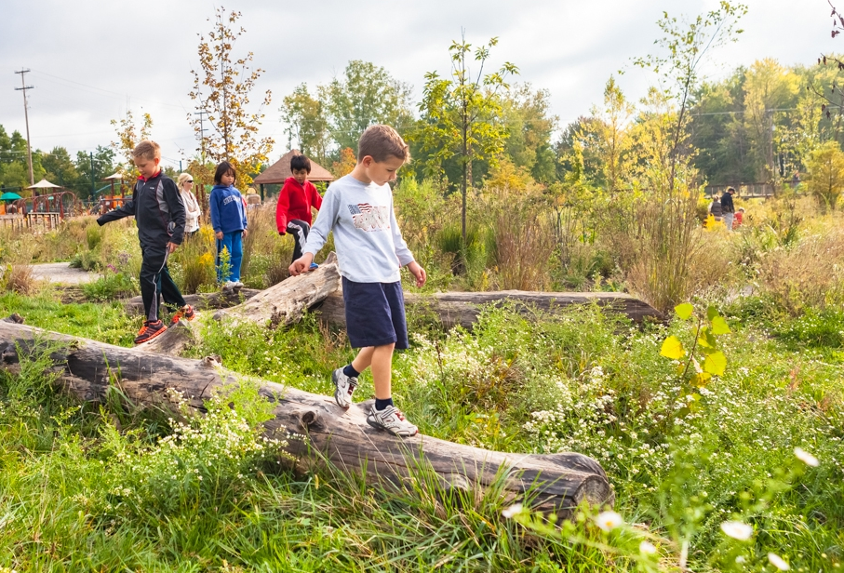
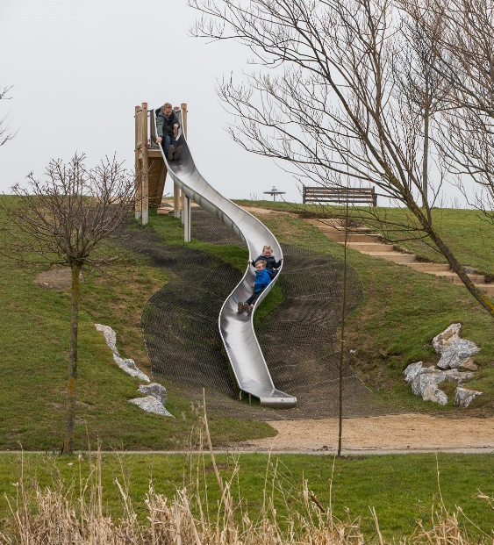
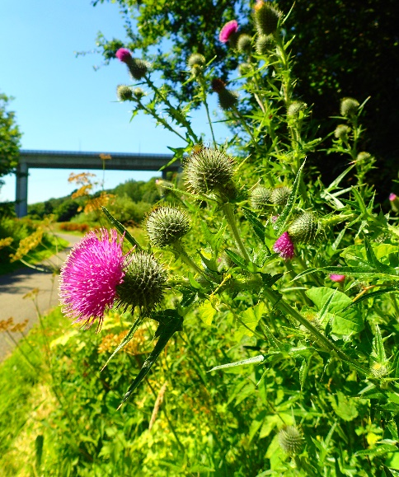
Playground For Waterstown:
Public Participatory Budget Update.
..

Slide 2
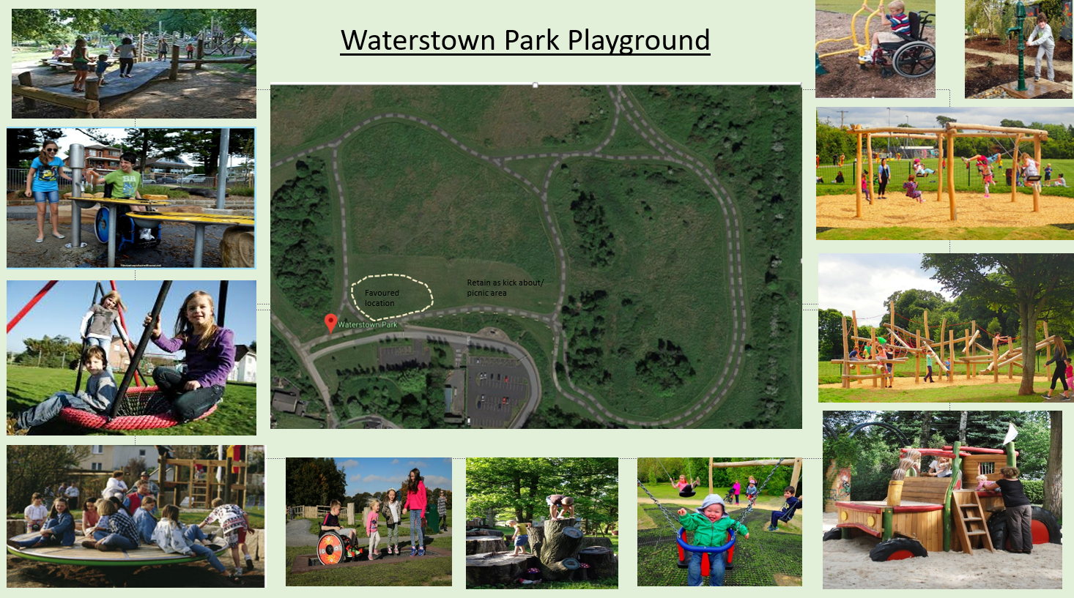
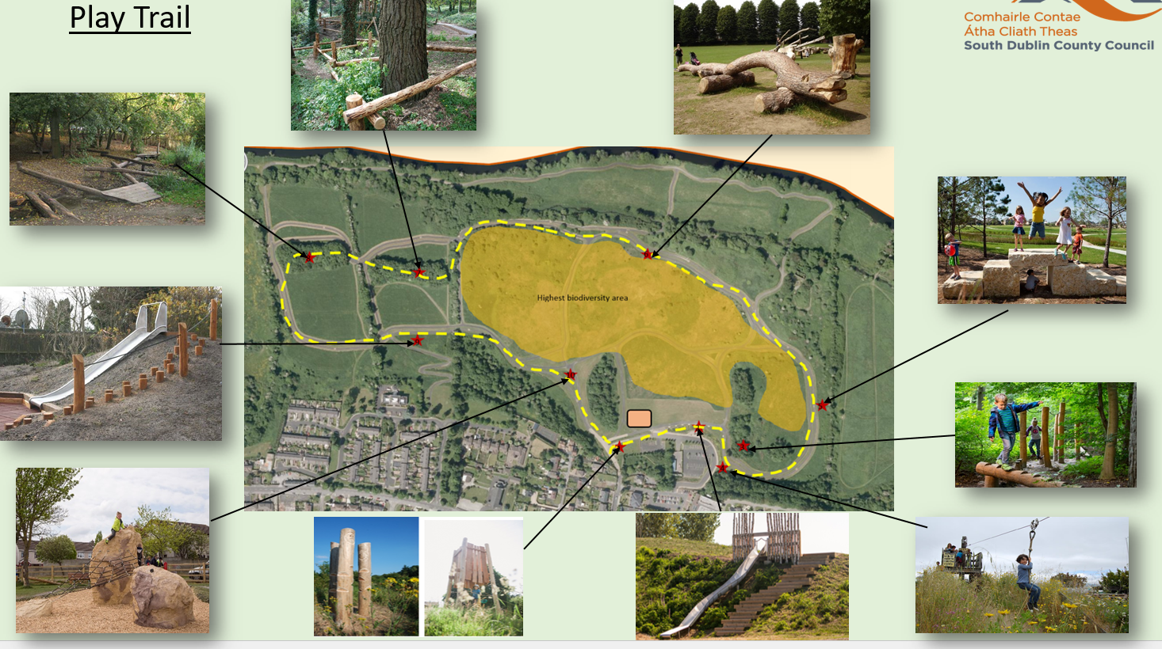
Waterstown Park Playground is being funded under the Councils Participatory budget.
Residents voted on a number of projects and this playground was selected with a budget of €120,000 including VAT A consultation process was carried out locally and residents asked for both a play area and a play trail in the Park
The Council issued a request for tenders dated 06/06/18 for the design and Installation of a Playground and Play trail. The closing date was 09/07/2018

Slide 3
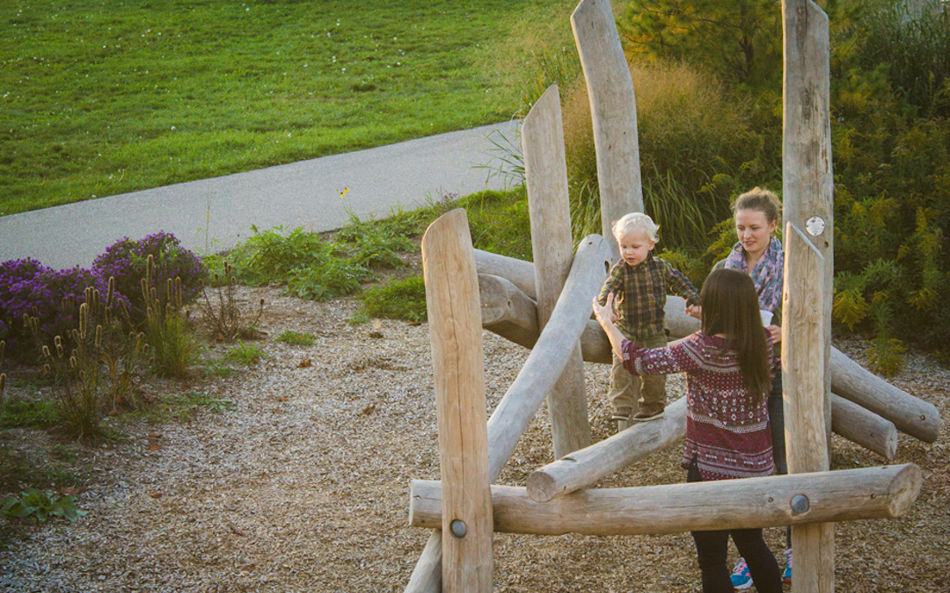
Tender Results
Four companies submitted tenders. All 4 had the required documents and there were no disqualifications.
The highest score was achieved by The Children's Playground Company Ltd, Naas, Co. Kildare. Their tender was strong in all categories and we are confident that the company has demonstrated the professional and technical capabilities to carry out the work as proposed in their tender proposals.
The design scored very highly in the following areas
Variety of play experiences for different ages and abilities
Suitability to the site
Robustness of equipment
Overall aesthetic.

Slide 4
Playground: comprises swings, equipped sand play area, play shop and Dutch disk plus seating and signage
Images

Slide 7
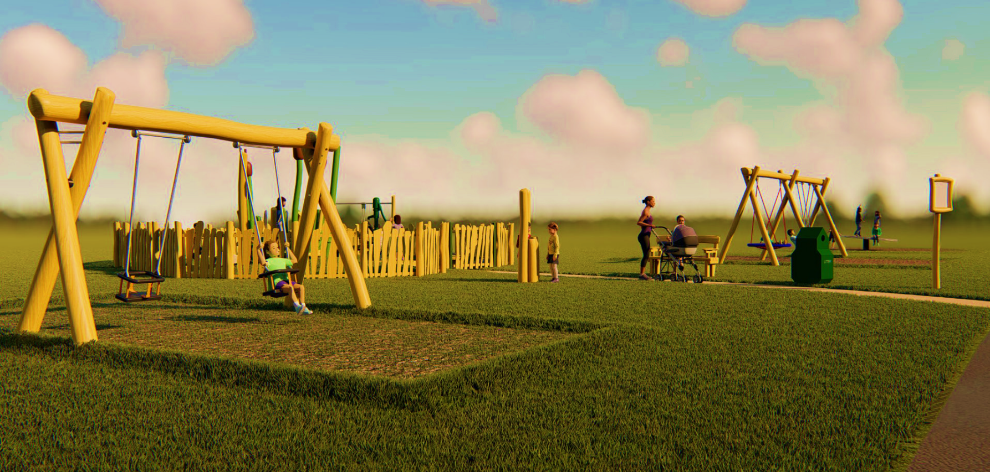

Slide 8
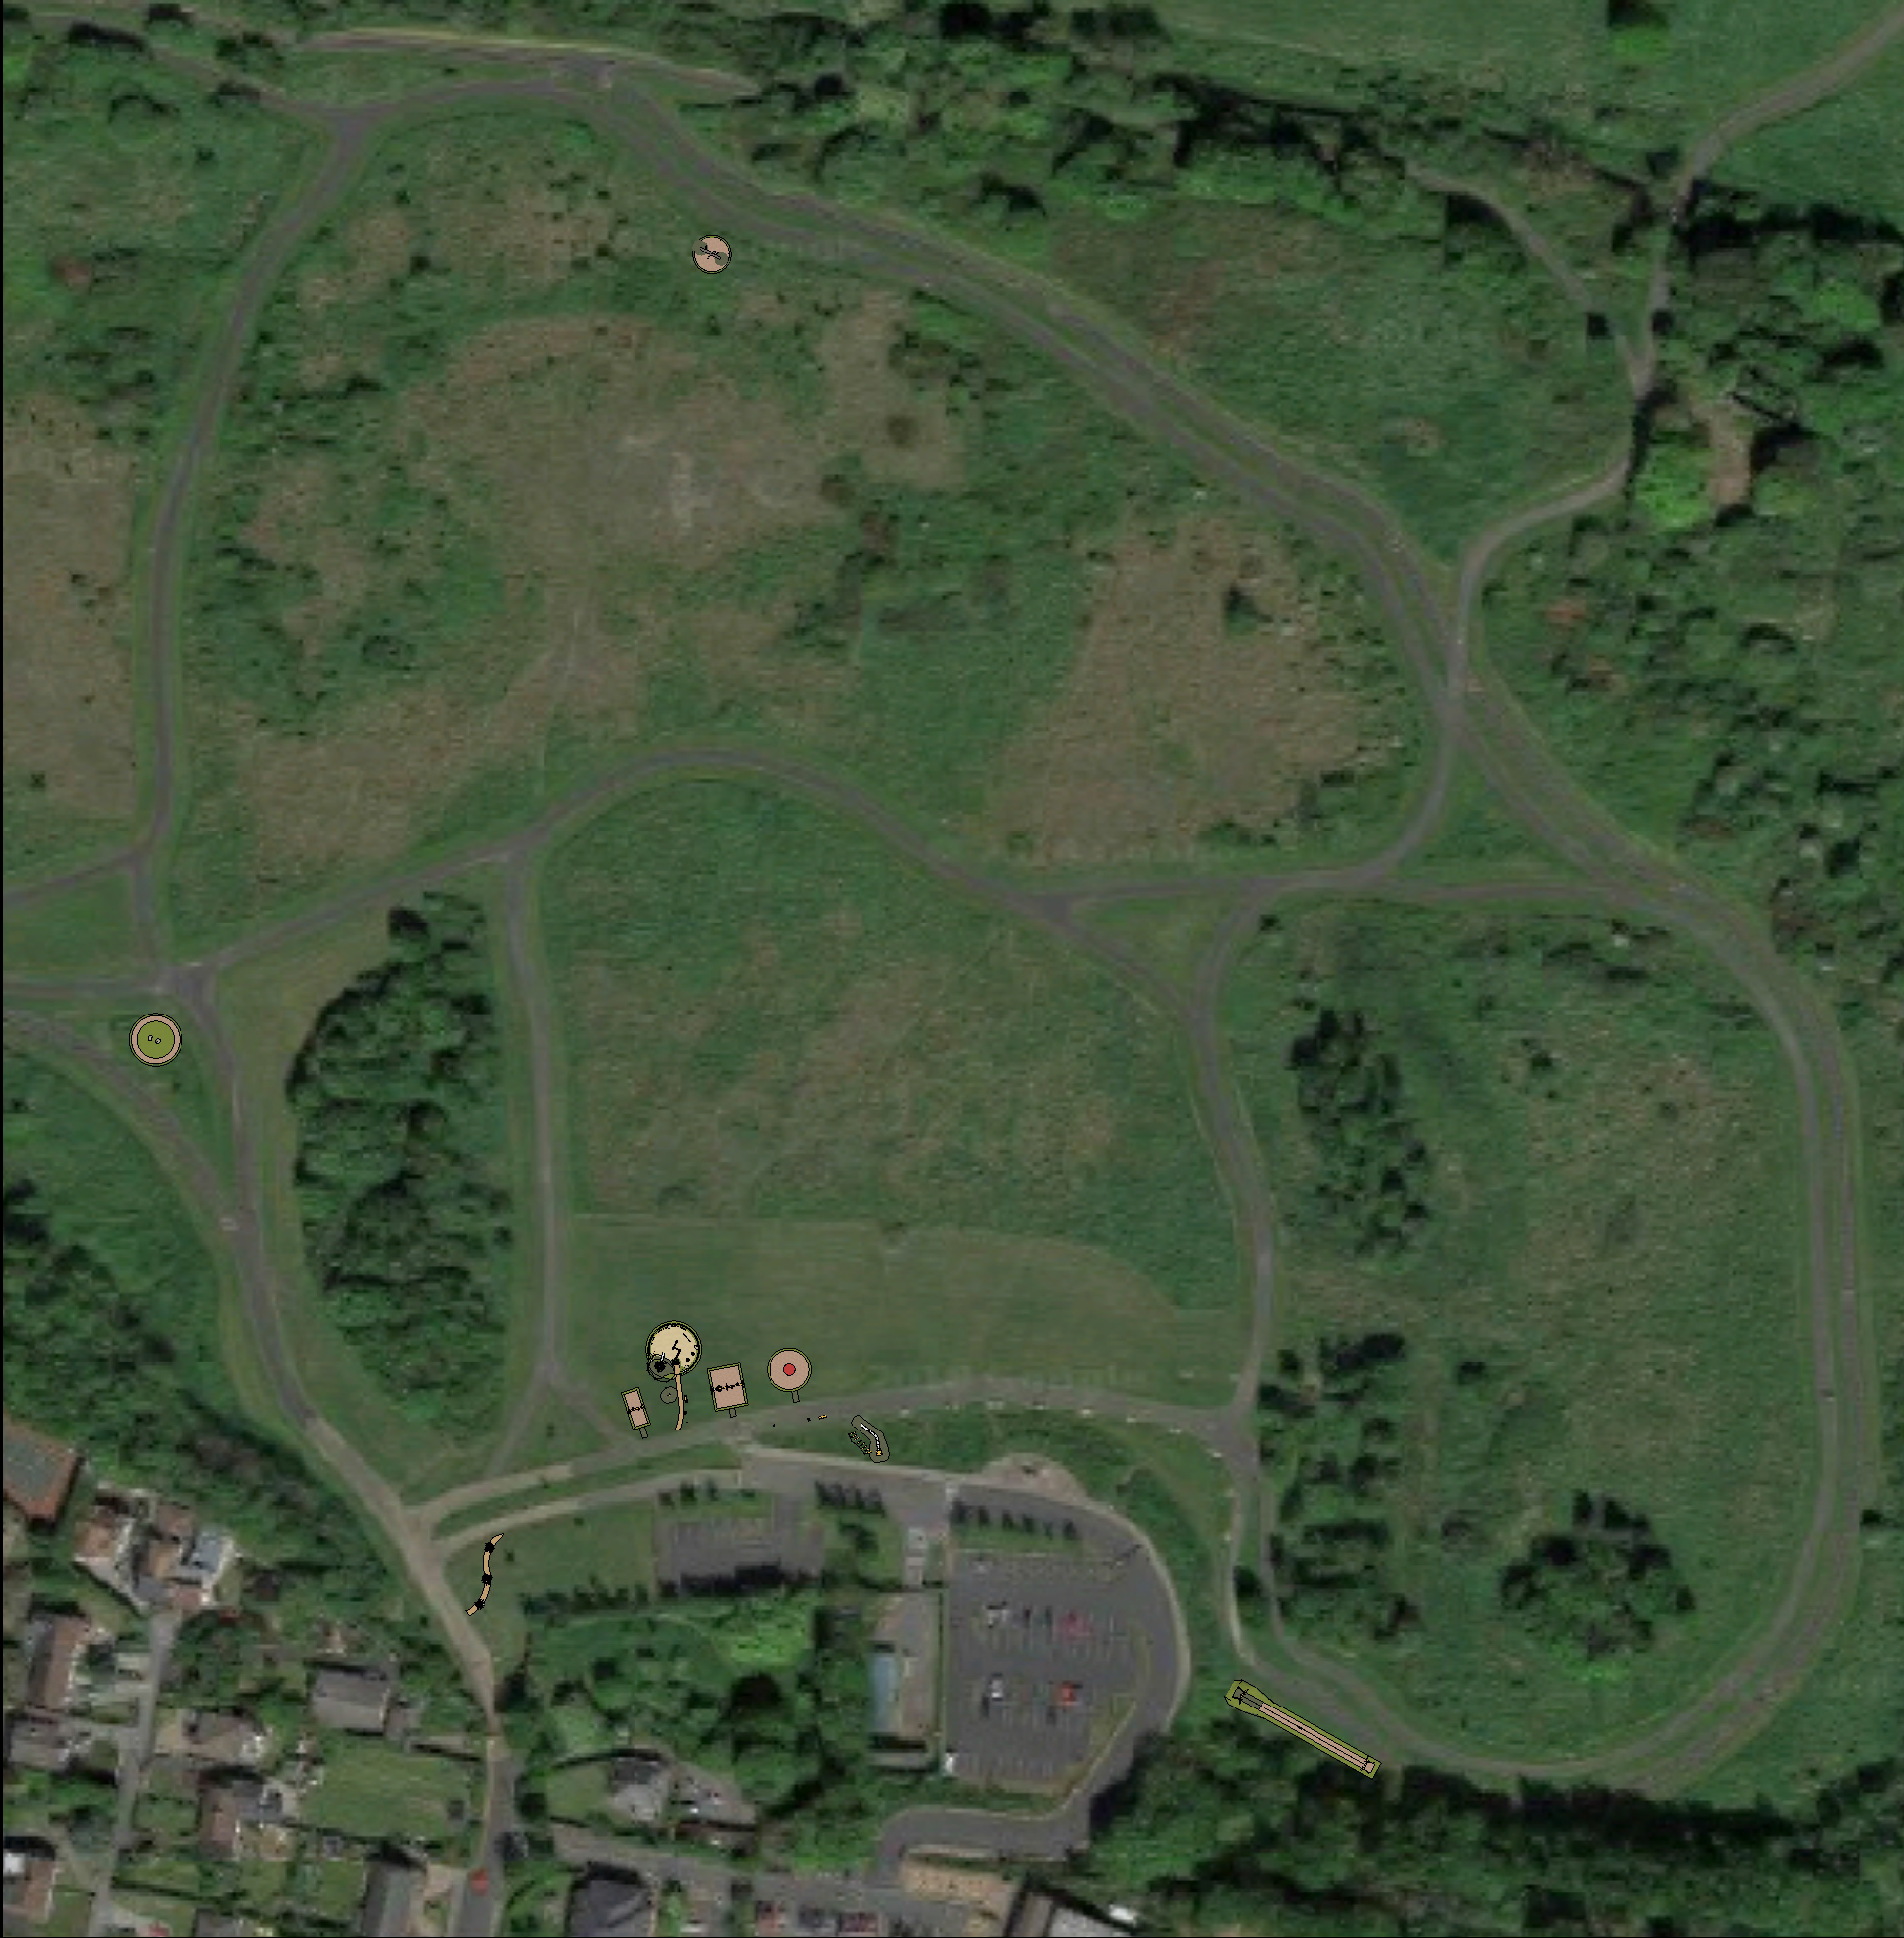
PLAY TRAIL

Slide 17
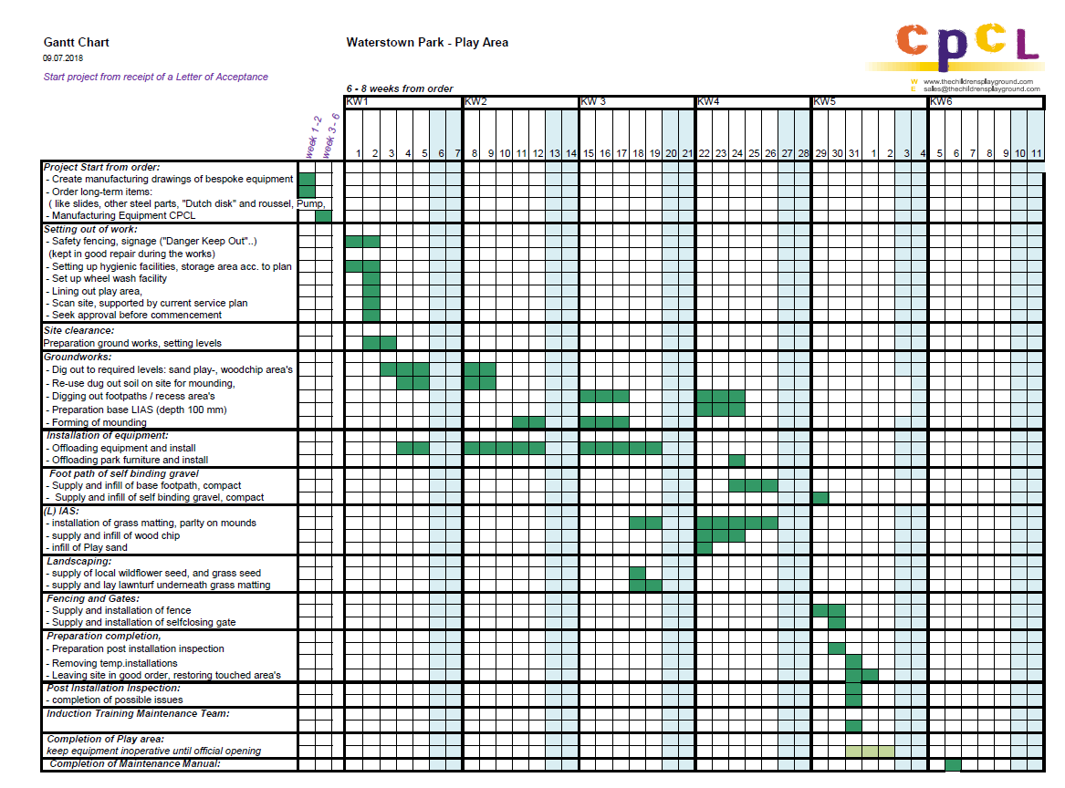
Manufacture of equipment /order and delivery of equipment from abroad mostly complete.
Specific location design and commencement of delivery to site week of 24/09/18
Full site mobilisation commencing not later than 15 October 2018.
5-6 week build including independent safety certification.
Opening of play areas thereafter assuming weather conditions allow

