Slide 1
HOUSING SUPPLY AND SITES UNDER CONSIDERATION

Slide 2

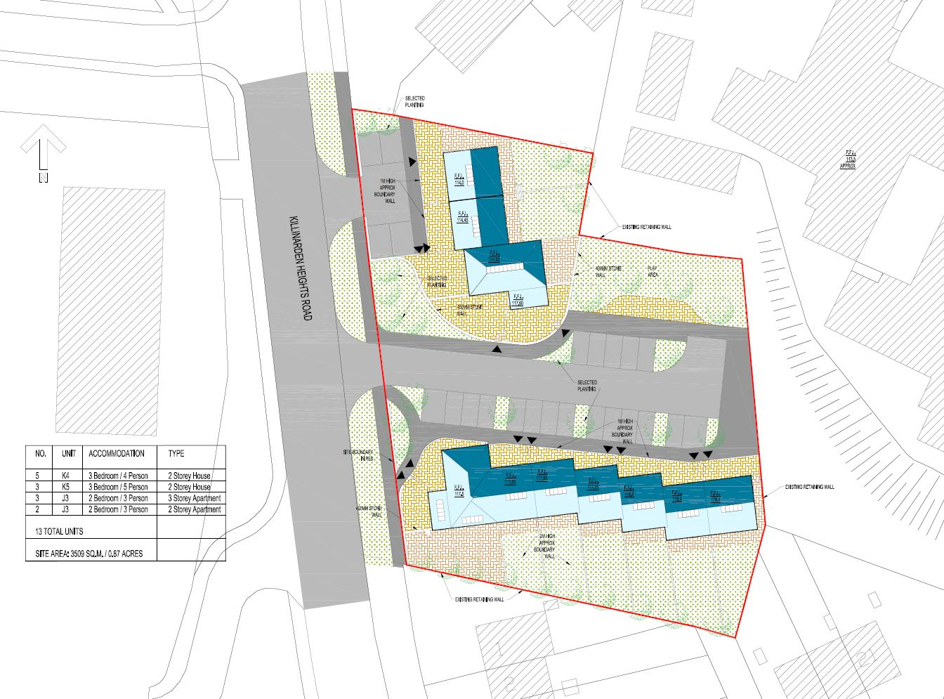
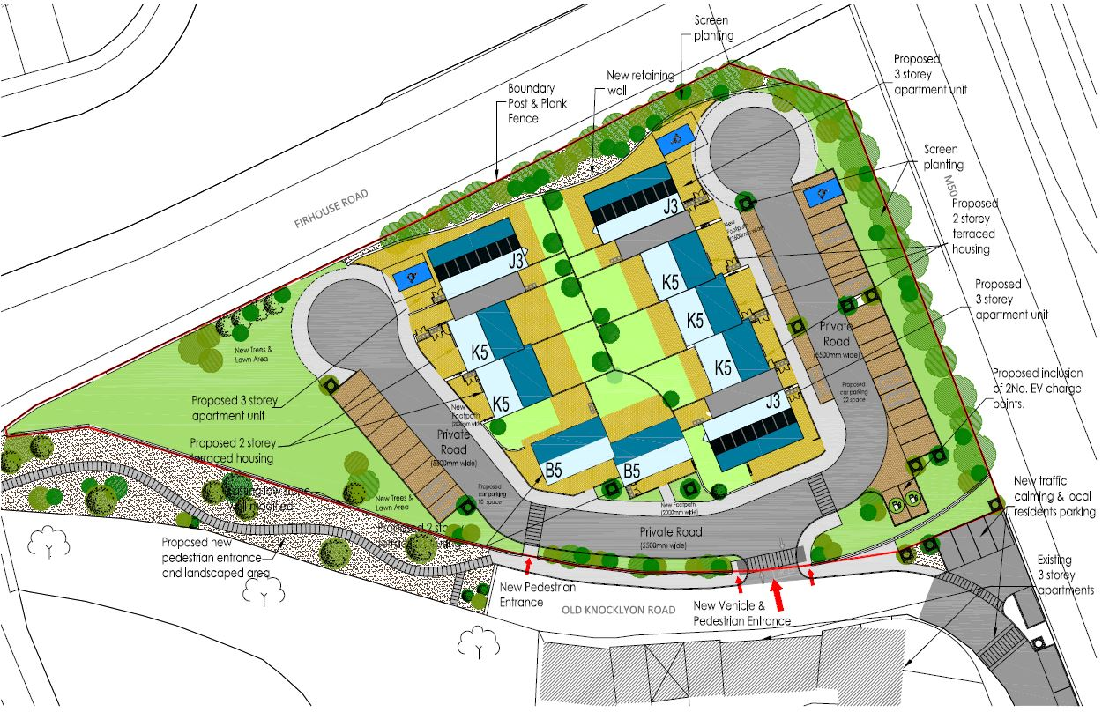

Homeville - 16 Units
St. Catherines, Knockmore – 13 Units
Approved at September Council Meeting
Site Location
Prepared by SDCC Architects Dept.

Slide 3
Part 8s Due Before the October Council Meeting
Fernwood & Maplewood – 53 Units
Riversdale, Clondalkin 44 units
Templeogue Car Park – 12 units

Slide 4
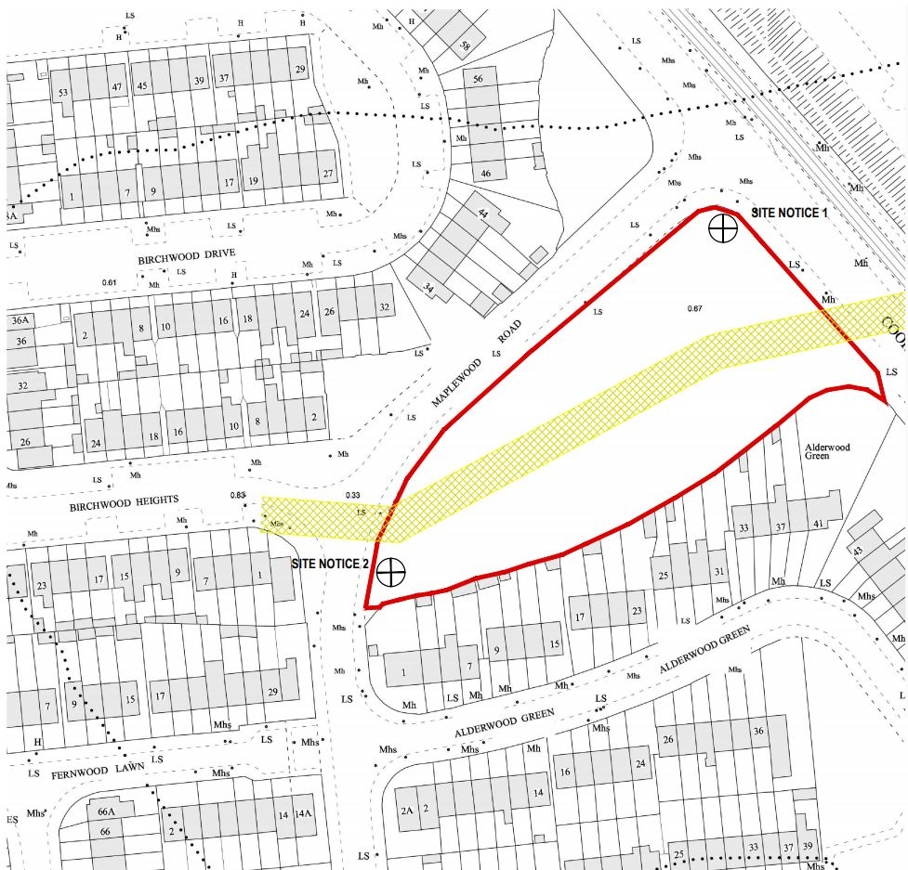
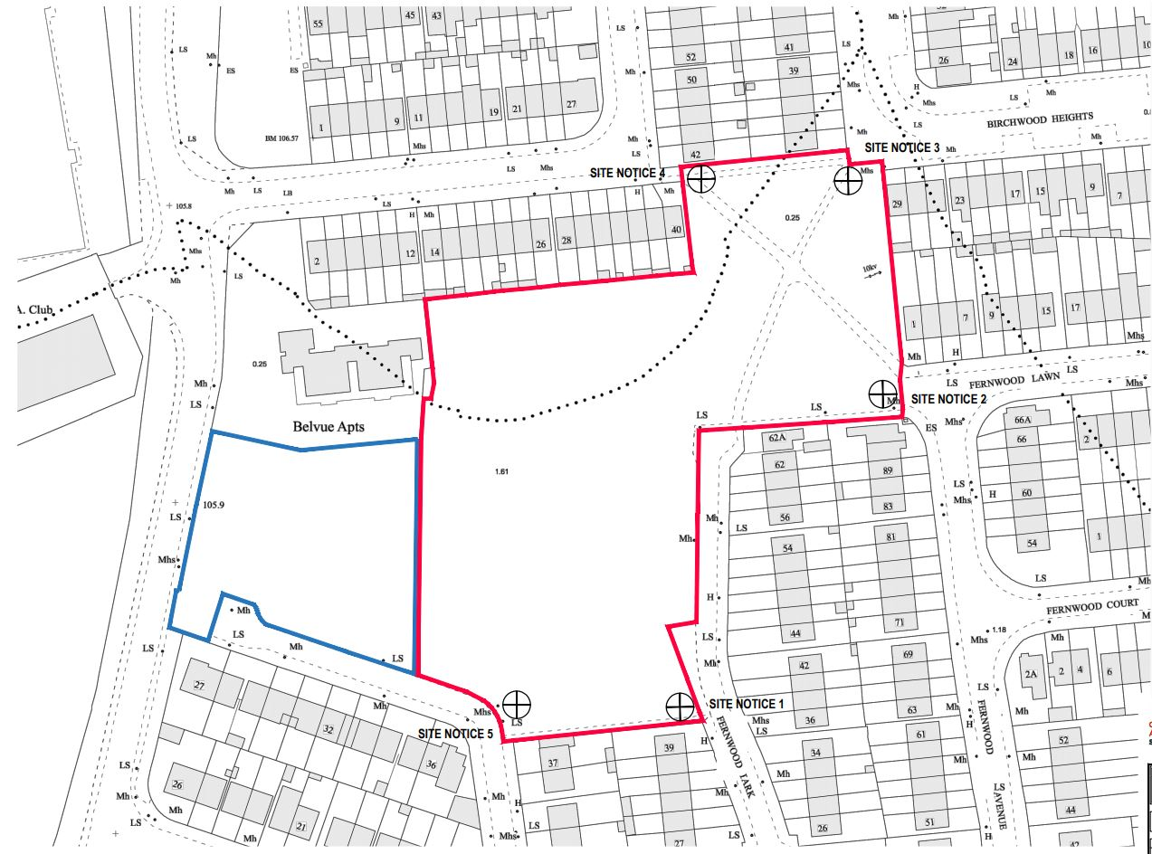
Site Locations-NTS
Prepared by SDCC Architects Dept.

Slide 5
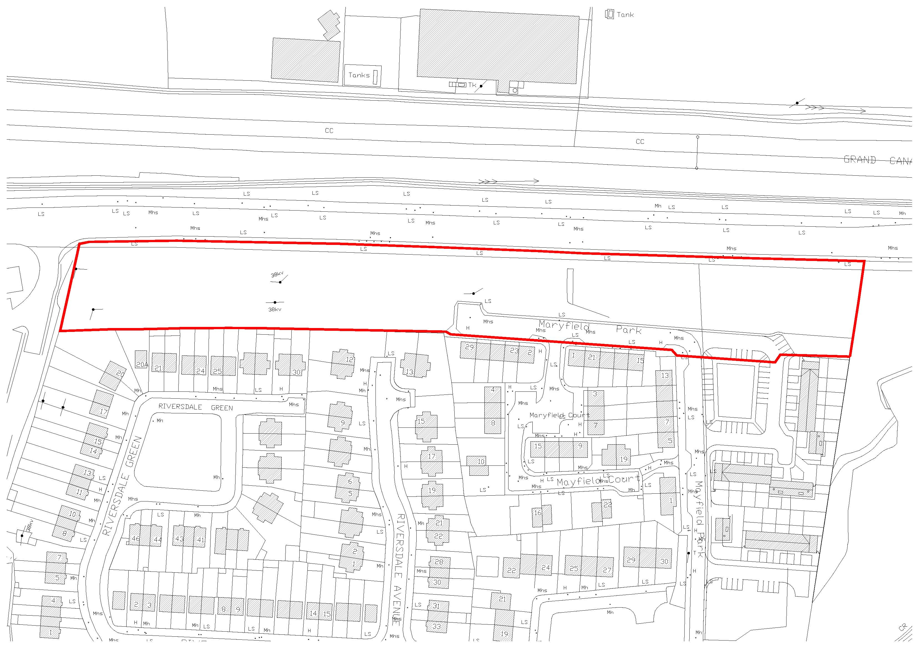
Site Location-NTS
Prepared by SDCC Architects Dept.

Slide 6
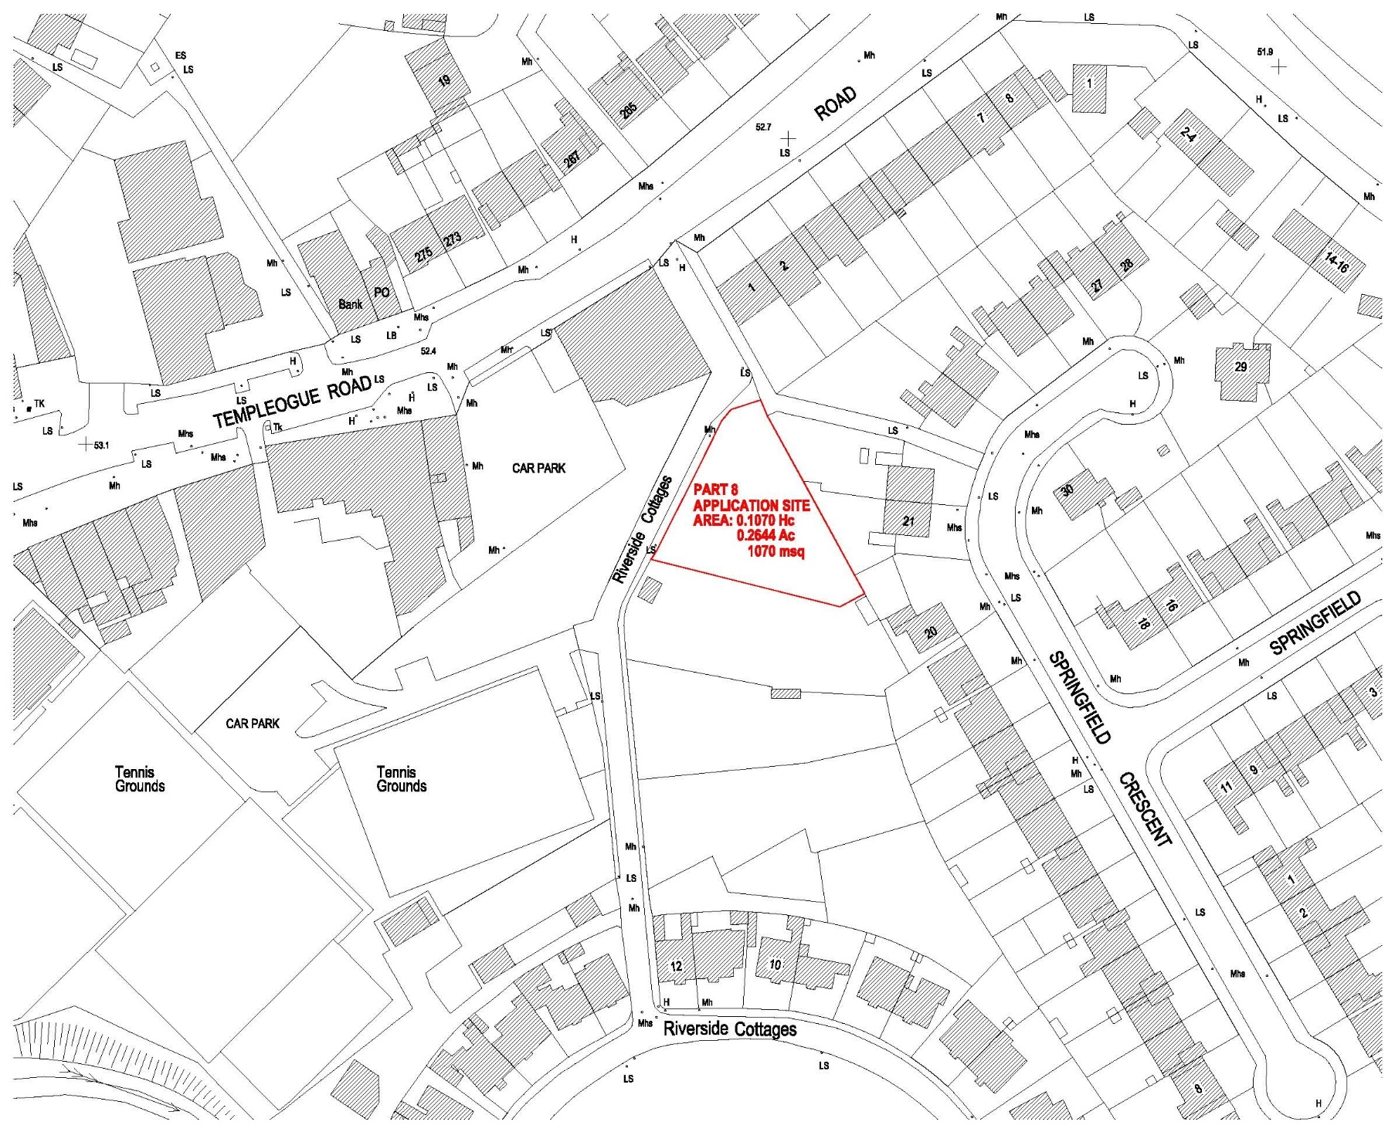
Site Location-NTS
Prepared by SDCC Architects Dept.

Slide 7
Whitestown Way, Tallaght
81 units
Published 13th September and will be due before the December Council Meeting

Slide 8
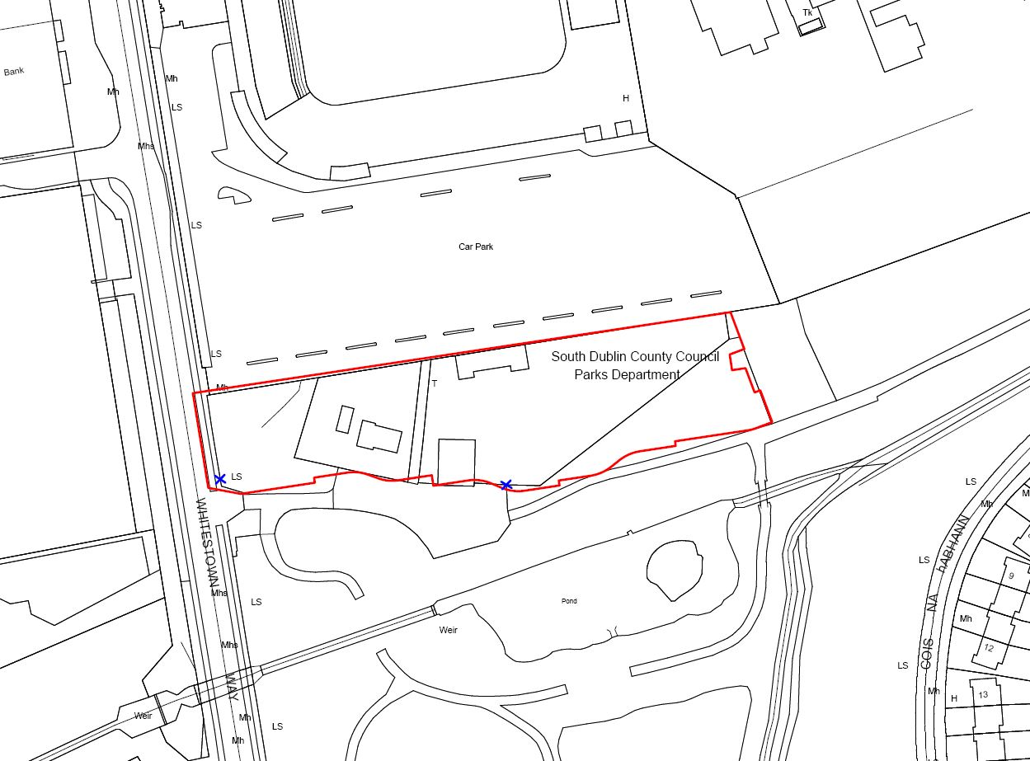
Site Location-NTS
Prepared by SDCC Architects Dept.

Slide 9
Sites being worked on to bring forward to Part 8 over the next few months
Stocking Lane
Balgaddy
Marks Avenue
3 sites to AHBs
Knocklyon
Eircom Site

Slide 10
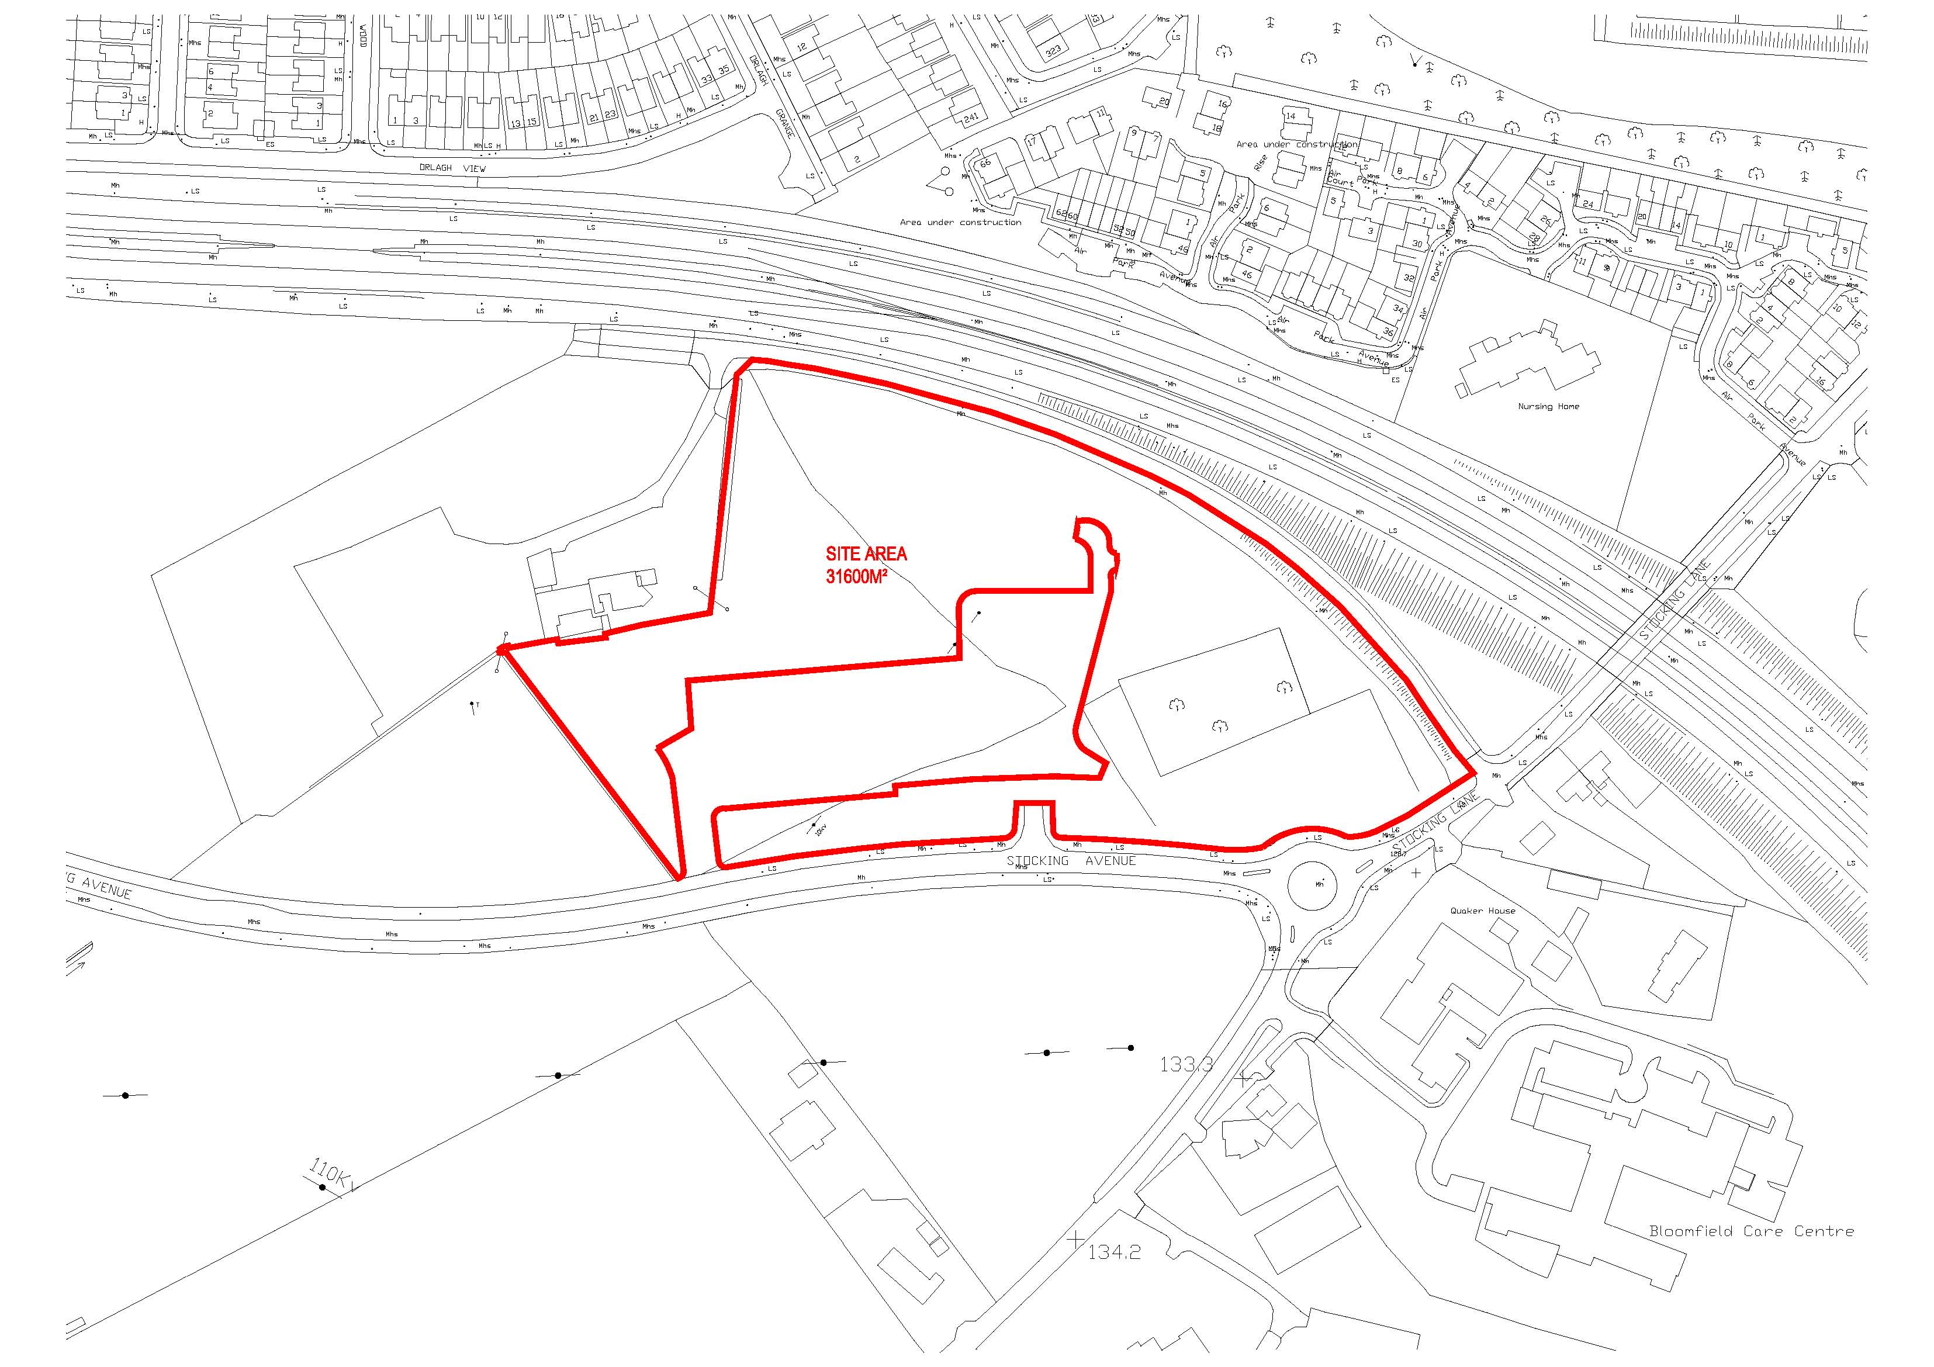
Site Location-NTS
Prepared by SDCC Architects Dept.

Slide 11
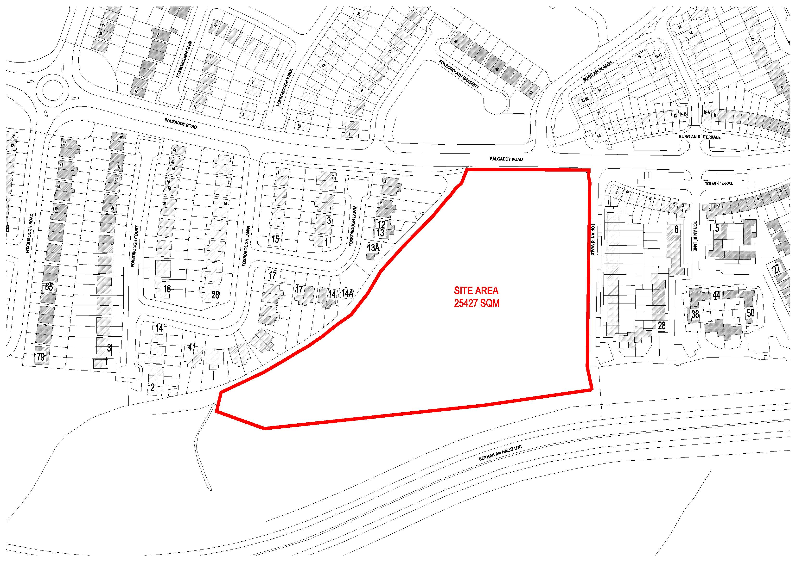
Site Location-NTS
Prepared by SDCC Architects Dept.

Slide 12
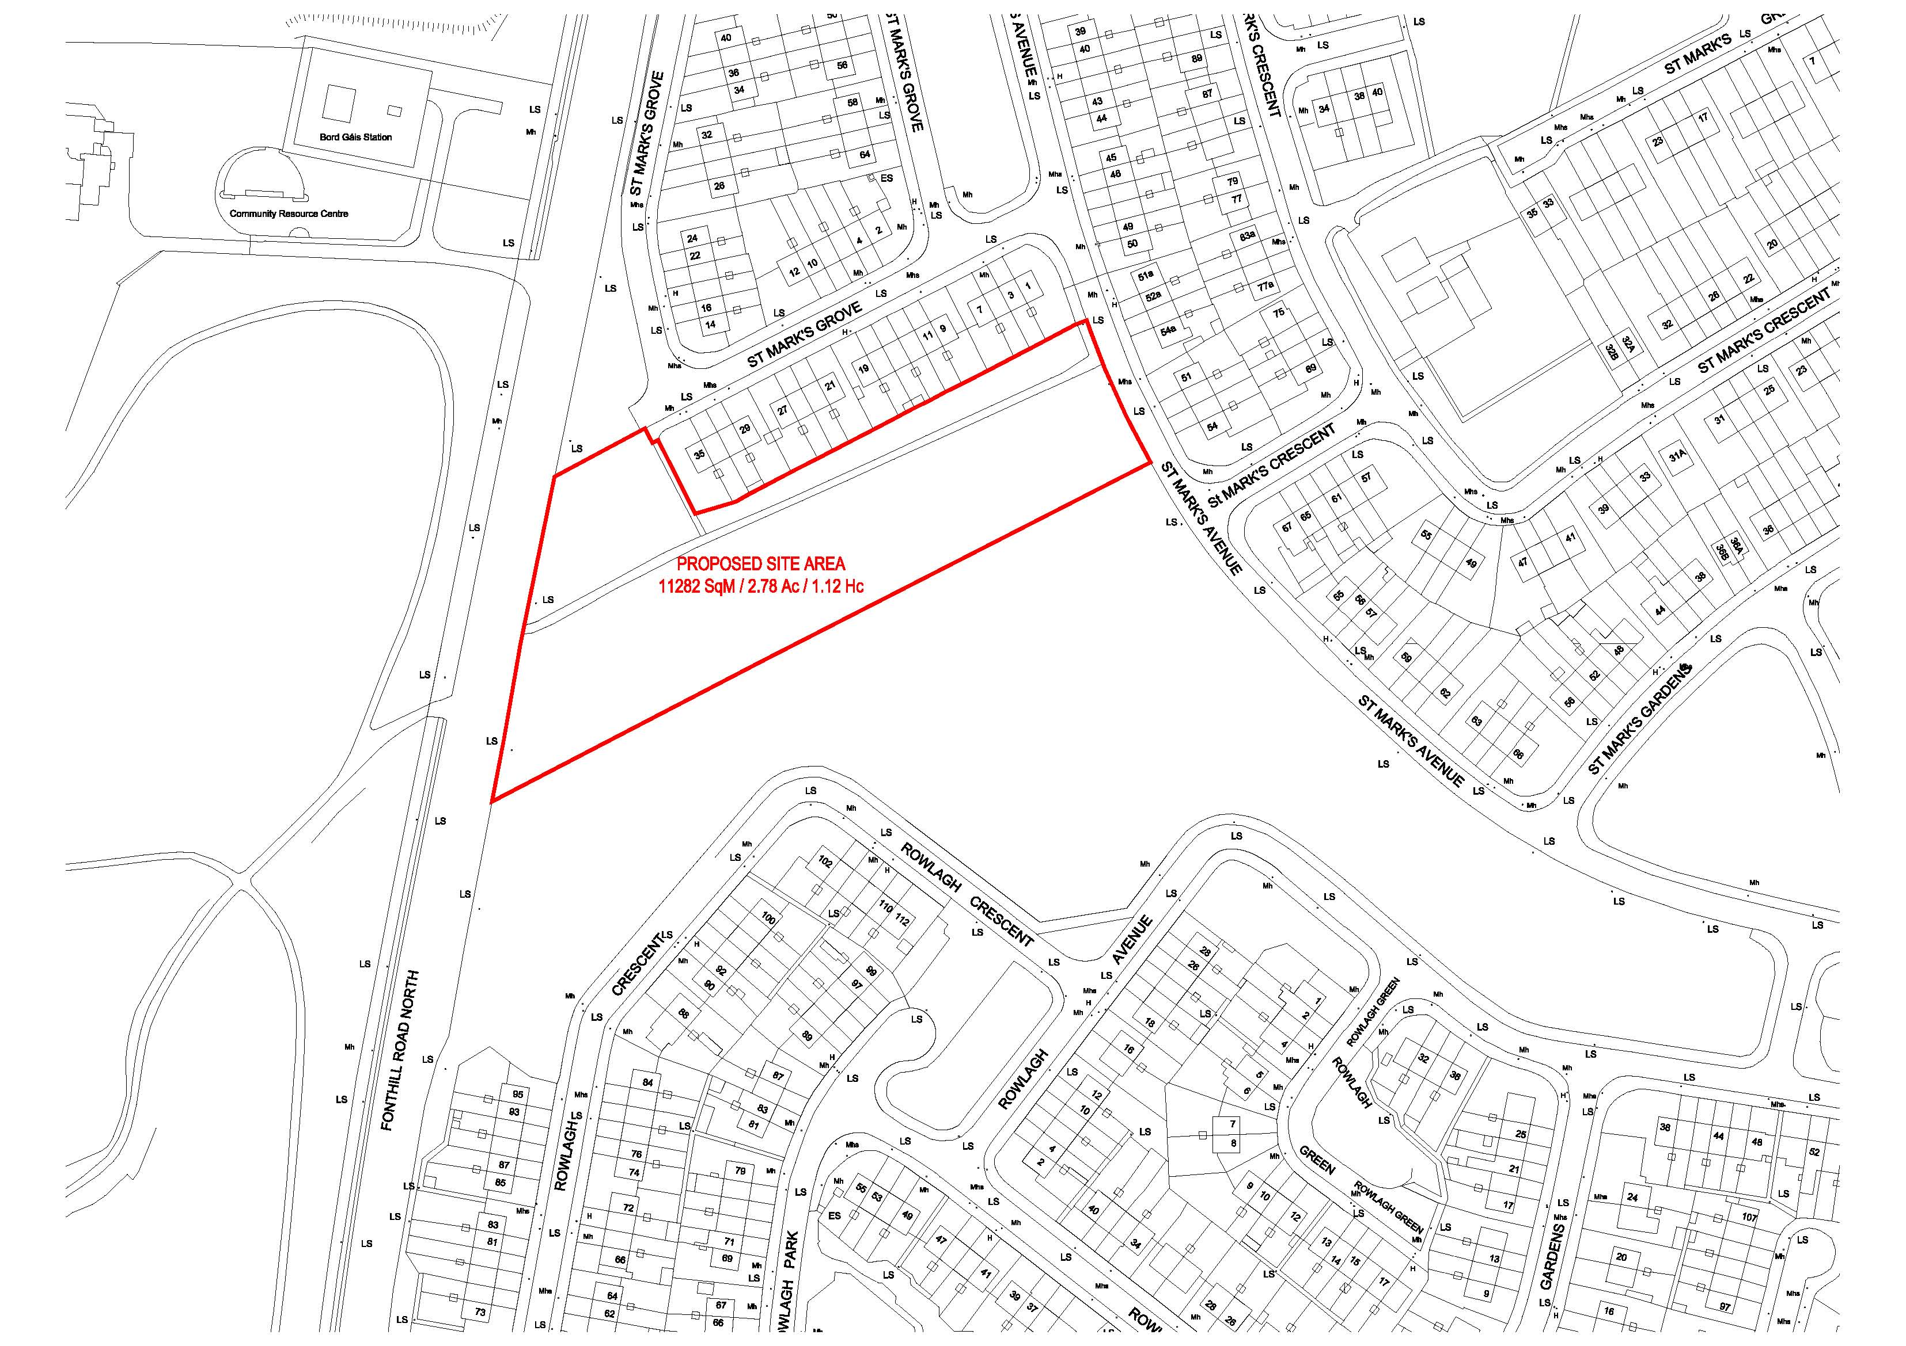
Site Location-NTS
Prepared by SDCC Architects Dept.

Slide 13
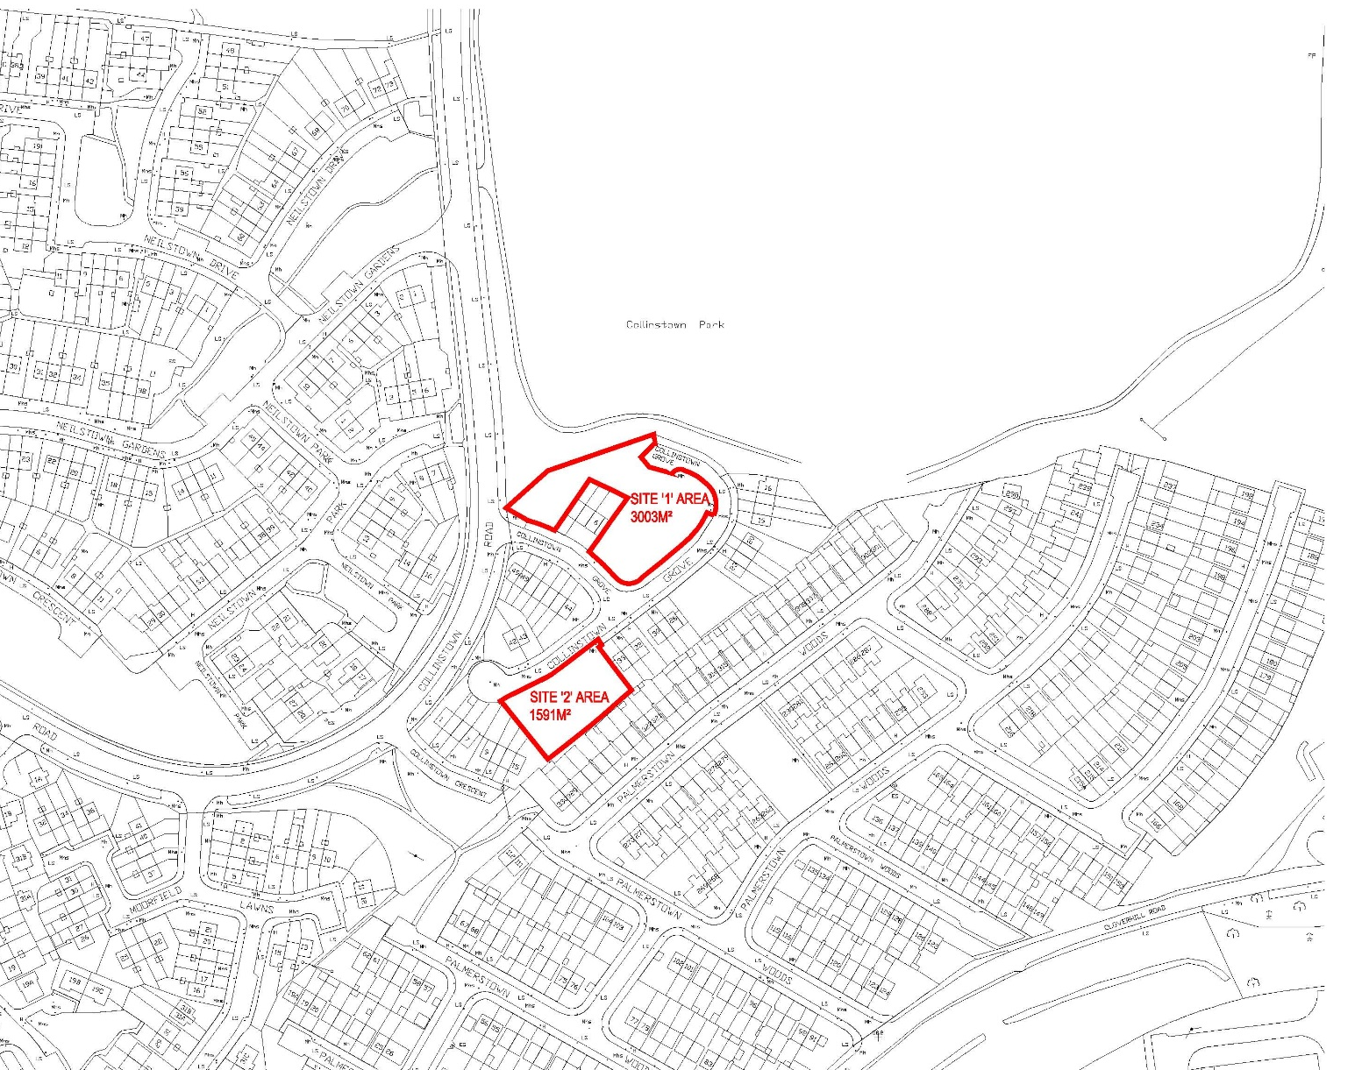
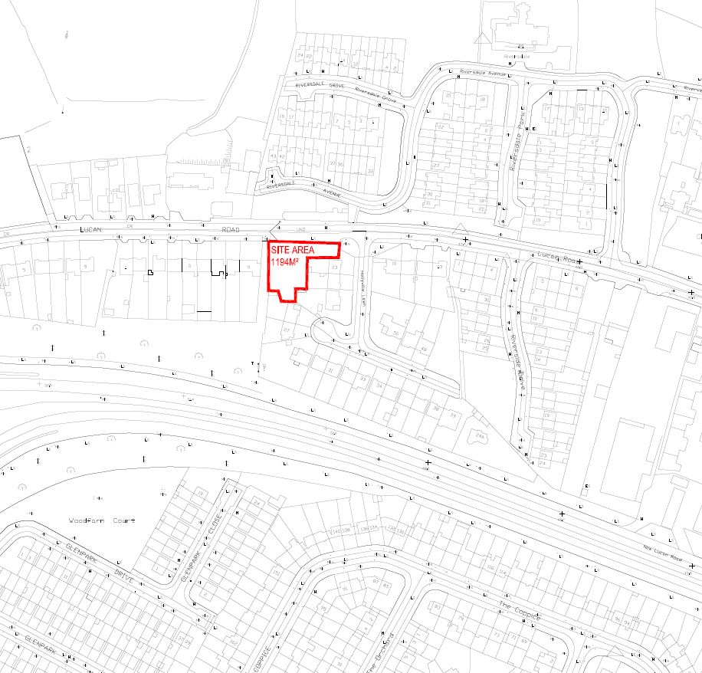
Site Location-NTS
Prepared by SDCC Architects Dept.

Slide 14
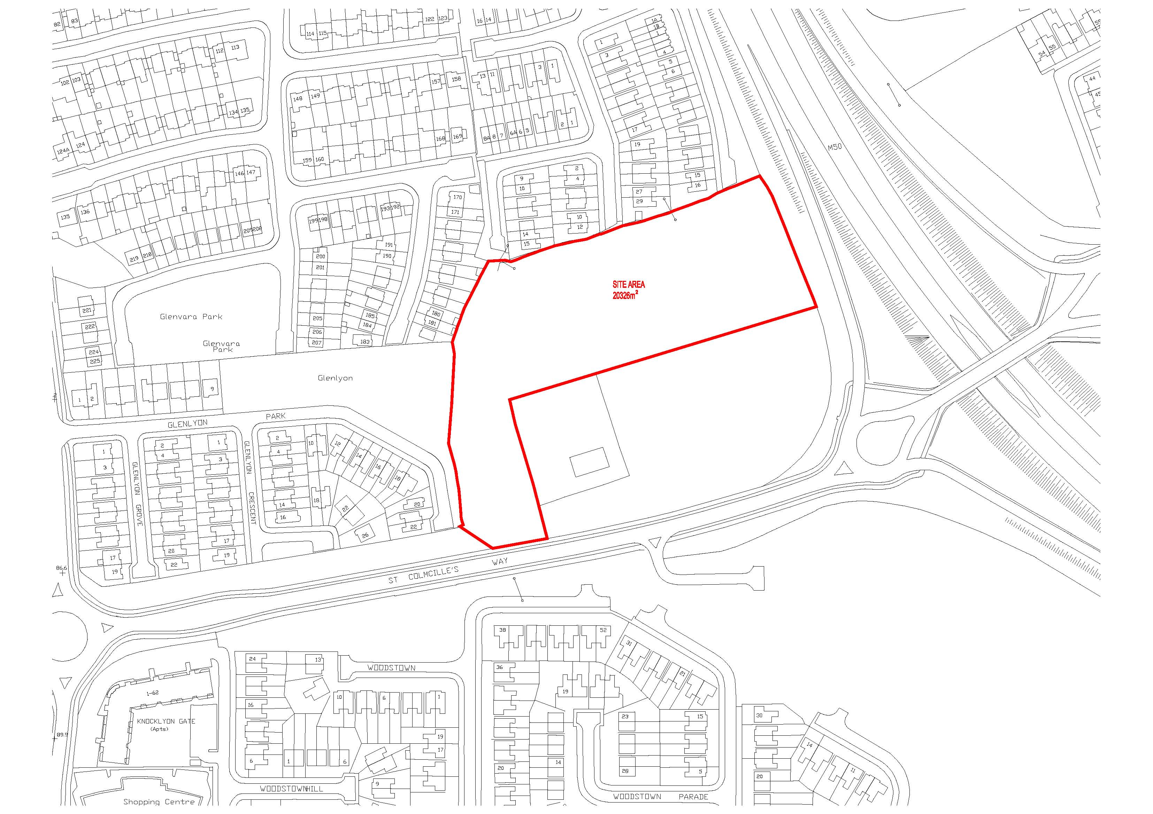
Site Location-NTS
Prepared by SDCC Architects Dept.

Slide 15
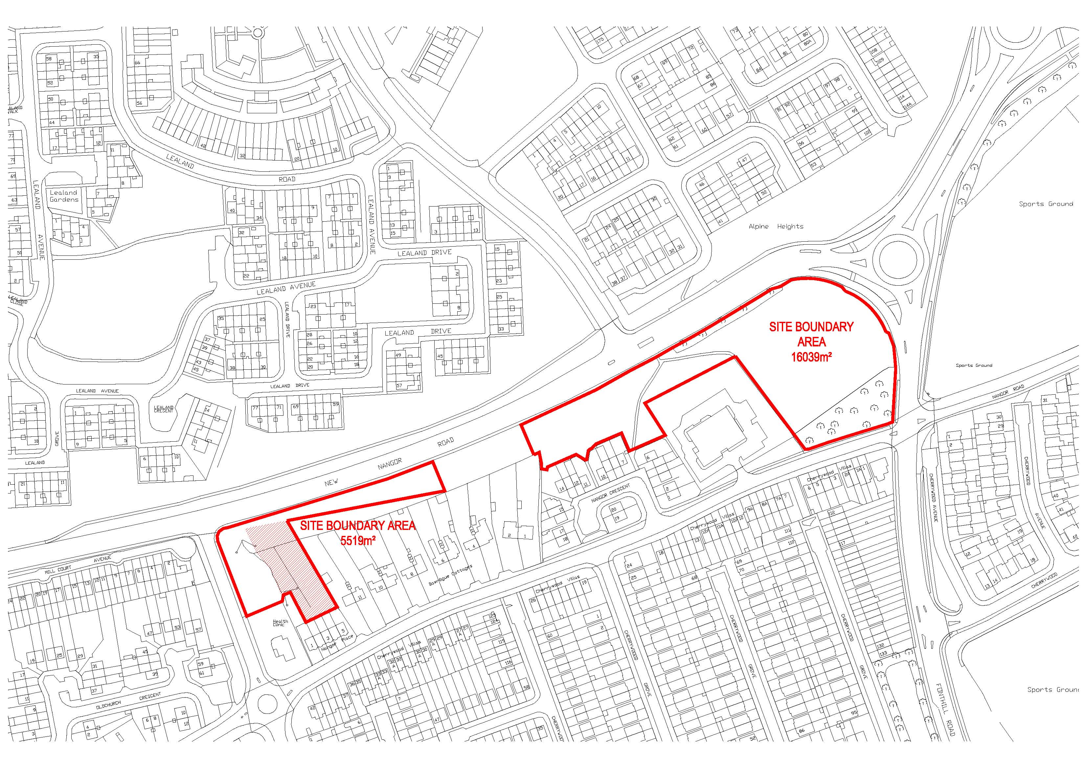
Site Location-NTS
Prepared by SDCC Architects Dept.

Slide 16
Sites under assessment:
Grand Canal- Lindisfarne
St. Marks Link Road (Ramp Road)
Infill Sites –
      Greenfort Gardens
      Rossfield
      Lane at Lindisfarne Lawns
      Melrose Avenue
      Oatfield Crescent
      Rowalgh Gardens/Park
      St. Ronan’s Crescent between 26 & 27

Slide 17
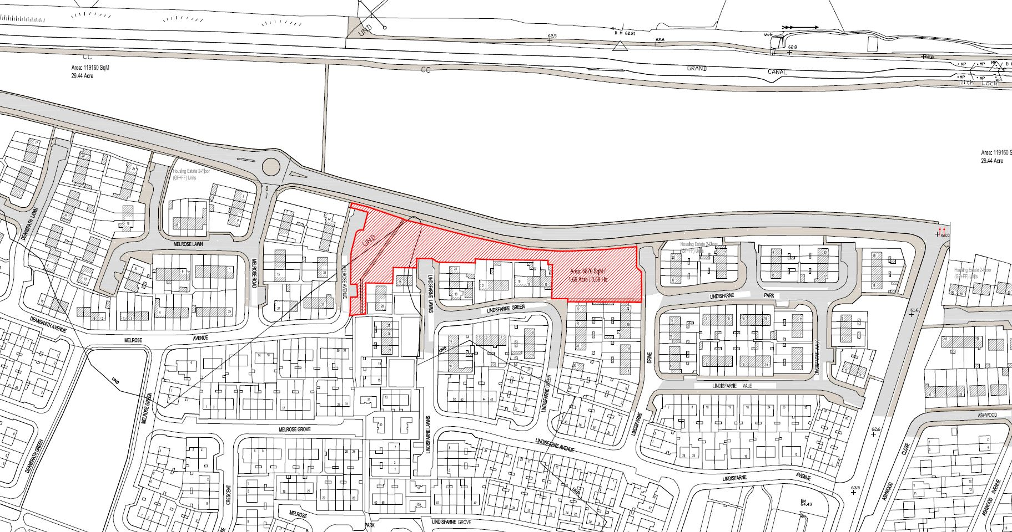
Site Location-NTS
Prepared by SDCC Architects Dept.

Slide 18
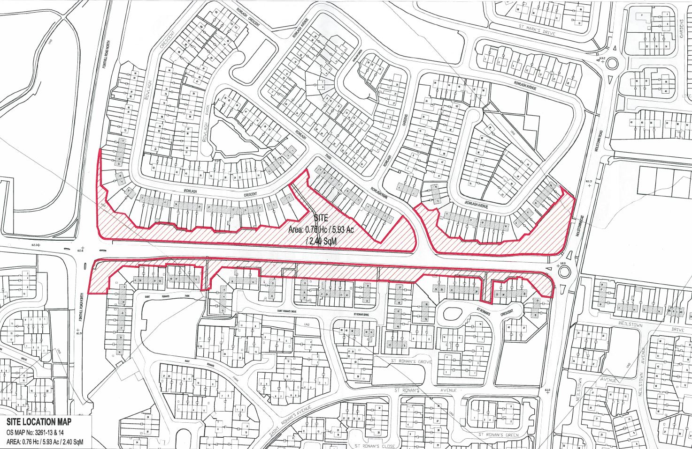
Site Location-NTS
Prepared by SDCC Architects Dept.

Slide 19
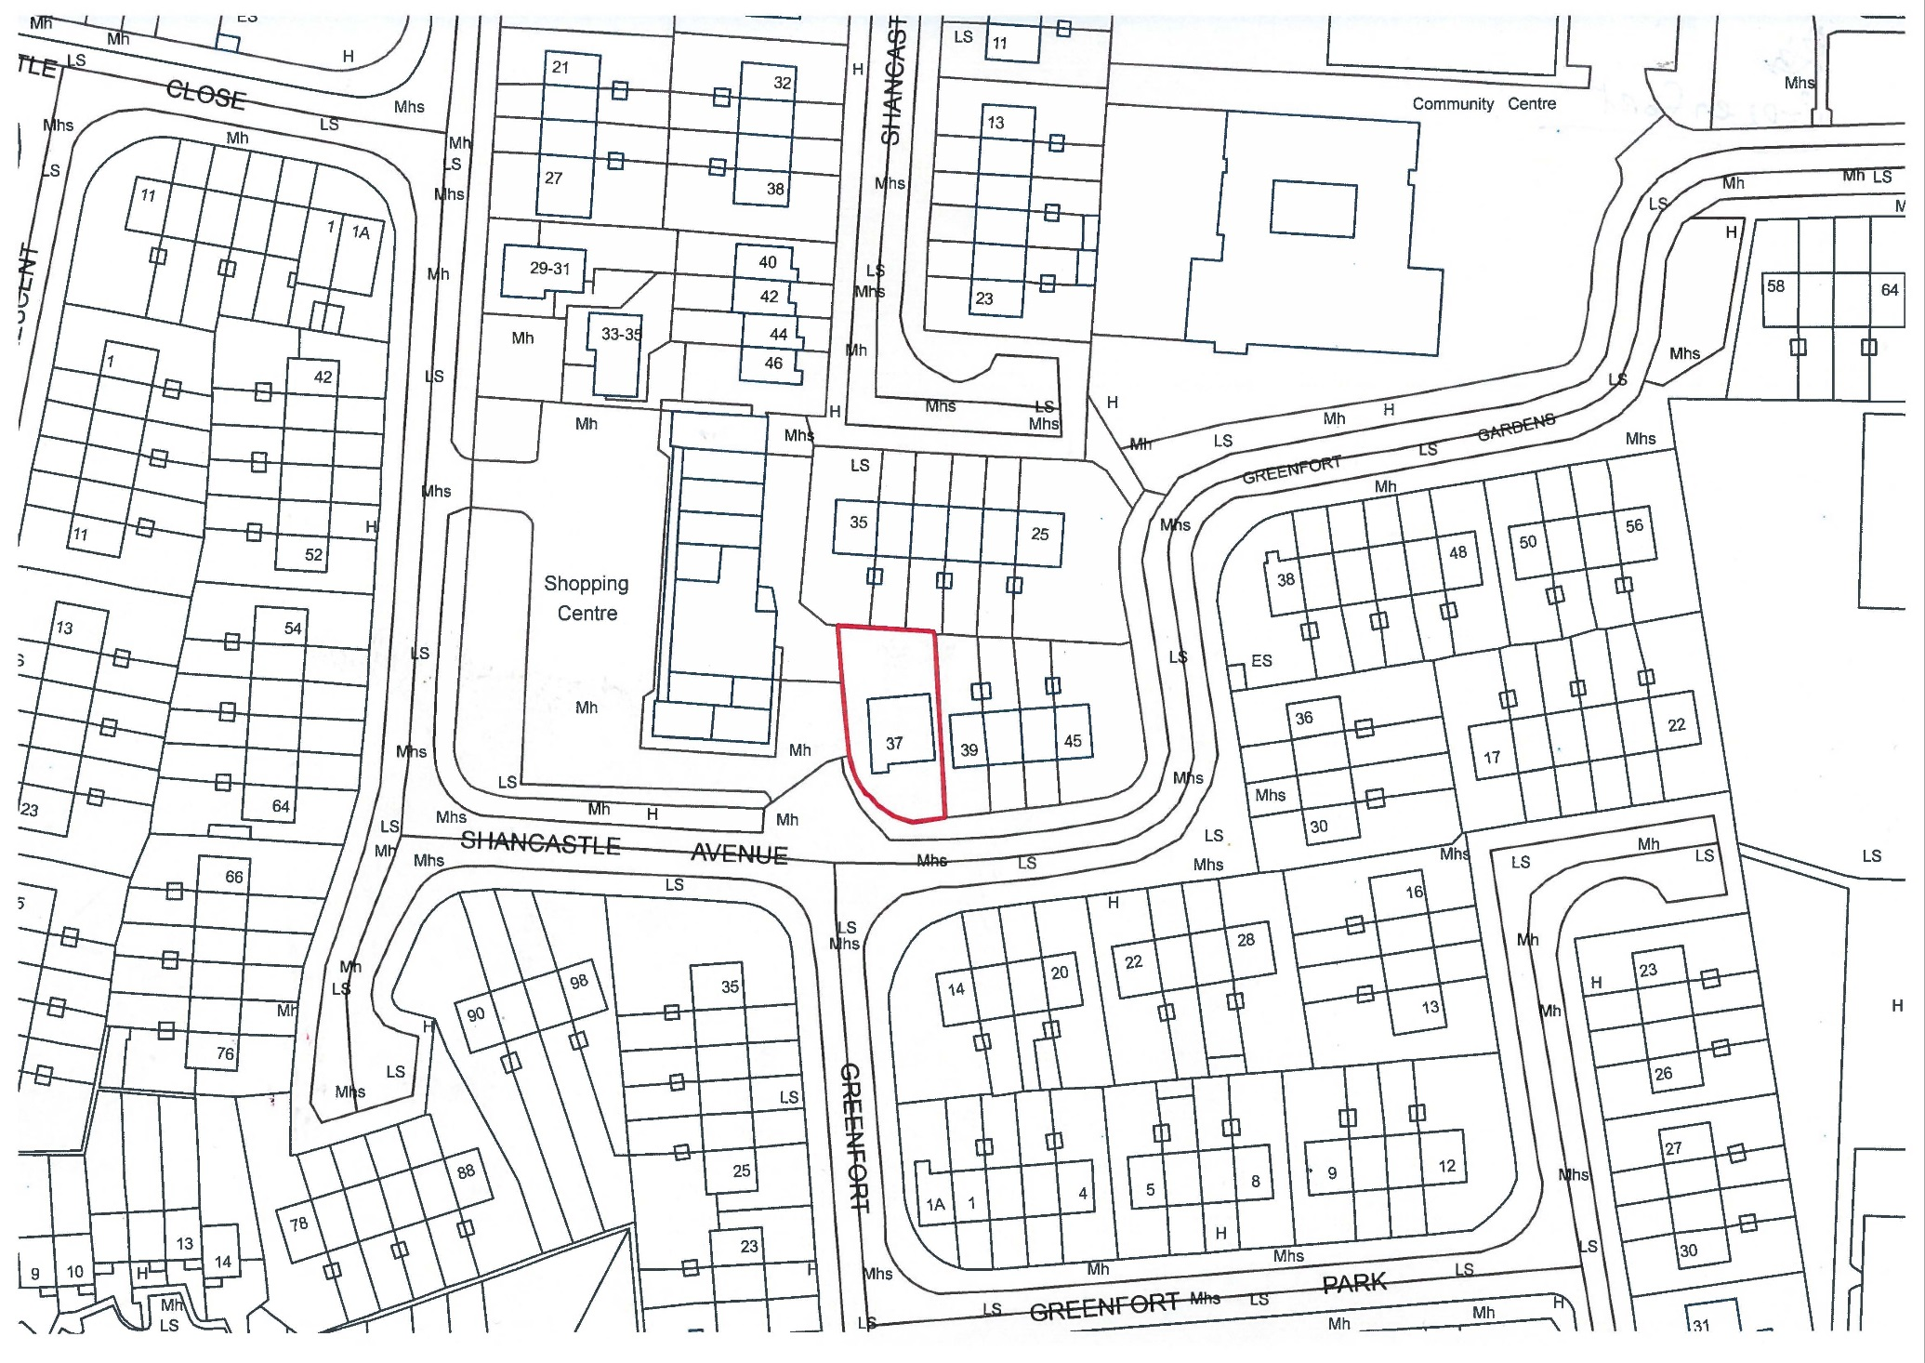
Site Location-NTS
Prepared by SDCC Architects Dept.

Slide 20
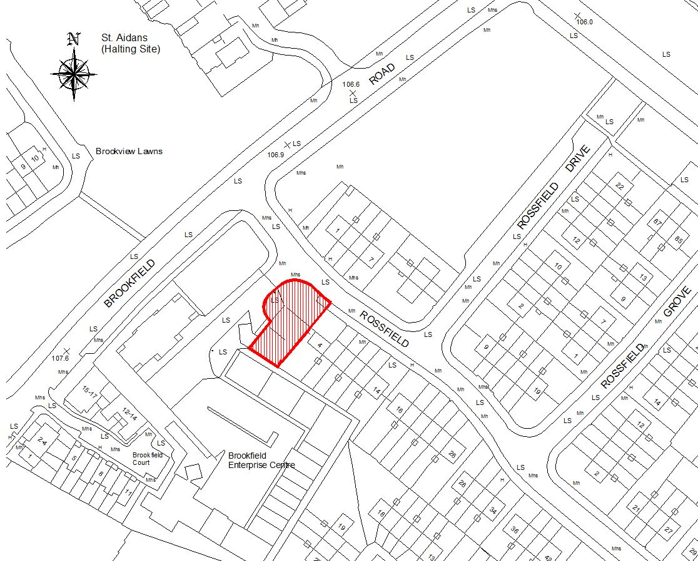
Site Location-NTS
Prepared by SDCC Architects Dept.

Slide 21
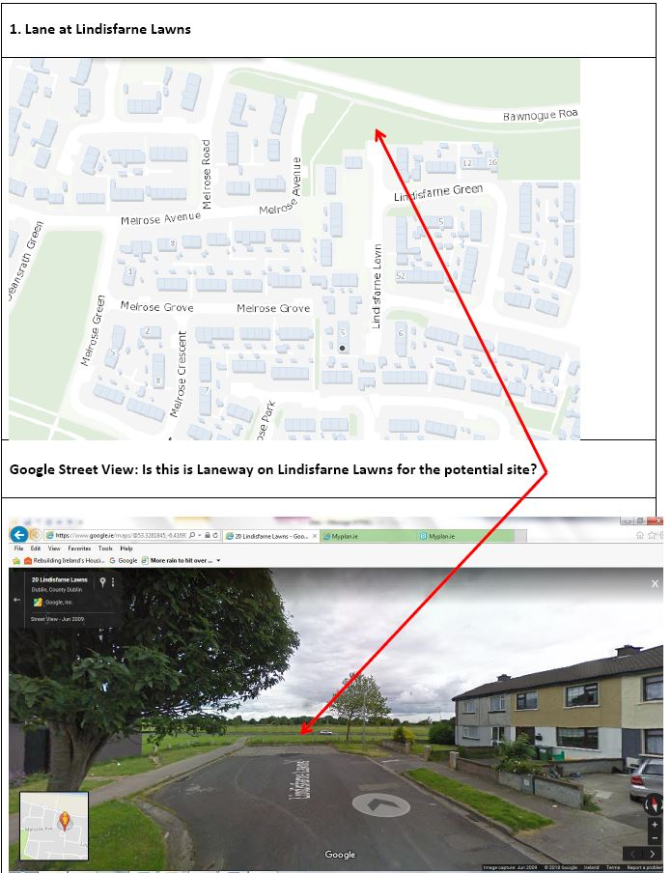
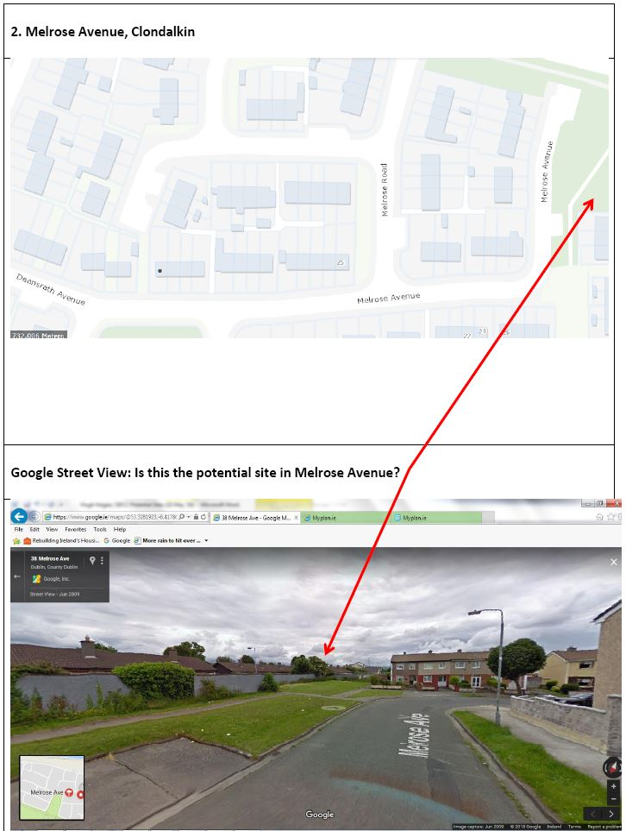
Site Location-NTS
Prepared by SDCC Architects Dept.

Slide 22
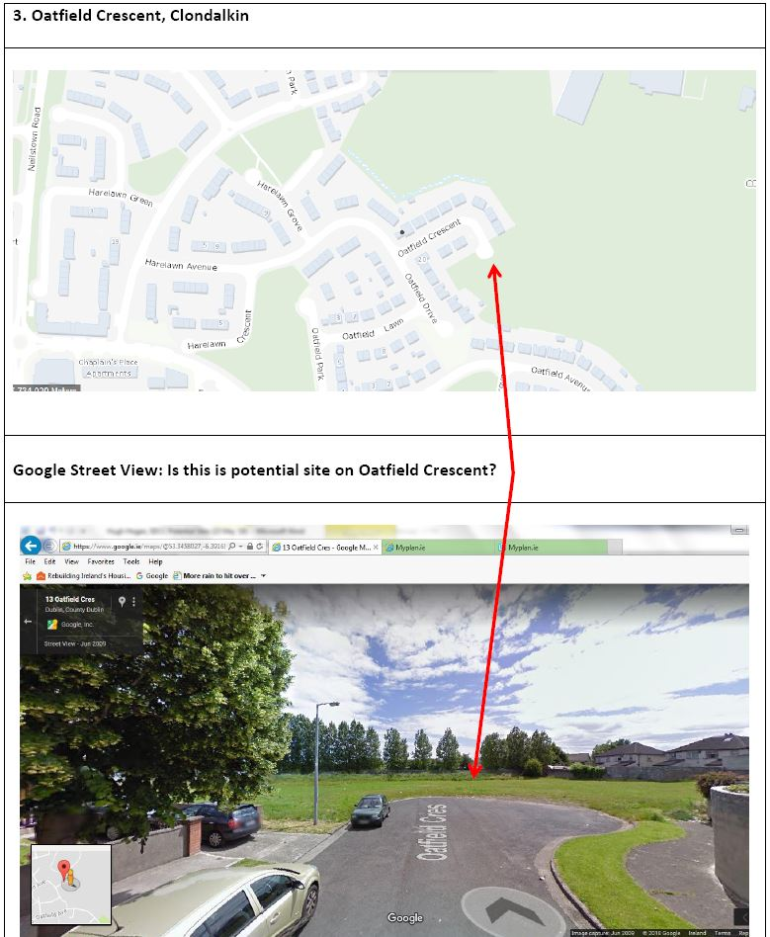
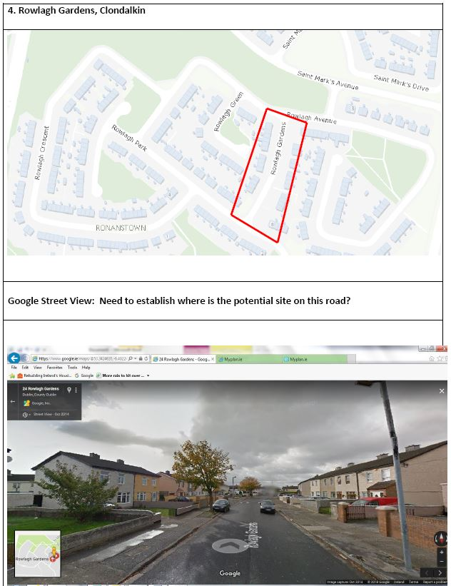
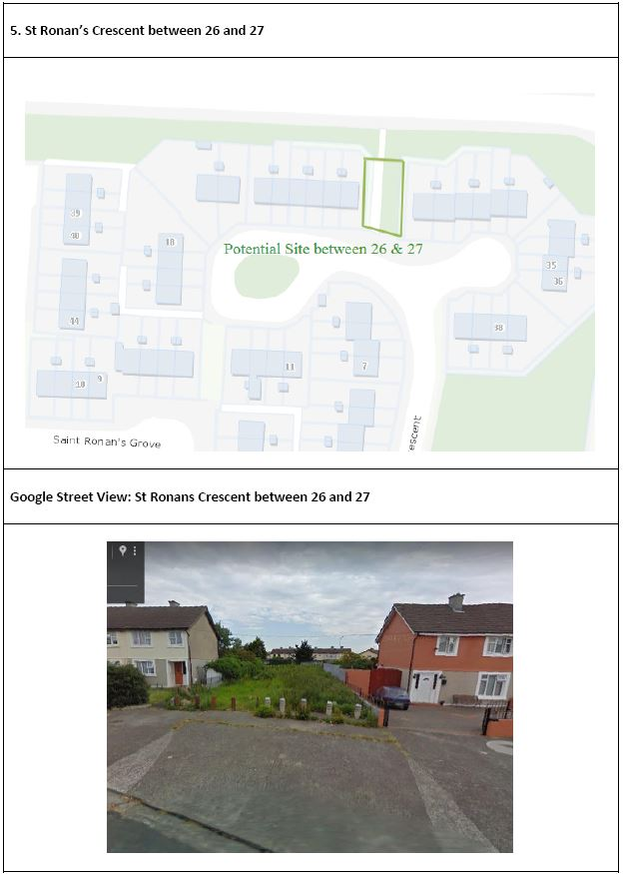
Site Location-NTS
Prepared by SDCC Architects Dept.

Slide 23
Large Capacity Sites
St. Maelruans
Hazelgrove
Rathcoole
Clonburris

Slide 24
Site Location-NTS
Prepared by SDCC Architects Dept.

Slide 25
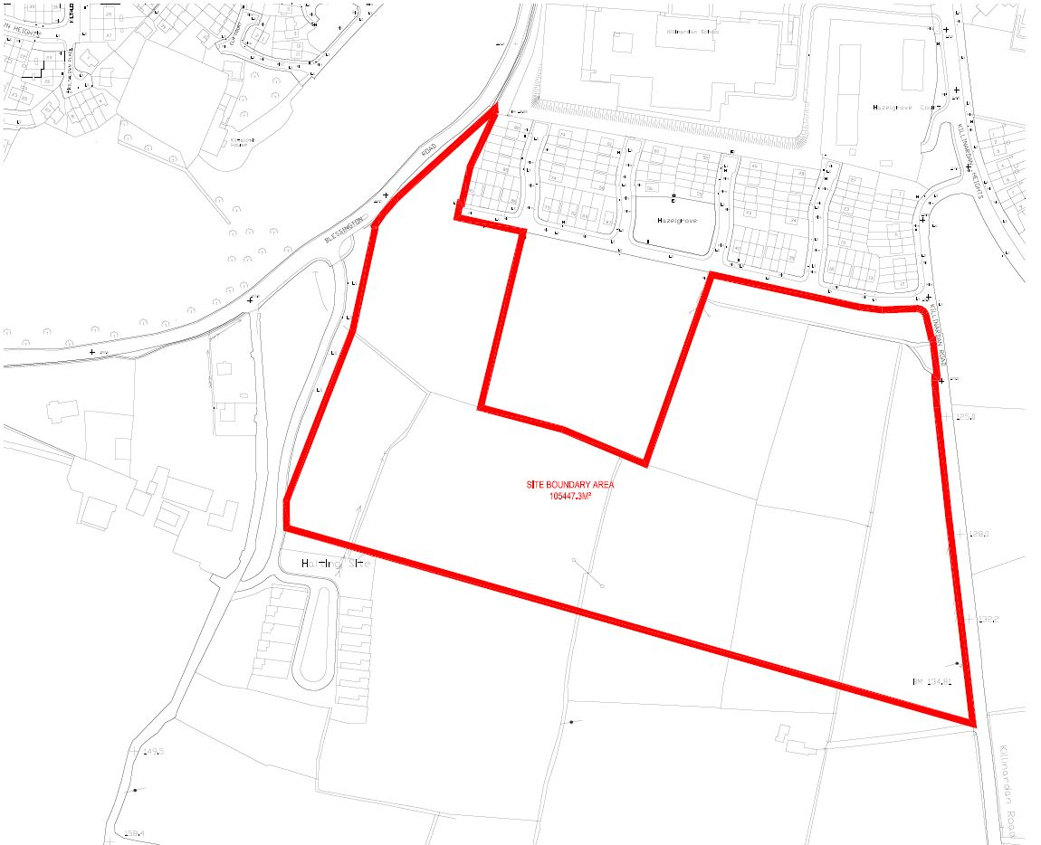
Site Location-NTS
Prepared by SDCC Architects Dept.

Slide 26
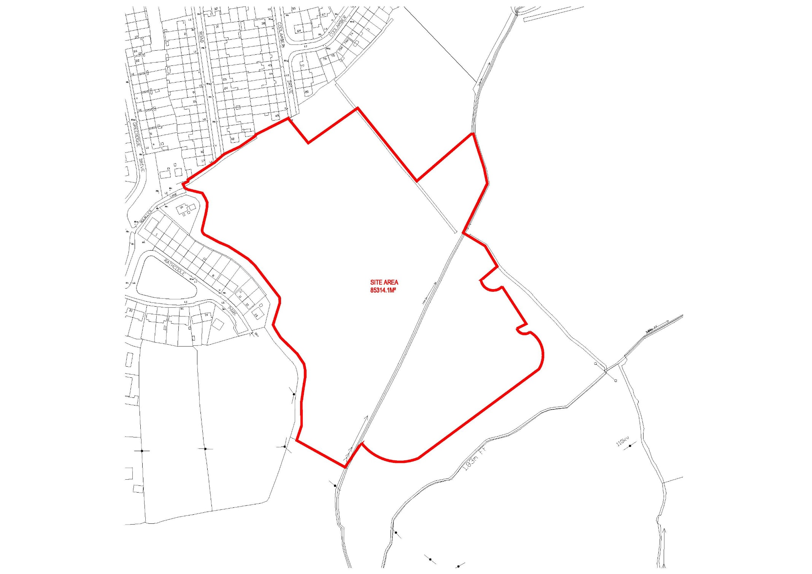
Site Location-NTS
Prepared by SDCC Architects Dept.

Slide 27
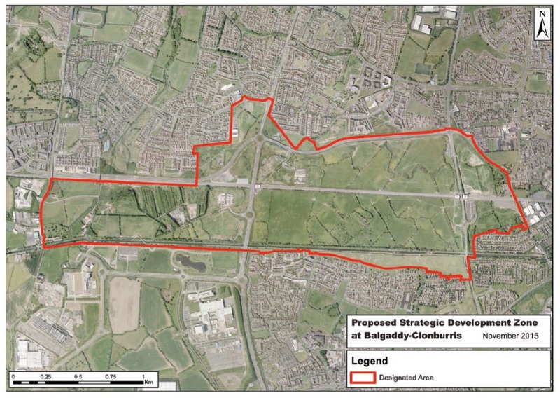
Site Location-NTS
Prepared by SDCC Architects Dept.

