Slide 1
St. Catherine’s Infill Part 8 Consultation
Briefing Presentation to Council
On Consultation Process and Recommendation for Approval

Slide 2
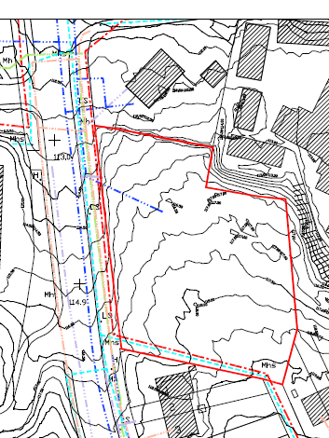
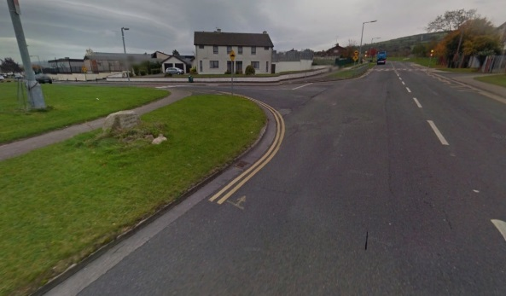
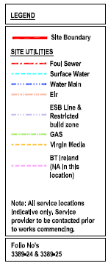
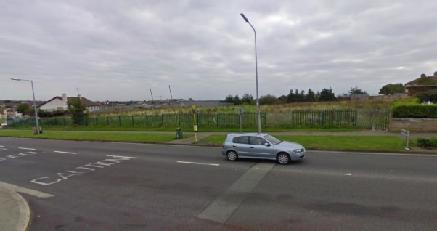
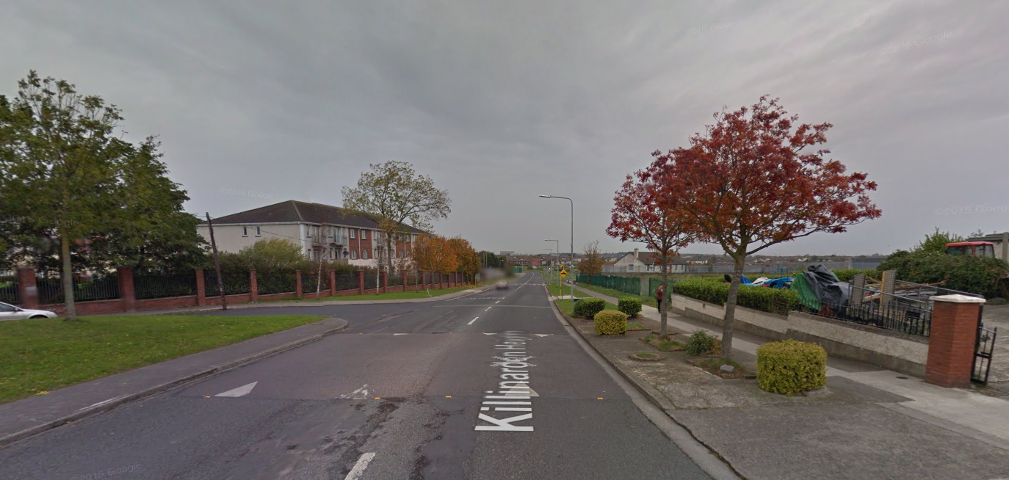
Photo 1
Photo 1
Photo 2
Photo 2
Photo 3
Photo 3
Photo 1
Aerial View
Photo 2
CONSTRAINTS & EXISTING ENVIRONMENT
Photo 3

Slide 3
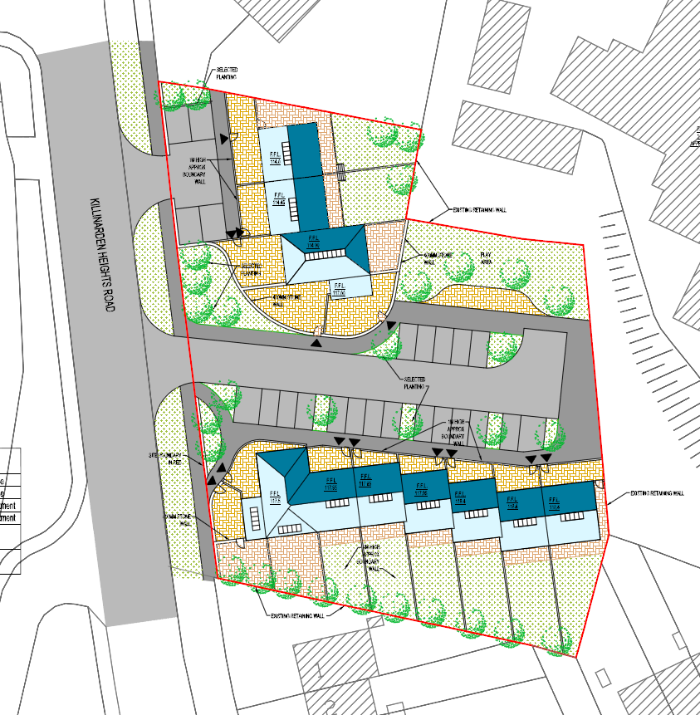
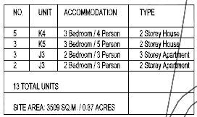
Plan showing block to south modified by reducing in height from three to two storey, and inserting two storey small family house mid terrace.
PROPOSED SITE PLAN

Slide 4
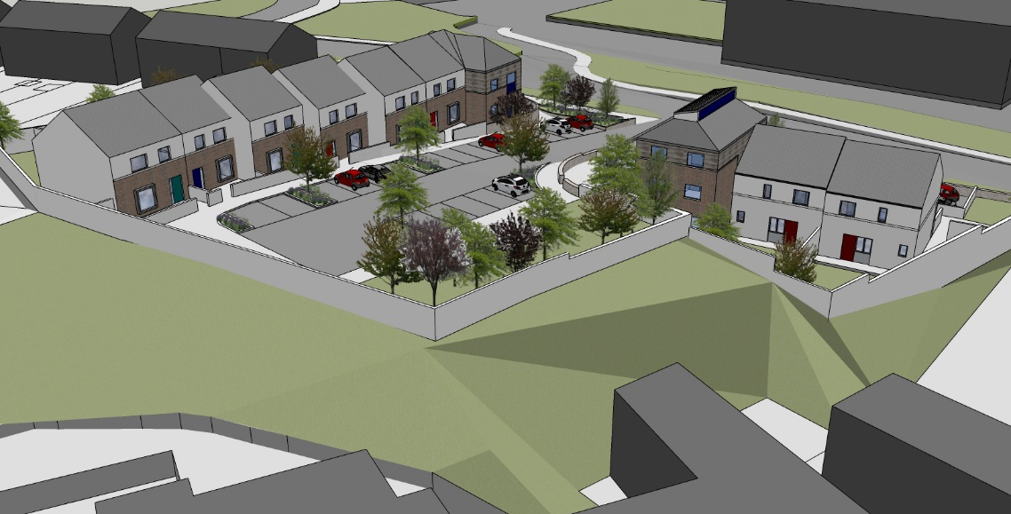
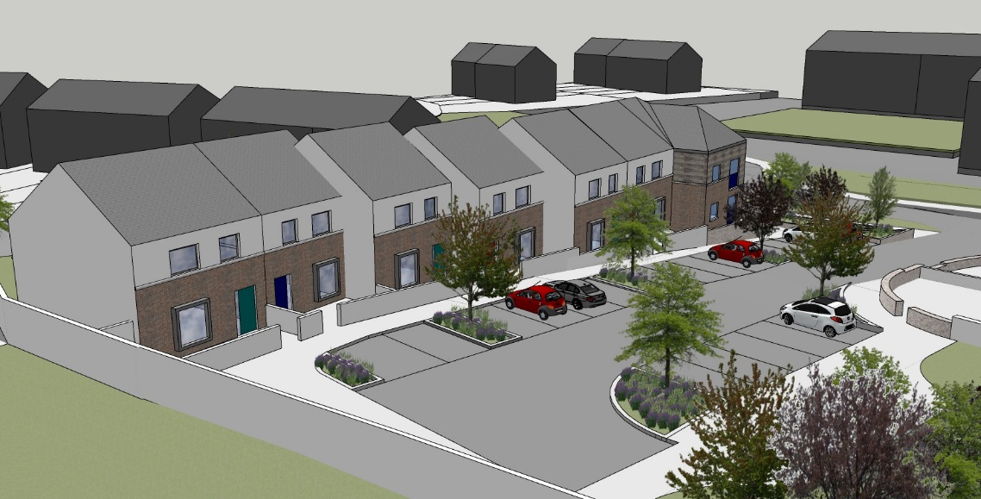
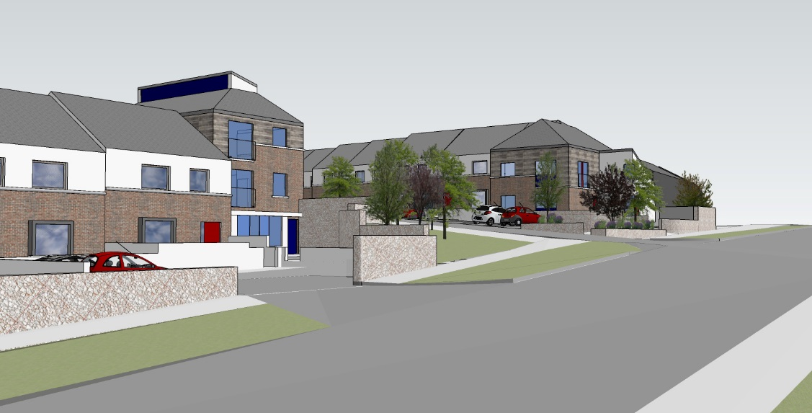
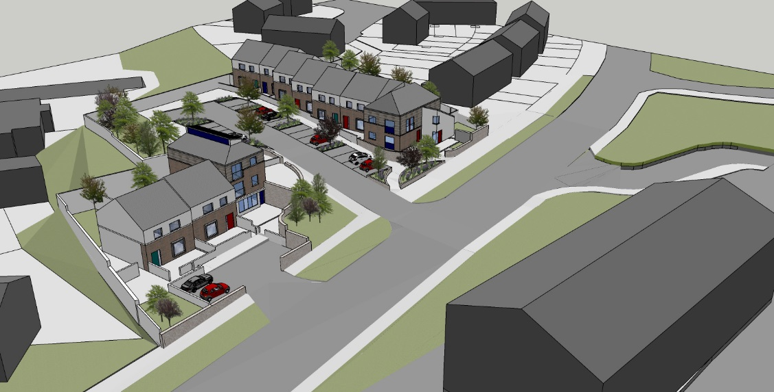
Aerial View
Block reduced in height
Proposed Entrance
Development Overview
3D Images

