Slide 1
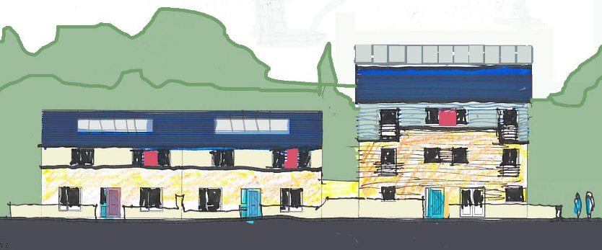
Homeville Infill Part 8 Consultation
Briefing Presentation to Council
On Consultation Process and Recommendation for Approval

Slide 2
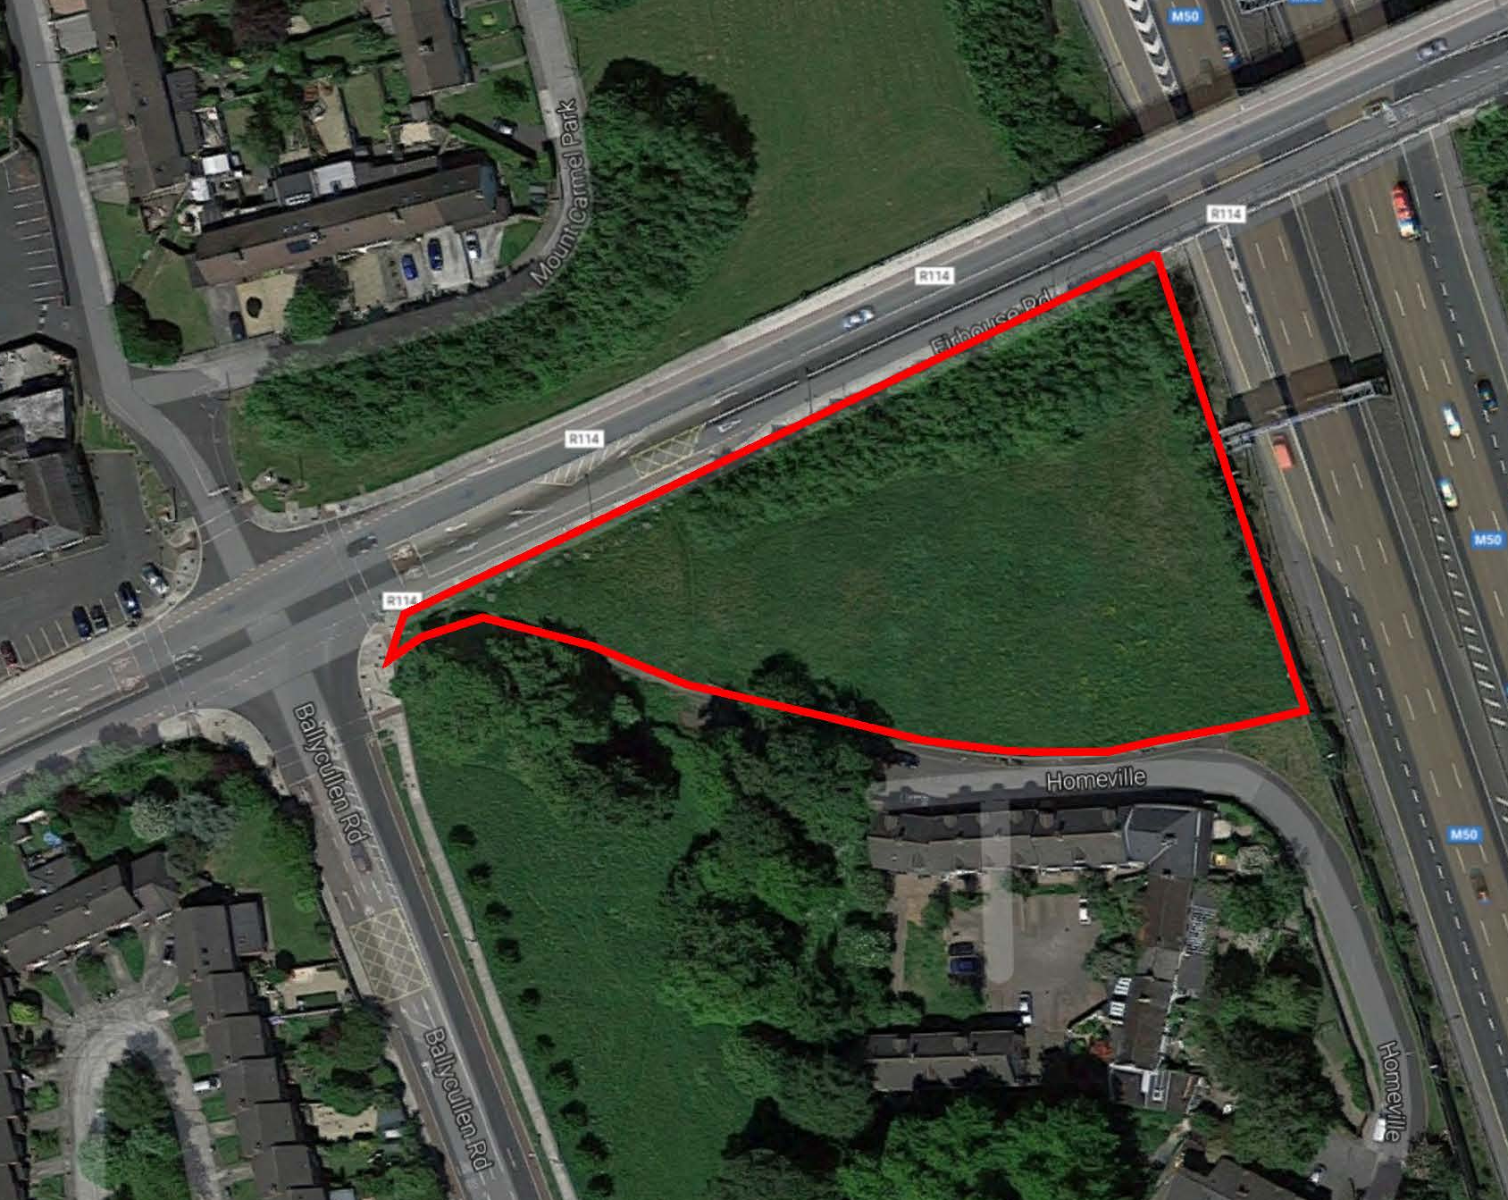
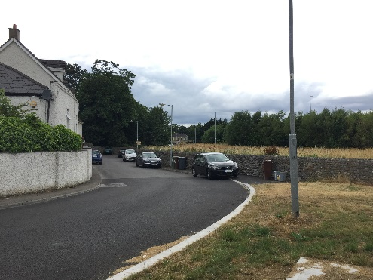
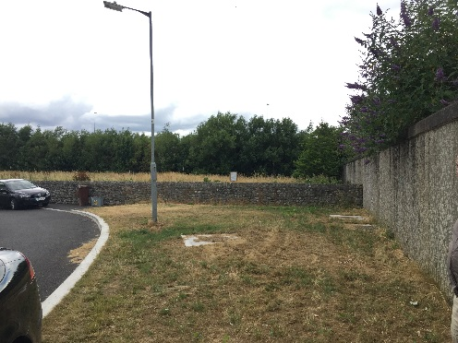
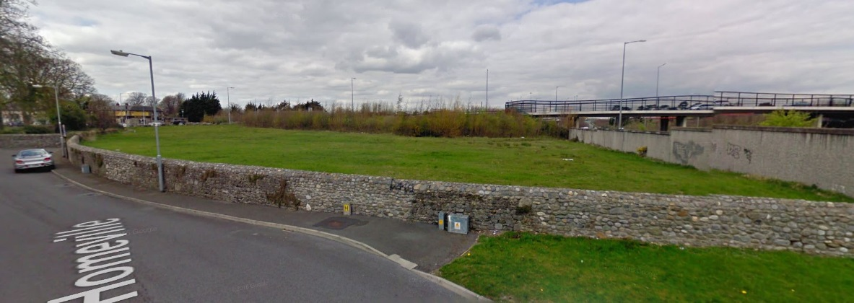
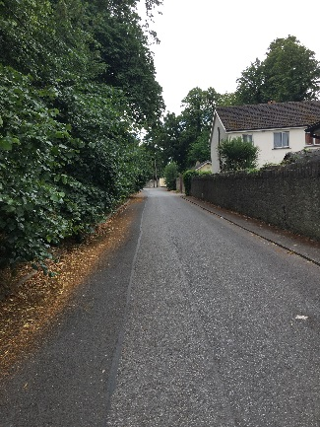
Photo 1
Photo 1
Photo 2
Photo 3
Aerial View
Photo 2
Street View
Photo 3
CONSTRAINTS & EXISTING ENVIRONMENT

Slide 3
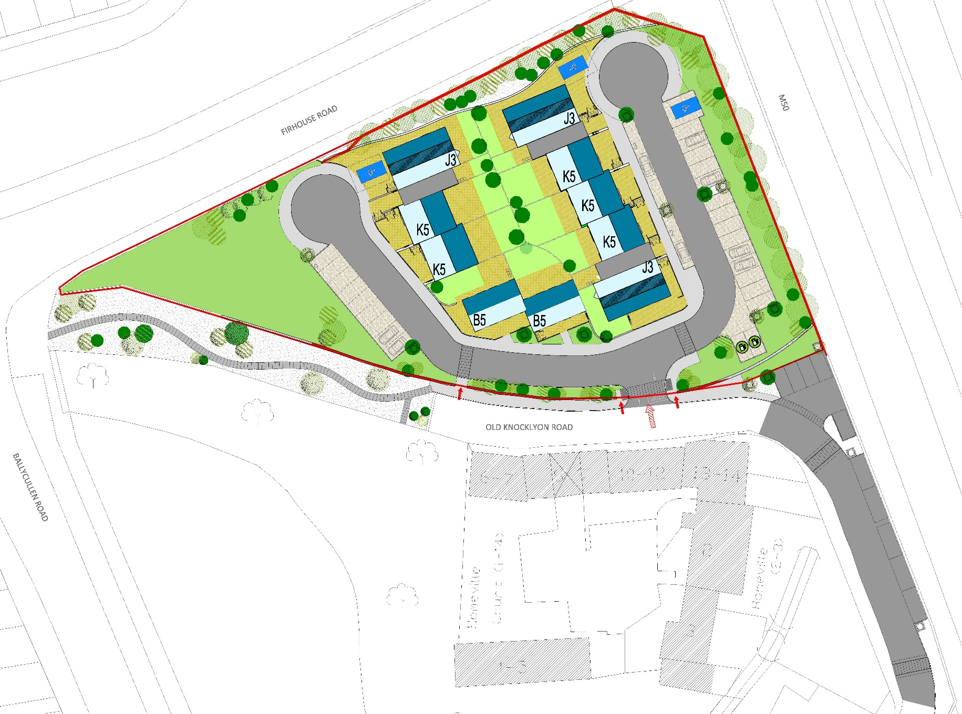
Proposed EV charge points.
Proposed new pedestrian
entrance and landscaping.
Entrance location moved
to allow additional traffic calming.
New traffic calming
& local resident parking.
PROPOSED SITE PLAN

Slide 4
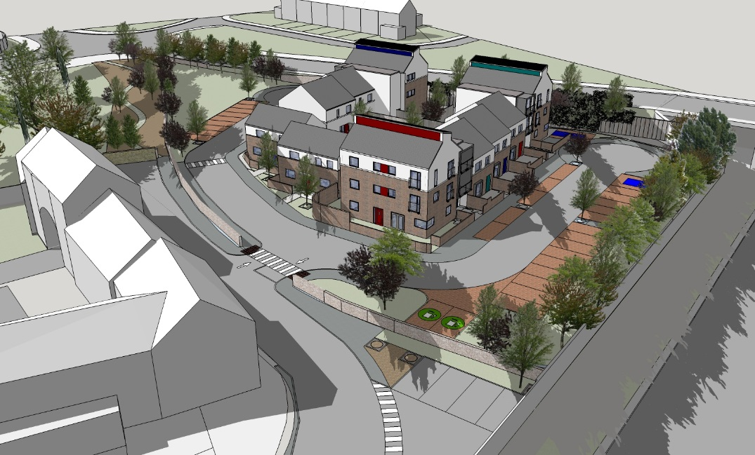
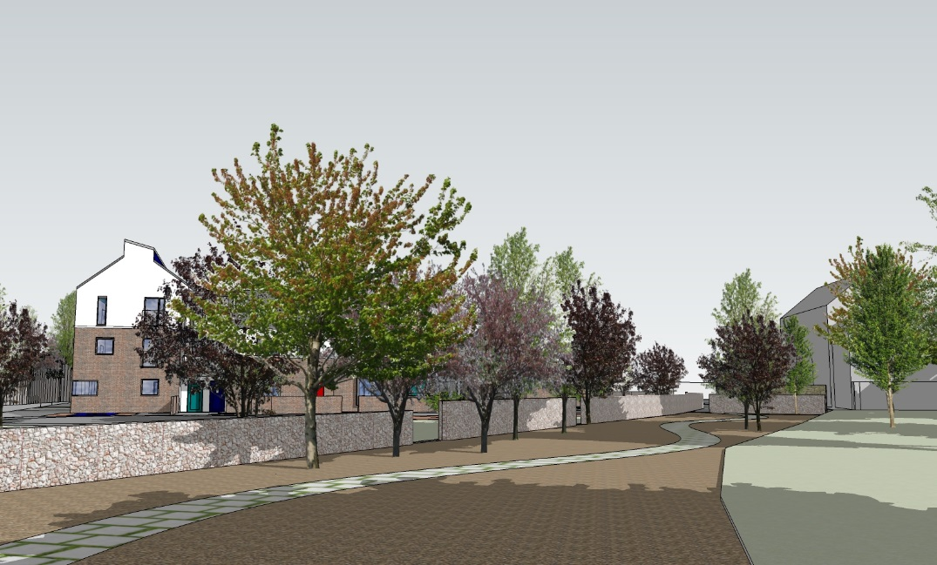
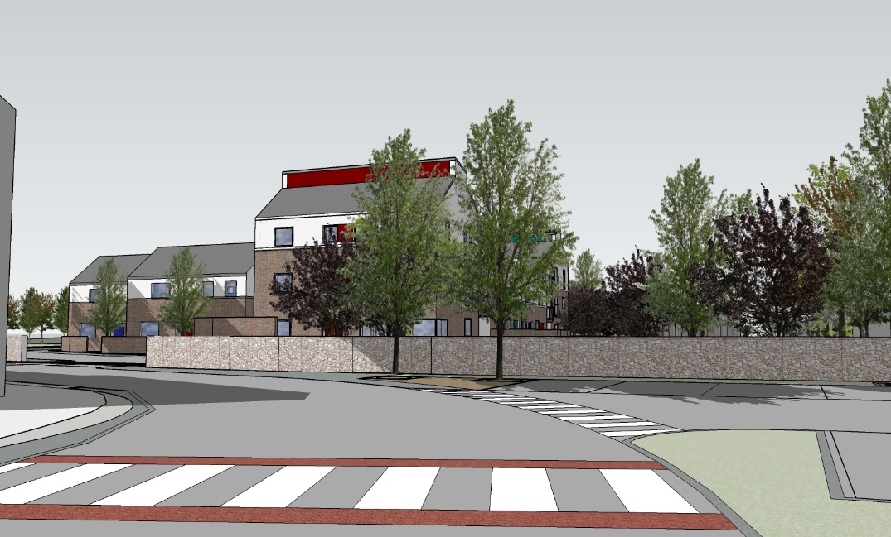
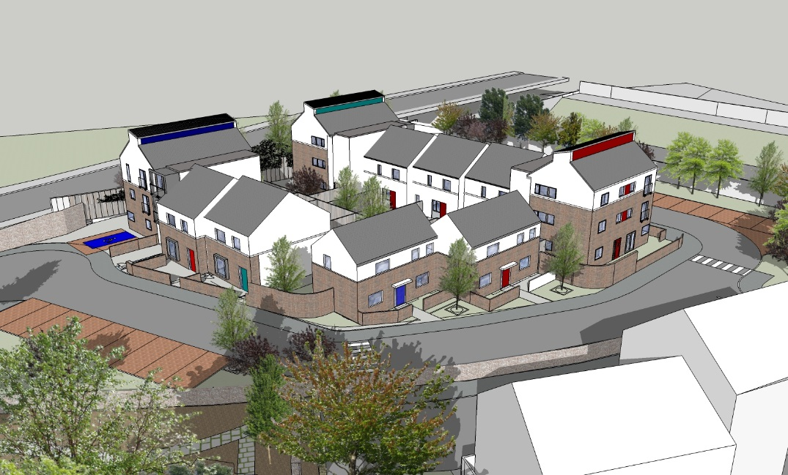
Aerial View
Proposed Pedestrian Walk
Additional Parking & Homeville Entrance
Homeville Overview
3D Images

