Slide 1


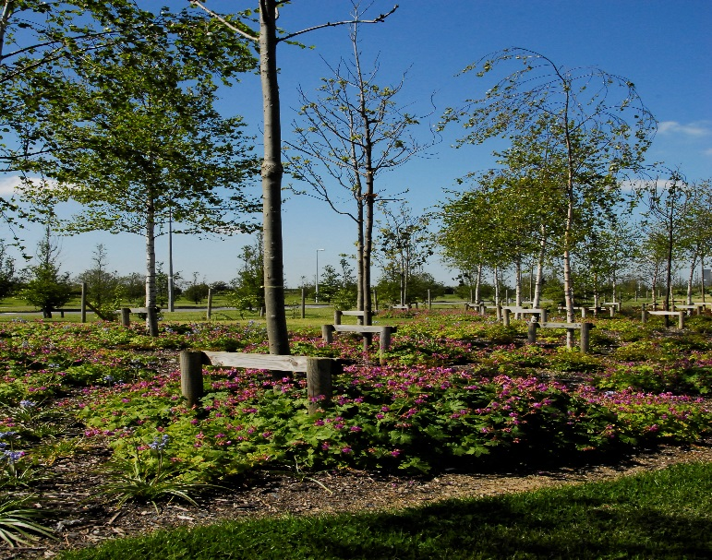
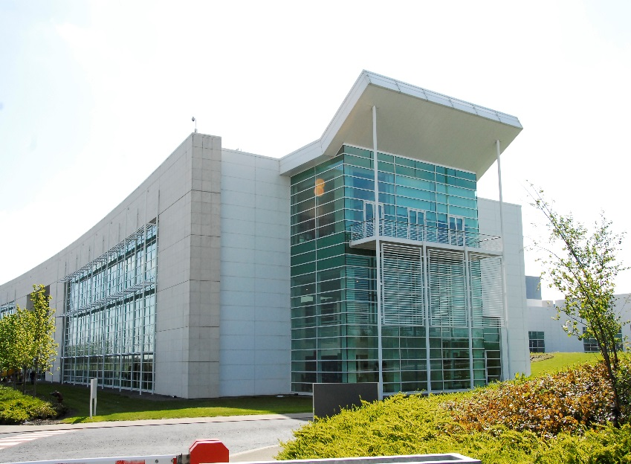

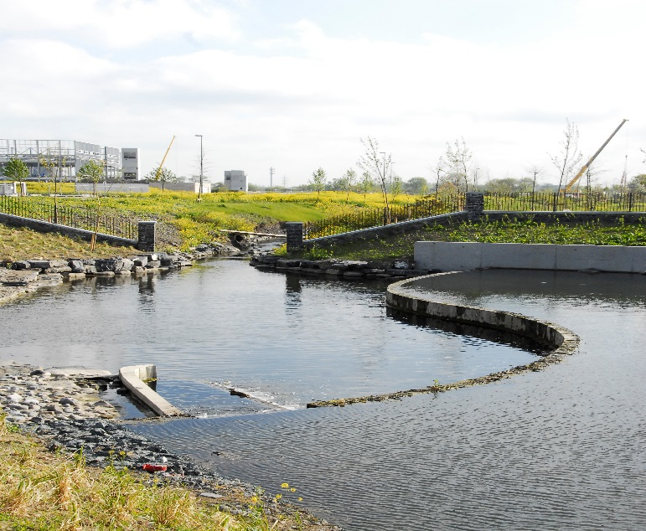
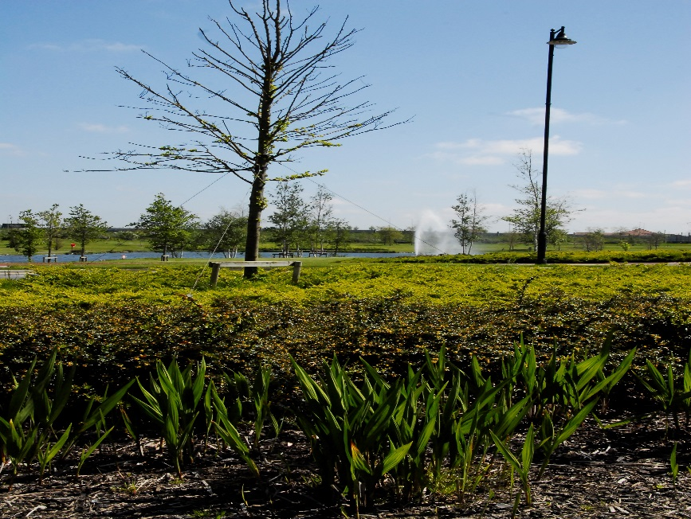
Grange Castle Business Park
SPC Update 06/09/18
Previous SPC Update 08/11/17 and 14/02/18

Slide 2
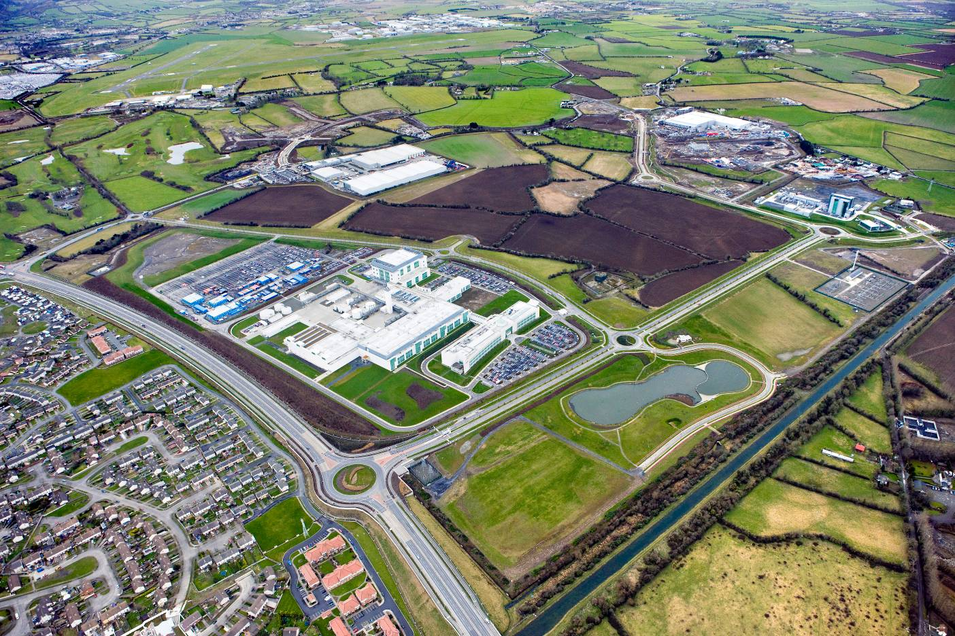













C
C
C
C
C
B
B
B
B
D
B
D
B
B
B
B
B
B
B
A
A
A
A
A
A
A

Slide 3
C
C
C
C
C
B
B
B
B
D
B
D
B
B
B
B
B
B
B
A
A
A
A
A
A
A

Slide 5
Clients Development Plans within current footprint:
(Only two sites of significant project scale remaining)
Pfizer – Relatively small upgrades ongoing.
Microsoft - Currently constructing Dub 9, 10 and 12.
Interxion – Opened in 2016. Currently seeking planning permission for doubling of capacity. Also IX have an option taken out on adjacent c.6 acres
Takeda – Currently building two new production plants. Regeneration & Oncology Drugs
Grifols – Currently building new production plant.
Google – Currently building new data hall extension to existing facility – GC South.
CyrusOne – Planning Application Submitted
Edgeconnex – Currently developing third data hall adjoining GCBP
Grange Energy – Planning Permission and EPA licence secured.

Slide 6
New Clients Secured since previous meeting
CyrusOne – Grange Castle South c.16 Acres DC and EMEA HQ Offices. Currently in the planning system
Amazon Web Services – Grange Castle South c 47 acres DC
Office site. Site shortlisted for Innovation Centre (Process shows viability of Grange Castle for Offices.

Slide 7
SDCC led development (high level of investment)
Recent developments 2015 – 2018 include
  strategic acquisitions: (Ballybane Pitch and Putt), Lands to West of R120
  roads and services (Interxion access, Central Carriageway and Google Access)
R120 / Nangor Road Improvement Scheme
  Works commenced well underway
Upgrades to internal park infrastructure, such as footpaths, cycleroutes, pumps stations, ducting etc.
Grange Castle South Archaeological Works
Grange Castle West Distributor Road
Grand Canal Greenway

Slide 8
Service providers
Utility enhancement: Eirgrid West Dublin 220KV station –
  Works on 220kV substation (Commenced September 2017) .
  Works on 220kV ducting is associated with Nangor road / R120 road improvement scheme (Commenced Q4 2017).
  Works on Outer Ring Road and Kishogue yet to commence
  Works on 110kV ESB infrastructure (ongoing)
Fibre – Improvements and extensions to fibre network (ongoing). Various Fibre Carriers
Water Services / Irish Water. Improvements to infrastructure and to Peamount Reservoir
Waterways Ireland. Grand Canal Greenway improvements and connectivity
Gas Networks Ireland. System Improvements

Slide 9
Variation to Zoning
Council Meeting 12/02/18
Economic Development, Enterprise and Toursim SPC 08/11/17
Enomic Development, Enterprise and Toursim SPC 14/02/18
Land Use Planning and Transportation SPC 15/02/18
Variation No. 1 South Dublin County Council County Development Plan 2016-2022 prepared in accordance with Section 13(2) of the Planning and Development Act 2000 (as amended) went on Public Display from Friday 16th February 2018 to Friday 16th March and was formally adopted at a special meeting of the Council on 21st May 2018.

Slide 12

Grand Canal Greenway
The proposed project will entail the following:
• Shared Cycle & Pedestrian Greenway adjacent to the Grand Canal’s northern towpath from 12th Lock Bridge to Hazelhatch Bridge linking the existing Eastern Greenway to the Arthurs Way Greenway.
• 0.45km of 4m wide Shared Cycle & Pedestrian Route connecting the proposed Grange Castle West Lands to the northern towpath of the Grand Canal including 150metres of elevated walkway overlooking a disused quarry.
• Upgrade of the existing Gollierstown Bridge including pavement resurfacing and installation of additional fall protection.
• 1 no. of new 4m wide Shared Cycle & Pedestrian Bridge located in the vicinity of Hazelhatch Bridge to provide connection with the existing Arthurs Way on the southern towpath. (This will form a future Part 8 application)
• Greenway furniture including kissing gates, bollards, signage, markings and all associated safety features, street lighting and CCTV installations, where appropriate.
• All associated landscape finishes and planting
• 6500m new service way from 12th Lock to Aylmer Bridge located under the proposed Greenway. Services included will be Power (LV & HV) Communications (Telecom) CCTV Public Lighting
• 1 no. of new service crossing under the Grand Canal adjacent to Gollierstown Bridge to connect the proposed Grand Canal service way to Grange Castle West Business Park.

Slide 15
To Date:
Briefings on proposals to further develop the canal route amenities were previously brought to CPG & Council Meeting (May), Lucan & Clondalkin Area Committee’s (July) and the Economic, Enterprise and Tourism Development SPC meetings,
  Grand Canal / Royal Canal Loop
  Permeability to Arthurs Way
Waterways Ireland have requested that Dublin City, South Dublin and Kildare County Councils prepare plans for the Greenway. They have also indicated that they would like to commence the scheme next year.
The Grand Canal in South Dublin traverses the Kildare County Border before reaching Aylmer Bridge. In order to deliver the scheme at the earliest possible date the Council approved the entering into of a Section 85 agreement with Kildare County Council and the June Council Meeting
NTA have agreed to fund the design costs in the region of €142k plus Vat.

Slide 16
Grange Castle West Access Road
The proposed Grange Castle West Access Road will include the following
features:
• 1.76km of Dual Carriageway with any average corridor width of 34m
• 0.35km of Single Carriageway with an average corridor width of 25m
• 4 No. two lane fully segregated roundabouts
• Raised 2m wide Cycle Track and Pedestrian Footway infrastructure
• An attenuation lake to accommodate the proposed road and surrounding
hardstanding areas surface water drainage requirements, this will double up
as an amenity area
• Landscaped entrance and Security structures to aesthetically mirror all
existing Grange Castle and Grange Castle South Business Park entrances.
• Underground utilities and Services including: Storm Water Drainage, Foul
Drainage, Watermain, Gas Main (4bar & HP), Power (HV/MV/LV), Telecoms,
Public Lighting, CCTV

Slide 18
Thank you
Questions?

