Slide 1
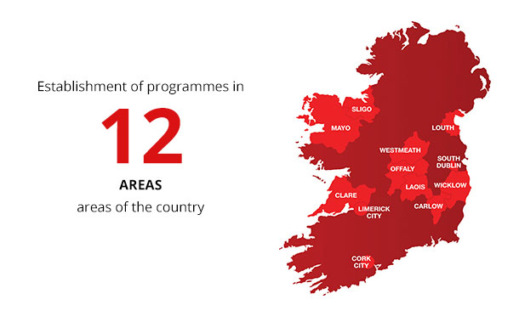
19 MG Areas… Country-wide by 2022
Including 7 new areas since Jan 2018:
Waterford City
Leitrim
Dun Laoghaire/Rathdown
Wexford
Kilkenny
Galway City
Kerry
Countrywide by 2022

Slide 2
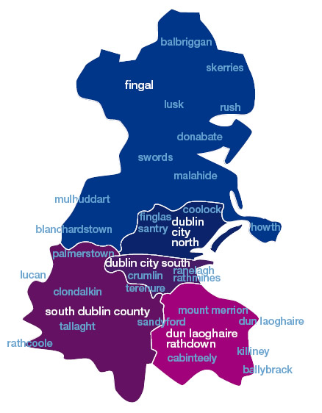
Music Generation South Dublin County Regions ( IN RED)
Tallaght Knocklyon
Jobstown Whitechurch
Killenarden Edmondstown
Firhouse Rockbrook
Palmerstown Athgoe
Rathfarnham Ballyroan
Terenure Baldonnell
Clondalkin
Neilstown
Lucan
Adamstown
Rathcoole
Saggart
Citywest
Brittas
Templeogue
Newcastle

Slide 3
So…. What music services are provided on the MG South Dublin Programme?

Slide 4
Music Generation Programmes in South Dublin
Programme | Description
Pre-school Programme
Early Starters 0-2 year olds 2-4 year olds (funded by SDCC Library contribution) | ‘Stepping Stone’ opportunity for very small children before they enter primary school. Song, percussive and movement based programme. Child-led through play with parental participation Tallaght, Ballyroan, Clondalkin and Lucan Libraries
Primary School Programmes
Early Years Primary (4-7 years) | Targeted at Junior, Senior & 1st classes. Song, Percussive and Movement based programme with opportunities for exploring improvisation & composition.
Ready, Steady, SING (7-12 years) | Development of the young voice in a group environment
Ready, Steady, PLAY (7-12 years) | Development of group instrumental technique on strings, wind, reed, guitar and percussion.

Slide 5
Primary Schools 2018-2019….
St. Brigid’s JNS, Brookfield
St. Aidan’s SNS, Brookfield
St. Thomas JNS, Jobstown
Scoil Aoife CNS, Fortunestown
NEW: Citywest & Saggart CNS, Citywest
St. Mary’s NS, Saggart
Scoil Chronain NS, Rathcoole
Holy Rosary NS, Firhouse
Glenasmole NS, Bohernabreena
Rathfarnham PNS, Rathfarnham
Esker Educate Together, Lucan
St. Ronan’s NS, Deansrath, Clondalkin
Lucan CNS
Divine Mercy, Balgaddy, Lucan
St. Andrew’s NS, Lucan
St. Martin’s NS, Brittas
Cheeverstown Special Needs School, Templeogue
NEW 2018: Gaelscoil Cluain Dolcáin, Clondalkin
NEW 2018: St. Mary’s BNS, Clondalkin.
NEW 2018 St. Peter Apostle NS, Neilstown, Clondalkin

Slide 6
Secondary Schools… through core programming and Suburban Sounds Schools
St. Aidan’s CNS Brookfield
NEW: St. Marks Community School, Tallaght.
Colaiste Bride, Clondalkin
Moyle Park, Clondalkin
Killenarden CNS, Killenarden
Firhouse Community School
Colaiste Eanna, Rathfarnham
Collinstown Community College.
NEW: Colaiste Life, Lucan
NEW: Colaiste Phadraig, Lucan
NEW: Kingswood College

Slide 7
Music Generation Programmes in South Dublin
Programme | Description
Post-Primary Programmes (12-18 Years)
Vocal, Ukulele, Guitar & Piano | Development of group instrumental classes. Enhances school vocal ensembles and orchestras
Suburban Sounds Schools | 12-week song-writing, recording and production programme with performance opportunities along the way. Targeted at teen band development in 9 secondary schools around the county
Community Initiatives
The Hubs | 2 community hubs in Rathcoole and Clondalkin offering subsidised group, duo and individual vocal and instrumental tuition.
Ensembles | County Traditional Ensemble NEW: County Vocal Ensemble (launching in Autumn 2018) NEW: County Strings Ensemble (launching in Spring 2019)
Special Needs Programme | 1 school: Cheeverstown NS in Templeogue facilitating a percussive and sensory music experience for children and young people from 5- 18 years with severe physical and mental disabilities.
Suburban Sounds Tallaght | Rich band development experience facilitated weekly in RUA RED.

Slide 8
New Initiatives and Strands 2018-2019….
Programme | Description
NEW: Vocal Commission (Funded by Creative Ireland)
Killenarden CNS | Both schools will collaborate to compose a ‘Signature Sound’ for the county. This special vocal commission, directed by an invited composer. provide the framework for the start of a County Vocal Ensemble
Firhouse Community School
Programme | Description
NEW: VIVO Music & Ukulele Workshops
Rathcoole & Clondalkin HUBS (Rathcoole Community Centre and Scoil Chronain NS) | All new students from 7 years upwards, participating in the community hubs programme hubs will take active music-making pre-instrumental course that will instil pulse, pitch and rhythmic skills before they commence formal music training.
Ukulele Workshops 8-12 year olds 12-16 year olds | Tallaght, Ballyroan, Clondalkin and Lucan Libraries Funded by SDCC Libraries

Slide 9
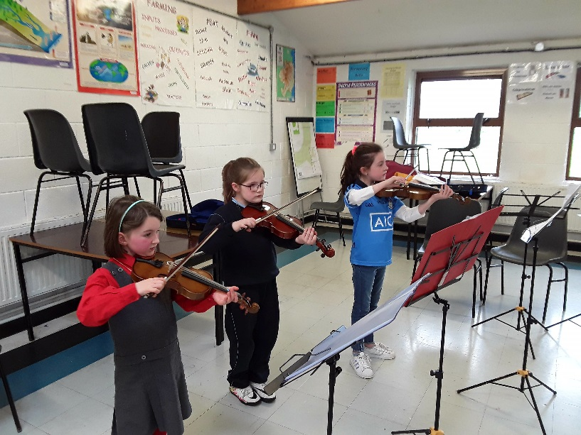
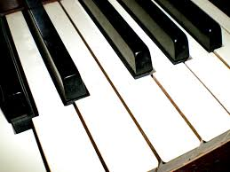
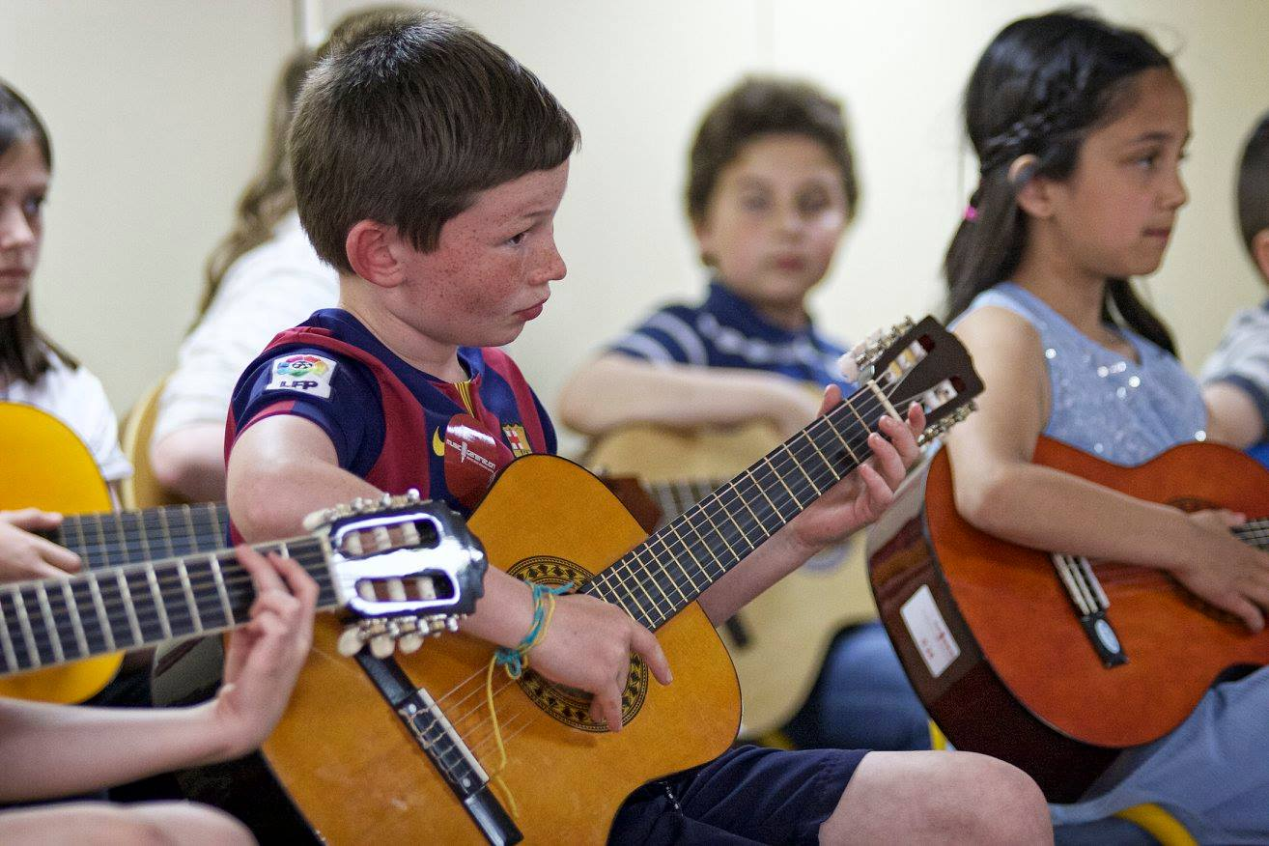
The Hubs
Rathcoole & Clondalkin Afterschool Music Hubs

Slide 10
The Hubs | Attendees by Age

Slide 11
Areas of Development…
Community Hubs Development:
The Mobile Music Machine facilitated workshops across June 2018 in feeder schools near to the hubs in Rathcoole and Clondalkin to encourage sign-up.
Regional Growth
Clondalkin and Lucan have been regions of expansion for the programme since 2017.
Recruitment
A Panel of Music Educators was established in July 2018 for 3 years. This Panel can be added to continuously and will be utilised subject to programme demand.
-Staff and Contractors : 1 Music Development Officer, 1 Assistant Development Officer, 40 Music Educators selected through Panel of Music Educators Call.

Slide 12
Statistics 2017
Music Generation South Dublin reaches…..
3500 children and young people in the county on a weekly basis.
Participation……
Advantaged areas: 11
Disadvantaged areas: 9
Mixed areas: 4
0-5: 444
7-12: 2905
12-15: 140
15-18: 82 (will be greater for 2018 statistics due to expansion of secondary school programming i.e. Suburban Sounds Schools
Working Musicians: 25 (now 40 due to Panel Call)

Slide 13
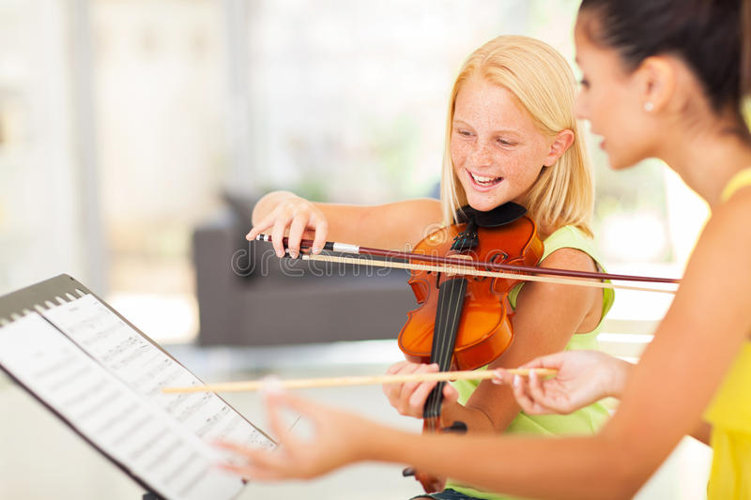
Community Partnerships
& Ensemble Opportunities…..

Slide 14
Other MG South Dublin partnerships & connections…..
Foróige
Crosscare
South Dublin Libraries
County Childcare Committee
Alternative Entertainments (Suburban Sounds)
Des Carty Tutors
Ruaille Buaille Children’s Music Festival
Lucan Comhaltas
Aras Chronain
RUA RED Arts Centre, Tallaght
Civic Theatre, Tallaght.
CONTACT Studio (part of SDCC Arts Office)
Tallaght Community Arts
Divine Mercy SNS Orchestra, Balgaddy
St. Martin’s NS, Brittas
Cheeverstown Special Needs School.

Slide 15
5-year Strategic Plan for MG South Dublin 2019-2024

Slide 16
REVISED MISSION STATEMENT…….
Existing Statement: To create the foundation for a sustainable music education service in South Dublin; which will inspire and engage children and young people to participate in active music-making in a musical county.
Revised: To develop a sustainable music education service in South Dublin County that engages children and young people in active, inspirational music-making in a musical county

Slide 17
Suggestions……
Aideen McLaughlin and MG South Dublin Steering Committee are currently working to develop the 5 year Strategic Plan alongside Eve O’Kelly (Development Officer of Music Generation)
Suggested Key Priorities:
Vision on:
-Cultural Diversity
-Partnership Working
-Inclusivity
-Equality
S
Sustainability:
- Of Finance
- Of Partnerships
Of Workforce
Of Quality Programming
Of Excellence

Slide 18
Going Forward…
Music Generation South Dublin will strive to…..
Place children and young people at the heart of all facilitation.
Establish a network for learning and exchanging ideas/resources
Actively Observe, Evaluate and reflect on practice.
Positively represent the MG South Dublin programme at all times both inside and outside the classroom.
Continuously transform the lives of children and young people through access to quality vocal and instrumental tuition.

Slide 19
Thank you!

