Slide 1
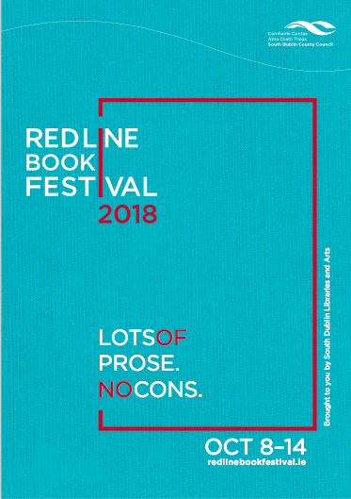
Notes:
New design and colours
Website revamped also

Slide 2
In brief
7 Days: Monday 8th October – Sunday 14th October 2018
14 Venues across South Dublin County – over 50 events.
90+ authors/speakers/actors/storytellers/facilitators
Events Management company – Boxroom Productions
Cultural partnerships established – Poetry Ireland, Arts Council and Creative Ireland, Rua Red and the Civic Theatre
Marketing & promotion underway - Photocall to maximise media attention, posters, brochures, social media and RTE Supporting the Arts campaign
Poetry and Short Story competitions.
Notes:
Authors of note:
Irish language events
History events:

Slide 3
Venues
Civic Theatre – Main Auditorium and The Studio
RUA RED
Pearse Museum, St Enda’s Park, Rathfarnham
Rathfarnham Castle
Cherrytree Pub Theatre
Clondalkin Round Tower Centre
Court of Petty Session, Rathcoole
Coach House, Palmerstown (Stewarts Library event)
Tallaght Stadium
Tallaght Adventure Centre
Library Branches – Tallaght, Ballyroan, Lucan, Clondalkin and Mobile Libraries

Slide 4
Pre-Festival Event
Join renowned writer, Jennifer Johnston and Poet and Musician John Sheahan for a relaxed and intimate afternoon of readings, conversation, and music chaired by Dermot Bolger at 2pm in the Pearse Museum on Saturday 8th September, 2pm – 4pm.
Notes:
Anam An Náisiún – Round Tower Centre
Magic in my Eyes - Rathfarnham Castle
Victorian Mavricks – Pearse Museum
Taking the Mic – Cherrytree Theatre
Mná and the Law - Rathcool Court
Exhibition and Launch - Rua Red
Mna Na hEireann
One yummy Mummy
Killer instincts
This Voice – working class writers
Take off your Cornflakes
Peter F Hamilton, Emilie Pine
Kill All Normies
Rick O’Shea bookclub
Red Riding Hood – Family Theatre on Sunday at noon

Slide 5
RTÉ Sunday Miscellany – live recording Sunday 14th October, Civic Theatre
Just a few highlights
Mná and the Law
Discussion on Women in politics
Wednesday 10th October
Court of Petty Session, Rathcoole
Internet Famous - Alison Spittle and friends
Tuesday 9th October Civic Theatre
This Voice – Writing and the working class
Wednesday 10th October
Rua Red
Magic in My Eyes – Hardy’s Poems of Love and Loss
Wednesday 10th October Rathfarnham Castle
Mná na hEireann - Historical Heroines
Saturday 13th October
Civic Theatre
Anam an Náisiúin - Ceol agus craic and poetry
Thursday 11thOctober, Clondalkin Round Tower Centre
Take off your Cornflakes
Thursday 11th October
Civic Theatre
Notes:
RTE Radio One Sunday Miscellany recording live @ Civic Theatre, Sunday 14th Oct
This radio programme is part of Sunday morning since 1968 and this is the second time coming to broadcast in Tallaght!
A mix of “music & musings” with poetry readings and essays it attracts over 300,000 listeners every Sunday. Our festival audiences will be able to attend the programme live in the Civic Theatre. An opportunity not to be missed!

Slide 6
Writing Awards and Tools of the Trade Workshops
RLBF Poetry Awards Ceremony 2018 and Launch of “Red Lines” Poetry Book
300 Poems from 168 Poets in Ireland
Tallaght IT awards for Short Story Competition 2018
200 entries from 17 Countries worldwide
Eight Workshops with well respected poets and authors:
Mary O Donnell, Jane Robinson, Rob Doyle, Eileen Casey, Lisa Harding, Mark Granier, June Caldwell and Colm Reynor
Notes:
Workshops – Tools of the Trade
Eight workshops for adults and young adults in various venues.
ITT - Short Story
Number of entries: 240 from all around the World
Prizes: 1st place €500, 2nd €250, 3rd €150.
Awards Thursday 11th^{th} October 2018 The Studio, Civic Theatre
SD Libraries Poetry
Number of entries: 300 from all around Ireland
Prizes: 1st place €300, 2nd €200, 3rd €100.
Awards Wednesday 10th October 2018 as part of Poetry evening at the Civic Theatre
Launch of Poetry book – Red Lines

Slide 7
Link, Share, Connect
www.redlinebookfestival.ie
Facebook.com/RedLineBookFest
@RLBFest

