Slide 1
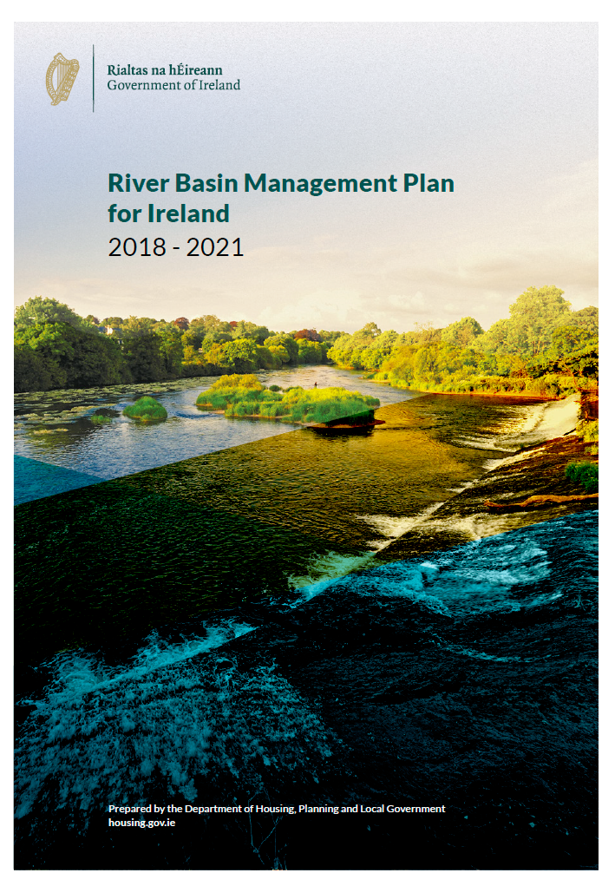
The River Basin Management Plan for Ireland 2018 - 2021
Briefing for the Environment, Public Realm & Climate Change SPC
3rd September 2018
Notes:
A briefing for SPC members on the River Basin Management Plan for Ireland and the new approach to water quality management

Slide 2
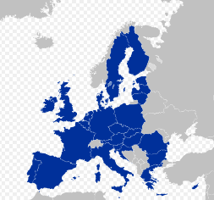
Background
The Water Framework Directive 2000/60/EC
European Parliament and Council in October 2000
‘a framework for community action in the field of water policy’ – information, consultation, active involvement.
To protect and restore ‘healthy waters’ in rivers, lakes, estuaries, groundwater and coastal areas.
Overall aim: “to achieve good ecological status in all waters”
Drivers: social and economic benefits of healthy waters.
Notes:
The foundations were set down in the EU Water Framework Directive

Slide 3
Water Framework Directive
River Basin Management Plans (RBMPs)
Programmes of Measures (PoMs)
Six year cycles
1st cycle
2009 -2015
2nd cycle
2016 -2021
3rd cycle
2021 -2027
Step 1 - Catchment characterisation – defining the problems.
Step 2 - RBMP & PoMs – setting targets and programmes.
Step 3 - Implement measures – delivering improvements.
Step 4 - Monitor and evaluate – gather data and information.
Step 5 - Report to EC – summary of progress and outcomes.
Notes:
The Water Framework Directive requires River Basin Management plans and Programmes of Measures to be developed and implemented in six year cycles.

Slide 4
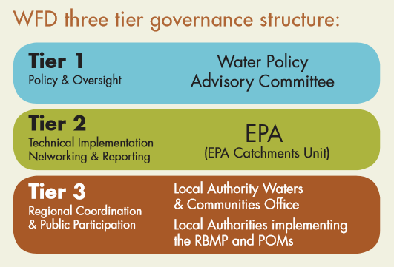
New governance structure
2014 EU Water Policy Regulations (S.I. No. 350 of 2014)
Competent authorities for WFD; Minister, EPA, Local Authorities.
Greater responsibilities on Local Authorities.
Minister - direction of water policy
EPA - science underpinning RBMPs and PoMs
LAs – regional coordination and public engagement
Notes:
A new governance structure has been put in place for WFD implementation with greater responsibilities placed on the Minister, the EPA and Local Authorities.
With ultimate responsibility with the Minister.

Slide 5
Public consultation on draft RBMP
Notes:
This cycle River Basin Management Plan has been developed with extensive public and stakeholder engagement and these have shaped priorities up to 2021 and beyond.
Significant Water Management Issues 2015
Draft River Basin Management Plan Consultation 2017
LAWCO local public consultation in 2017.

Slide 6
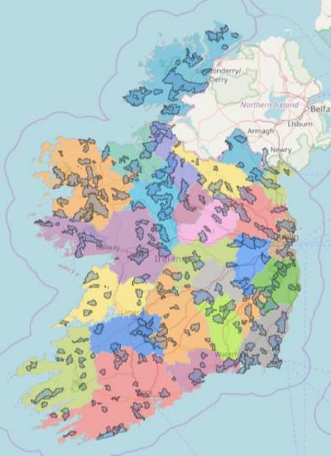
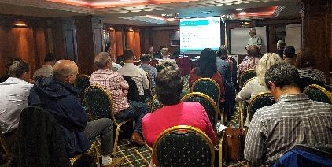
Priority ‘Areas for Action’
46 catchments in the country.
5 Regional Catchment Characterisation Workshops in 2017.
Built on EPA evidence.
All 31 LAs involved.
Relevant public agencies involved.
Expert local knowledge and discussion.
190 Priority ‘Areas for Action’ identified.
For more information see www.watersandcommunities.ie
Notes:
During the development of this Plan, a prioritisation exercise was undertaken by the local authorities, the EPA, agencies and other stakeholders to identify those water bodies that require immediate action within this plan cycle to 2021.

Slide 7
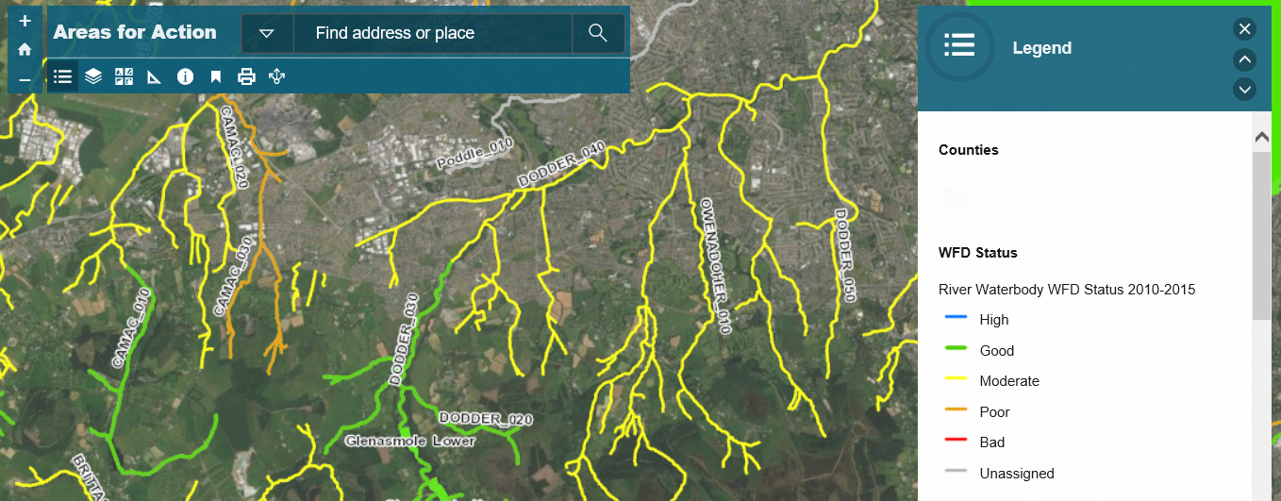
SDCC ‘Areas for Action’
River Dodder

Slide 8
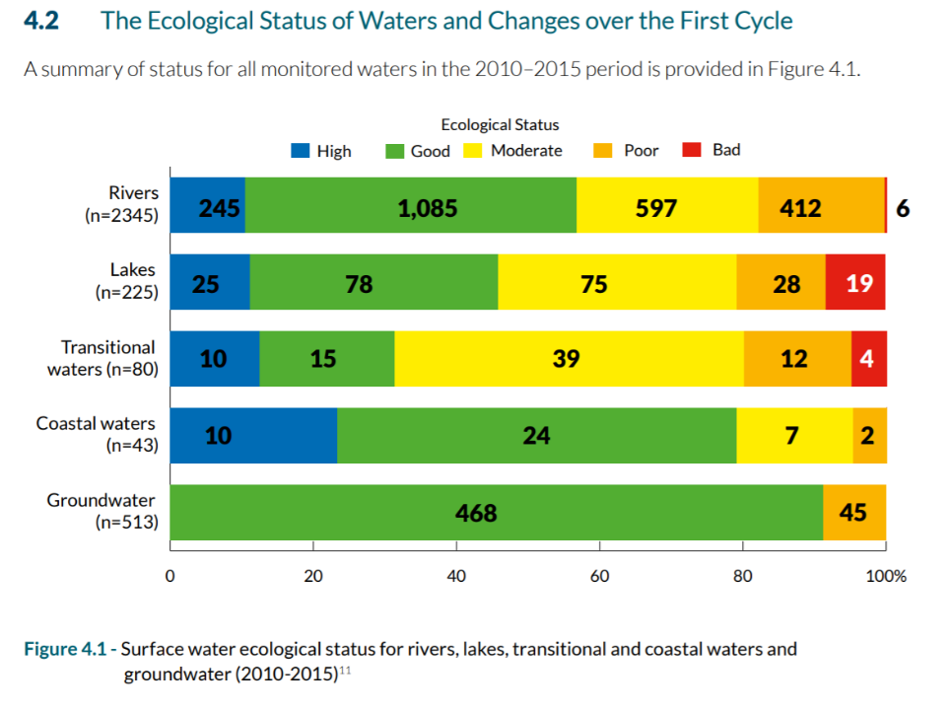
Notes:
This slide shows the status of water quality in all monitored waterbodies up to 2015.
For an example if we look at Rivers:
245 at High status, 1,085 at Good, 597 at Moderate, 412 at Poor and 6 at Bad status.
The Water Framework Directive requires all these to be Green and Blue. That would mean no yellow, orange or red in this graph

Slide 9
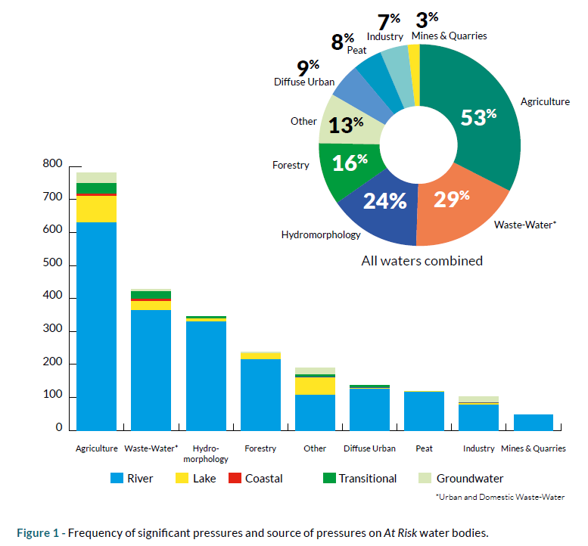
Significant pressure impacting on 1460 ‘At Risk’ waterbodies
Waterbodies ‘At Risk’
of not meeting WFD objectives.
Waterbodies
Total = 4,829
Not at Risk = 2,113
At Risk = 1,460
Unassigned 1,256
Note
c50% impacted by 1 pressure
c50% by multiple pressures
Notes:
Water bodies ‘At Risk’ means at risk of not meeting water framework directive objectives.
Of the total 4,829 waterbodies in the country, there are 2,113 ‘Not At Risk’, 1,460 ‘At Risk’ and 1,256 unassigned.
For those 1,460 waterbodies ‘At Risk’ the significant pressures impacting on them are set out in the Donut shaped diagram.
Agriculture is 53% = 774 waterbodies, these ar eon the bar chart.

Slide 10
Programme of Measures
Agriculture
Urban waste water
Water abstractions
Water and Planning guidance
Drinking water source protection
Domestic waste water treatment systems
Physical condition of surface waters
High Status waters
Forestry
Peatlands
Hazardous chemicals
Lead strategy (drinking water)
Flood risk management
Climate change
Invasive alien species
Notes:
This is the full list of programme of measures. More details on each of these is included in the Executive Summary of the River Basin Management Plan. A copy is provided for you.

Slide 11
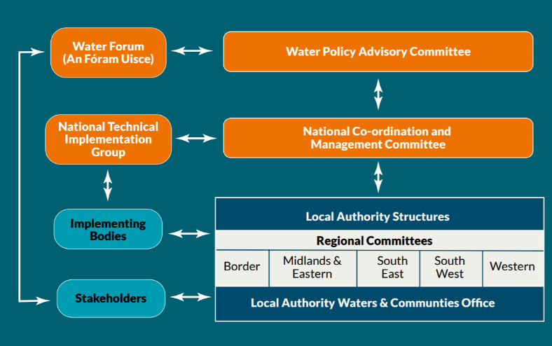
New Implementation structure
Notes:
A new structure has been established to implement this cycle of the River Basin Management Plan. With formal arrangements for cooperative working relationships and knowledge transfer between Local Authorities, agencies and stakeholders.

Slide 12
Local Authority Waters Support and Advice Team (LAWSAT).
Shared service alongside the Waters & Communities Office (LAWCO). 35 Scientists – 7 per Region.
Further assessments of the 190 priority Areas for Action.
Collaborative approach with stakeholders, agencies and LAs.
Working with industry, farmers and local stakeholders to find solutions.
Public meetings will be held in Areas for Action in advance of further catchment assessments.

Slide 13
Agricultural Sustainability Support and Advisory Programme
30 new Agricultural Advisors.
Funded by DHPLG, DAFM and the Dairy Co-ops.
Staff work under Teagasc and the Dairy Co-ops.
Link with LAWSAT in ‘Areas for Action’.
One-to-one with farmers – free advice and solutions.
Best agricultural practices in ‘Areas for Action’.

Slide 14
Community Water Development Fund
supporting community action.
Notes:
This is a new fund administered by the Waters & Communities Office.
Established to support local community water projects and initiatives.
A particular focus on proposed projects that align well with the priority actions in the plan.
Closing date for applications was 28th May and these are currently being processed.

Slide 15
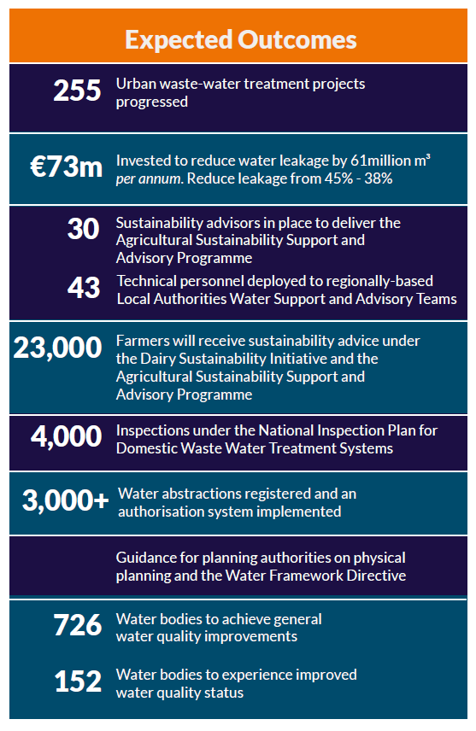
Expected outcomes over the life of the RBMP
Notes:
Based on information set out in the plan, it is expected that the following will be achieved over the period up to 2021.

Slide 16
Key Aims 2018 - 2021
Build the foundations and momentum for long-term improvements.
Regional work programmes to be developed and implemented by local authorities and agencies working together.
The new governance structures will underpin effective implementation.
Support for community led projects and initiatives.
Better approach to water quality management both locally and nationally.

Slide 17
To conclude…
The River Basin Management Plan
aims to benefit;
Public Health
The Environment
The Economy
Agriculture, Industry, Tourism

