Slide 1
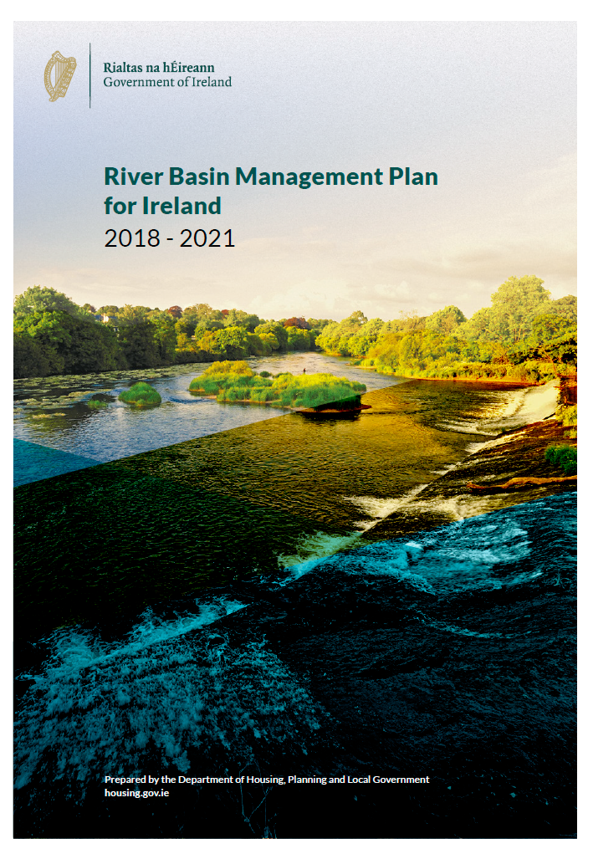
The River Basin Management Plan for Ireland 2018 - 2021
Briefing for South Dublin County Council
9th July 2018
Notes:
A briefing for SPC members on the River Basin Management Plan for Ireland and the new approach to water quality management

Slide 2
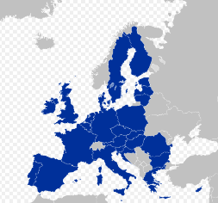
Background
The Water Framework Directive 2000/60/EC
European Parliament and Council in October 2000
‘a framework for community action in the field of water policy’ – information, consultation, active involvement.
To protect and restore ‘healthy waters’ in rivers, lakes, estuaries, groundwater and coastal areas.
Overall aim: “to achieve good ecological status in all waters”
Drivers: social and economic benefits of healthy waters.
Notes:
The foundations were set down in the EU Water Framework Directive

Slide 3
Water Framework Directive
River Basin Management Plans (RBMPs)
Programmes of Measures (PoMs)
Six year cycles
1st cycle
2009 -2015
2nd cycle
2016 -2021
3rd cycle
2021 -2027
Notes:
The Water Framework Directive requires River Basin Management plans and Programmes of Measures to be developed and implemented in six year cycles.

Slide 4
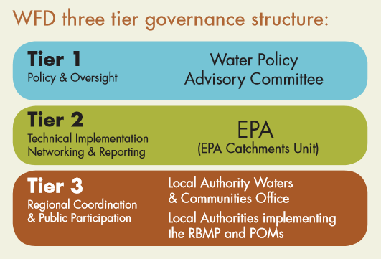
New governance structure
2014 EU Water Policy Regulations (S.I. No. 350 of 2014)
Competent authorities for WFD; Minister, EPA, Local Authorities.
Greater responsibilities on Local Authorities.
Minister - direction of water policy
EPA - science underpinning RBMPs and PoMs
LAs – regional coordination and public engagement
Notes:
A new governance structure has been put in place for WFD implementation with greater responsibilities placed on the Minister, the EPA and Local Authorities.
With ultimate responsibility with the Minister.

Slide 5
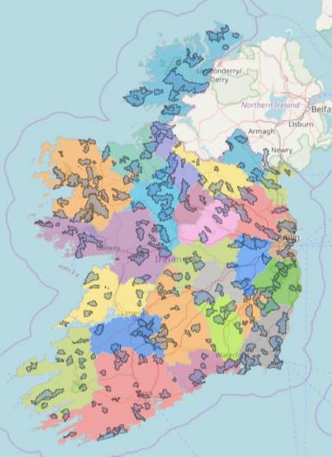
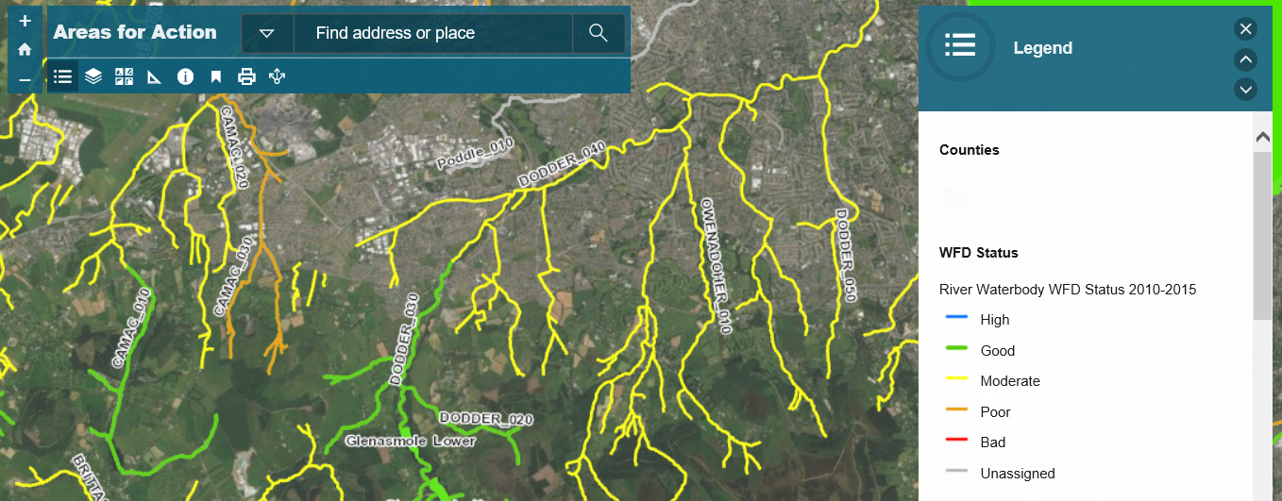
Priority ‘Areas for Action’
190 Priority ‘Areas for Action’ identified throughout Ireland
River Dodder prioritised for SDCC area (as per Dun Laoghaire-Rathdown Co. Co. and Dublin City Co.)
For more information see www.watersandcommunities.ie
Notes:
During the development of this Plan, a prioritisation exercise was undertaken by the local authorities, the EPA, agencies and other stakeholders to identify those water bodies that require immediate action within this plan cycle to 2021.

Slide 6
Local Authority Waters Support and Advice Team (LAWSAT).
Shared service alongside the Waters & Communities Office (LAWCO). 35 Scientists – 7 per Region.
Further assessments of the 190 priority Areas for Action.
Collaborative approach with stakeholders, agencies and LAs.
Working with industry, farmers and local stakeholders to find solutions.
Public meetings will be held in Areas for Action in advance of further catchment assessments.

Slide 7
Agricultural Sustainability Support and Advisory Programme
30 new Agricultural Advisors.
Funded by DHPLG, DAFM and the Dairy Co-ops.
Staff work under Teagasc and the Dairy Co-ops.
Link with LAWSAT in ‘Areas for Action’.
One-to-one with farmers – free advice and solutions.
Best agricultural practices in ‘Areas for Action’.

Slide 8
Community Water Development Fund
supporting community action.
Notes:
This is a new fund administered by the Waters & Communities Office.
Established to support local community water projects and initiatives.
A particular focus on proposed projects that align well with the priority actions in the plan.
Closing date for applications was 28th May and these are currently being processed.

Slide 9
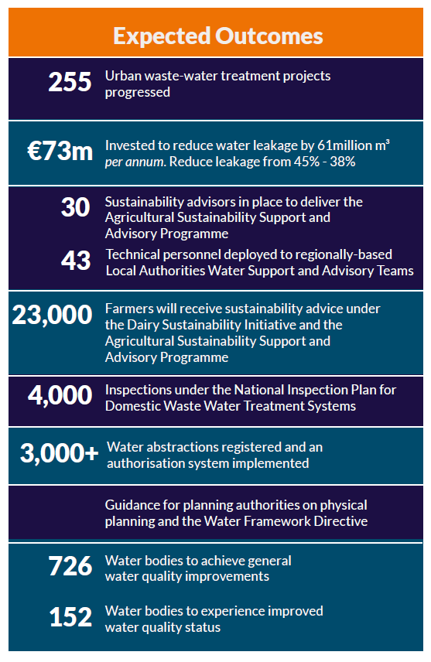
Expected outcomes over the life of the RBMP
Notes:
Based on information set out in the plan, it is expected that the following will be achieved over the period up to 2021.

Slide 10
To conclude…
The River Basin Management Plan
aims to benefit;
Public Health
The Environment
The Economy
Agriculture, Industry, Tourism

