Slide 1

County Development Plan
Proposed Variation No. 1
Meeting 21st May 2018

Slide 2

Development Plan Variation
Planning & Development Act 2000 (As Amended)
Section 13.— (7) In making a variation under this section, the members of the authority shall be restricted to considering the proper planning and sustainable development of the area to which the development plan relates, the statutory obligations of any local authority in the area and any relevant policies or objectives for the time being of the Government or any Minister of the Government.

Slide 3
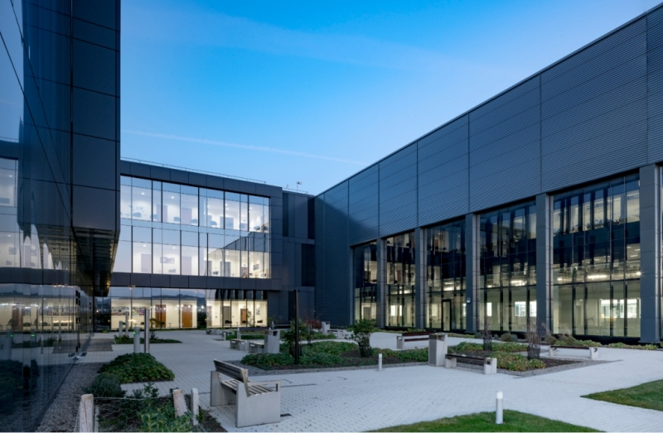
Variation Requirement
Lack of Availability of Serviced Greenfield Sites of Scale for FDI & Larger Indigenous Industry
IDA/EI Engagement: Existing & Emerging Demand
Increased Activity in Existing Business Campus
Limited Capacity in Other Business Parks to Accommodate Projects of Scale
Safeguard Future Investment & Employment Opportunities
15 – 20 Year Managed Expansion of Enterprise/Employment Zoned Land

Slide 4
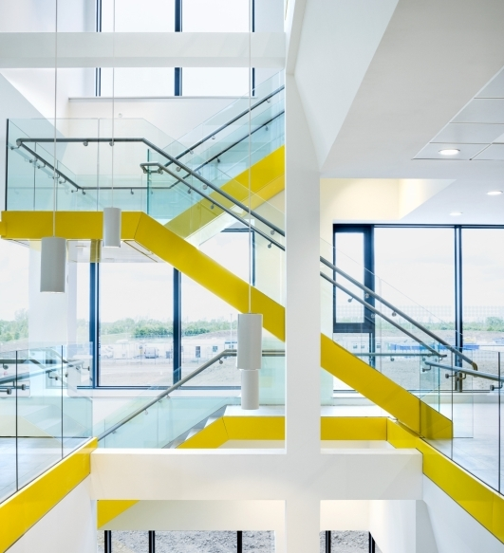
Locational Importance
Proximate to Existing Successful & Almost Built-out Business Park
Existing & Developing Services (i.e. Transport & Utilities.
Provides Opportunity to Identify a Coherent Land Block of Scale for Enterprise/Employment
Proximity to SDZs, Existing Business Park & Corkagh Park Exemplifies Live/Work/Play Corporate Strategy in Practice

Slide 5
Development Plan Preparation
Enterprise/Employment Space Demand & Service Supply Latent;
Future Demand Recognised: ET3 – SLO1 Provision – Presently Being Actioned;
Demand Pipeline & Service Delivery Established.

