Slide 1
South Dublin Libraries Development Plan 2018-2022 (Draft)

Slide 2
Contents
Introduction
Executive Summary
Mission Statement
Profile of South Dublin Libraries
The Communities We Serve
Consultation Process
Research Outcomes
Key Challenges
Making It Possible
Appendices

Slide 3
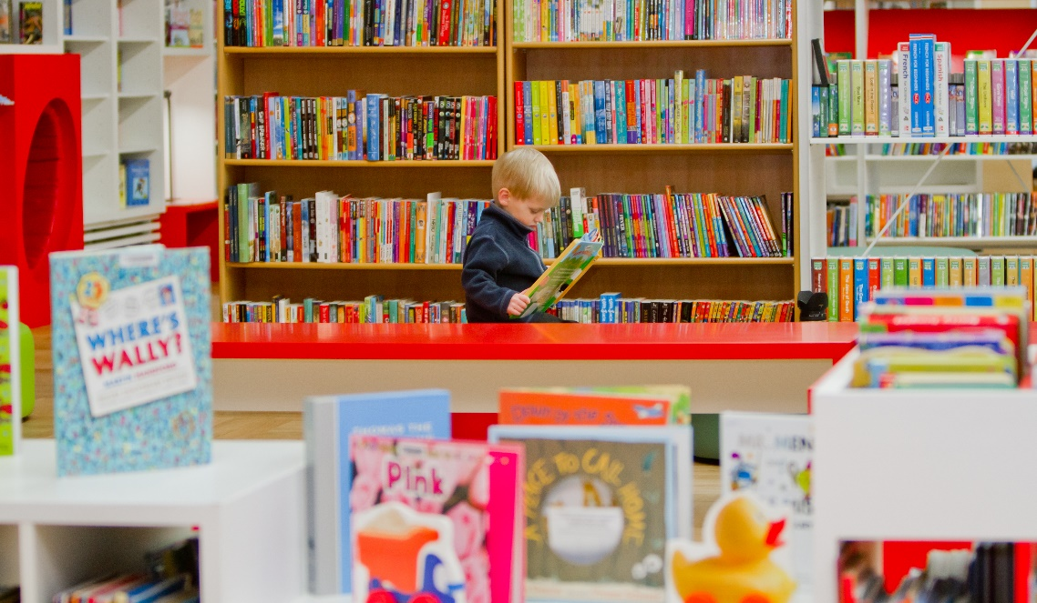
Mission Statement
To enrich the quality of life in South Dublin County by promoting access to a broad range of knowledge, information, technology, culture and heritage, in a welcoming, inclusive, and supportive way.

Slide 4
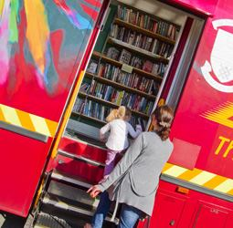
The Communities We Serve
Total Population: 278,767
Children: 82,115
  0-4 years: 21,733
Nationalities: 120
Education:
  20,772 (11.9%) aged over 15 years of age have either only primary education or no formal education at all
Economic Activity:
  6,000 businesses in the County;
  85,000 work in South Dublin County
Computer access:
  10.6% do not have internet access;
  23.4% do not have a personal computer
Fastest Growing Areas: Saggart, Rathcoole, and Tallaght

Slide 5
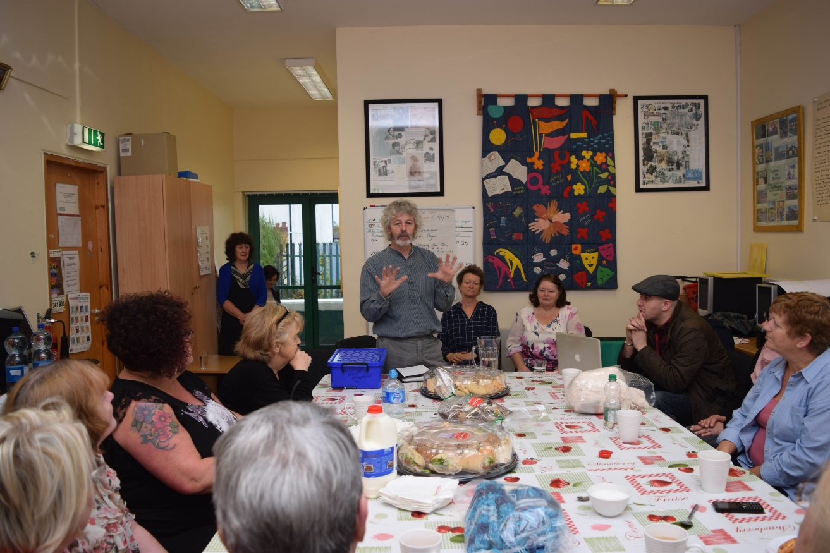
The Consultation Process
Online Survey
Public Consultation
SWOT Analysis
PESTLE Analysis
Research Outcomes

Slide 6
6 Key Objectives

Slide 7
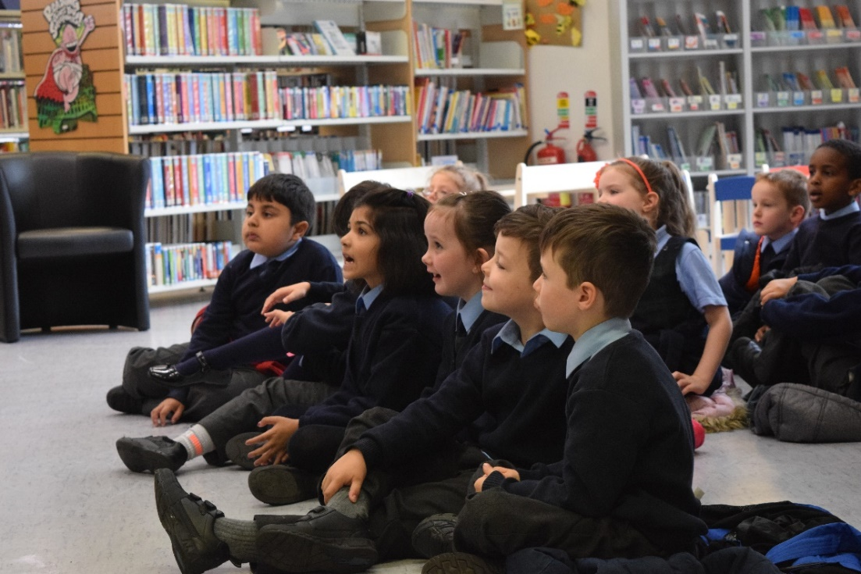
Objective 1: Reading and Literacy
Appoint a Right to read Co-ordinator and compile a Right to Read Action Plan annually
Develop and deliver programmes for adult and family literacy
Participation of all service points in Spring into Storytime and Summer Stars national programmes
Organise and facilitate creative writing groups for diverse groups
Delivery of programmes from basic to advanced , designed to develop and enhance digital literacy skills, with particular focus on adult and older users

Slide 8
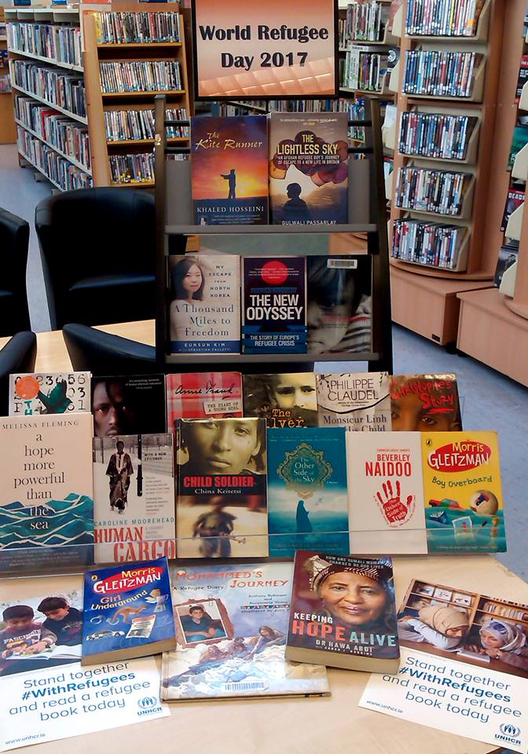
Objective 2: Marketing and Promotion
Redevelop the existing South Dublin Libraries website to offer customer focussed, interactive, easily accessed and streamlined information
Develop and implement a social media marketing strategy to advertise and continuously update the range and extent of services and programmes on offer in South Dublin Libraries

Slide 9
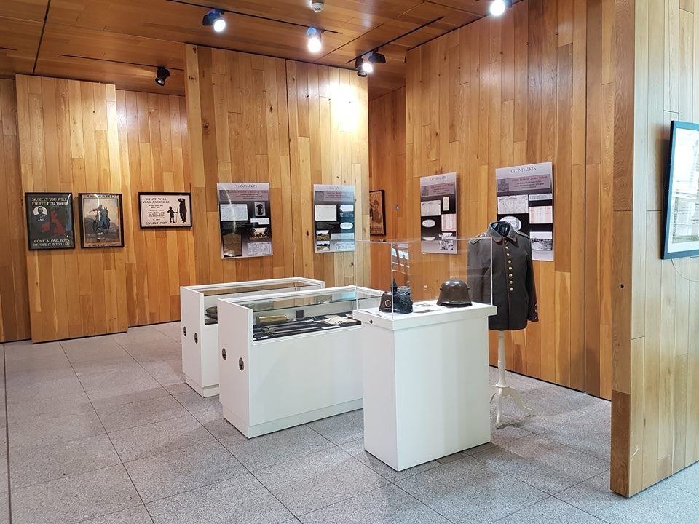
Objective 3: History and Heritage
Continue to develop the Local Studies collection and regularly review the Collection Development Policy
Actively develop collections relating to the centenaries of the War of Independence and Civil war – sourcing memorabilia, photographs pertaining to this period of our history, and utilise these materials in exhibitions, talks and publications
Collaborate on joint projects with the Heritage Officer and provide research support to the County Promotions Unit in the delivery of heritage tourism projects, specifically the Historic Villages Walks project

Slide 10
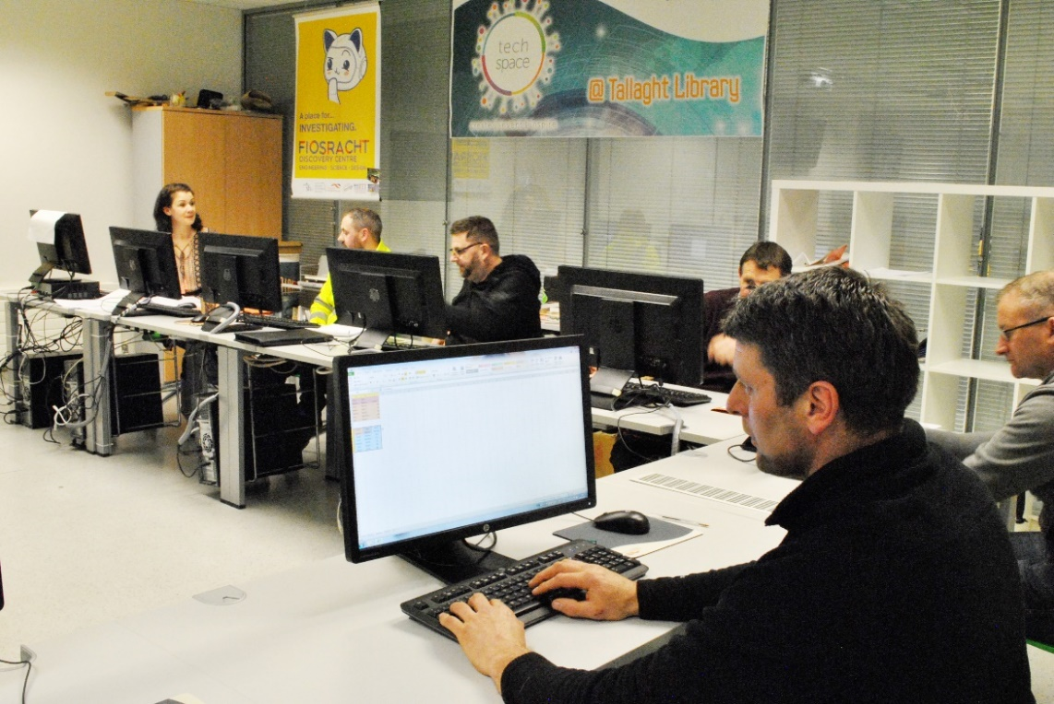
Objective 4: Information and Communication Technology (ICT)
Create and maintain clearly branded dedicated Work Matters spaces for hot-desking in all of our libraries
Redesign the South Dublin Libraries website
Maintain the national library management system, including support to staff and liaison with colleagues nationwide
Management of Data Protection requirements

Slide 11
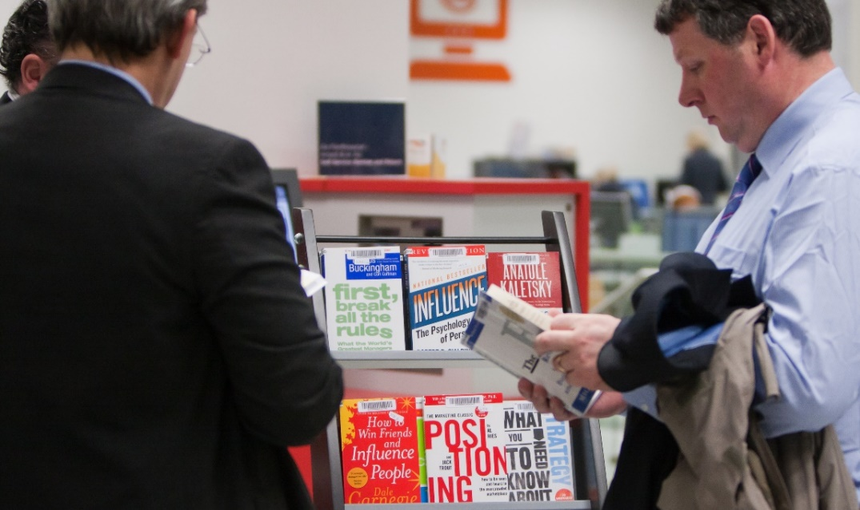
Objective 5: Information and Lifelong Learning
Full participation in the National Work matters in the Library programme, building on the working relationship with South Dublin LEO and other relevant agencies
Participate in the Healthy Ireland at your Library programme to inform the public about health issues and encourage them to make positive changes in their lives
Deliver Festivals, Exhibitions, Talks, Cultural Events and Readings reaching out to different audiences and meeting diverse needs

Slide 12
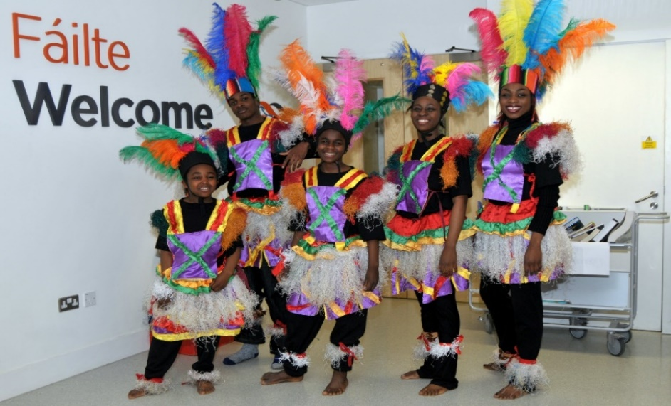

Objective 6: Community and Culture
Continue to expand and develop the Red Line Book Festival
Expand and develop the unique role of the library as an important Community Hub serving as a meeting place for community clubs and groups.
Support the delivery of the Creative Ireland Programme 2017-2022

Slide 13
Making It Possible

Slide 14
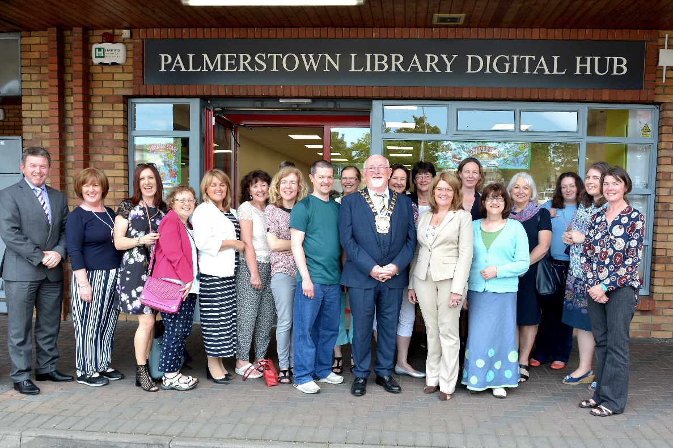
Staff Development
Endeavour to maintain a full complement of staff in line with the agreed Workforce Plan
Utilise the PDP process to enhance staff development
Provide Customer Care training in order to deliver a consistent, quality customer service

Slide 15
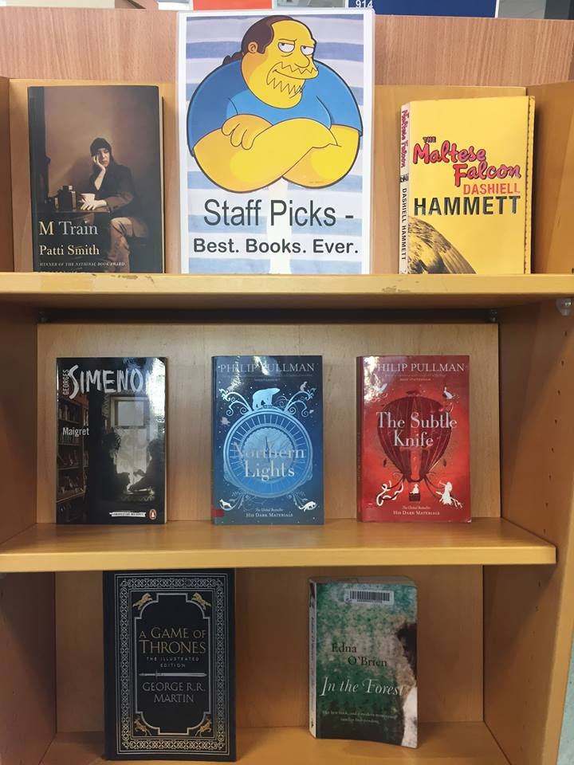
Collection Development
Maintain book stock; continue expansion into digital collections
Utilise Collection HQ data to make informed purchasing decisions
Continue to work within the National Framework for supply of book and non-book material

Slide 16

Budget
Regularly review capital budgets to ensure adequate funding provided to enable service delivery and complete identified capital projects
Pursue available funding programmes which will supplement delivery and promotion of our strategic goals
Adhere to procurement guidelines and frameworks

Slide 17
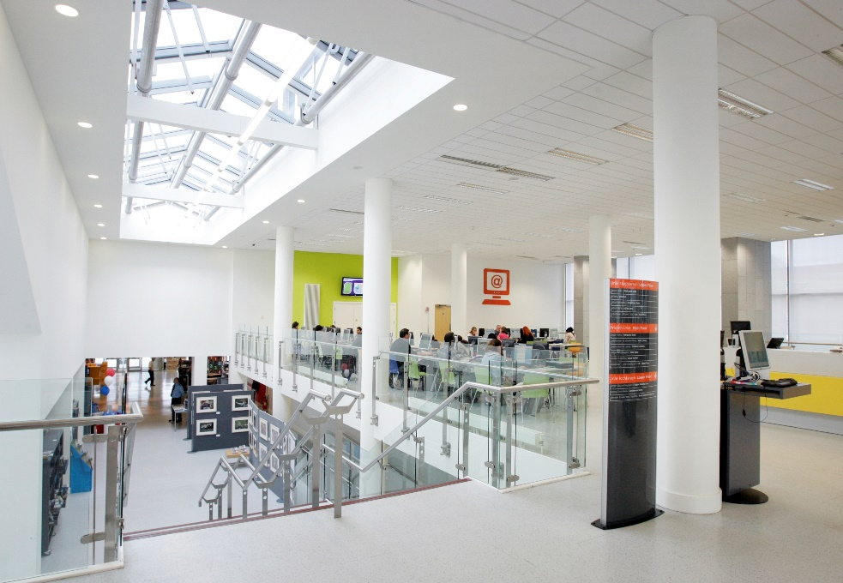
Capital Programmes
Completion of a purpose-built library at North Clondalkin, the first library for this community
Replacement of the leased library building at Castletymon with a new purpose-built library at a central location
Explore the possibility of regional service points in densely or fast-growing areas of population

Slide 18
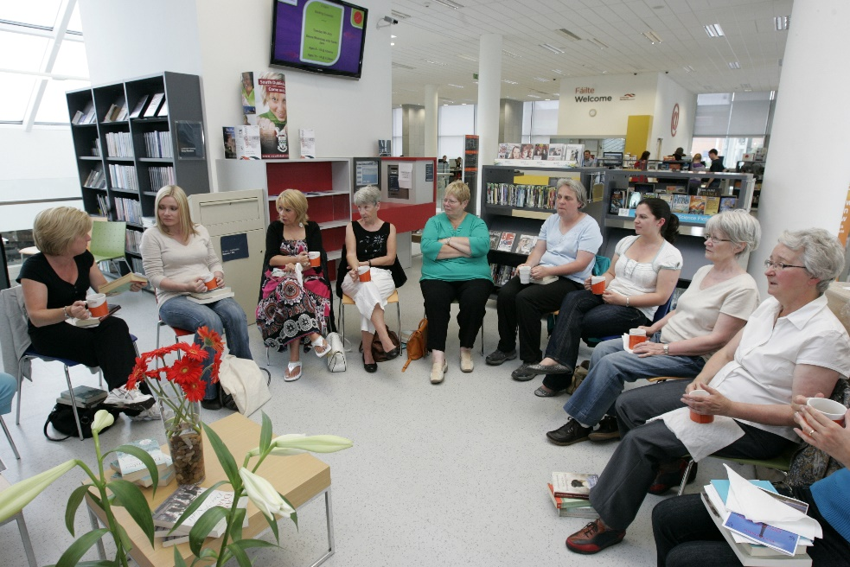
Analysis
Consult with individuals and groups to identify service needs
Establish a strategy for the collection and dissemination of qualitative and quantitative data to assess impact and relevance of both long-term and short-term strategic programmes

