Slide 1


Preliminary Report on the Teenage Study with
Draft Recommendations
May 2018

Slide 2
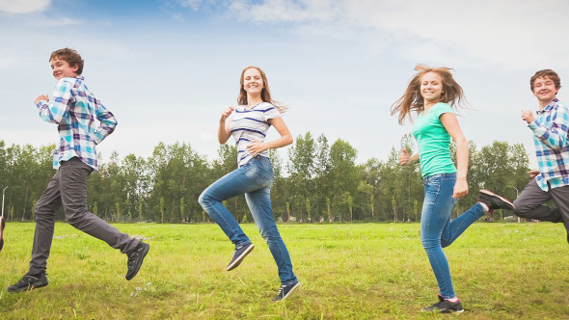
Background
During the roll out of the playspace programme, there were repeated requests for the provision of additional facilities for older children and teenagers.
Allied to this was the use of the new playspaces by teenagers which sometimes led to conflicts with other users.
Teenagers regularly expressed the view that they were being excluded from facilities which they believed that they should have access to.
In 2017 it was decided to carry out a study regarding the facilities for teenagers in parks and open spaces in South Dublin County; including the consideration of an increased provision of Youth Cafés where appropriate within parks and open space locations.
A survey was carried out to identify the current level of provision for teenagers, assess of needs and Identify opportunities for future provision of facilities and services

Slide 3


















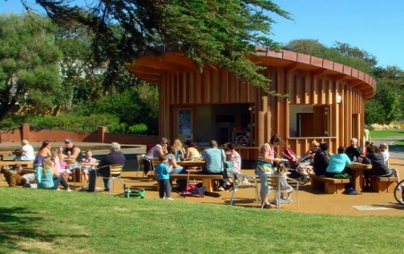


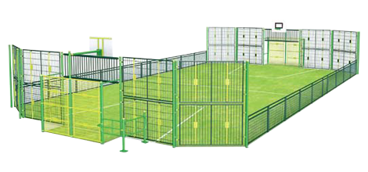


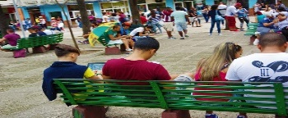
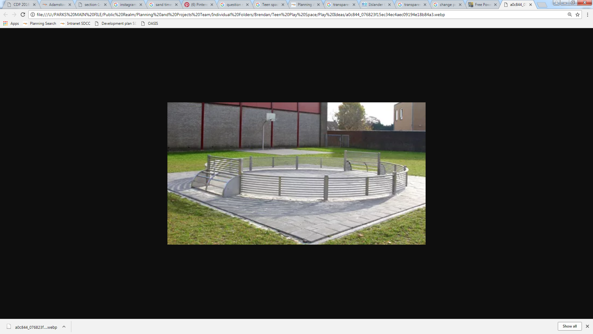
Teen Study Overview
The Main Questions Evaluates
Time Frame For Survey
Promoted Extensively Through
Respondents
10th Nov 2017 to 19th Jan2018
458
80% of whom were in the target age range of 9 to 18 years old
What facilities do teens need?
Existing Facilities
What do Teens Do?
Community Centres/ Youth Café
Reason For Not Using Public Facilities
How Teens Currently Spend Their Time
Park’s
Library's
Swimming Pools
Structured 44%
Unstructured 56%
68%
Of respondents visit parks daily
14%
Of respondents visit Community Centres or Youth Café’s daily
6%
Of respondents use a Library’s daily
5%
Of respondents use a swimming pool daily
Feeling unsafe/ unwelcomed
Fear of anti social activity
Facility being unsuitable
What facilities do Teenagers want?
Recommendations
Hangout Area
Research Conducted Highlights The Need for Teen Spaces
90%
Over 90% of teens want unstructured activities
60%
Over 60% of teens want a hang out area to socialise with their friends
30%
In total 30% of teens want a place for unstructured activities
APP
Many teens are unaware of existing facilities. An app could compile all relevant Information on facilities and services together in the correct format
Cafés
Cafes in parks would be particularly beneficial to teens and could be located to give passive security to play spaces or teen spaces.
Play Facilities
Seating
MUGA
Astro- Pitches
Shelter
Music
Skate Parks
Biking Facilities
Toilets
Free Wi-Fi
Basketball
Outdoor Fitness

Slide 4

Survey Finding
The survey shows that teenagers feel excluded from many public places. They report being unwelcome, feeling unsafe and being deterred by anti‐social activity.
Over 90% of respondents want areas for hanging out and unstructured physical activity
With only 5% asking for more sports facilities.
Hanging out is seen as a desirable activity in itself.
Providing more organised activities for teenagers is not what they want.
Research into provision of existing facilities for teenagers within the county has found that there are ample opportunities for teenagers to engage in sport
Teenagers are not fully aware of existing facilities that they could be availing of.

Slide 5
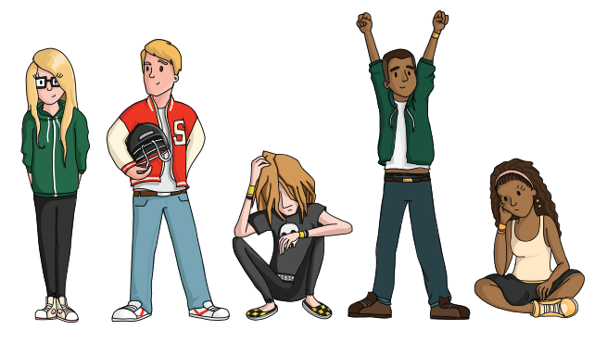

Based on the results of the survey
the following 4 recommendations are made:
Create a series of Outdoor Hangout/Meeting Places
2. Create areas for Outdoor Unstructured Physical Activity
3. Investigate means of providing Indoor Hangout / Meeting Places such as Unstructured Hangout Areas in Community Centres or Cafés in Parks.
4. Develop a Specific App or centralised digital information point to provide better information on Council facilities and Services to teenagers.

Slide 6


Recommendation 1.
Create a series of Outdoor Hangout/Meeting Places for teenagers.
places to sit and chat ; access to play facilities; free WIFI; a place to play music.
.
Example of stylish seating allowing teens to meet up and hangout in small or large groups. These spaces
are not only a a destination for passive recreation but can add vibrancy to an area.

Slide 7
Teenagers want to engage in play but are excluded from playgrounds. Some play items should be included at teen meeting points

Slide 8
Recommendation 2.
Provide Outdoor Areas for Unstructured Physical Activity.

Slide 9
Recommendation 3.
Provide Indoor Meeting Places/Hangouts for Teenagers:
Community Centres
Cafés in parks

Slide 10


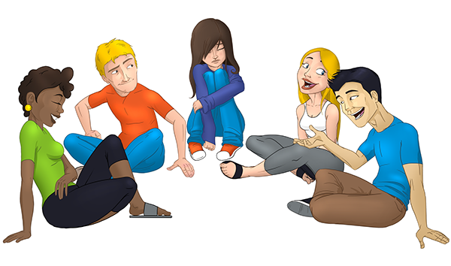
Recommendation 4.
Develop a Specific App or centralised digital information point to provide better information on Council facilities and Services to teenagers.

