Slide 1

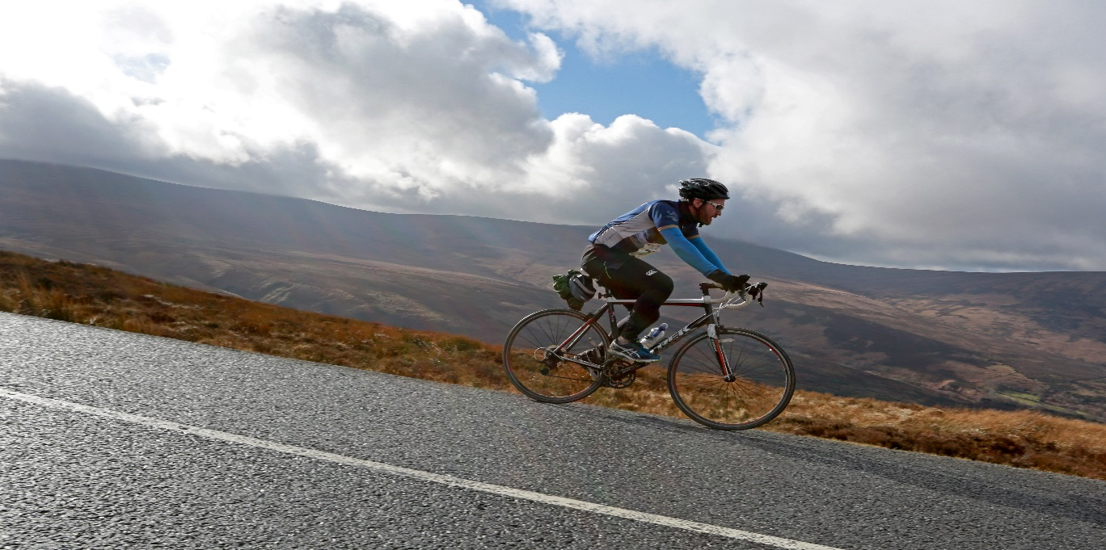
South Dublin Tourism Strategy
Economic, Enterprise
and Tourism Development SPC
9th May 2018

Slide 2
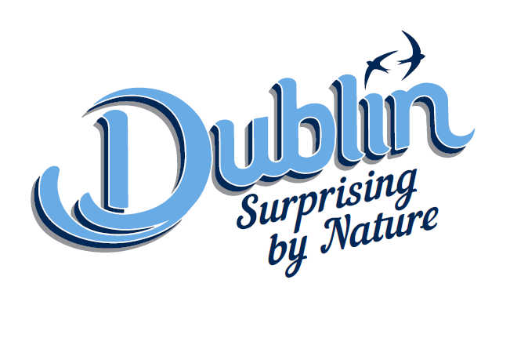
Failte Ireland – Dublin Tagline & Logo
Result of research to evaluate the strength & perception of brand
Need to reflect vibrant capital city alongside the natural outdoors
Roll-out to commence in July 2018

Slide 3

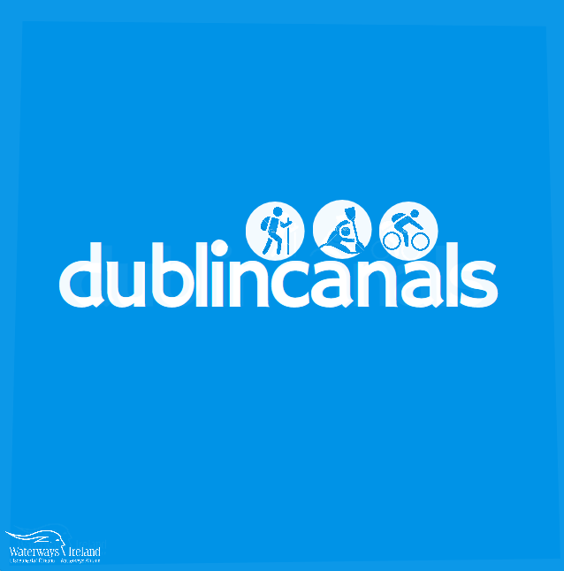
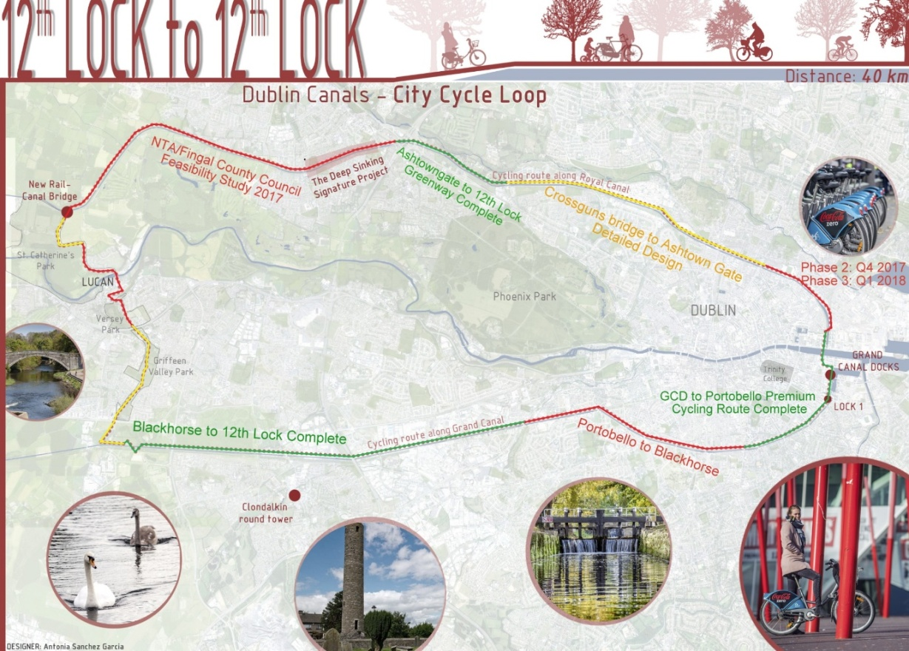
  Dublin Canal Greenway Project Feasibility Study- Lucan Village

Slide 4

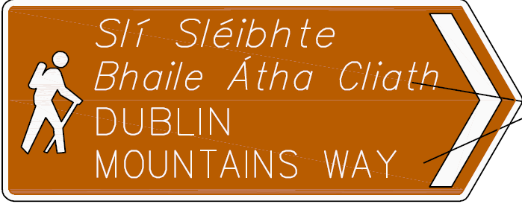
Dublin Mountains
Dublin Mountain Visitor Centre Update
Dublin Mountains Way- Update
ABP have requested bird survey of application area to be completed by the 30th September 2018 and date for Oral Hearing to be notified thereafter
New Wayfinding Signage and Route Markers have been installed in Tallaght

Slide 5
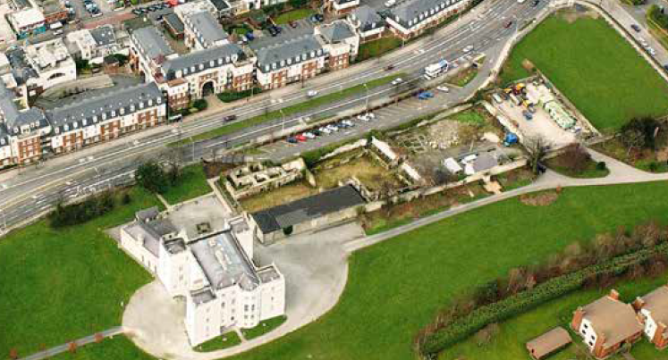
Rathfarnham Castle Stables
& Outbuildings
Conservation Works
Consultant Architect engaged and works have now commenced with estimated completion date in Autumn 2018
Expressions of Interest on Future Use
Research is being finalised to prepare requests for EOIs under a Competitive Dialogue process to explore use options, building design and cost/finance

Slide 6
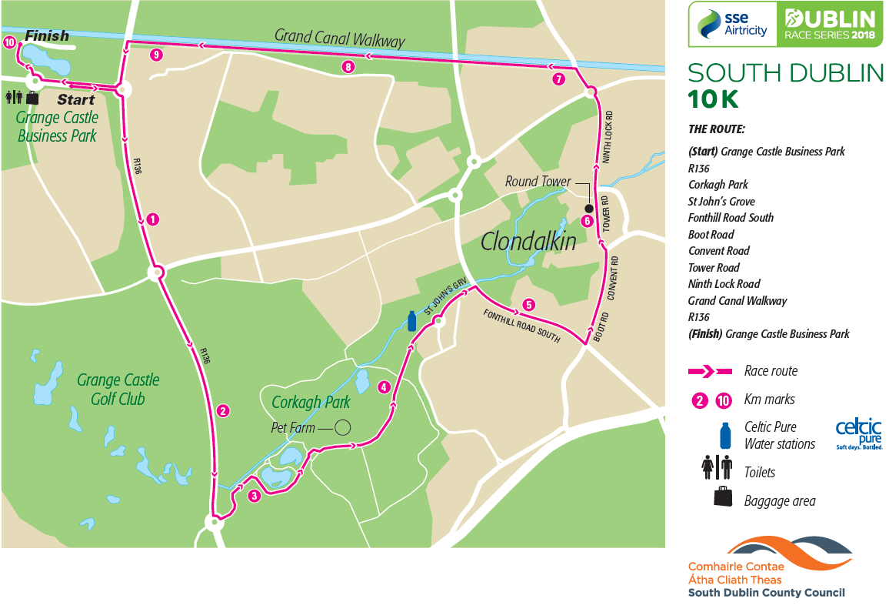
SOUTH Dublin 10K -Grange Castle Business Park
Sunday 22nd July at 10.35 am

Slide 7
Other Tourism Updates:
Pilot Event and Festival Grant Scheme 2018- Closed 3rd May
Dublin Bus and Luas Marketing Campaign for the Round Tower will commence in June 2018
Round Tower Centre will host 1 Year Anniversary event as part of the Clondalkin Village Festival
Dublin’s Outdoors Tourism E- zine to launch in June 2018
Series of Tourism Brochures to be published themes- Heritage, Family, Accessible and Activity Tourism
Opening Ceremony for Special Olympics Ireland will take place in Tallaght Stadium 14th June. The overall Games will involve 1600 athletes, 600 coaches and official delegates, 2500 volunteers and 5000 family members.
Tender for Tallaght Heritage Interpretation Signage to issue May 2018.

