Slide 1
Establishment of
Climate Action Regional Offices (CARO)

Slide 2
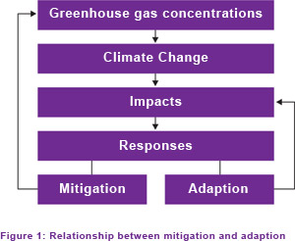
Strategies to address climate change:
Mitigation aims to reduce mans impact on climate change
Adaptation aims to reduce the negative impacts of climate change or to take advantage of emerging opportunities

Slide 3
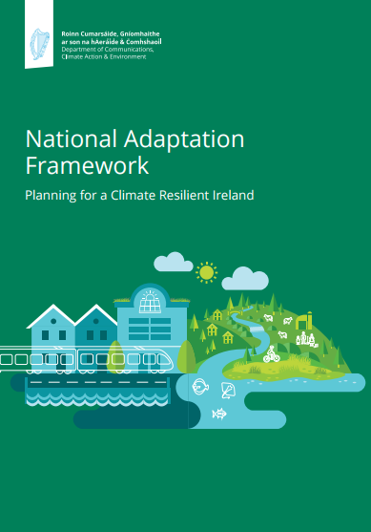
Climate Action and Low Carbon Development Act 2015
Legislative background
Transition to
Low-carbon
Climate-resilient
Environmentally sustainable
economy by 2050
Basis for:
National Mitigation Plan
National Adaptation Framework

Slide 4
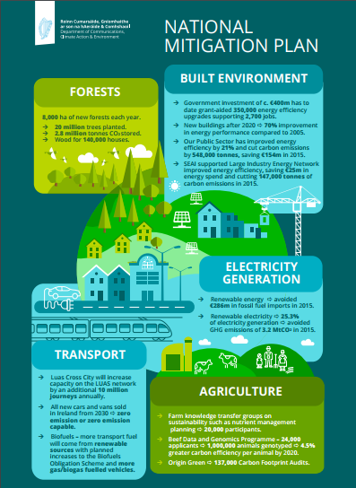
National Mitigation Plan, July 2017
Policy to manage GHG emissions:
Electricity generation
Built environment
Transport
Agriculture & forestry
National and International targets
106 actions,
Local Authorities Lead one: ‘Establish regional climate action offices to coordinate Local Authority response ……’

Slide 5
National Adaptation Framework January 2018
Policy for strategic adaptation response to climate change
12 Actions identified, among them:
Each local authority to make and adopt local adaptation strategies based on a regional governance approach to adaptation planning
Advance proposals to establish regional climate action offices to coordinate Local Authority response to climate change

Slide 6
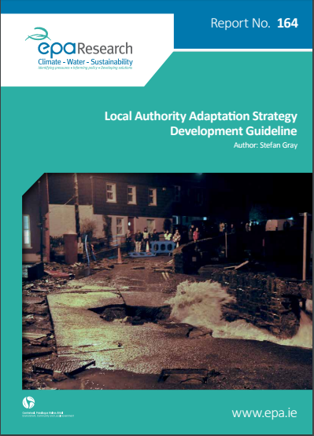
3. Identifying and prioritising adaptation options
4. Developing an adaptation pathway map
5. Monitoring and reviewing the adaptation strategy
2. Assessing future climate risk
1. Assessing the current baseline
Local Adaptation Strategies – resources available
EPA Guidelines published 2016
5 - step process

Slide 7
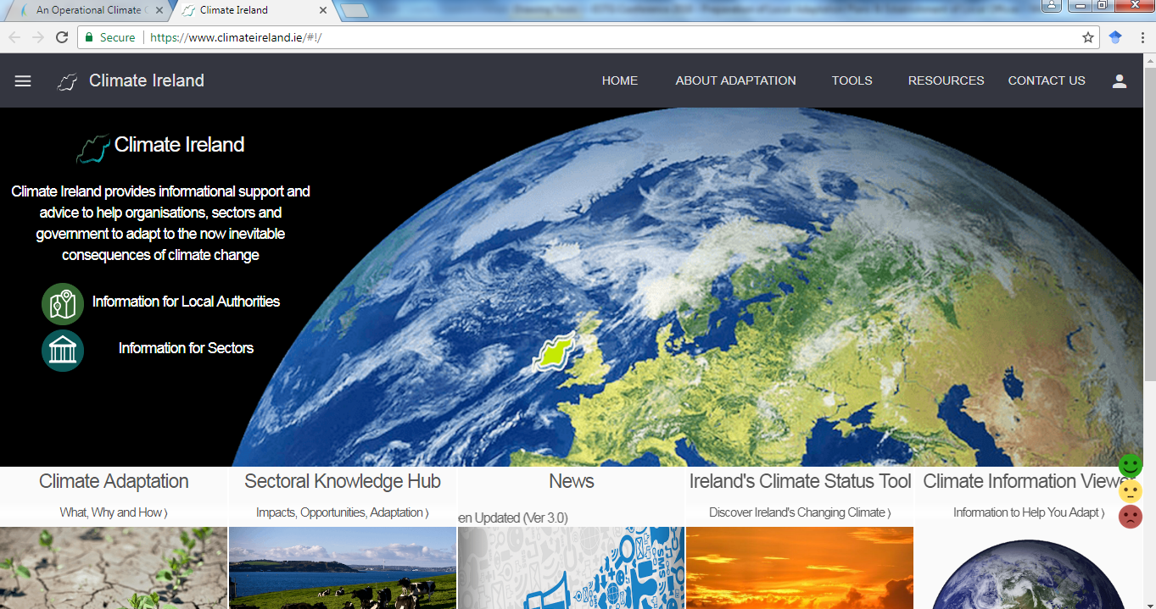
Local Adaptation Strategies – resources available
Climate Ireland portal - Developed by MarEI / UCC to provide a source of climate change information and its impacts on Ireland.
Tools for global and national climate data and projections
Information on climate adaptation policy
Case studies

Slide 8
Need for Shared Service
Coordinated National Approach for development of Climate Change Plans
Reporting and Governance at Regional, National and International levels.
Facilitate Community attitudinal and behavioural change
Foster interagency collaboration and support
Address identified weaknesses in the sector
Advance mitigation and adaptation in regions with common risks.

Slide 9
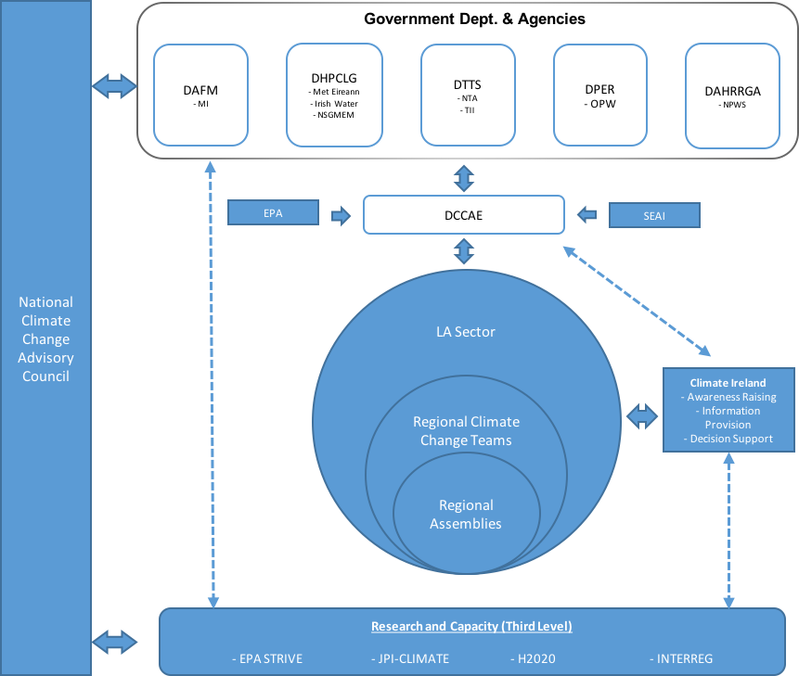
Climate Change: Role of Local Authorities

Slide 10
Regional Climate Action Offices Business Case
4 geographical/topographical regions, based on climate risk

Slide 11
Regional Climate Action Offices
Dublin Metropolitan
Dublin City Council
Dún Laoghaire-Rathdown
Fingal County Council
South Dublin County Council
Atlantic Seaboard North
Mayo County Council
Atlantic Seaboard South
Cork County Council
Eastern & Midlands
Kildare County Council

Slide 12
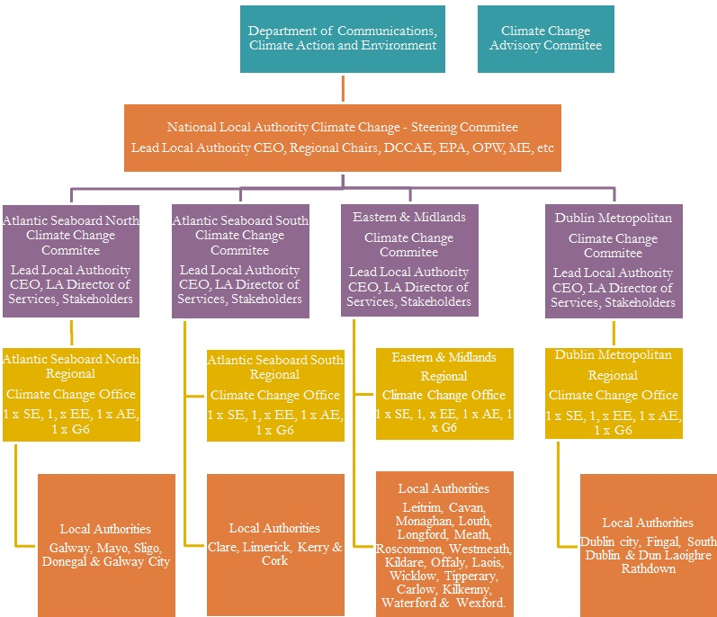
Regional Climate Action Offices
January 2018, €10 million in funding over 5 years announced for Regional offices
Service Level Agreements with DCCAE.
Governance structure being put in place

Slide 13
Climate Action Regional Offices - Next steps
Staff recruitment - Staff of 4 reporting to DoS Environment
Initial tasks of CAROs –
‘Formulation of Regional Adaptation Plan Templates
Advising local authorities on the formulation and implementation of individual Local Plans’
Regional climate action training to LA staff by MaREI In May/June 2018
Awareness at Senior Management Level
Establishment of Baseline Information in Local Authorities
Managing Adaptation and resourcing for the future
Asset Management
Environment, Roads, Housing, Water Services, Community Development, Economic Development........

