Slide 2
Festival that takes place in Lucan and the surrounding areas
Initiated in 2008
60 events over 4 days
Three strands to the festival: Schools Performance and Workshops Library events Park events
Audience and Participants
Estimated Audience 2017: 7000 approx (over 4 days)
Estimated Participants 2017: Adult Performers 62….Junior Participants 450 approx

Slide 3
Ruaille Buaille is produced by South Dublin County Council Arts and Library Services
Programme Director and Festival Co-ordinator: Artscope, Lucan
Festival Objectives:
To enable access for children to music performances in school, library and community venues.
To provide masterclasses and performance opportunities for young musicians and singers in the county in collaboration with professional artists and ensembles.
To commission new music and new arrangements of existing music for performance on the Main Stage of Ruaille Buaille in the Park.
To develop festival partnerships and in doing so provide access to excellence in music performance and quality listening experiences.

Slide 4
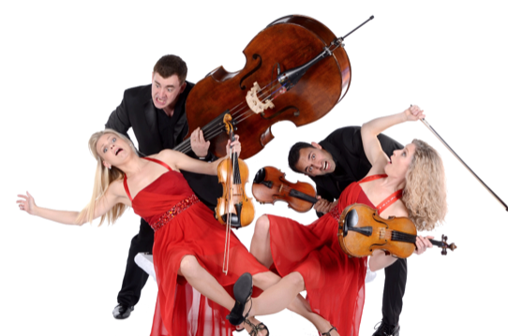
Programme Highlights:
Graffitti Classics string quartet
Quiet Tree a music show for children produced by Thomas Johnson
The Whistleberries Band with arrangements of original music for children
Whistle in the Wind a music trail for the park in association with
the National Concert Hall
Tea-Time Concert with Kila on the Friday evening to mark the opening of events in the park
Music Generation Trad Ensemble
Lucan Gospel Choir Big Sing joined by choirs from Scoil Mhuire and Scoil Aine Naofa
Big Stage Marquee, Early Years Tent, Percussion and Trad Stage, Library and Storytelling Corner as part of the activities in the park

Slide 5
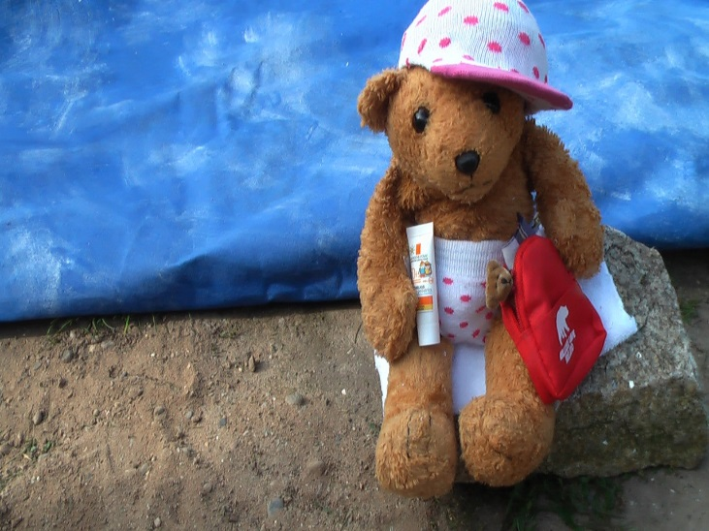
Wed 6 June: Concert Trad for Folk – For under 7s: Cormac Breatnach (whistle), Brian Fleming (drums) & Eamon Sweeney ((guitar/lute) – Irish Music with a story: where the tunes came from and who listened to them including Granuaile, Queen Elizabeth, Henry VIII.
Show: The Rain Forest 10–10.45: Under 3s. 11–11.45: 3–5yr olds
Eamon Sweeney (musician):– Rain, water, birds...enchantment
Thurs 7th June:
Show: Bear Goes to the Beach
“It’s a perfect day for the beach! Must get organised and pack everything we’ll need… how will we get to the beach? What will we do when we get there?”
10–10.45: Under 3s. 11–11.45: 3–5yr olds
Eamon Sweeney (musician): and Niamh Lawlor (Púca Puppets):
8th June:
Show: The Sound Bath – A special musical experience for parent and baby – gongs, rain sticks, chimes, song... 10–10.30: Under 1s 10.45–11.15: Under 1s 11.30–12: Under 1s
Eamon Sweeney (musician)
Ruaille Buaille Library Events will open for bookings on Monday May 21
www.ruaillebuaille.ie

Slide 6
“Is this what Electric Picnic is like?”
“I want to be a singer”
“ It was magic in the tent”
“ I didn’t recognise the park”
“I wish Ruaille Buaille was on everyday”
“It was great to see famous people play”
“ My school was the best!”

