Slide 1
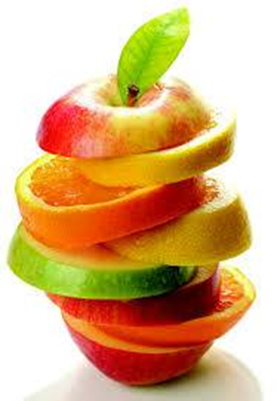

Healthy Ireland at Your Library
Arts, Culture, Gaeilge, Heritage & Libraries SPC
May 2nd 2018

Slide 2
Healthy Ireland at Your Library
Healthy Ireland is a National Initiative which took place from November 2017 – April 2018
Funded by the Government (An Pobal) through the LGMA
Topics
Healthy Childhood
Healthy Eating and Active Living
Wellbeing and Mental Health
Positive Ageing
Alcohol
Tobacco
€220 for every branch library in the country for HI events.
Notes:
Healthy Ireland at your Library - This project ran from November 2017 to end of April 2018. During this time South Dublin Libraries were involved in the national champagne to encourage Irish citizens to lead a healthier lifestyle by providing a range of resources, services and support to users and communities.

Slide 3
Healthy Ireland at Your Library
The Library Service provided a range of resources, services and support to users and communities through out the country, including:
• Book Stock
• Online Resources
• Health Information Service
• Branding and Promotion
• Programmes and Events
• Staff Training
Notes:
• Book stock - A comprehensive collection of books on health and wellbeing will be available in all public libraries
• Online resources - New e-books, e-audiobooks and e-magazines will be accessible in every library and by remote access
• Health information service - Trained staff will be able to provide information guidance and direction to users with health and wellbeing queries and promote health awareness in the community
• Branding and Promotion - Promotional materials, banners and bookmarks, and online promotion through the Libraries Ireland website and social media
• Programmes and events - Talks, discussions and workshops with a focus on physical health, mental health and health literacy
• Staff training - The LGMA provided training sessions to build the knowledge and skills of library staff to respond confidently to requests and provide direction to relevant health resources

Slide 4
Healthy Ireland at Your Library
Networking / Partnerships
Council Departments
Social Inclusion Unit
Community Dept.
South Dublin Community Sports Partnership
Arts Department
Library Groups
Agencies and Support groups
Irish Heart foundation - Blood pressure check clinic - Mini Heart check
Jigsaw Tallaght - Mental health information
          - Read your Mind Collection of books
Notes:
Council Departments
Social Inclusion Unit
Community Dept.
South Dublin Community Sports Partnership
Community Walks
Park Run 9.30pm every Saturday morning all year round
Arts Department
In Context 4 - Rock to the top
Christmas event - Unwrapped – walk from IT Tallaght to the Library Square
Library Groups
Book clubs
Hobby groups
Agencies and Support groups
Irish Heart foundation - Blood pressure check clinic - Mini Heart check
Jigsaw Tallaght - Mental health information
- Read your Mind Collection of books

Slide 5

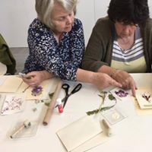
Healthy Ireland at Your Library
South Dublin Libraries programmed 30 events (16 were funded by An Pobal).
Healthy Lifestyle
Healthy Talks
Growing Good for All
Meditation & Mandala
Nutrition Wellness Talk
Growing Veg in the Urban Garden
Declutter your Home
Life Well Lived (Jim Lucey)
Caring for the Carers
Declutter Your Home
Nutrition Wellness Talk
Coping with a Child's Diagnosis -ASD, ADHD
Cop On: What it is and Why Your Child Needs it (Colman Noctor)

Slide 6
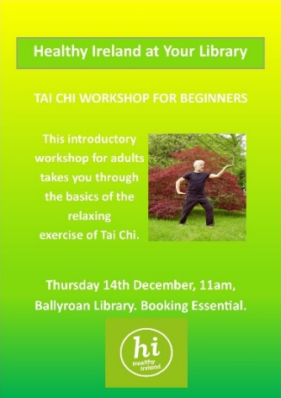
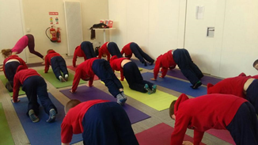
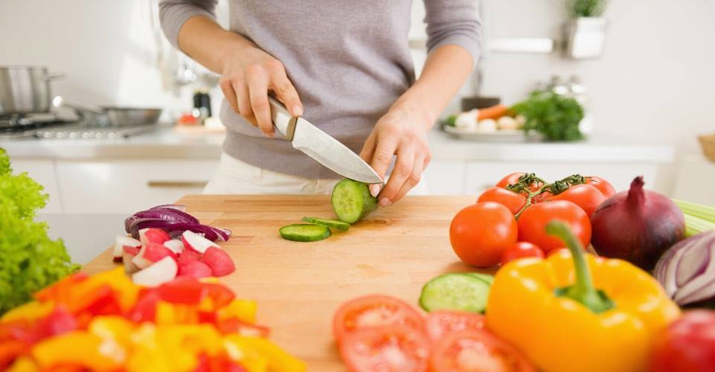
Healthy Ireland at Your Library
Over 800 people attended these events.
Healthy Children
Healthy Eating
The Cool Food School
Tai Chi for Kids
Positive Psychology Teens
Eating for a healthy Heart County Library
Healthy Eating with Healthy Living
Whole Food talk

Slide 7
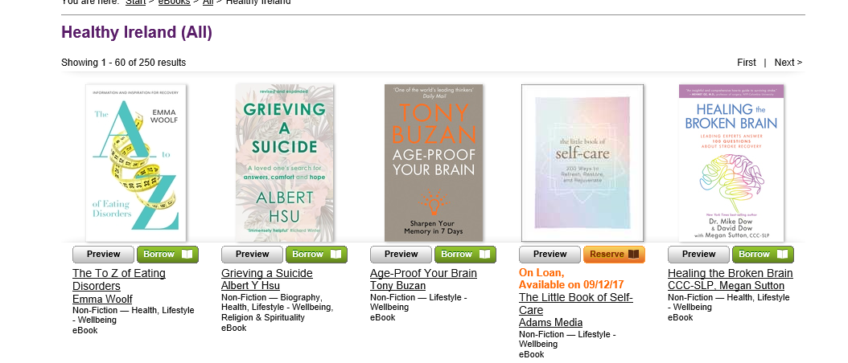
Healthy Ireland at Your Library
A comprehensive collection of books on health and wellbeing, advised by the Dept. of Health and the LGMA, was purchased and made available in each of our branch libraries.
Online resources were supplemented with new recommended e-books , e-audiobooks and e-magazines which are accessible in the libraries and by remote access.

Slide 8
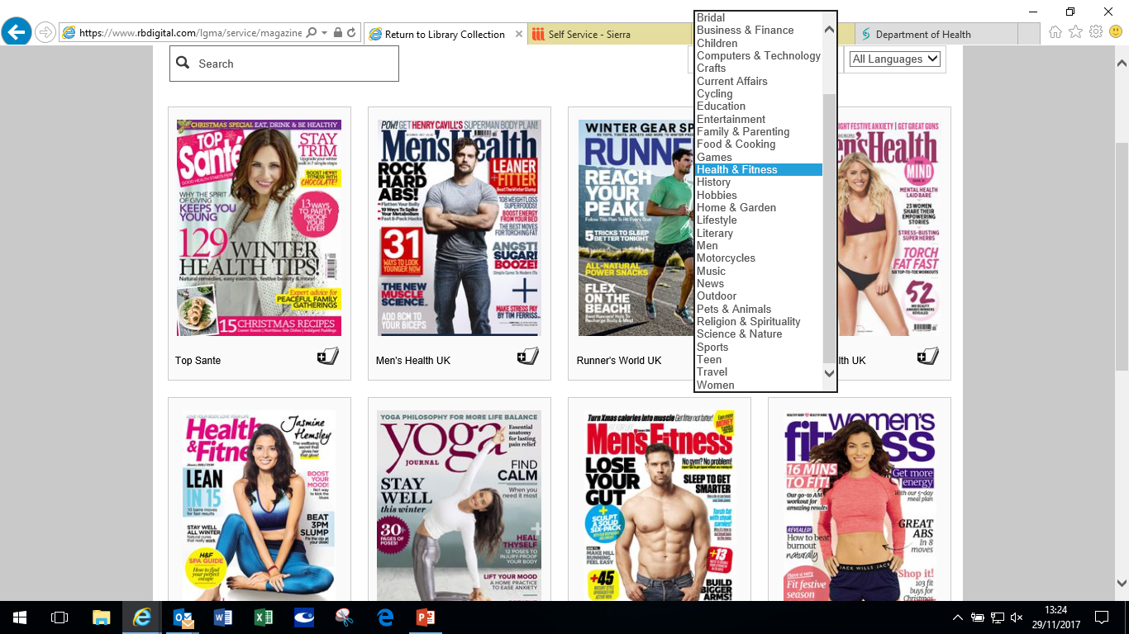
Healthy Ireland at Your Library
e-magazines are accessible in the libraries and by remote access.

Slide 9
Healthy Ireland at Your Library
Phase One
National Media promotion campaign started mid-December 2017 (Radio Ad)
Local promotion on our website and social media.
Promotional material - banners, posters, flyers and bookmarks were made available.
Staff received training in providing quality guidance on reputable library stock and websites to help people with health awareness queries.
South Dublin Libraries met all the given milestones, reporting deadlines and qualified for available grants.
Phase Two
LGMA is presently in discussions with An Pobal and hopefully the second phase of Healthy Ireland at your Library will commence in the coming months.

Slide 10
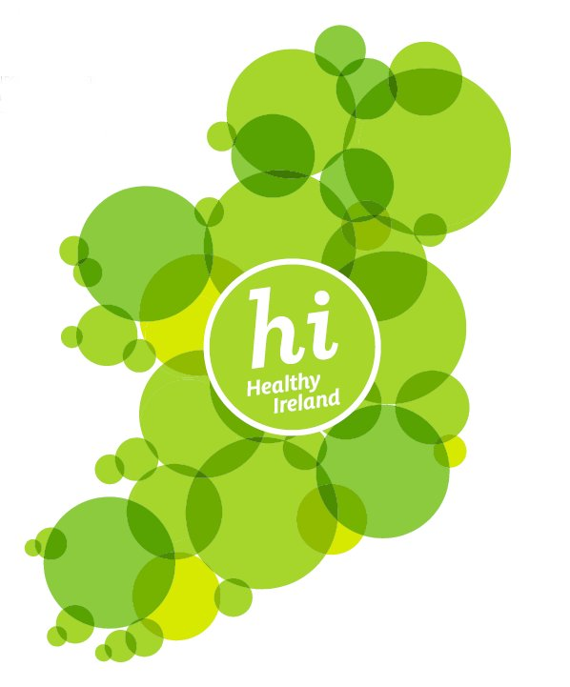
Healthy Ireland at Your Library
Check-out the Healthy Ireland section on the
Librariesireland.ie website

