Slide 1
Liffey Valley Cluster South Dublin Tourism Strategy
Liffey Valley Area Options
Feasibility Study

Slide 2
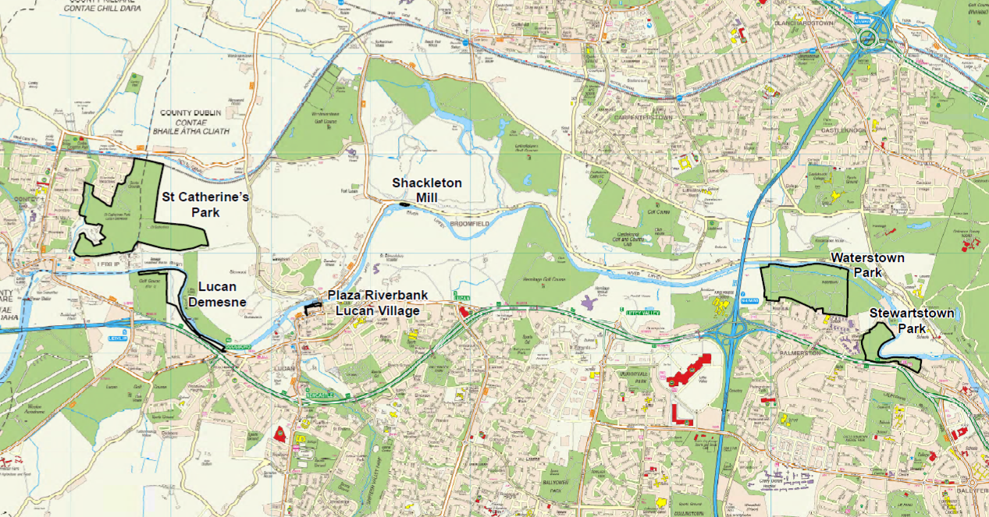

Slide 3
Main Themes of Study
Connecting Places & People
Active People
Education & Special Interest
Community Events

Slide 4
Connecting Places and People
Initial Actions | Implementation
Strategic Canal Linkage | Waterways Ireland / SDCC / FCC
Feasibility study on Shackleton Mills | FCC
Active Family Play Facilities in Waterstown & St. Catherine’s Parks | SDCC / FCC
Feasibility Study Silver/Guinness Bridge | FCC co – funded by SDCC
Wayfinding, Signage for Lucan/Palmerstown and Development of Food Offering in Lucan | SDCC
Branding: “Liffey Valley Way” | SDCC/FCC

Slide 5
Connecting Places and People
Potential Opportunities:
Feasibility Study of Liffey Crossings at:
Waterstown, Palmerstown or St Catherine’s Park
Develop Mill Race
Examine Access/Egress Options:
Wren’s Nest Weir/Sluice Weir/ Waterstown Park
River access route at Hermitage( and Parking)
Explore suitable locations for bunk house
Investigate Greenway potential on south side of River Liffey

Slide 6
Connecting Places & People: Initial Priorities | Phase 1 (Yrs 1-2) € | Phase 2 (Yrs 3-4) € | Phase 3 (Yrs 5-6) €
Strategic Canal Linkage | tbc | tbc
Waterstown/St. Catherine‘s Play Facilities | €248k
Feasibility Study Shackleton Mill | €25k
Report on Guinness / Silver Bridge | €25k
Wayfinding Signage | €40K | €40K

Slide 7
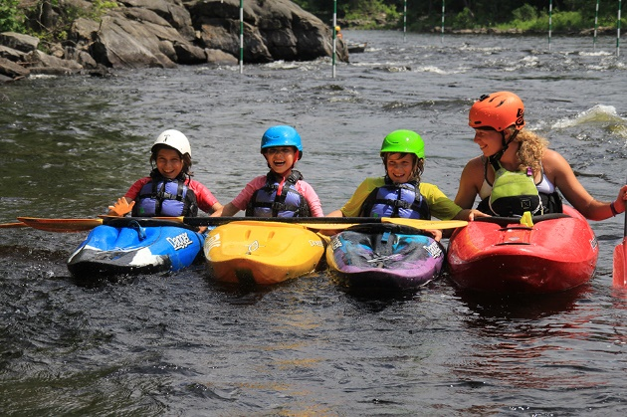
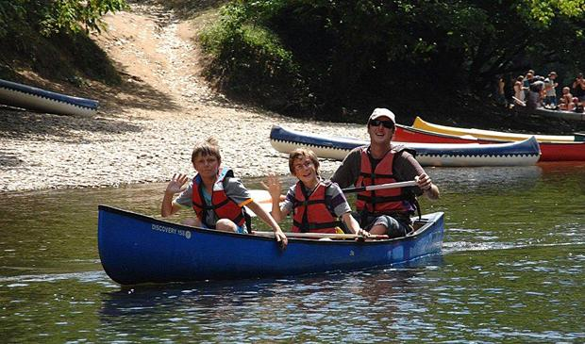
Active People
Activities aimed at families, individuals & groups to increase health and wellbeing.
Introductory on-water activities through network of clubs, agencies, businesses;
Adventure race events & walking groups /programmes.
Park Run / Operation Transformation.
Examples of family friendly water-based activities that could be available at ‘Waterstown River Park’

Slide 8
Education and Special Interest
Programmes & activities using rivers/parks as natural ‘classroom’
‘Something Fishy’ educational programme / Dublin Angling initiative / River Liffey Clean Up Days
Green Schools Programme / Area Conservation Group
Nature/Wildlife photography & Backwoods Cooking and Bush Craft courses
Community Events
Support & develop festivals/events
Develop River Liffey Valley Festival event
Support for local community & activity events

Slide 9
Summary/Estimate Costings
Theme | Cost
Connecting Places & People | 2,600,000
Active People | 180,000
Education and Special Interest | 165,000
Community and Complementing Project work | 120,000

Slide 10
South Dublin - Next Steps…
Presentation by Waterways Ireland on Grand/Royal Canal Loop at Lucan ACM - 24th April focusing on Lucan on the Liffey.
Assess Potential Opportunities Projects- Canal Loop Development will inform future plans
Identify Funding
Detailed Implementation Plan
Develop Brand and Marketing Strategy

