Slide 1


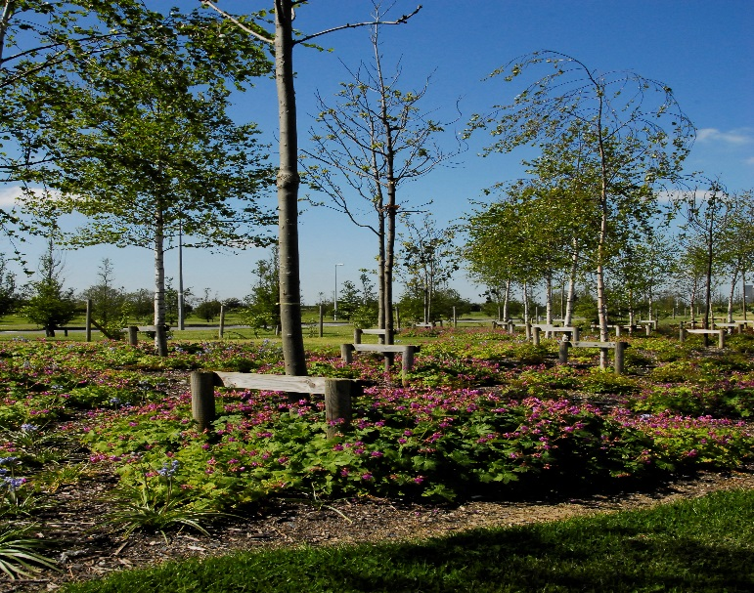
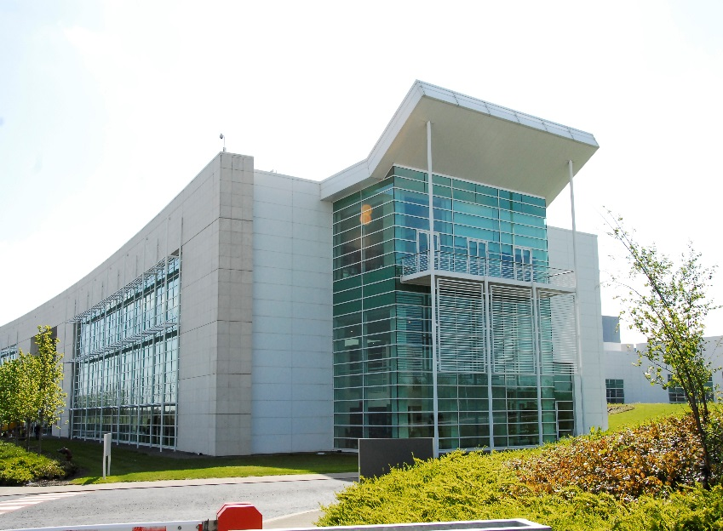

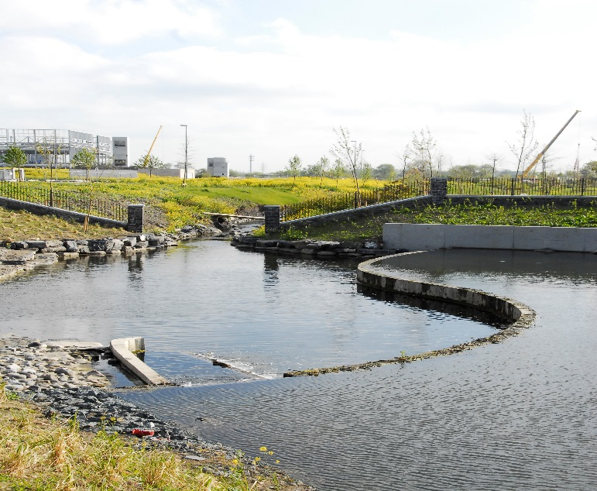
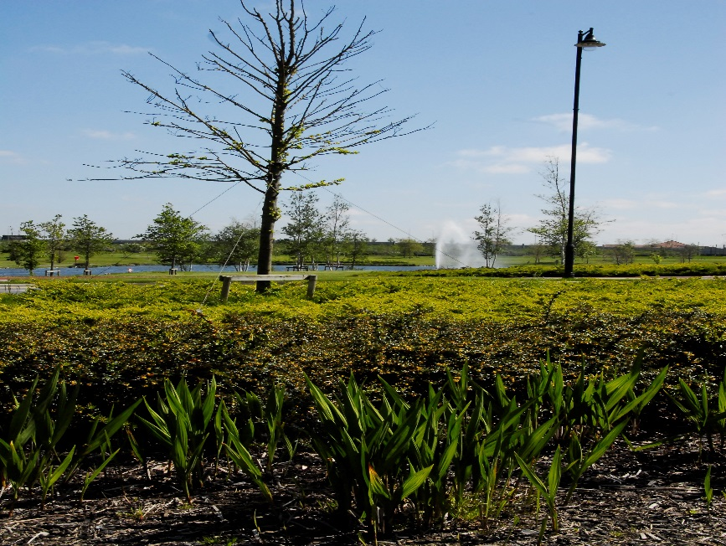
Grange Castle Business Park
SPC Update 15/02/18

Slide 2
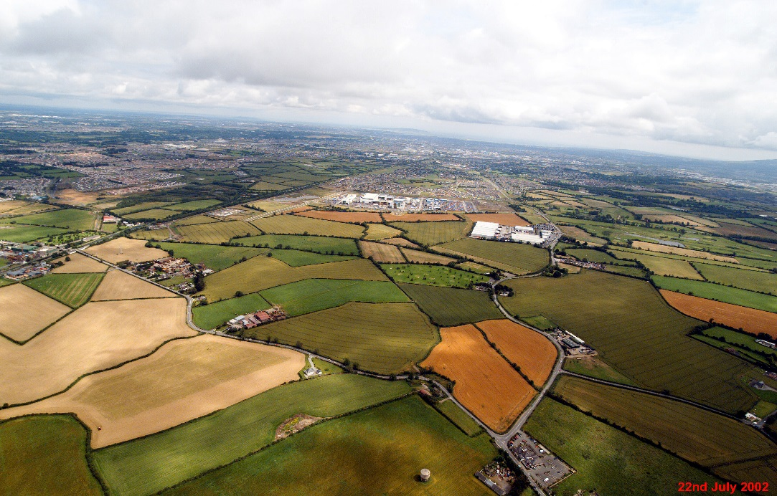
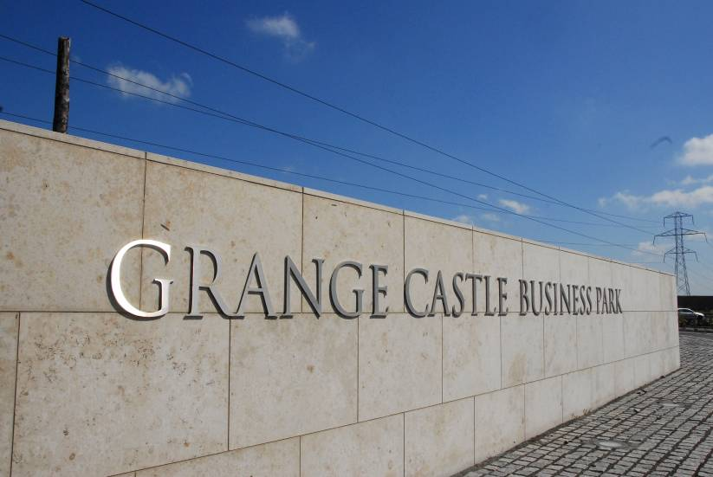
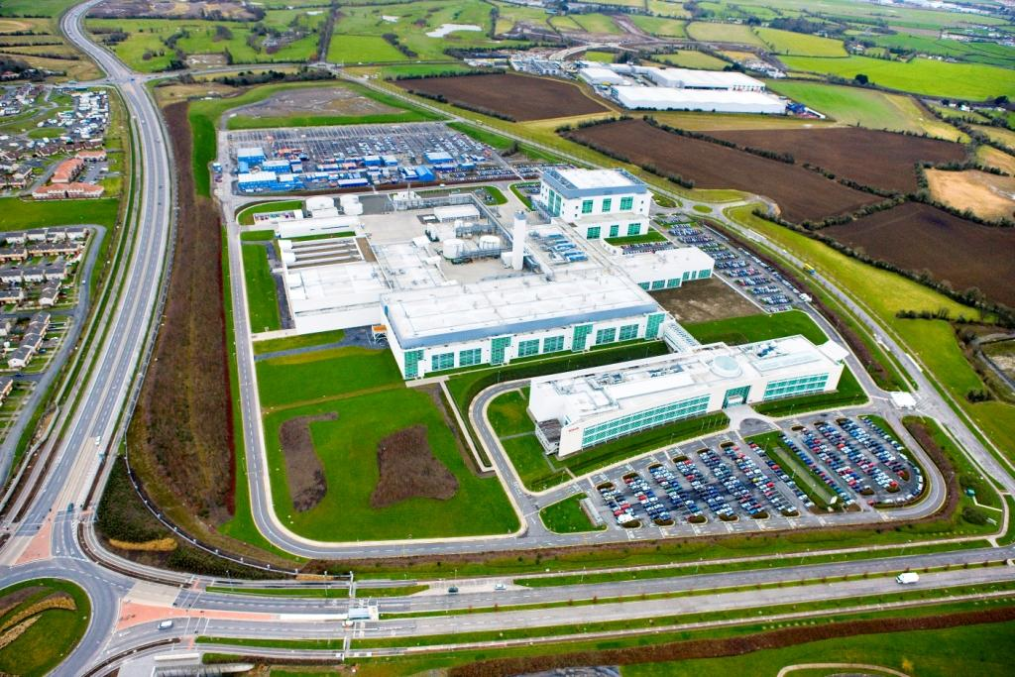
GRANGE CASTLE
Business Park - History
South Dublin County Council formed 1994
Identification of strategic business location
Zoning of land for industrial development
Expansion of land-bank: 200 to 475 acres
Griffeen River Scheme, utilities investment
Construction started: 2000, first tenants,2002
Outer Ring Road: 2006
Grange Castle Facilities Mgmt Ltd
Current tenants: Pfizer, Microsoft, Takeda,
Aryzta Grifols. Under construction: Microsoft,
, Google.

Slide 3
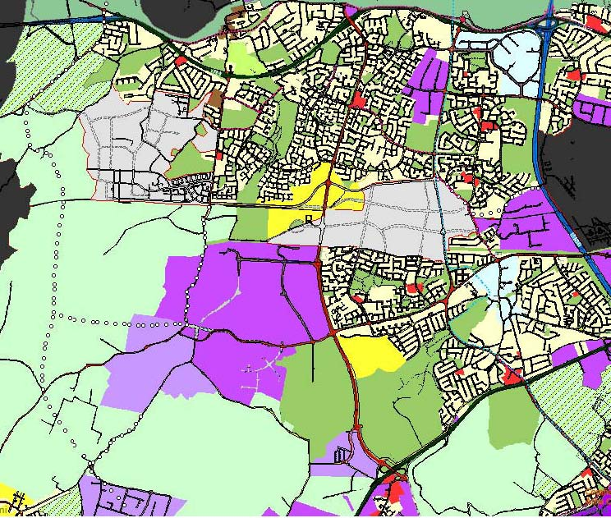
CONNECTED THINKING…
DEVELOPMENT PLAN ZONINGS
PLAY
LIVE
WORK
LIVE
PLAY

Slide 4
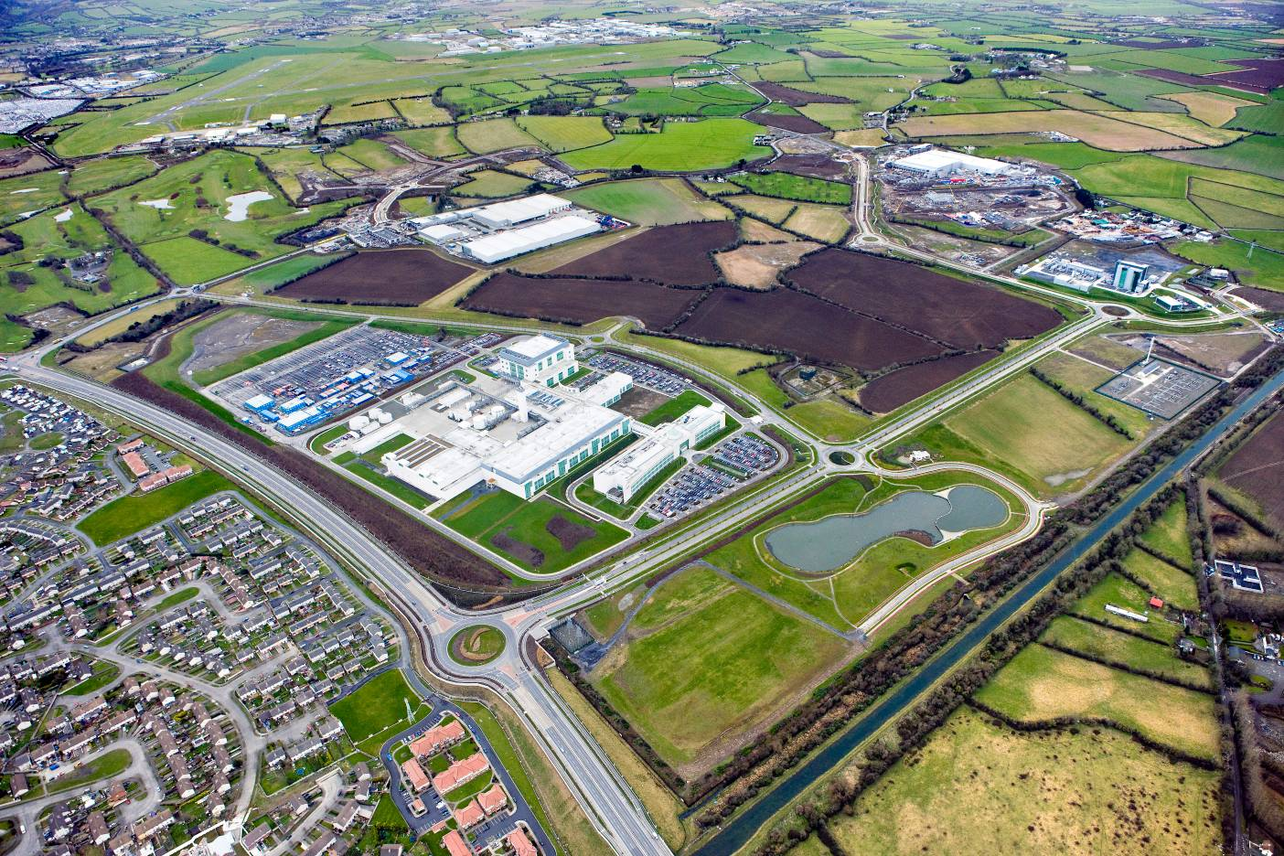












C
C
C
C
C
B
B
B
B
D
B
D
B
B
B
B
B
B
B
A
A
A
A
A
A
A

Slide 5
Clients Development Plans within current footprint:
(Only two sites of significant project scale remaining)
Pfizer – Relatively small upgrades ongoing.
Microsoft - Currently constructing Dub 6, 7 and 8 plus DSF (Dub 11). Plans in place for 3 more data halls – to reach site capacity.
Interxion – Opened in 2016. Small site but has good short / medium term expansion capacity.
Takeda – Currently building two new production plants. Further capacity available for one more facility.
Grifols – Currently building new production plant. Limited capacity remaining.
Google – have acquired a 50 acre campus joining Grange Castle South / Profile Park. Good Capacity
CyrusOne – At contract stage – good capacity short to medium term
Edgeconnex – Currently developing third data hall adjoining GCBP – limited capacity.

Slide 6
SDCC led development (high level of investment)
Recent developments 2015 – 2018 include
  strategic acquisitions: (Ballybane Pitch and Putt), Lands to West of R120
  roads and services (Interxion access, Central Carriageway and Google Access)
R120 / Nangor Road Improvement Scheme
  Works commenced Q4 2017
Upgrades to internal park infrastructure, such as footpaths, cycleroutes, pumps stations, ducting etc.
Grange Castle South Archaeological Works
Western Lands Feasibility and Infrastuctural Plan

Slide 7
Service providers
Utility enhancement: Eirgrid West Dublin 220KV station – works on 220kV substation (Commenced September 2017) . Works on 220kV ducting is associated with Nangor road / R120 road improvement scheme (Commenced Q4 2017). Works on 110kV ESB infrastructure (ongoing)
Fibre – Improvements and extensions to fibre network (ongoing). Various Fibre Carriers
Water Services / Irish Water. Improvements to infrastructure and to Peamount Reservoir
Waterways Ireland. Grand Canal Greenway improvements and connectivity
Gas Networks Ireland. System Improvements

Slide 8

PROPOSED RE-ZONING
Insert Page Heading Here
Insert Sub-Heading here
• Insert Bullet Point 1 here
• Insert Bullet Point 2 here
• Insert Bullet Point 3 here
• Insert Bullet Point 4 here

Slide 9
INFRASTRUCTURAL PLAN LAYOUT

Slide 10
Variation to County Development Plan
Proposed Variation No. 1 South Dublin County Council County Development Plan 2016-2022
Council Meeting 12/02/18
Economic Development, Enterprise and Toursim SPC 14/02/18
Land Use Planning and Transportation SPC 15/02/18
The proposed variation has been prepared in accordance with Section 13(2) of the Planning and Development Act 2000 (as amended). The proposed variation is accompanied by a Strategic Environmental Assessment (SEA) Report and Determination and an Appropriate Assessment Screening Report and Determination.
Public Display: The Proposed Variation No. 1 of the South Dublin County Council County Development Plan
2016-2022 along with accompanying environmental reports is being placed on public display and may be inspected from Friday 16th February 2018 to Friday 16th March 2018 (both dates inclusive) during normal opening hours at County Hall Tallaght, the Civic Offices Clondalkin and in County Library, Tallaght and all Local Branch Libraries during normal opening hours for each library (excluding Bank Holidays).
The documents may also be viewed on South Dublin County Council’s website at www.sdcc.ie
Making a submission: Written submissions or observations with respect to this proposed variation can be made in writing to the address below no later than 4.00pm 16th March 2018 (12.00 midnight if made online).

Slide 11
Rationale
The proposed variation is part of the review of the zoning of lands required under
Policy ET3 SLO1 of the South Dublin County Development Plan which seeks to
conduct a review of the zoning of lands to the south of the Grand Canal with a view
to preparing a long term plan for the expansion of the Grange Castle Economic and
Enterprise Zone to the area.
The existing ‘EE’ employment zoned lands within South Dublin County are well established and do not have sufficient sized parcels of land which could accommodate significant FDI projects of scale.
Subject to the adoption of the proposed variation, the intention is to replicate and build upon the success of the existing world class location at Grange Castle which will
provide a strategic land bank for South Dublin County Council which will be
developed sustainably over an extended period by both indigenous and foreign firms.
Capitalise on investment to date in developing world class services, such as power, fibre, water services, road network, and permeability to the area

Slide 12
CONTACTS
Stephen Deegan
P: 353 (0)1 414 9000
E: sdeegan@sdublincoco.ie
http://www.grangecastle.ie/
Dept. of Economic, Enterprise and Tourism Development
County Hall, Tallaght, Dublin 24.
E: econdev@sdublincoco.ie
P: 353 (0)1 414 9000
F: 353 (0)1 414 9104

