Slide 1

Progress to Date on the Dublin Local Authority Climate Change Action Plans
South Dublin County Council Environment, Public Realm and Climate Change SPC
06/02/2018

Slide 2
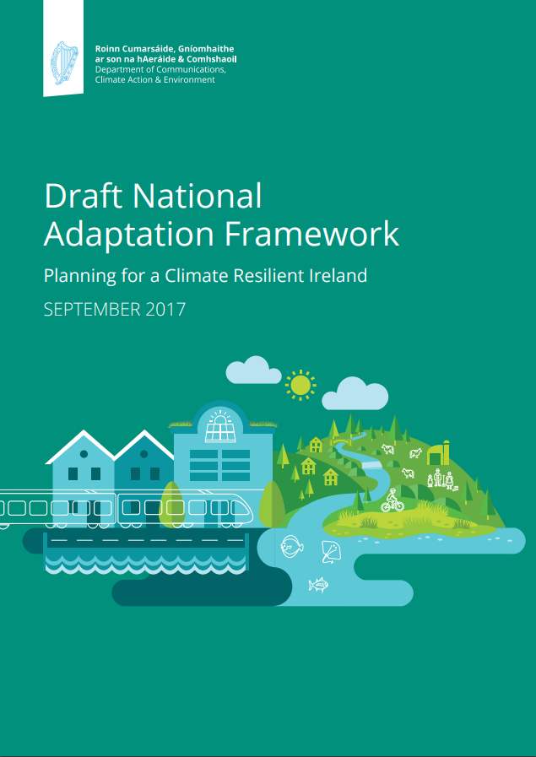

EU
Climate & Energy Framework
Related Directives
National
National Adaptation Framework
Regional
Regional Planning Guidelines
Local Authority
Corporate Strategy
National Mitigation Plan
National Planning Framework
Development Plan
LECP
Climate Action Plans
International
COP21
Kyoto
Sustainable Development Goals
Regional Spatial and Economic Strategies
Climate Action and Low Carbon Development Act 2015

Slide 3
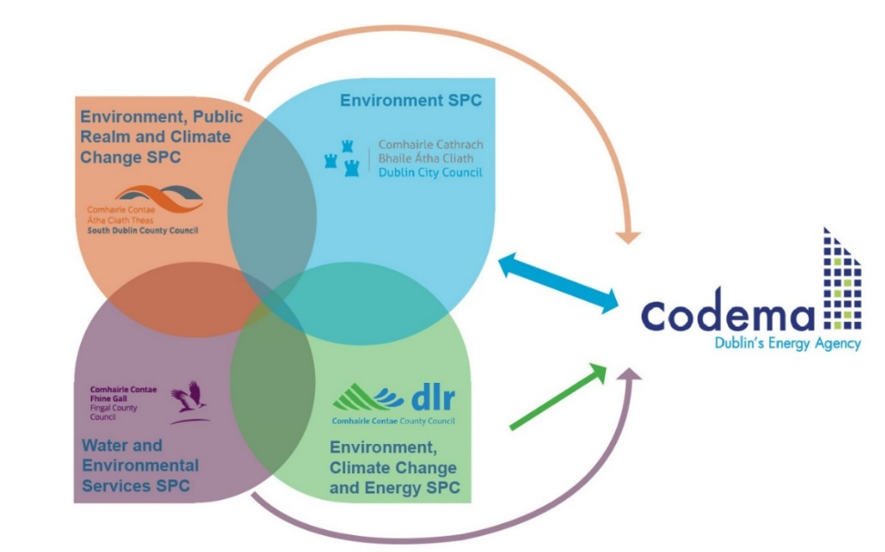
Led by Directors of Services
Technical Teams within each LA
Codema facilitation and PM
Approval through Environmental SPCs

Slide 4

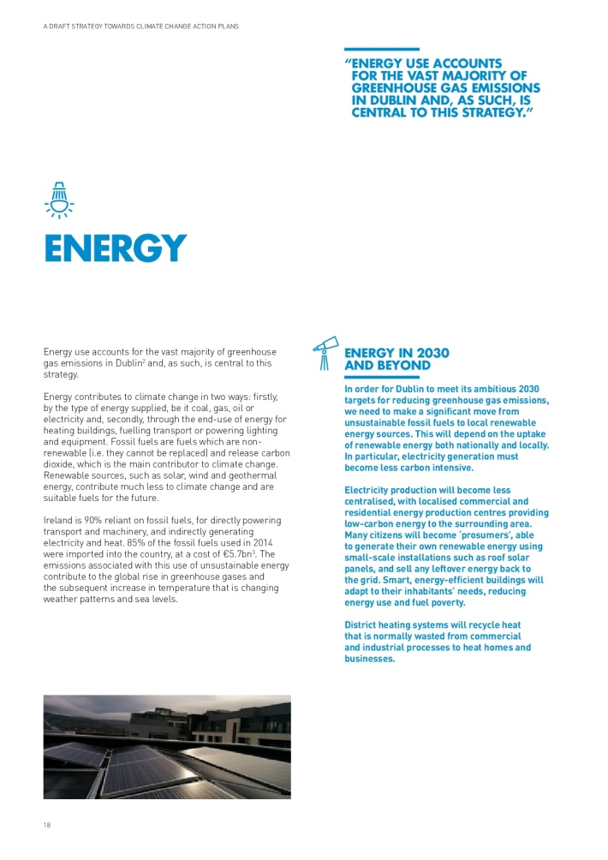
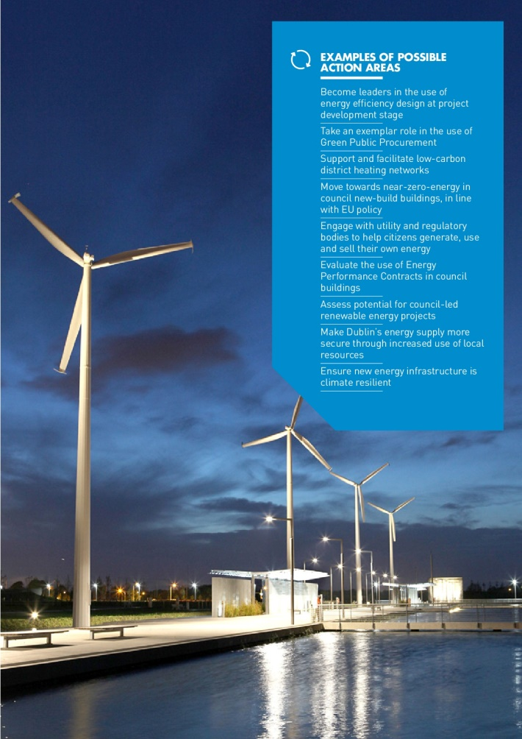

Slide 5
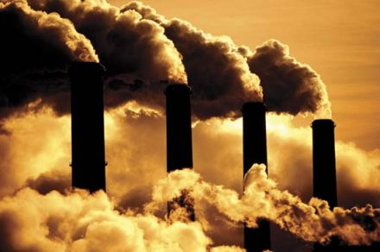
Baseline Emissions
Municipal
Social Housing
Residential
Transport
Commercial
Agriculture
Waste & Waste Water

Slide 6
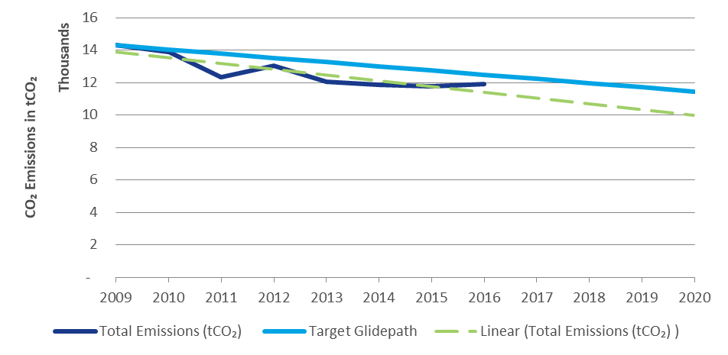
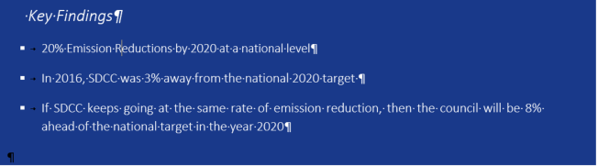
16% RE – 20% (33%) EE – 20% CO2

Slide 7
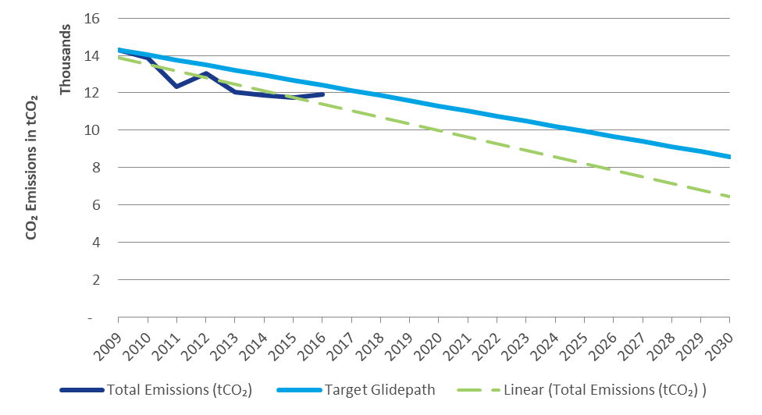
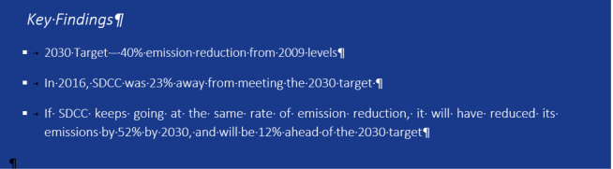
30% (EU) – 20.4% - CoM 40%

Slide 8
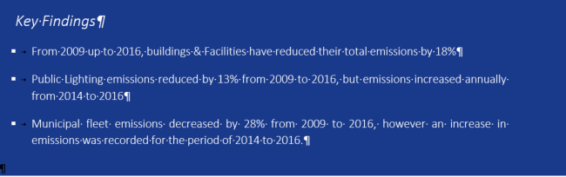

Slide 9
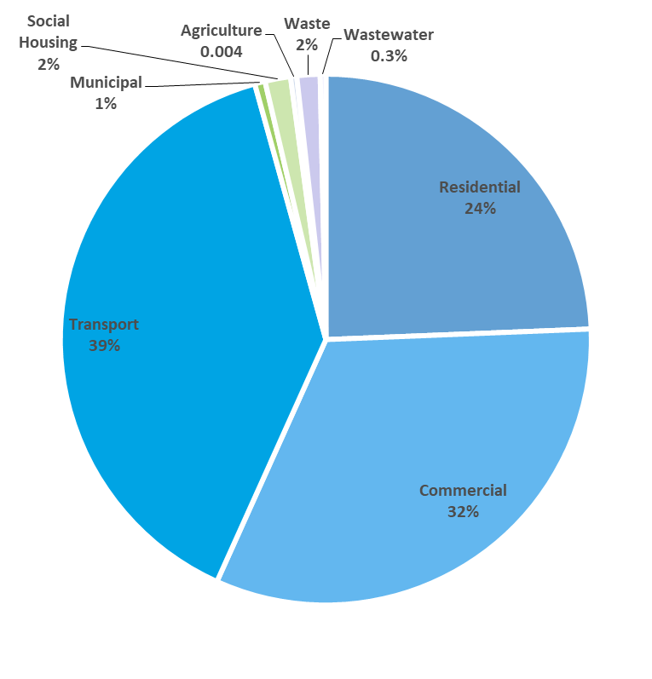
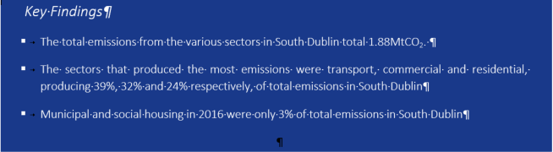

Slide 10
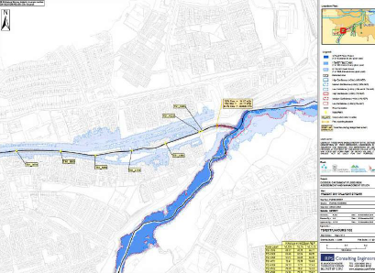
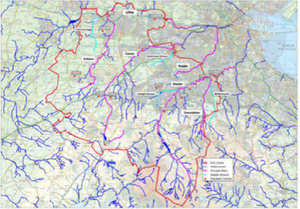
Adaptation Baseline

Slide 11


Plan Development Process
Milestone 1 - Initiate
Identify climate change impacts & risks
Develop Strategy for CAPs
Milestone 2 - Research
Collect baseline data
Meetings with staff
Workshops
Identify goal & targets
Milestone 3 - Plan
Develop actions & indicators
Develop monitoring & reporting system
Milestone 4 - Implementation
Local Authority - Climate Change Team
Milestone 5 - Monitor and Iterate
Local Authority - Climate Change Team
Notes:
Where we are at

Slide 12
Workshop Objectives:
  Bring all staff from all four local authorities together
  To facilitate:
      Collaboration
      Networking
      Relationship building
      Ownership
      Innovation

Slide 13
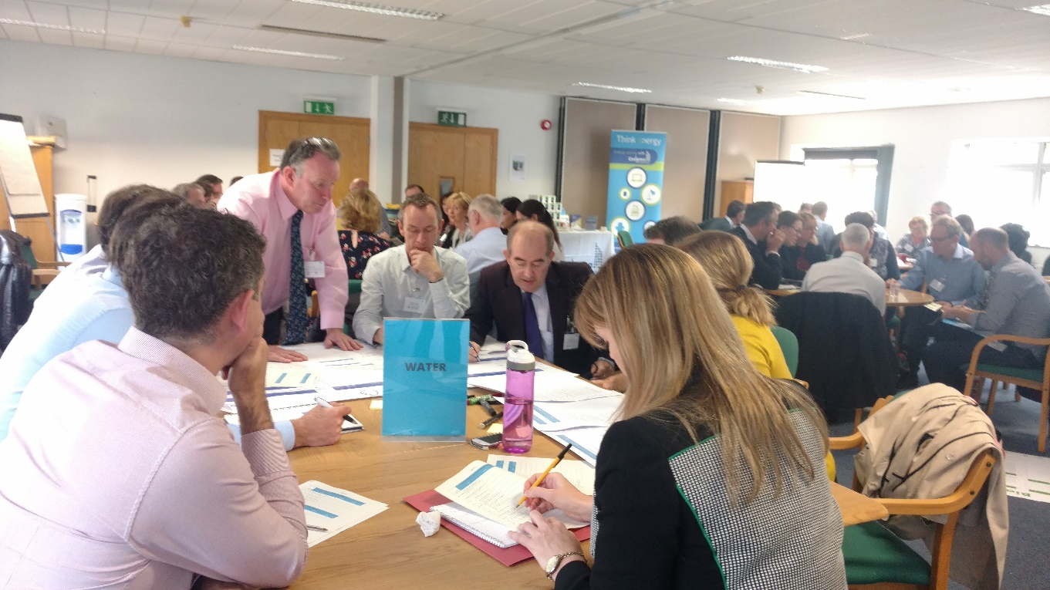
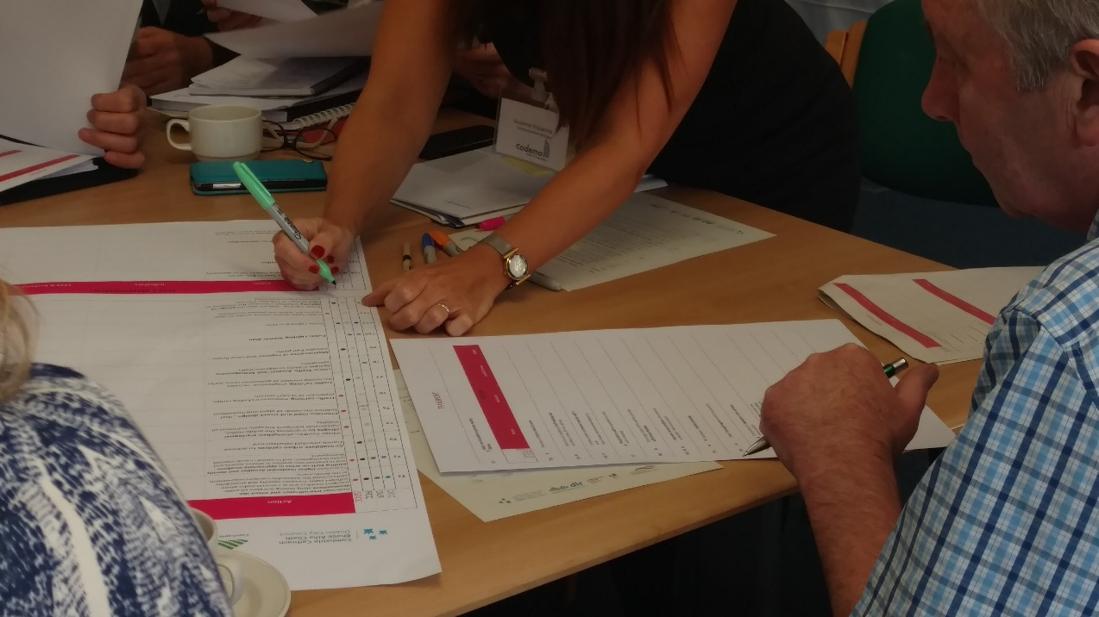

Slide 14
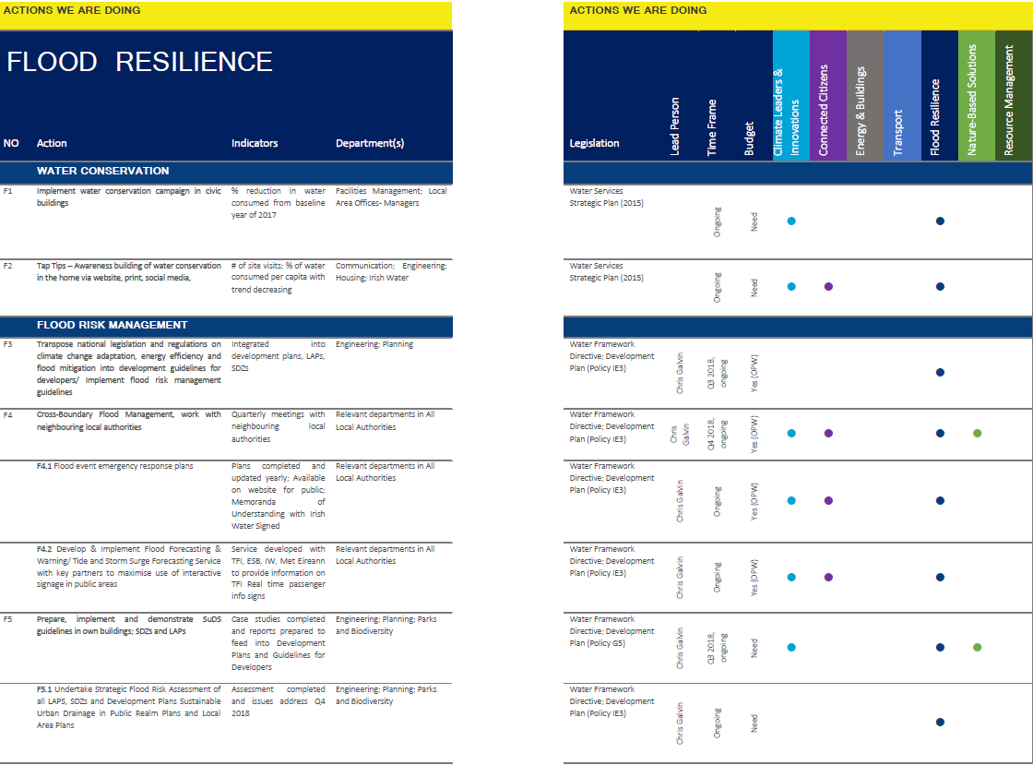

Slide 15
Introduction/ Exec Summary
Chapter 2 – Building Resilience
Chapter 4 – Where do we want to go?
Chapter 1 – Action on Climate Change
Chapter 3 – Current &Future Risks
Chapter 5 – How we are going to get there

Slide 16
  Next Steps:
  Peer review in progress
  Public engagements strategy
  Impact of actions calculated
  Final design
  6 Week public engagement
  Submissions reviewed and incorporated
  Final sign off

Slide 17
Contact
Declan Mc Cormac
017079818
dec.mccormac@codema.ie

