Slide 1
Red Line Book Festival 2017

Slide 2
Events took place in 13 venues around the County
Civic Theatre
RUA RED
Chocolate Warehouse, Walkinstown
Pearse Museum, St Enda’s Park, Rathfarnham
Rathfarnham Castle
Cherrytree Pub Theatre
Clondalkin Round Tower Centre
Court of Petty Session, Rathcoole
Coach House, Palmerstown ( Stewarts Library event)
Libraries (Ballyroan, Clondalkin, Lucan, Tallaght)

Slide 3
Festival Events Attendance
To date we have received initial data reports form
Milestone Inventive, the events management company and a report from
Vanessa Fox O’Loughlin, the literary strand curator
Total sales & bookings - 3,019
Comparison with 2016 - 9% increase on last year
Over a third of visitors planned to attend multiple events
Percentage total available tickets sold & booked = 77% of capacity.

Slide 4
Audience Profile and Feedback (of those who answered survey)
The peak booking time was less than 2 weeks out.
Predominantly female (72%) older than 45 years
Local audience from all over South Dublin and neighbouring counties.
The average group size was 3 people
84% rated their experience of the festival as 'excellent‘
13.5% rated as 'Good' (no one selected the options 'poor' or 'very poor‘)
98.2% said they would recommend The Red Line Book Festival to a friend.

Slide 5
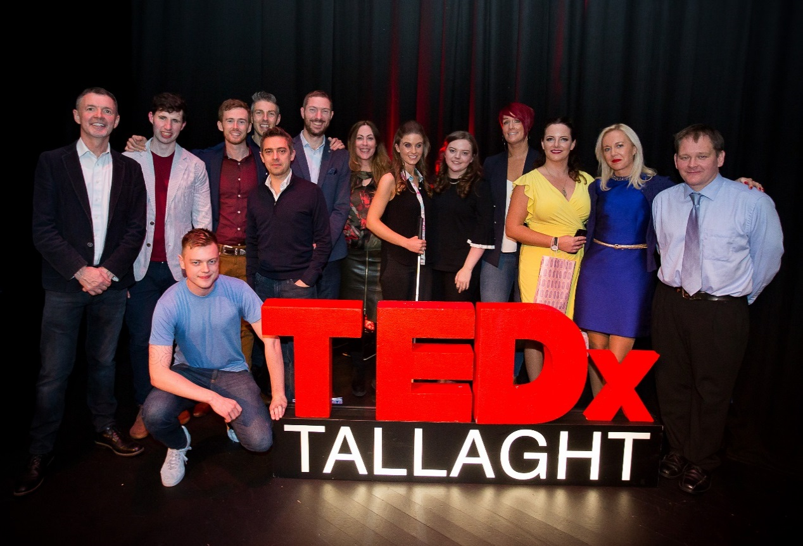
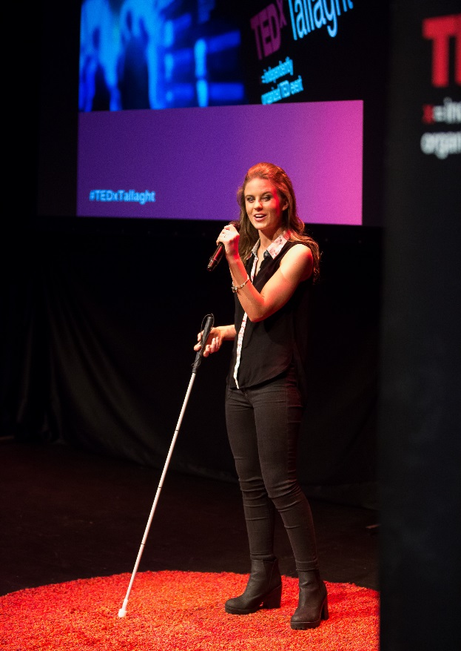
TedX Tallaght - Thursday 12th October
13 inspired speakers shared their thought-provoking ideas and stories on The Propagation of Ideas to a full house in the Civic Theatre.
MC: Bobbie Hickey

Slide 6
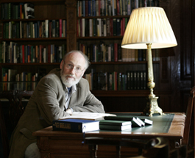
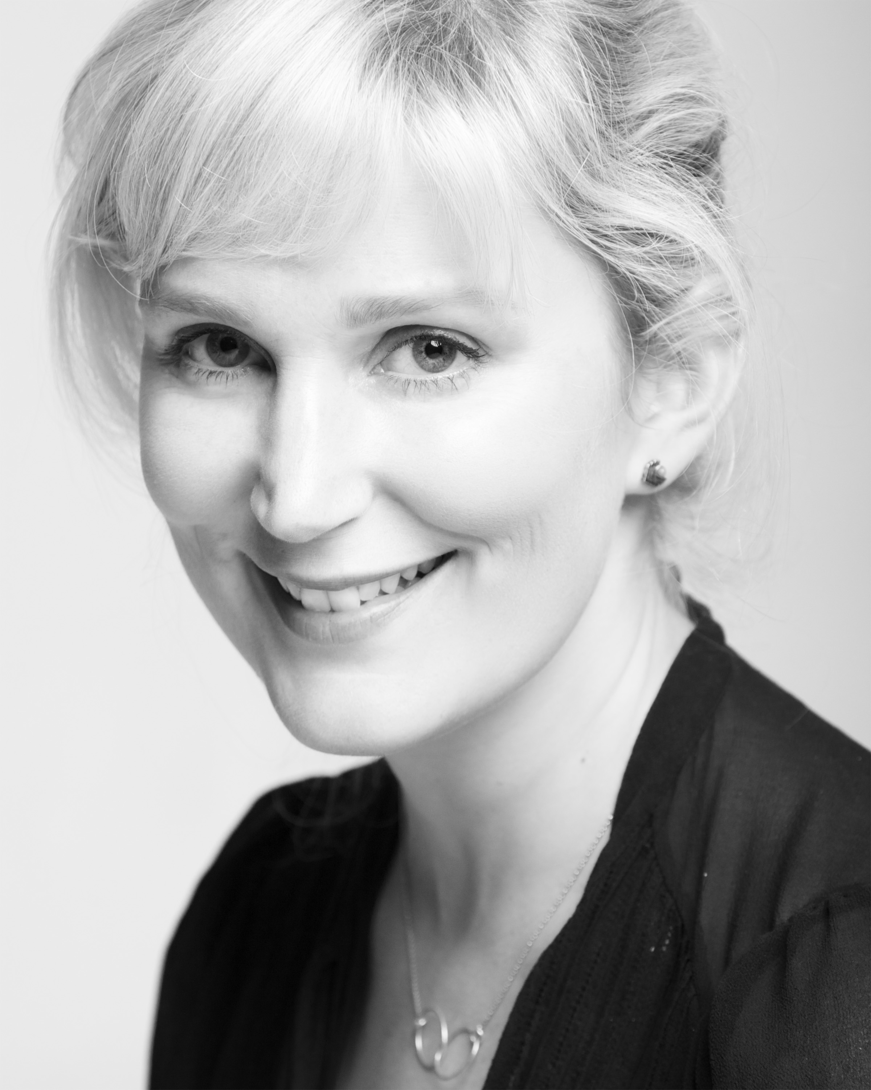
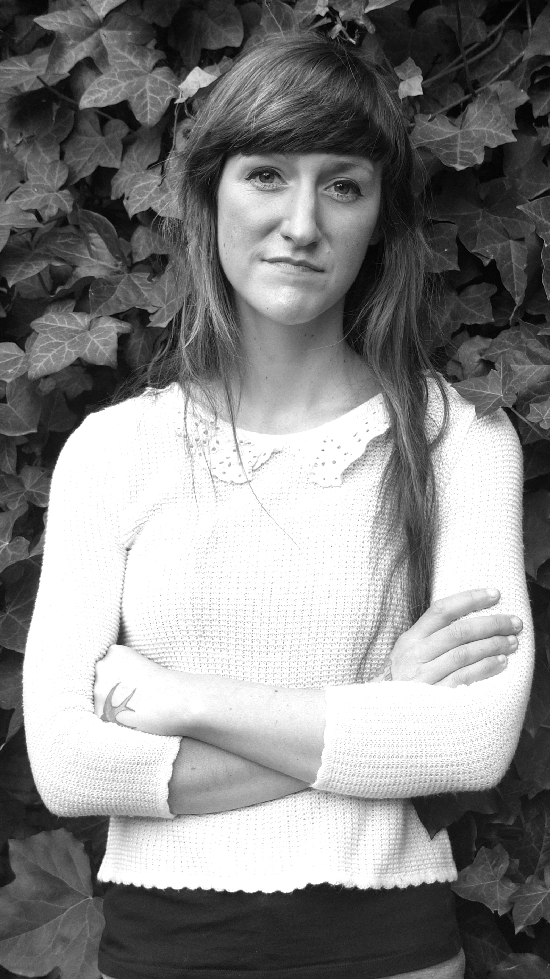
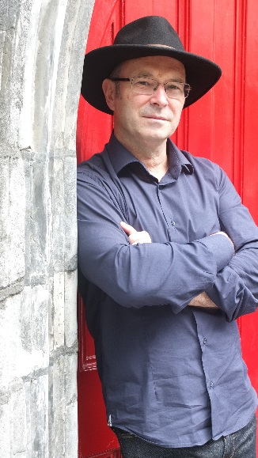
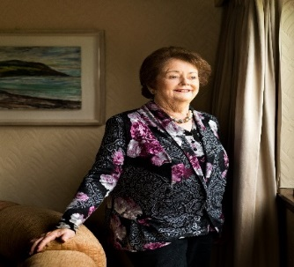
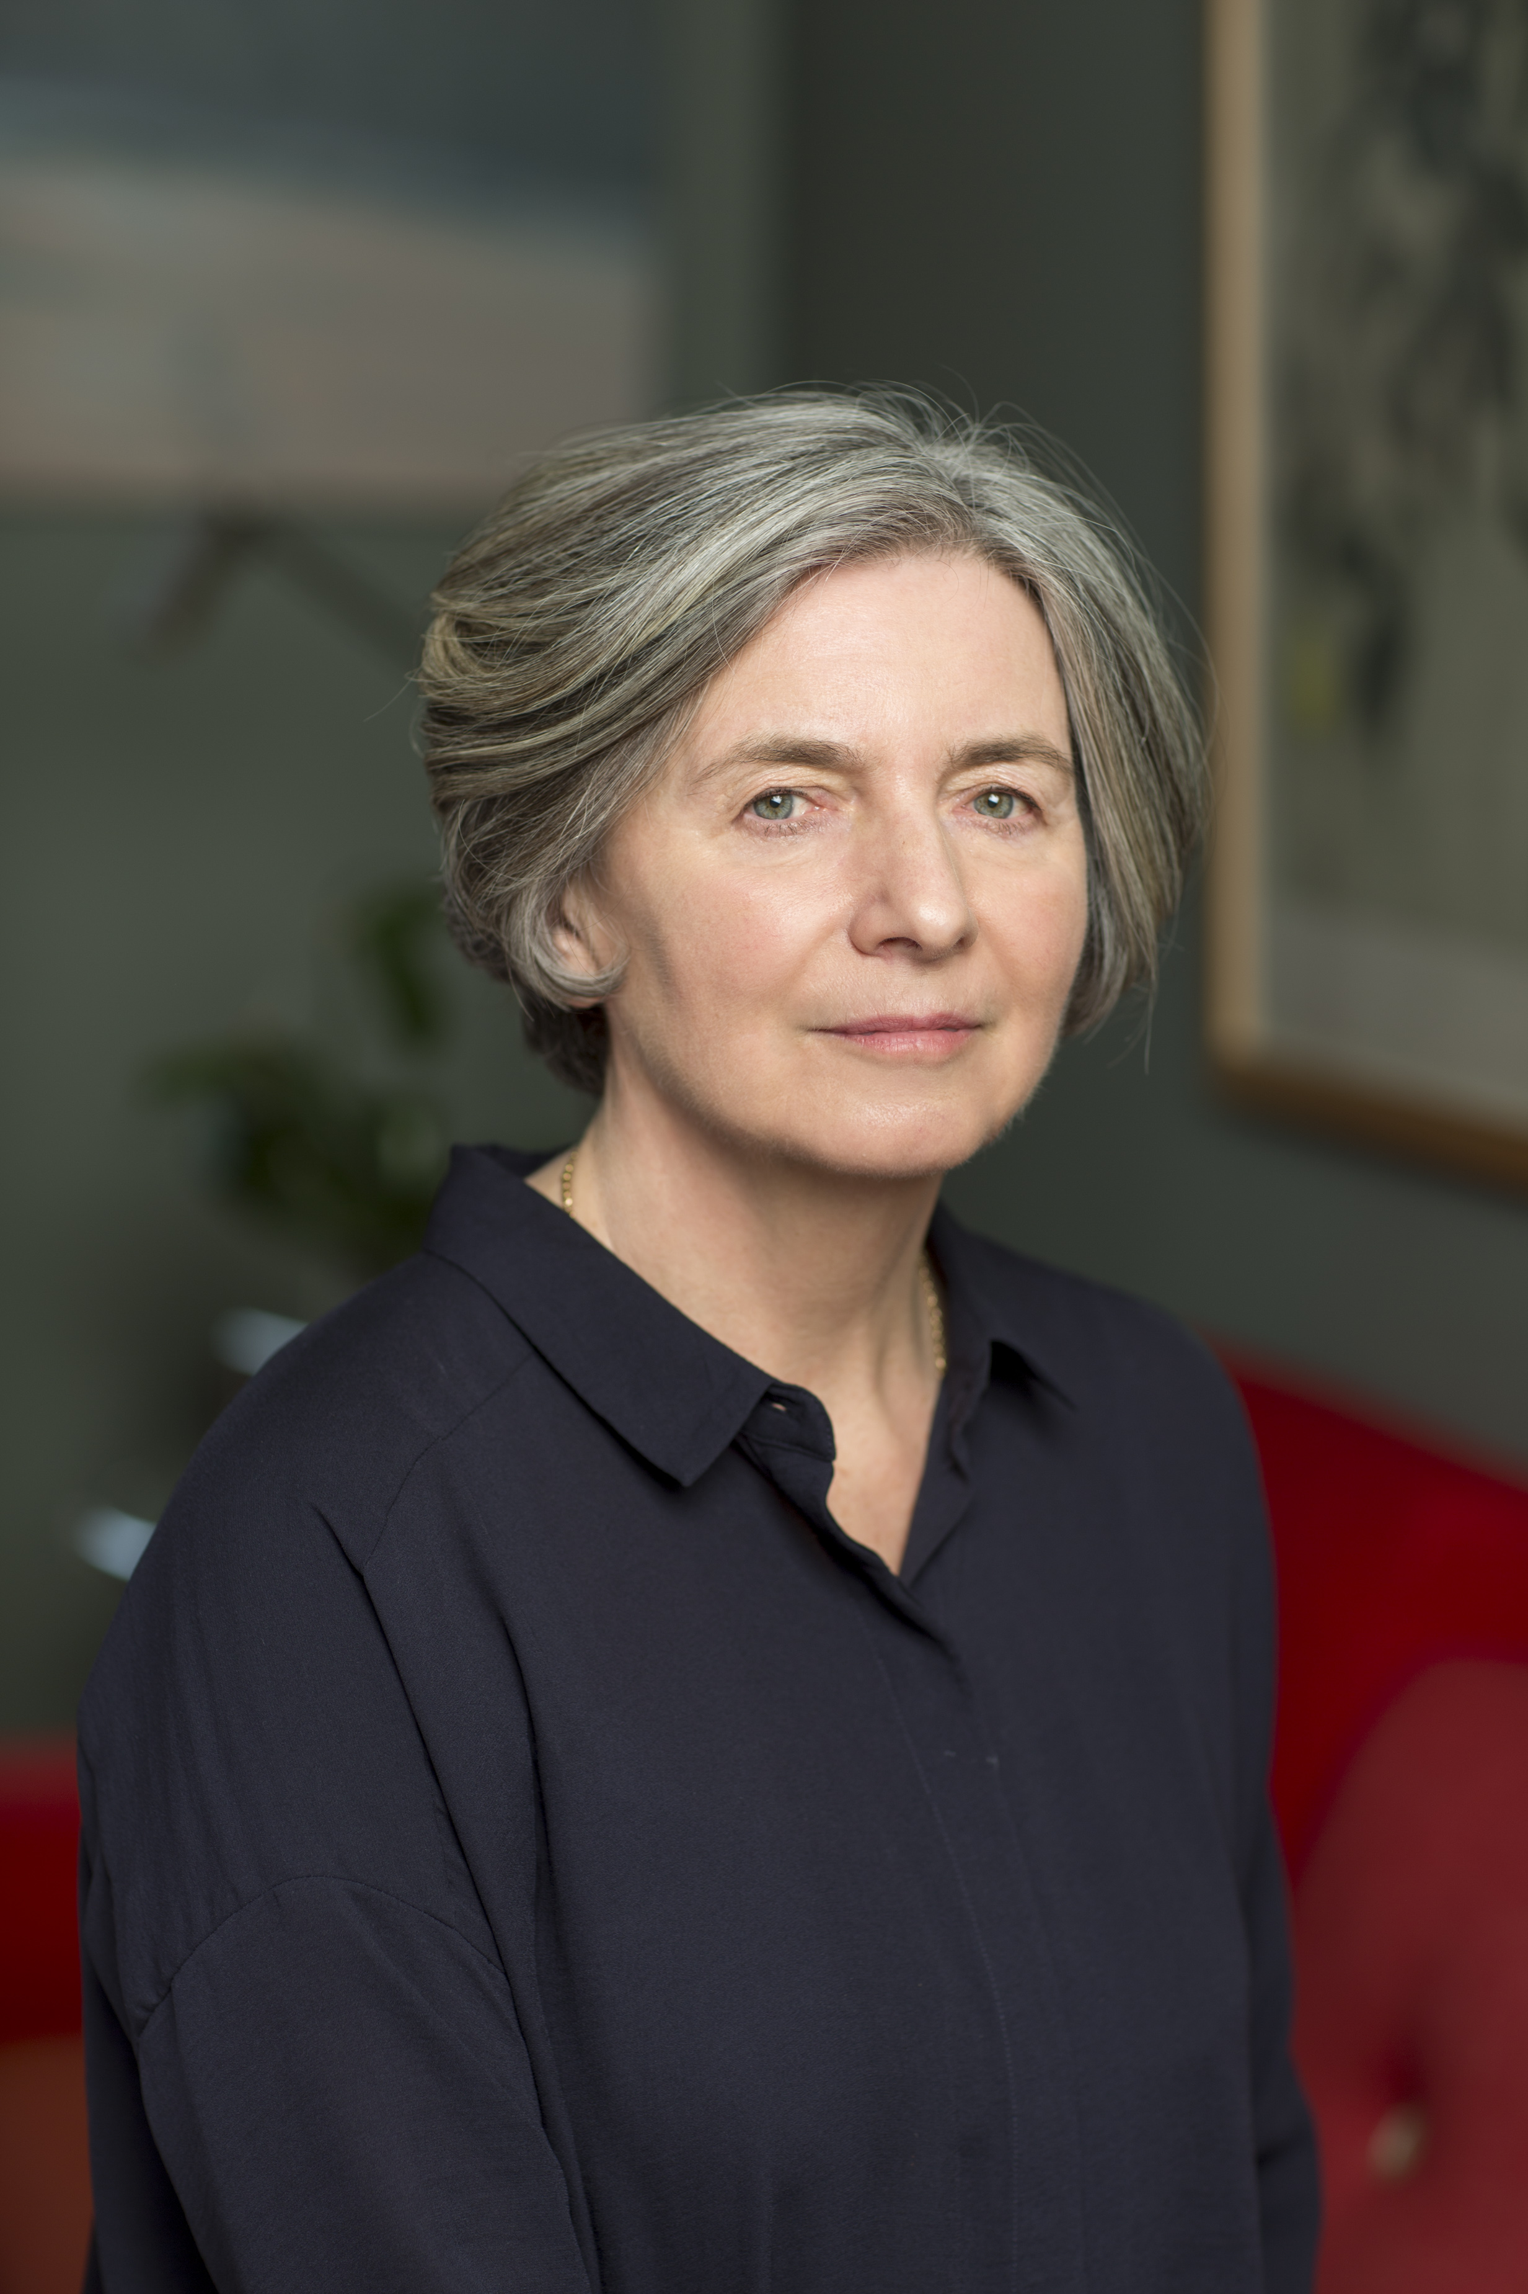
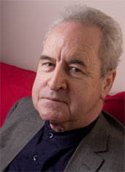
Readers Day - Saturday 14th October
As Mary said …. All in all, a very satisfactory day!
Mary O Rourke’s article Chaos in Catalonia and reflections in Tallaght Athlone Advertiser, Thu, Oct 26, 2017
158 attended in the Civic Theatre
A relaxed and intimate day of readings and public conversations chaired by Dermot Bolger. This year's line-up featured Lisa Harding, Sara Baume, Mike McCormack, Mary O’Rourke, Julie Parsons and John Banville

Slide 7
Literary Strand
Our Literary strand included workshops, panel discussions, readings and spoken word events.
Attendance
Poetry First event – 45 attended in the Civic Theatre
Electric Lines – 24 attended in the Loose End
Author talk - Kevin Toolis – 40 attended in Ballyroan Library
Staccato Lite – 24 attended in The Cherrytree
Forgotten – 49 attended in Rathfarnham Castle
Writing workshop at the County Library (28)
Writing workshop at Lucan Library (34)
Events were mostly free

Slide 8
RLBF Family Events
Death By Chocolate with Alan Nolan: at the Chocolate Warehouse in Walkinstown Friday 13th October Attendance : (35 attended - 2 shows)
Big Goldilocks and the Three Bears Plus…. in Lucan Library Saturday 14th October (full house 60+)
The Curious Adventured of Pinocchio presented by Lyngo Theatre, Civic Theatre Sunday 15th October (full house - 280)
Myths and Monsters of Harry Potter – A fun afternoon for the Children with History Live in Rathcoole Village. Sunday 15th October (62 attended)

Slide 9
RTÉ Radio 1 Sunday Miscellany Sunday 15th October, Civic Theatre
A great ending on a high note to a full house in the Civic Theatre
A good relationship is developing with RTE.
The producer of Sunday Miscellany has promised to consider participation in the RLBF as an annual or biannual event
Notes:
RTE Radio One Sunday Miscellany recording live @ Civic Theatre, Sunday 15th Oct
This radio programme is part of Sunday morning since 1968 and this is the second time coming to broadcast in Tallaght!
A mix of “music & musings” with poetry readings and essays it attracts over 300,000 listeners every Sunday. Our festival audiences will be able to attend the programme live in the Civic Theatre. An opportunity not to be missed!

Slide 10
Link, Share, Connect….
www.redlinebookfestival.ie
Facebook.com/RedLineBookFest
@RLBFest
Dates for next year’s festival Weds 10th – Sun 14th October 2018.

