Slide 1
Wellington Lane cycle scheme update

Slide 2
Part 8
WELLINGTON LANE – WHITEHALL ROAD CYCLE TRACK SCHEME
Pursuant to the requirements of the above, notice is hereby given of the proposed provision by South Dublin County Council of the above scheme. The proposed works will comprise the following:
Construction of new off-road cycle tracks on Spawell Road and Wellington Lane;
Provision of new advisory cycle lanes on Whitehall Road;
Road safety improvement works, including new Toucan/Zebra Crossings, at:
Firhouse Road – Spawell Road junction
Spawell Roundabout
Wellington Lane – Osprey Road Roundabout
Wellington Lane – Limekiln Road junction
Wellington Lane – Templeville Road Roundabout
Public realm upgrade works, including traffic calming and a 30km/h speed limit on Whitehall Road in the area of the business premises at Whitehall Close and Whitehall Park;
Improvements to existing bus stops along the route;
Provision of bicycle parking at locations along the route;
Replacement of affected trees and other landscaping works throughout the scheme;
Footpath improvement works throughout the scheme;
Provision of new road drainage and associated works where required;
Provision of new public lighting, road markings and signage.

Slide 3


Slide 4
“The National Transport Authority is responsible inter alia for the funding of sustainable transport measures in the Greater Dublin Area (GDA), including South Dublin County Council.
To this end the NTA allocates funding annually to local authorities in the GDA for the planning and implementation of measures to support walking, cycling and public transport in furtherance of the objectives set out in the NTA’s Transport Strategy for the Greater Dublin Area 2016 – 2035.
As the referenced route constitutes an element of the Greater Dublin Area Cycle Network Plan, the NTA is supportive of developing the cycle route connecting from Spa Well Roundabout to Templeville Road, including the junctions and roundabouts therein.
The NTA and South Dublin County Council will meet shortly to consider the overall funding envelope for 2018 and beyond, and discuss how best to proceed with this project in that context.
As with all NTA funded projects, the delivery of this project will be required to comply with the NTA Project Management Guidelines, and with the NTA National Cycle Manual.”

Slide 5
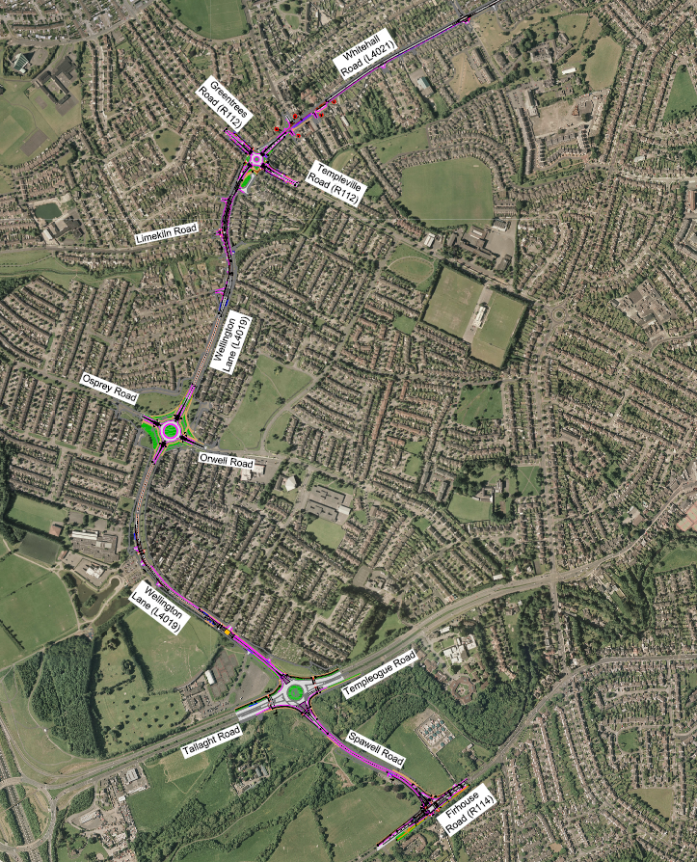

Slide 6
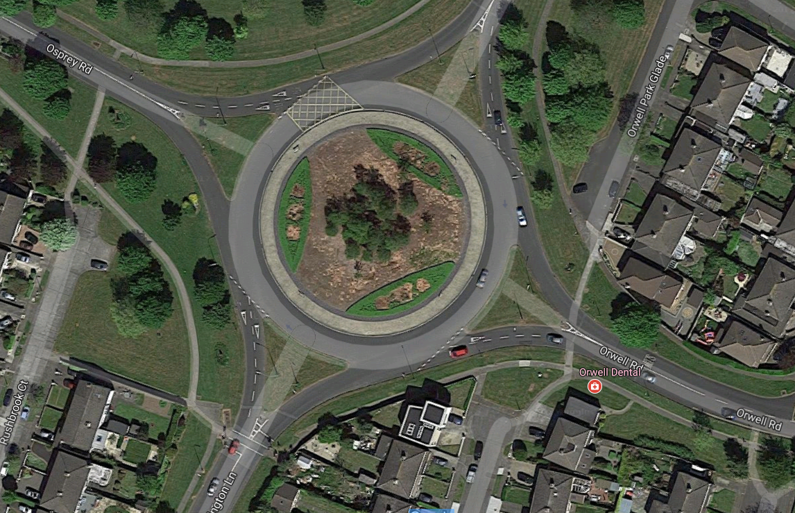

Slide 7
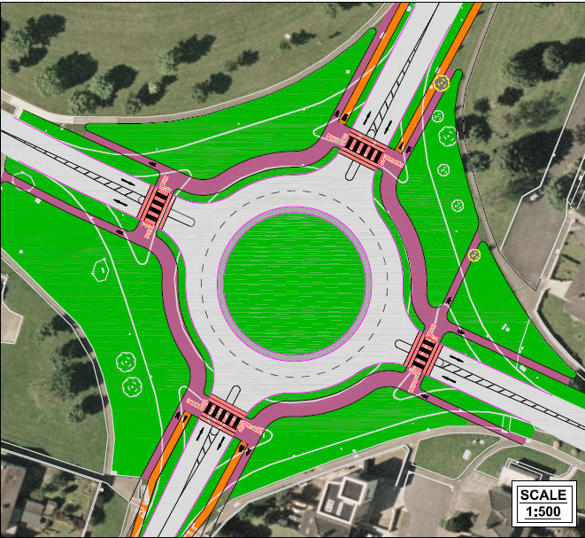

Slide 8
