Slide 1
Belgard Sq N to Cookstown Link Road

Slide 2
CDP 2016-2022

Slide 3
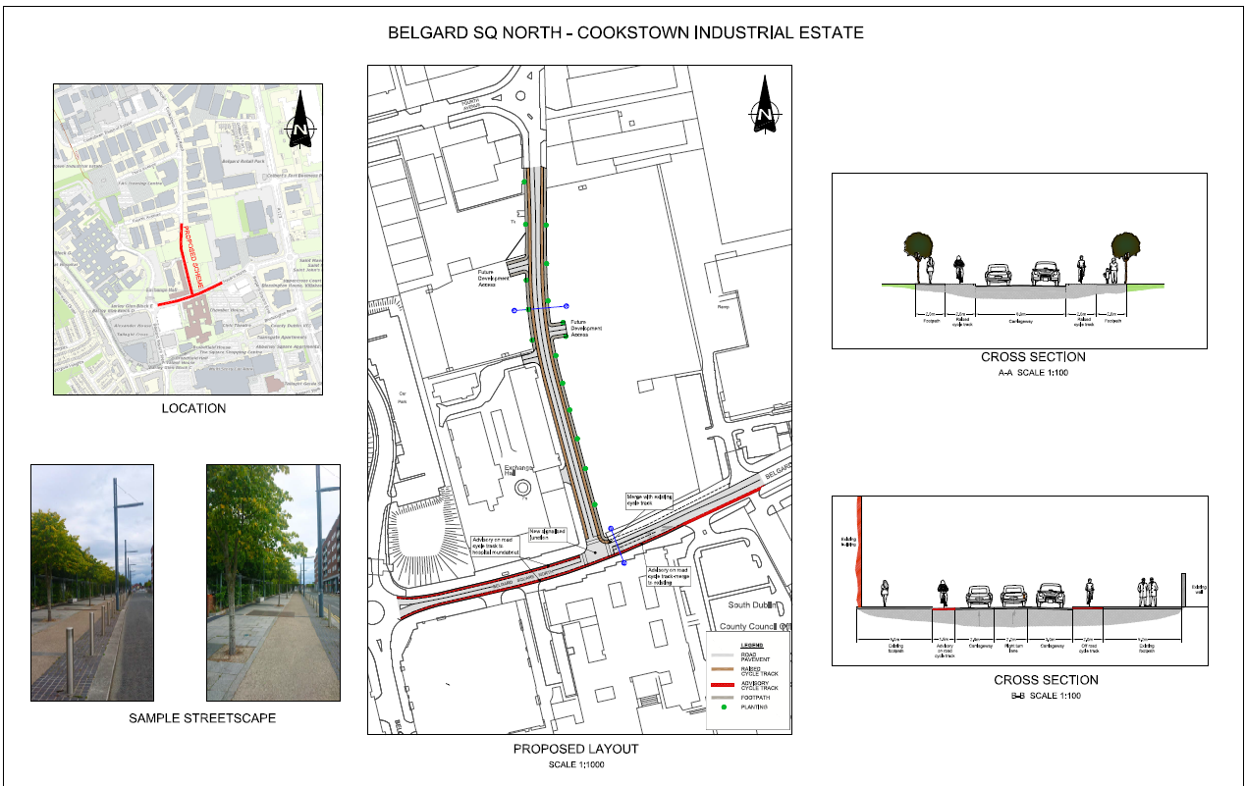

Slide 4
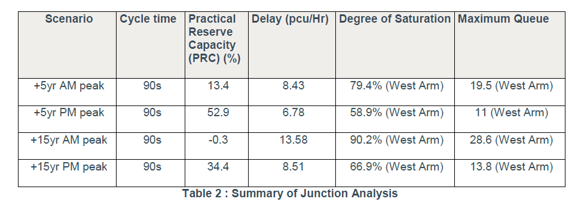
Junction Analysis

Slide 5
Environmental Reports
Appropriate Assessment Screening
An AA Screening report has been prepared to determine the potential effects, if any, of the proposed scheme on sites with European conservation designations, i.e. Natura 2000 sites located near the proposed route of the scheme.
The proposed works will not entail any land-take, habitat alteration, etc. within any Natura 2000 site, and as such there will be no direct impacts associated with the proposed survey.
Ecological Impact Assessment (EcIA)
The aim of the EcIA process is to ensure that projects that may potentially affect protected and/or ecologically sensitive sites, habitats and/or species are assessed in advance so that the competent authority is aware of what those effects are likely to be.
In summary, the proposed development will have no significant impact on the local ecological resource.

