Slide 1

South Dublin County Council
Prioritised river water quality assessment and improvement work
as part of Water Framework Directive 2nd Cycle RBMP measures
Eastern & Midlands Region

Slide 2

Background: Water Framework Directive (WFD) 2000/60/EC
Legal framework to protect and restore clean waters and to promote sustainable use of water
Achieved through River Basin Management Plans (RBMP’s)
Plans are required every 6 years
Current draft Plan is for the period 2018 to 2021
Overall Objective: “to achieve good ecological status in all waters”

Slide 3
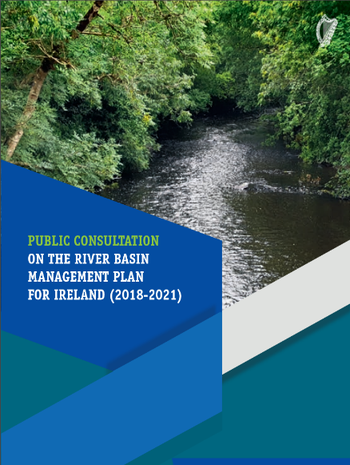
The current draft River Basin Management Plan
outlines the importance of our natural water resources,
the many pressures on our waters and the measures proposed to address these pressures.
Local Authorities Role
  Working with communities (e.g. LAWCO)
  Technical approach
    Based on sound EPA scientific information and working towards improvements in co-operation with all stakeholders
    ‘Boots on the Ground’ looking at waterbody and field scale issues

Slide 4
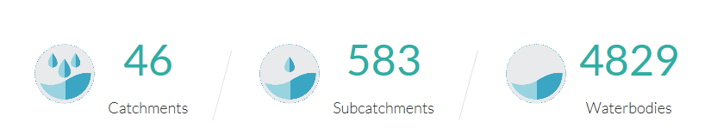
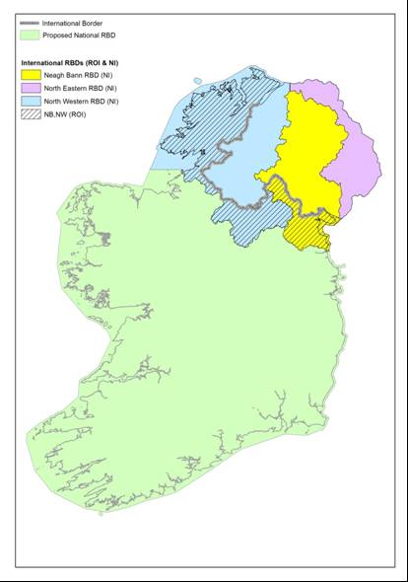
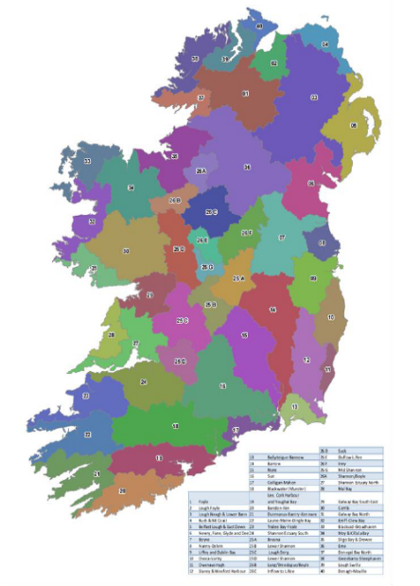
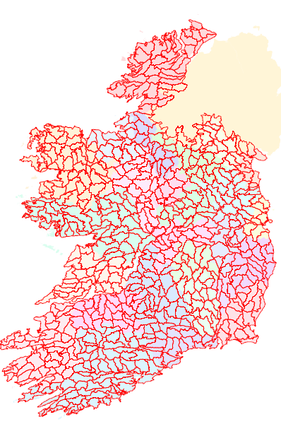
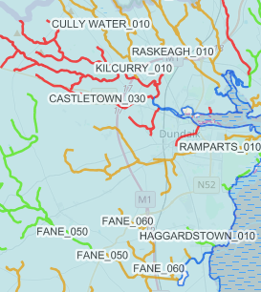
Technical Approach

Slide 5
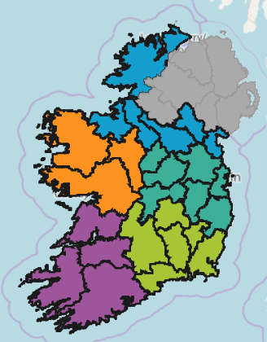
Regional operation areas
Midlands and Eastern
South East
South West
West
Northern and Border Counties

Slide 6
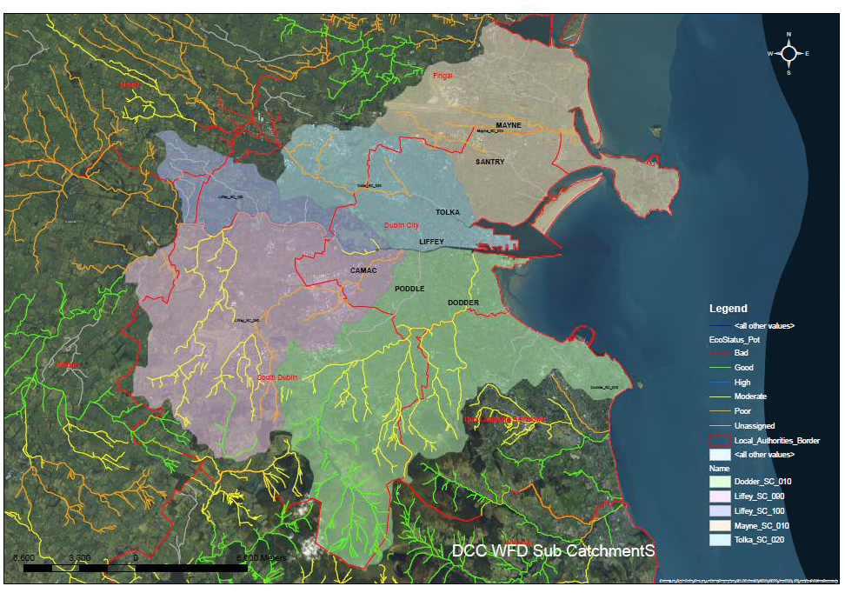
Dublin Area water body status

Slide 7
Why “prioritised areas for action”
30 waterbodies at risk in the Eastern & Midlands Region will be addressed in 2018-2021 period,
Resources and sufficient information not available to address all 300 water bodies in the Midlands and Eastern area in short term – rest to be addressed post 2021, and
River Dodder chosen as a focus catchment for the purpose of improving knowledge of similar type urban river catchments

Slide 8
Multi-agency workshops were held to prioritise rivers for WFD assessment and improvement work
Multi-agencies including
Local Authorities
EPA
Irish Water
IFI
Forest Service
Coillte
NPWS, Teagasc, etc.

Slide 9
How were “areas for recommended action” selected?
Step 1. Prioritisation of areas based on the National priorities (in the draft River Basin Management Plan)
Compliance with existing EU legislation (e.g. Urban Wastewater Treatment Directive)
Prevent deterioration of existing Good quality rivers
Meet water objectives for designated ‘protected areas’
Protect High status areas, and
Implement targeted actions and pilot schemes in focus catchments

Slide 10
Step 2. Taking a pragmatic approach
Fair distribution
Headwater First
Address multiple pressures together – where work is already planned e.g. IW investment…
Sub catchment projects addressing where issues exist in multiple water bodies within a sub catchment
Build on existing programmes and community group initiatives
Build on water quality improvements that are already occurring
Quick wins and longer term challenges

Slide 11
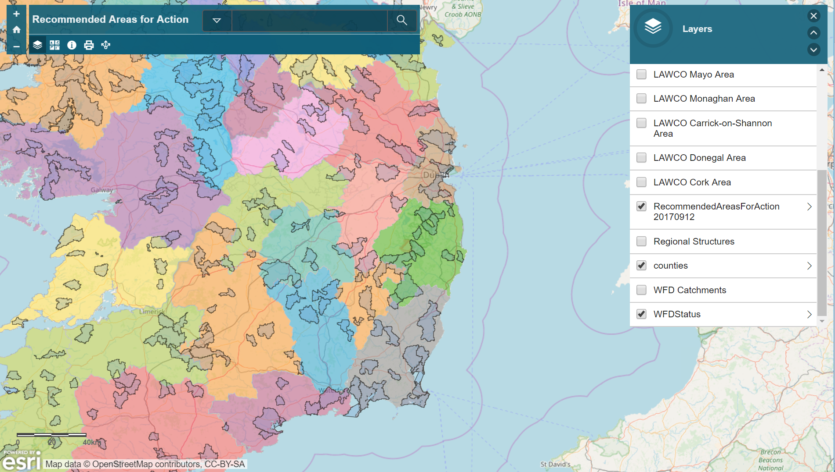
Prioritised areas for 2018 – 2021 period ‘at a glance’

Slide 12
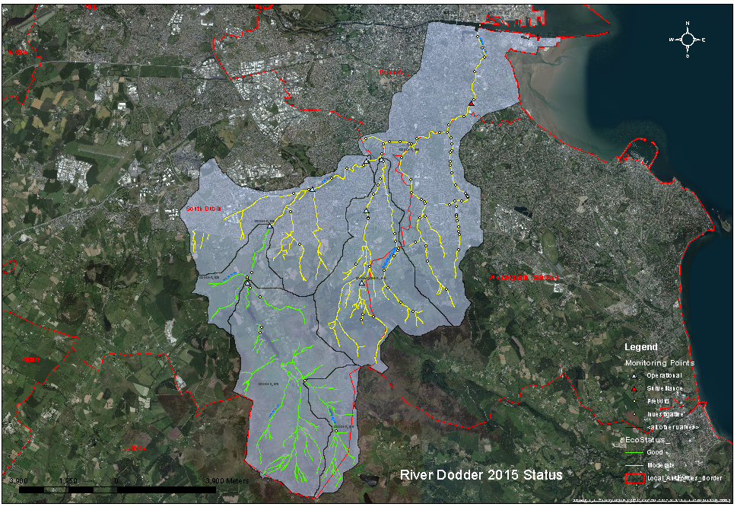
Prioritised Waterbody SDCC area – R. Dodder is the focus catchment
(in conjunction with DCC and DLR)

Slide 13
What about other rivers and streams in the SDCC area?
These will continue to be monitored and improved through pollution complaint responses, investigative assessments and planned inspection, e.g. discharge licensing

Slide 14
What happens next?
Agreed work programme on this Dodder catchment recommended for action will be incorporated into Final River Basin Management Plan
Public bodies will continue to implement existing programme of measures to improve water quality,
National Water Forum will act as an umbrella group for all stakeholders
LAWCO will drive public engagement and participation with communities and stakeholders at local level.
Co-ordinated National, Regional and local governance structures will work together to improve implementation.
Progress on implementation will be tracked and information shared.

