Slide 1
N4 to City Centre Phase 2 Section 38 Report

Slide 2
Scheme Proposals
The proposed works will comprise the following:
The removal of the right turn from R136 (Outer Ring Rd) (southbound) on to the N4 on-ramp (westbound), in order to provide a segregated cycle route in both directions across the bridge over the N4. This will allow for the separation of buses and cyclists, thereby increasing safety for cyclists.
The extension of the right turning lane from R136 (Outer Ring Rd) (southbound) on to Willsbrook Rd in order to increase capacity and prevent delays to southbound traffic.
The provision and improvement of almost 1.3km of two way off road cycle track from the R136 (Outer Ring Rd)/Willsbrook Rd junction to the R136 (Outer Ring Rd)/Old Lucan Rd junction.
Improved crossing facilities on all arms of the R136 (Outer Ring Rd)/Old Lucan Rd junction.
Bus stop improvements with Real Time Passenger Information (RPTI) and improved set-down facilities, including setting back the existing bus stop on the south side of Old Lucan Rd, which currently blocks traffic.
Additional landscaping works throughout the scheme
Provision of new public lighting, road markings and cycle route signage

Slide 5
Submissions
195 submissions received
The following tables give the main submissions and responses
Submission | Response
Removal of right turn will force traffic through areas such as Willsbrook intersection and Lucan Village.
Objects to the removal of trees to add a set down bus stop in front of Woodville Downs’s estate. Object to the construction of a bus bay in front of the Woodville Estate. The Bus which currently blocks traffic helps people exit Esker Lane | The bus stop is being set back to prevent buses from blocking traffic through the R136/Old Lucan Rd junction. There will be a yellow box incorporated as part of the scheme, which will help residents to exit the junction at Esker Lane.
Concerned about the safety cyclists using the newly proposed road layout for the Texaco slip road. | The scheme is required to go through a detailed design procedure, including a mandatory Road Safety Audit process. Due to the high speed on this slip road, consideration to changing the cycle facility to a segregated cycle facility will be investigated. It will be designed to the highest standards as prescribed in the National Cycle Manual.
Current cycle lanes facilitates are adequate due to low numbers of cyclists in the area.

Slide 6
Submission | Response
Objects to the proposed removal of the right turn from R136 (ORR) (Southbound) onto N4 (Westbound) in Lucan in order to provide a segregated cycle route in both direction across the bridge over N4. Removal of right turn will significantly increase traffic volumes driving through Lucan Village. | The scheme proposes to remove the right turning lane (Westbound) in order to allow for a segregated cycle lane in both directions on the R136. We would be concerned about northbound cyclists sharing the bus lane with buses and taxis at this location due to the number of buses using this section of bus lane and due to the narrowness of the bridge. Where cyclists share bus lanes in other locations, there is generally a footpath. At this particular location, the cyclist could be crushed between a bus and the bridge parapet. In addition southbound cyclists will have a segregated cycle facility. During the morning peak there are only 29 vehicles using this right turn on to the N4 Westbound. This represents only 1.6% of all traffic crossing over the R136 (ORR)/M50 bridge. We feel the benefits of the scheme considerably outweigh the small number of movements, which will be discommoded.
How will traffic access N4 Westbound? | The N4 Westbound traffic will either travel through Lucan Village to the Newcastle interchange or else travel through Willsbrook Rd to this interchange.
Health and Safety concern regarding motorists who may perform U-turn at the entrance to Hermitage housing estate . | The change in traffic behaviour will be monitored by the Roads Dept. and any undesirable behaviour will be discouraged.

Slide 7
Submission | Response
The Proposed Cycle Lane would get a minimal amount of Cyclists due to its peripheral location on the outskirts of the village. | This scheme is being designed to bring some measure of choice for the residents of Lucan and to encourage parents to allow their children to cycle to school rather than being driven. The proposed cycle network produced by the NTA shows a primary cycle route along the N4 to the City Centre. There is a proposed secondary route along the R136 to join with the N4 primary route, which is part of this scheme. This scheme will provide a safe route for school children to cycle to the large number of schools in Lucan village and commuters to the primary route to the City Centre along the N4. Whilst cycle numbers may not be significant at present, providing high quality cycle facilities will help to increase cycle figures in the area. This has already been shown to be the case, the recent CSO figures has shown an increase in cycling of 43% between 2011 and 2016.
Objects to the proposed Bus stop improvements with Real Time Passenger Information (RPTI) and improved set-down facilities, including setting back the existing bus stop on the south side of Old Lucan Rd, which currently blocks traffic. | Noted, the bus stop is being set back to prevent buses from blocking traffic through the R136/Old Lucan Rd junction. There will be a yellow box incorporated as part of the scheme, which will help residents to exit the junction at Esker Lane.
There is safer alternative route for cyclists through Willsbrook Park to gain access to the village. | While the Willsbrook Park cycle route is a good alternative for schoolchildren, the R136 route is a more direct route for commuters, which will link to the N4 cycle route and on to the City .

Slide 8
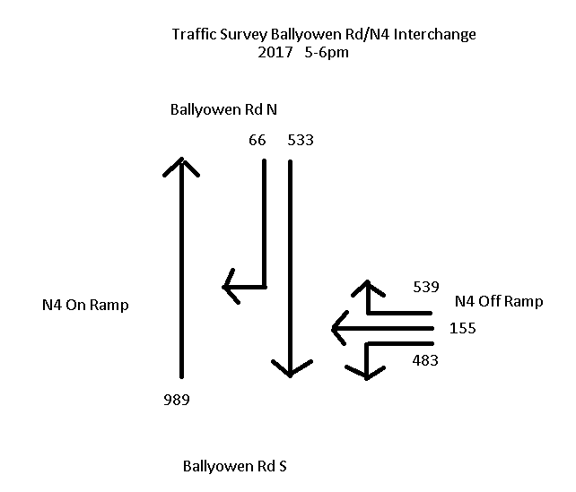
Traffic Surveys Ballyowen/N4 Interchange 2017
As shown, for the N4 on-ramp (right turn) traffic movement only, it represents 1.6% of all movement over the bridge in the morning peak and 3.2% in the evening peak.

Slide 9
Recommendations
Due to the significant number of objections, particularly focused on the right turning ban, SDCC are proposing to construct the full scheme but introduce the ban on a trial basis on the bridge only. This will consist of flexi kerbs and bollards, to delineate the north and southbound cycletrack on the bridge, and amended lane markings. The rest of the cycle scheme will be permanent works. A survey including queue lengths will be carried out before the works commence and six months after to gauge the effect of the ban. If the ban is found to be detrimental to the traffic movements in and around this location, other options will be explored. In addition, cycle training workshops will be set up in all the local schools in order to encourage cycling and to publicise the cycle tracks in the area.

Slide 10
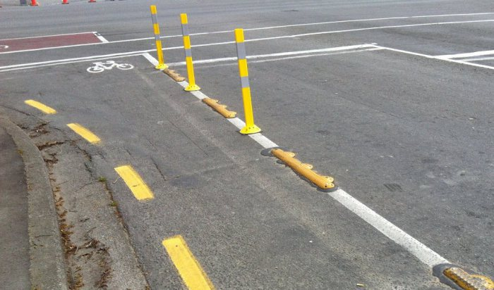
Proposed temporary cycle track

