Slide 1
River Basin Management Plan for Ireland (2018-2021)
Presentation
to
Tallaght Area Committee Meeting
Date: 22nd May 2017.

Slide 2
Water Framework Directive (WFD) 2000
Legal framework to protect and restore clean water ….. and to ensure its long-term, sustainable use.
Three cycles
1st Cycle: 2010-2015 (minimal community engagement)
2nd Cycle: 2016-2021 (2 years behind)
3rd Cycle: 2022-2027
…… “to achieve good ecological status in all waters”.

Slide 3
Water Framework Directive (WFD) 2000
Develop River Basin Management Plans –
Identify the pressures on water quality
Set out the programme of measures to address these significant pressures.
Public consultation and engagement

Slide 4
Key Learnings from 1st Cycle Plan
Need for better evidence base (EPA characterisation work)
First cycle too ambitious
… “fragmented institutional structures”
… “no single body having ultimate responsibility”
Single RBD with national plan the responsibility of Minister
New governance & implementation structures right
Local Authorities central to this
Need for improved communication & public engagement
Consultation central to development of draft Plan
Specific resource developed through setting up the Local Authority Water and Community Office (LAWCO).

Slide 5
River Water Quality, past, now, future?
?
?
?
% river channel length at satisfactory status
2015
2027

Slide 6
EPA Characterisation
Detailed assessment of 46 catchments with 4,882 water bodies
45% of rivers and 54% of lakes at less than “good status”
Drop in “good” or “high” status numbers since 2007-2009
Notes:
Programme of measures to address, amongst other things, the following pressures:
Agriculture*
Septic tanks
Urban waste water
Forestry
Peat harvesting
Invasive alien species
Protected areas
High status waters - “blue dot catchments programme”
Hydromorphology
Floods
Land use planning and water

Slide 7
Water Bodies “at risk” of not meeting their objective
53% are impacted by more than one significant pressure

Slide 8
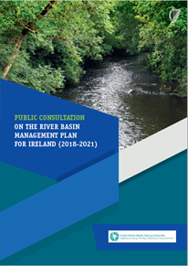
Draft River Basin Management Plan
Draft Plan approved by the Minister
Publication 28th February 2017
6 months public consultation process
Final RBMP by December 2017

Slide 9
Objectives & Priorities
“…Good ecological status for all waters”
Priorities identified in the Plan:
Compliance with existing EU legislation (e.g. UWWTD)
Prevent deterioration
Meet water objectives for “protected areas”
Bathing areas, drinking waters, shellfish, SACs etc
Protect high status waters
Supporting measures implemented in approximately 600 to 700 prioritised water bodies

Slide 10
Programme of Measures (Ch. 7)
Agriculture
Septic tanks
Urban waste water
Forestry
Extractive industry incl. peat harvesting
Invasive alien species
Physical modification
Water abstractions
Industry
Waste
Historically polluted sites
Water treatment
Others

Slide 11
Implementation Strategy
Implementation of basic measures
Supporting measures targeted at priority water bodies
Regional structure in coordinating resources across agencies and other stakeholders
Evidence based approach
Community engagement and awareness
(Local Authority Waters and Communities Office - (LAWCO))
(National Water Forum)
“......the right measures in the right place”

Slide 12
Role of LAWCO

Slide 13
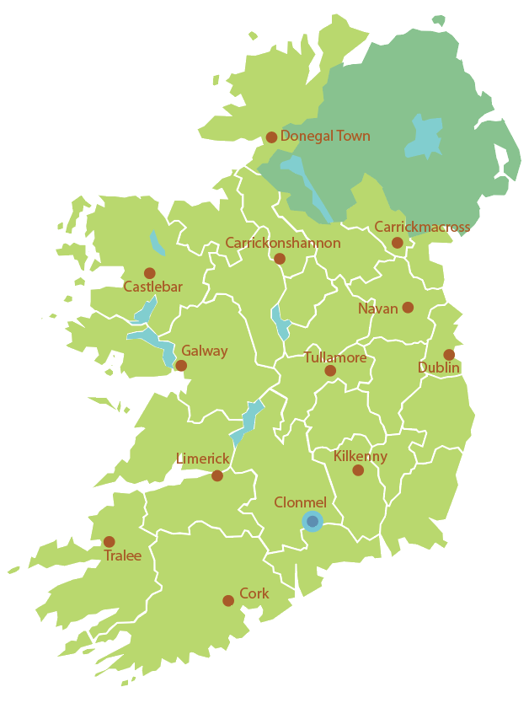
Jimmy McVeigh
Community Waters Officer Locations
Karen Kennedy
Gretta McCarron
Mick Kane
Aoife McGrath
Catherine Seale
Basil Mannion
Sinead Hurson
Ruairí Ó Conchúir
Ann Phelan
Head Office - Clonmel
Bláithín Ni Ainín
Kieran Murphy

Slide 14
National Water Forum
Facilitate stakeholder engagement on all water issues.
Inform public views on the links between
Clean water supplies
Good water quality
Public Health
The Value of water as a resource

Slide 15
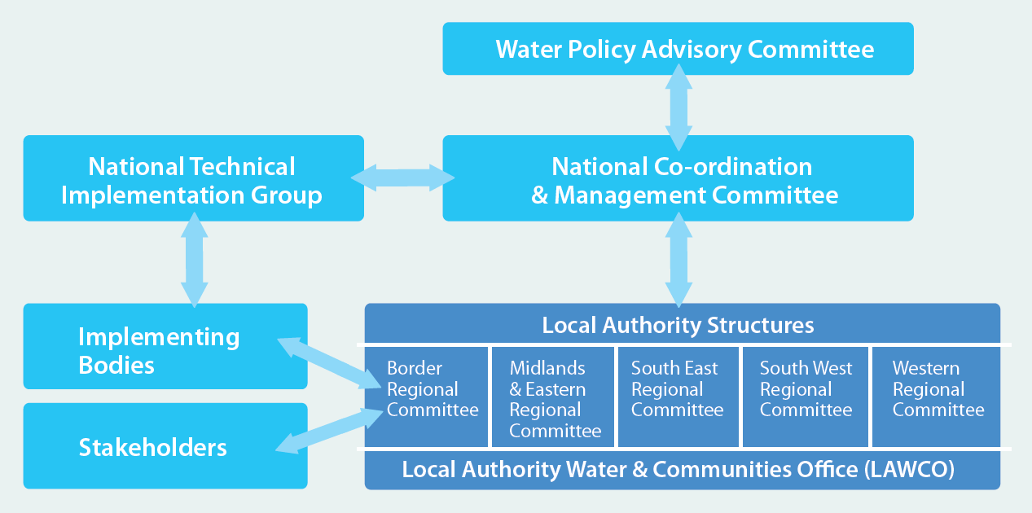
Proposed Implementation Structure

Slide 16
Role of Local Authorities
Coordinated delivery of measures at regional and local level
Tracking progress and effectiveness of measures
Annual reporting of progress
Ensuring public and stakeholder engagement in implementation
Integrated approach across functional areas
Supporting national policy development and implementation

Slide 17
Communication & Engagement
Previous consultations highlighted need for:
Better engagement in water policy at national level
Facilitation of public and stakeholder engagement at local level
Response to above in draft RBMP
National Water Forum will feed into WPAC and other structures
Local Authority Waters and Community Office (LAWCO) to drive public participation and consultation
EPA/DHPCLG/LA networking & knowledge sharing
catchments.ie website

Slide 18
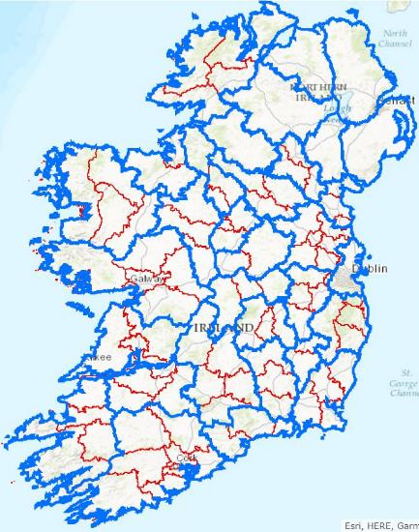
Community Engagement (LAWCO)
Public meetings to be held in local areas (c. 100)
To be completed by end of August 2017
Include a focus on local issues

Slide 19
Public Meetings
Your LA.
South Dublin:
15th May @7.30pm - Clarion Hotel Dublin, Liffey Valley.
18th May @ 7.30pm- Louis Fitzgerald Hotel, Newland’s Cross.

Slide 20
High level: Department of Housing Planning Community and Local Government website (RBMP@housing.gov.ie ): now to end of August 2017 Local level: Public consultations meetings: end of April to end of August 2017 Local Authority submissions Online Surveymonkey Consultations though PPN and sectoral organisations National meeting to be organised by DHPCLG
How can people input to plan?

Slide 21
http://www.housing.gov.ie/

