Slide 1
Hellfire Mountains project
CPG 2nd May 2017
Report on open days Tallaght Stadium 6th & 7th April

Slide 2
Background
Grow Dublin Report (“Breath of Fresh Air”)-2014
South Dublin Tourism Strategy-2015
Mountains project feasibility (with Coillte) – 2016.
Hellfire/Masseys identified as optimum opportunity.
Commence process for planning application to ABP -2017.
Project supported by Bord Failte capital grants scheme – April 2017. (E100K)

Slide 3
Current status
ABP view sought on application-response awaited.
Coillte contact with local residents/landowners followed by 2 meetings in Whitechurch/Tallaght Stadium.
Open days held in Tallaght Stadium. (Thursday 6th & Friday 7TH April).
Meetings were to provide information and seek feedback-NOT FORMAL PLANNING CONSULTATION. (Full report available)
Planning documentation being prepared informed by above meetings.

Slide 6
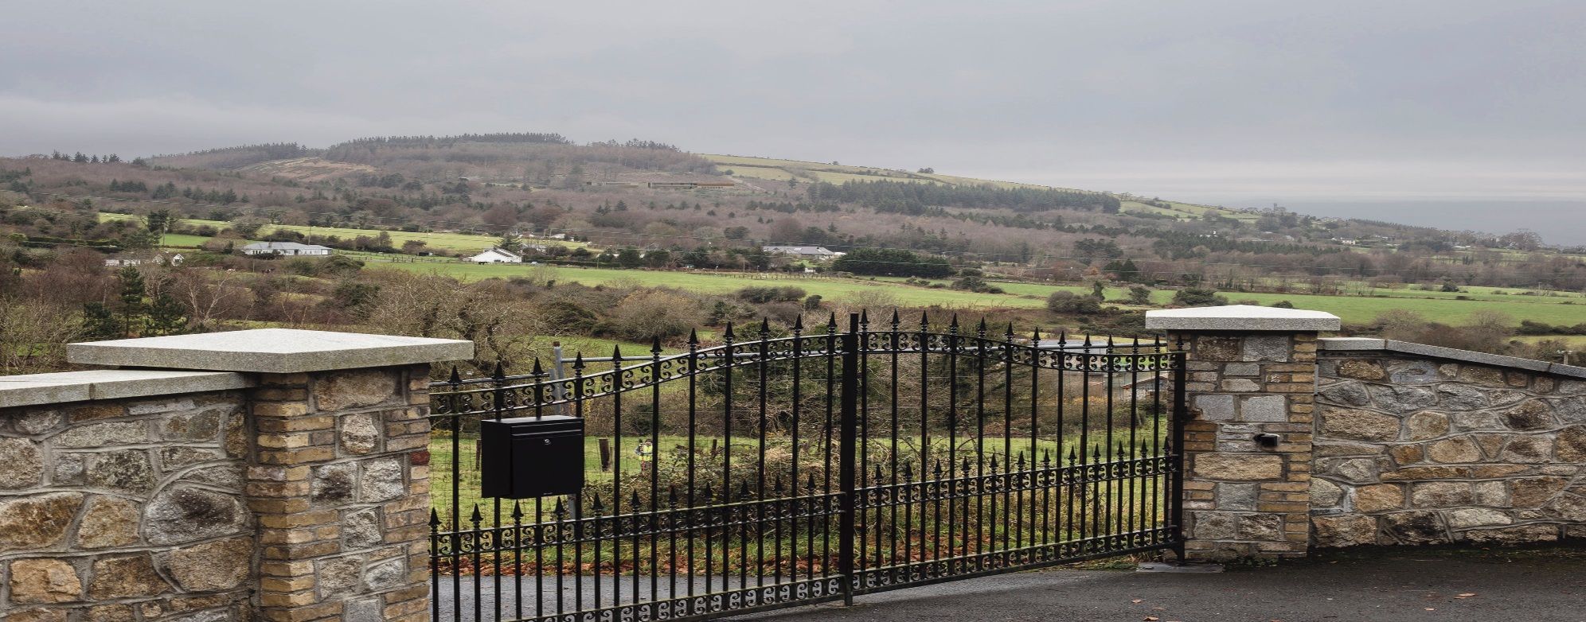
Current building proposal and visual impact of feasibility proposal

Slide 7
Plan of proposed building

Slide 8
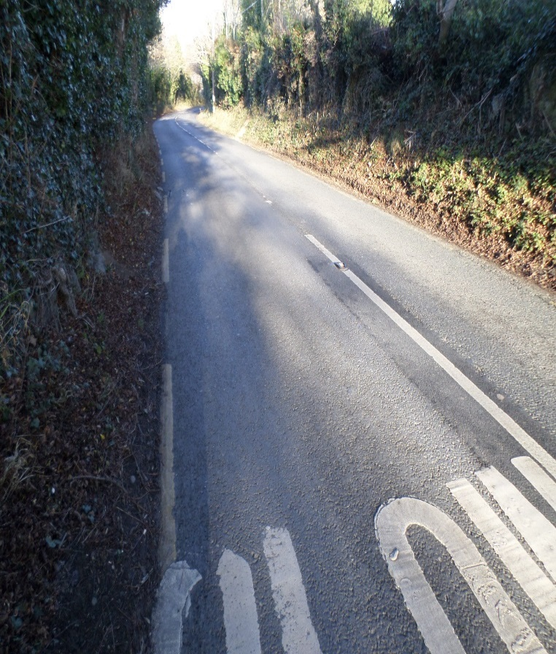
Traffic…
& potential solutions

Slide 9
Feedback 1 – overview
The overall feedback received from the public was positive with only a small number turning up to issue a complaint or protest to the project.
Several members of the public and those within the tourism sector who attended the meetings openly expressed their support for the project
Many there to receive more information on the development before they made up their mind about it.
Lot of misinformation particularly nature and scale of development at the Hellfire location itself varying from large structures beside to demolition of the existing building, large scale development in Masseys etc.
Genuine concerns raised on environmental impacts including flora and fauna, visual impacts, existing agricultural activity etc.
Main concerns related to traffic and security issues – some in relation to scale and type of development.

Slide 10
Feedback 2 – concerns & response
Concerns were raised by the public surrounding the overall environmental impact the development would have. (Bridge structure of particular concern to some).
The EIA & planning application must deal with all impacts and identify sustainable solutions
The high number of people who don’t use the car park and instead park on the road illegally.
The pinch point sections of the roads will create congestion and a backlog of traffic.
The poor maintenance and vandalism of the area.
Security of the carpark.
Public transport to and from the area.
The above issues are very real and existing. It is obvious that these will increase in intensity as recreational usage increases in the Mountains. The project offers an opportunity to both manage and maximise benefit from this increase.

Slide 11
Hellfire Mountains project
CPG 2nd May 2017-next steps
Await response to ABP correspondence.
Respond to Failte Ireland approval for project
Finalise EIA & planning documentation.
Prepare model & present to Members before formal planning process.
Lodge with Board June/July 2017. (Or possibly SDCC process but considered unlikely).
Update to full Council.

