Slide 1

Lucan Pool
Griffeen Valley Park
ABK
architects

Slide 2
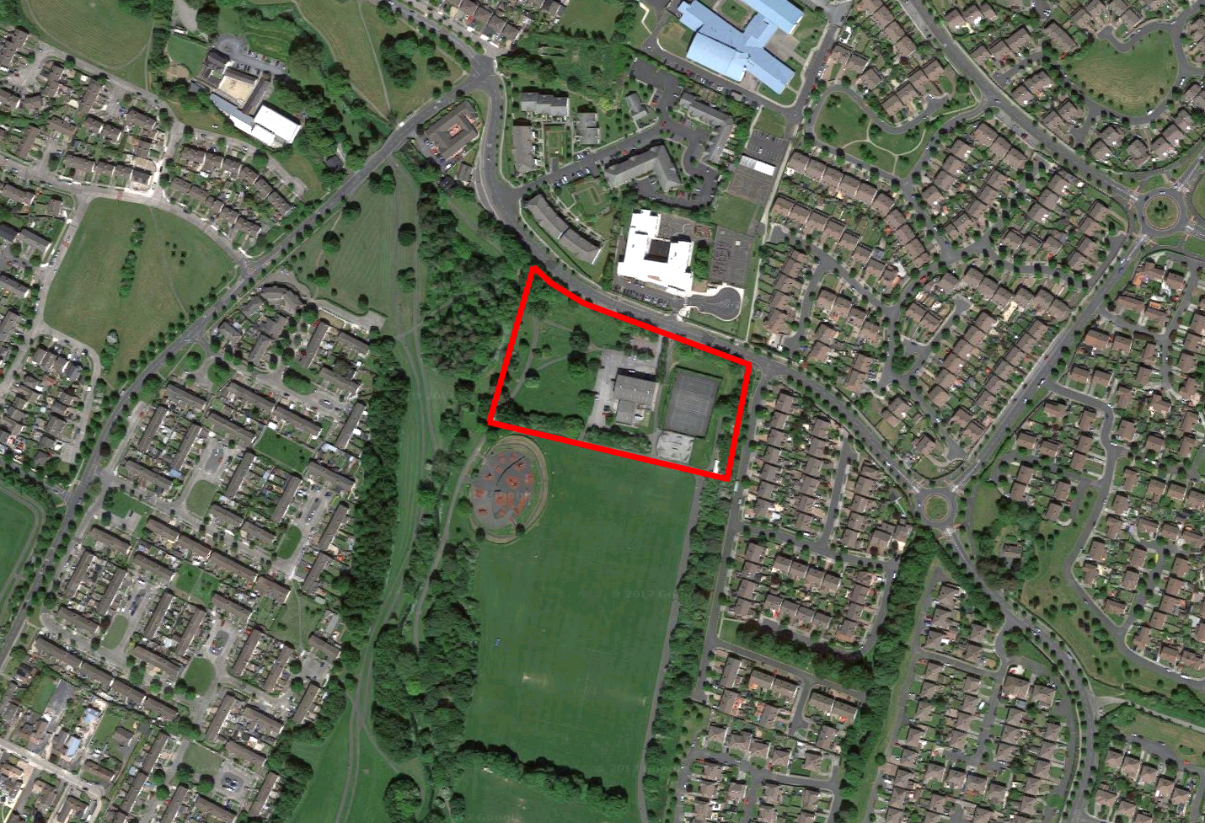
ABK
architects
ABK
architects
Lucan Pool
Aerial photograph showing site outlined in red
April 2017

Slide 3
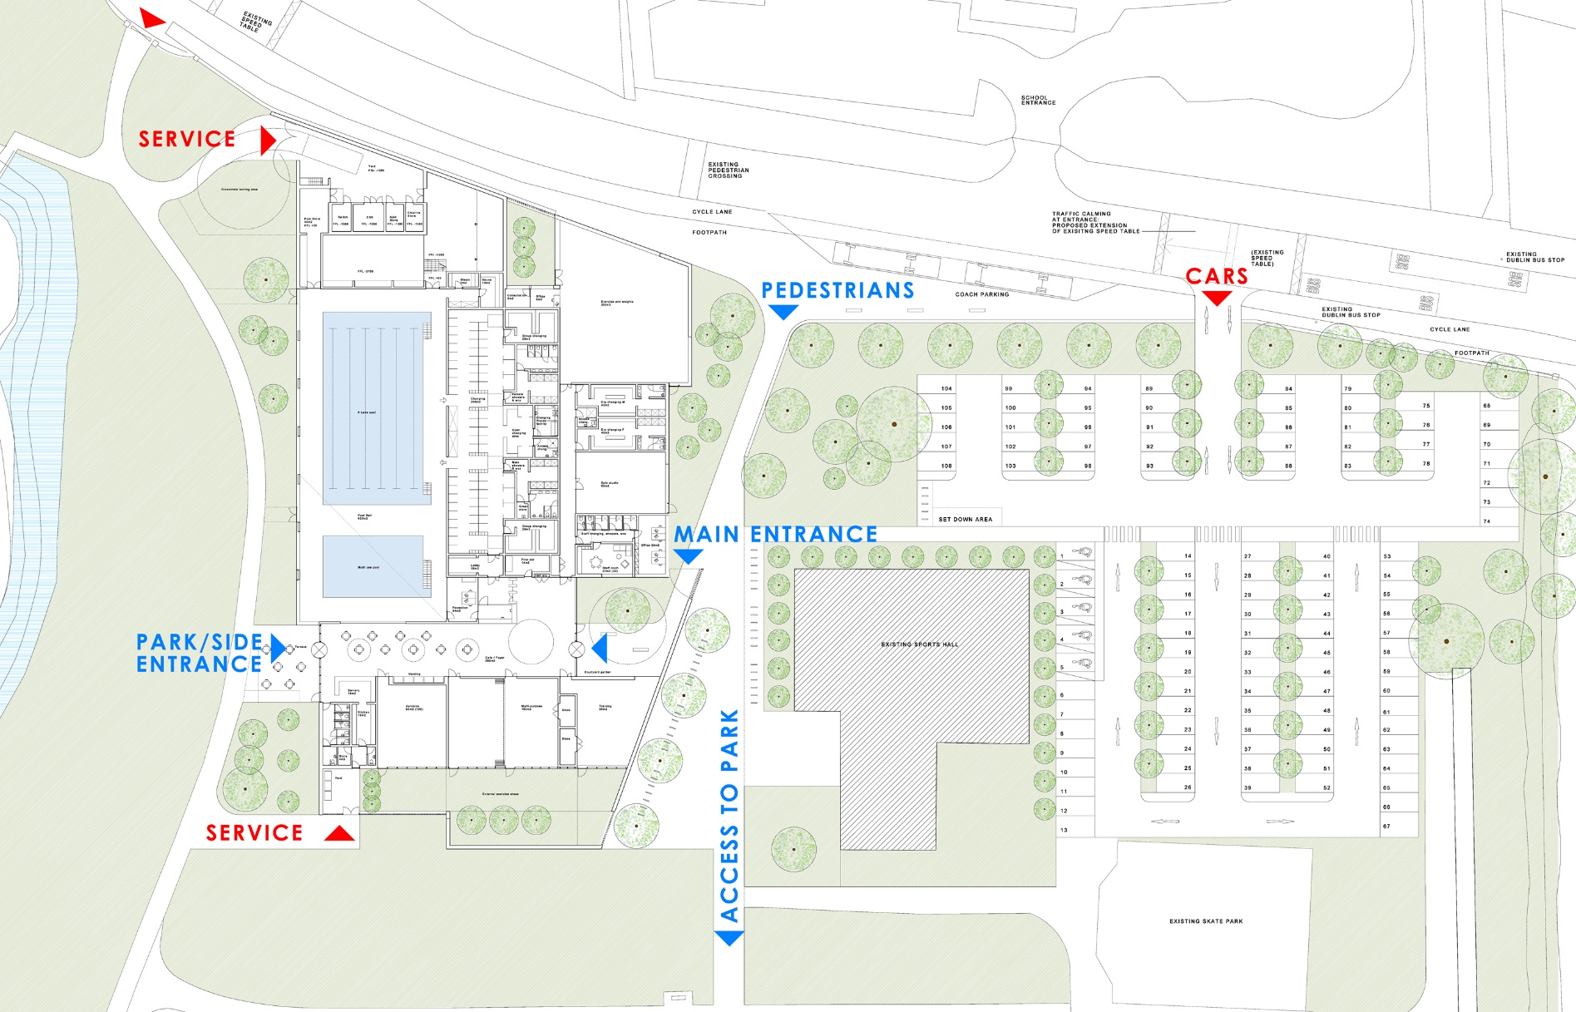
ABK
architects
ABK
architects
Lucan Pool
Proposed plan
April 2017

Slide 4
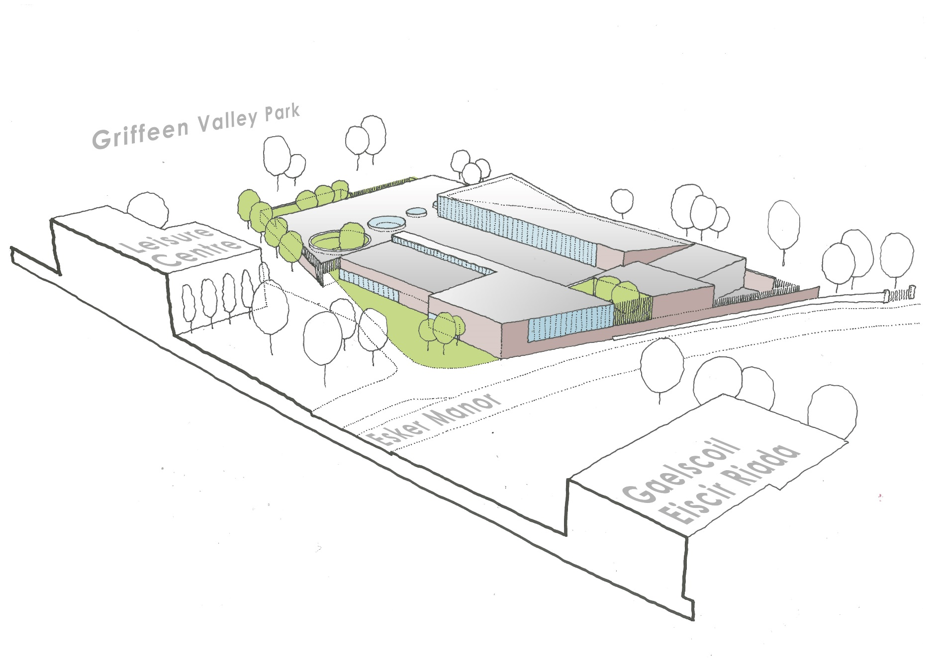
ABK
architects
ABK
architects
Lucan Pool
3D sketch view from north-east
April 2017

Slide 5
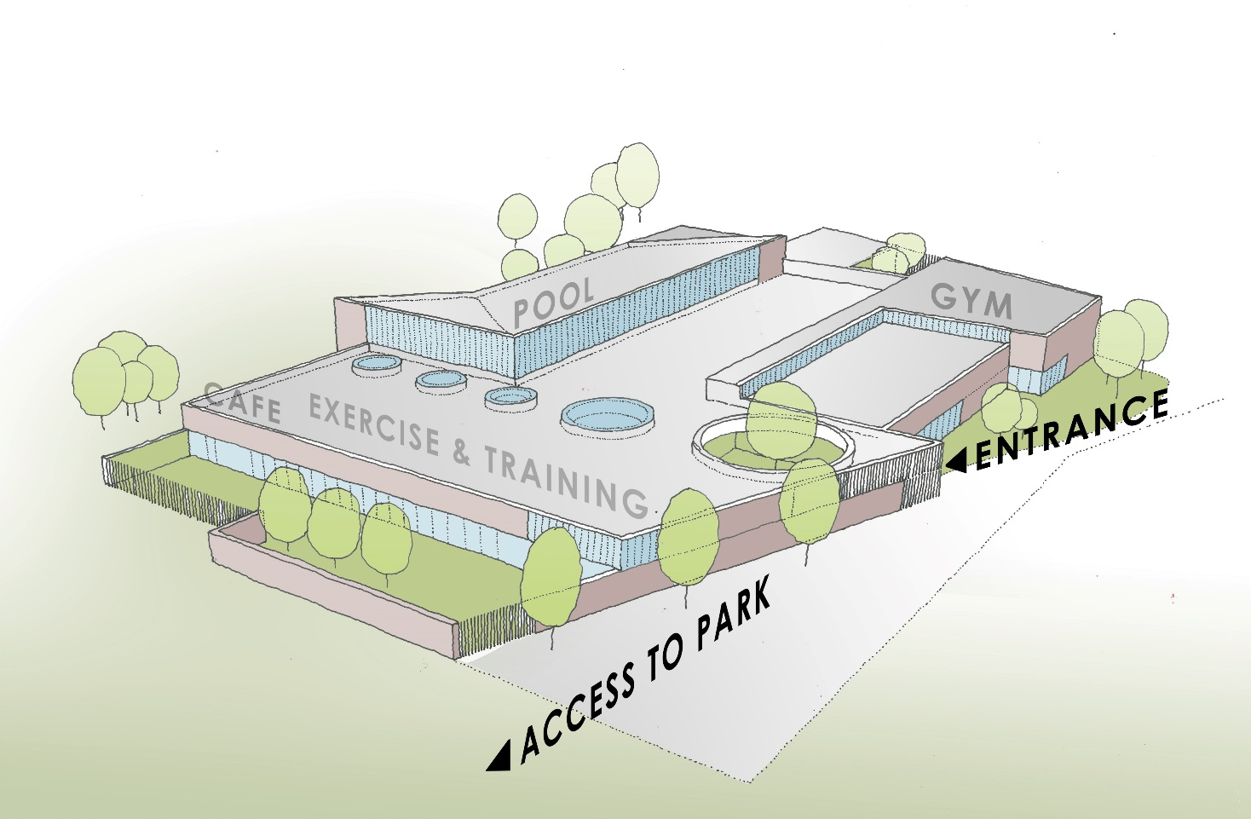
ABK
architects
ABK
architects
Lucan Pool
3D sketch view from south-east
April 2017

Slide 6
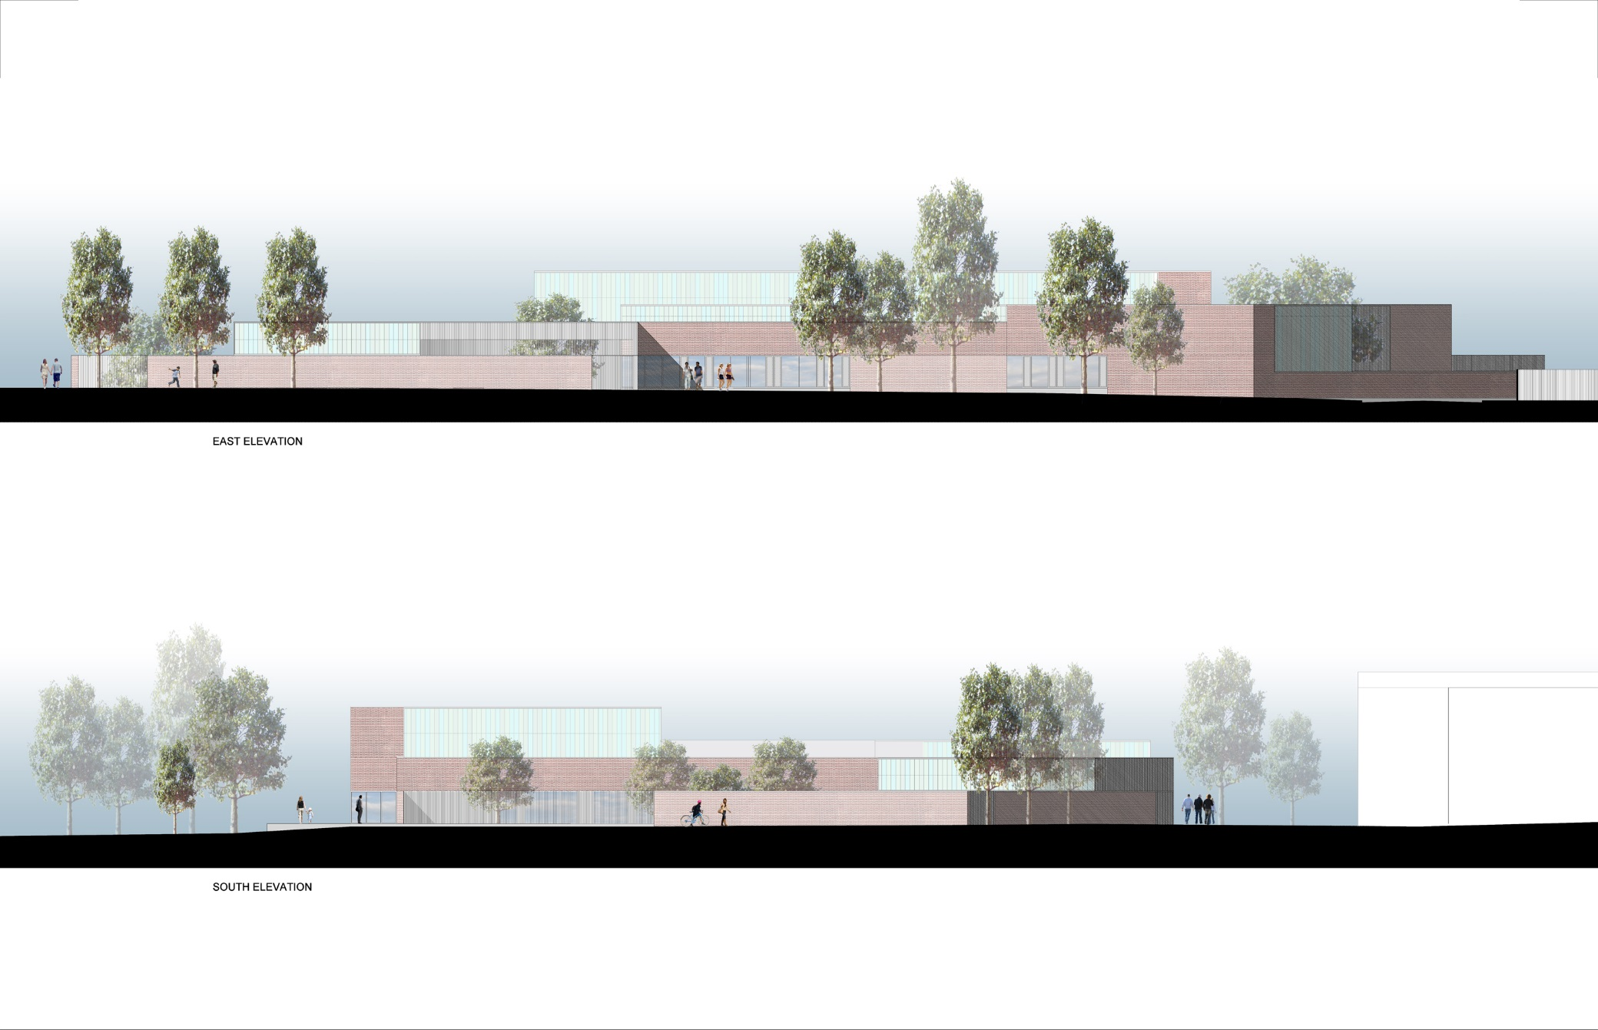
ABK
architects
ABK
architects
Lucan Pool
Proposed east and south elevations
April 2017

Slide 7
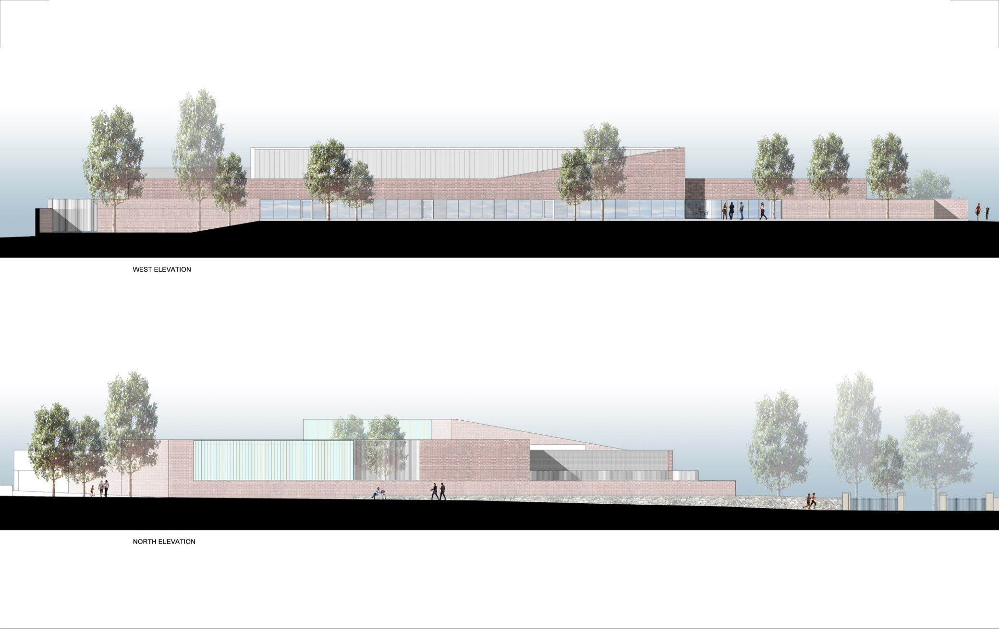
ABK
architects
ABK
architects
Lucan Pool
Proposed west and north elevations
April 2017

Slide 8
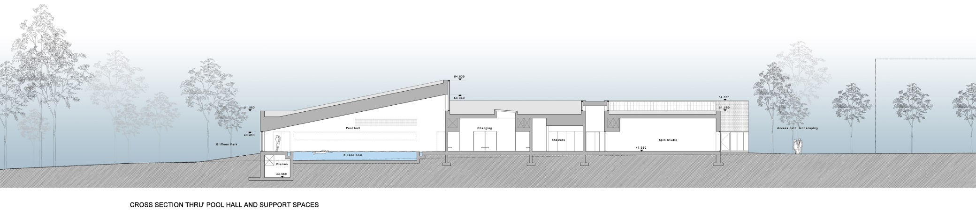
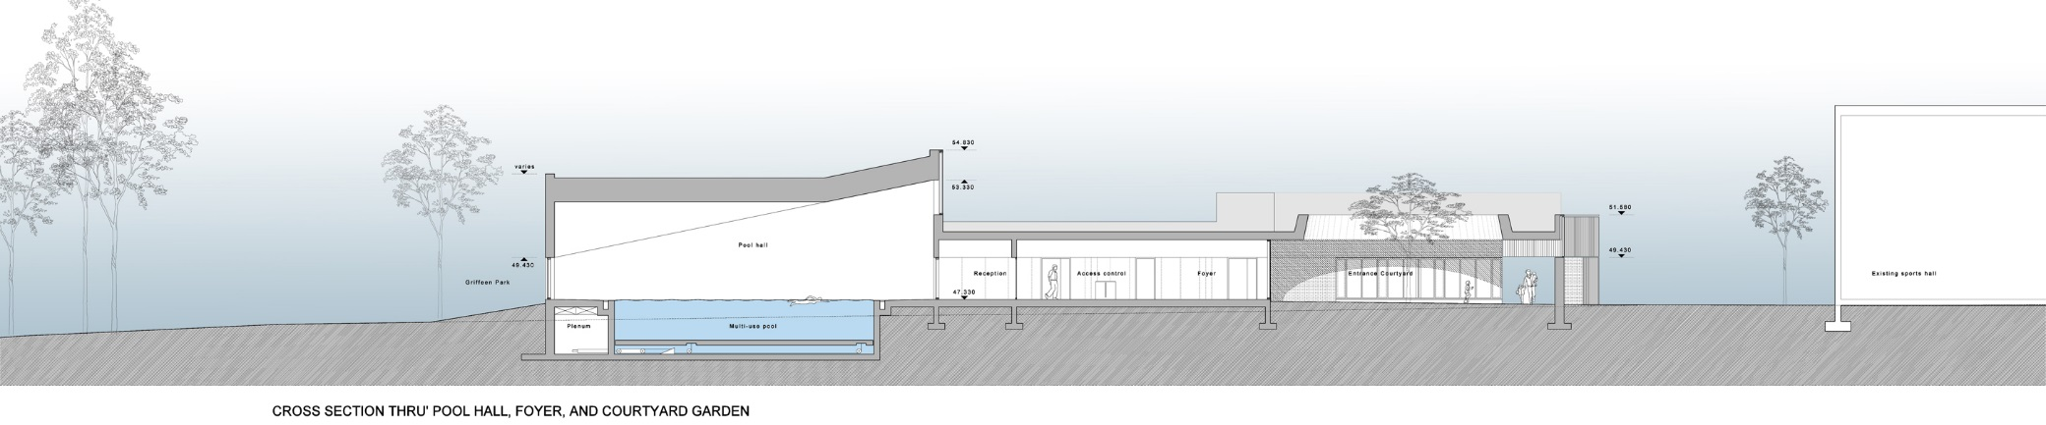
ABK
architects
ABK
architects
Lucan Pool
Proposed cross sections
April 2017

Slide 9
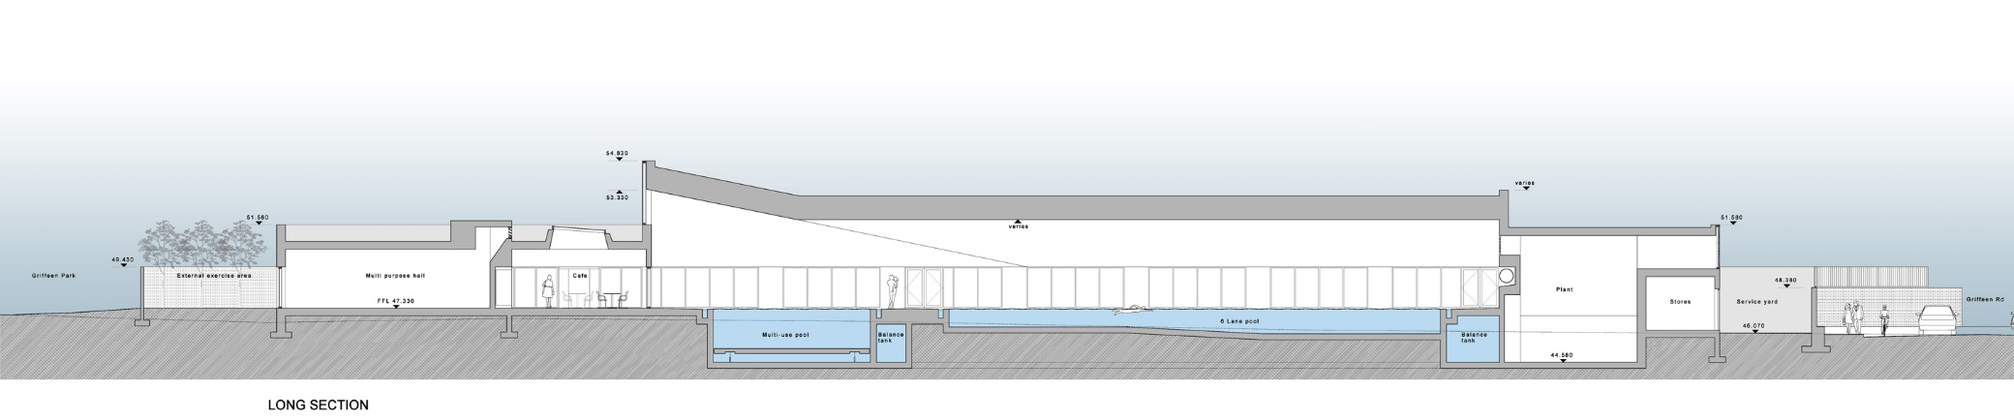
ABK
architects
ABK
architects
Lucan Pool
Proposed long section
April 2017

Slide 10
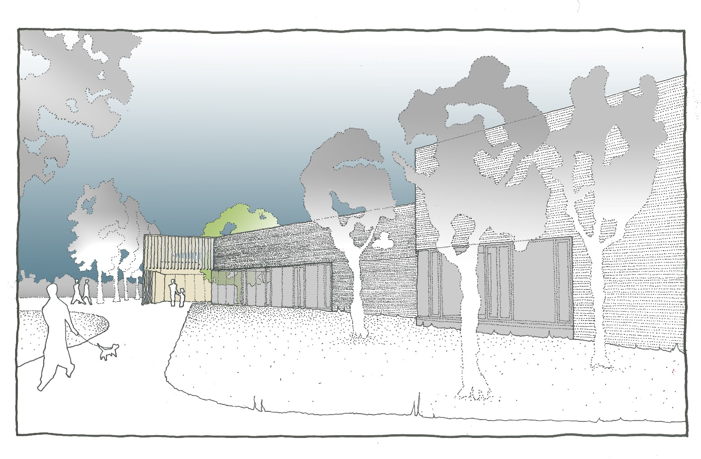
ABK
architects
ABK
architects
Lucan Pool
Sketch view towards main entrance
April 2017

Slide 11
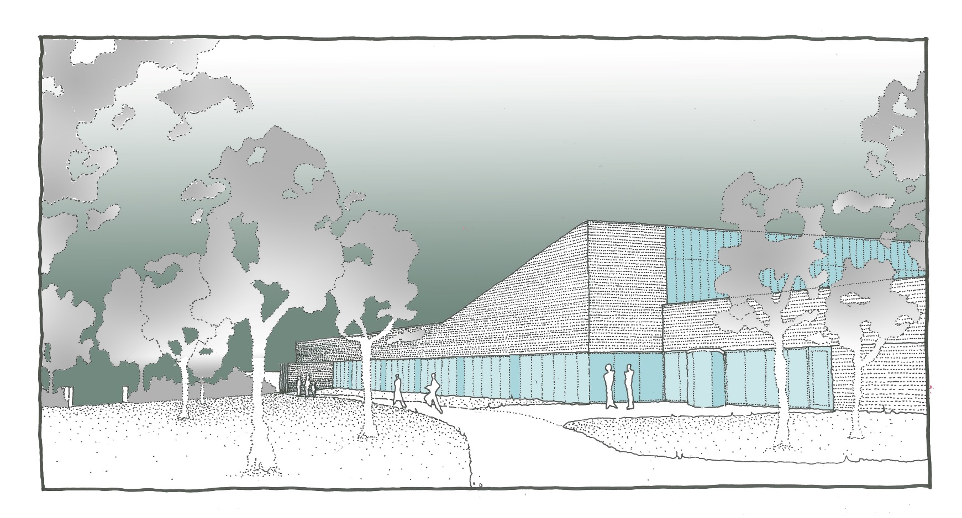
ABK
architects
ABK
architects
Lucan Pool
Sketch view from park towards pool and side entrance
April 2017

