Slide 1
Kilcarbery The Grange Integrated Housing Project
Council Meeting 10th April 2017

Slide 2
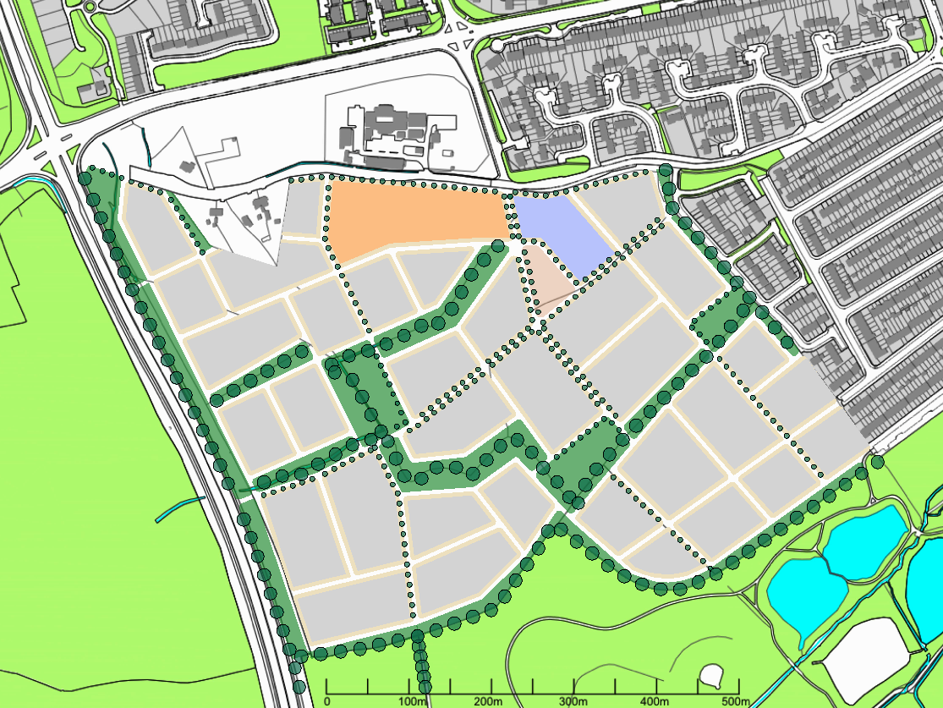
KILCARBERY – GRANGE: ARCHITECTURAL FRAMEWORK
Prepared By South Dublin County Council
EDDIE CONROY
County Architect
Architectural Services Department
April 10, 2017

Slide 3
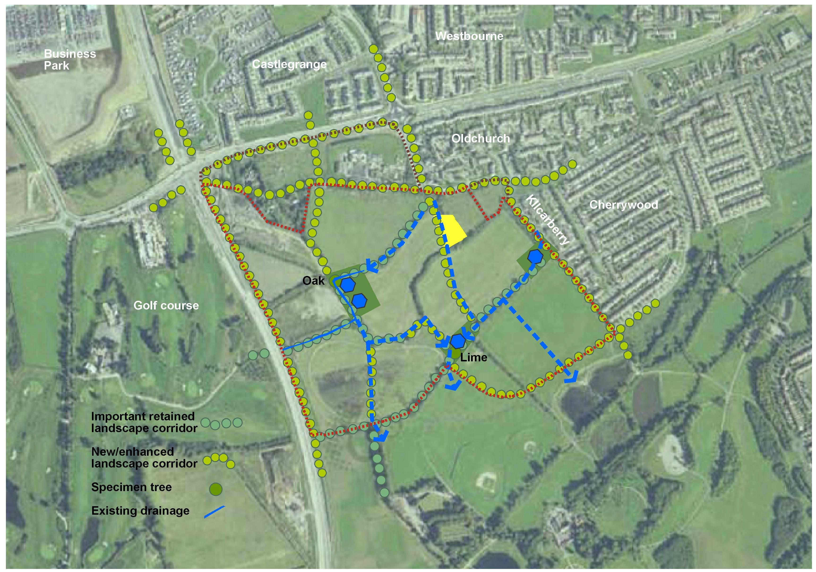
LANDSCAPE & SUDS

Slide 4
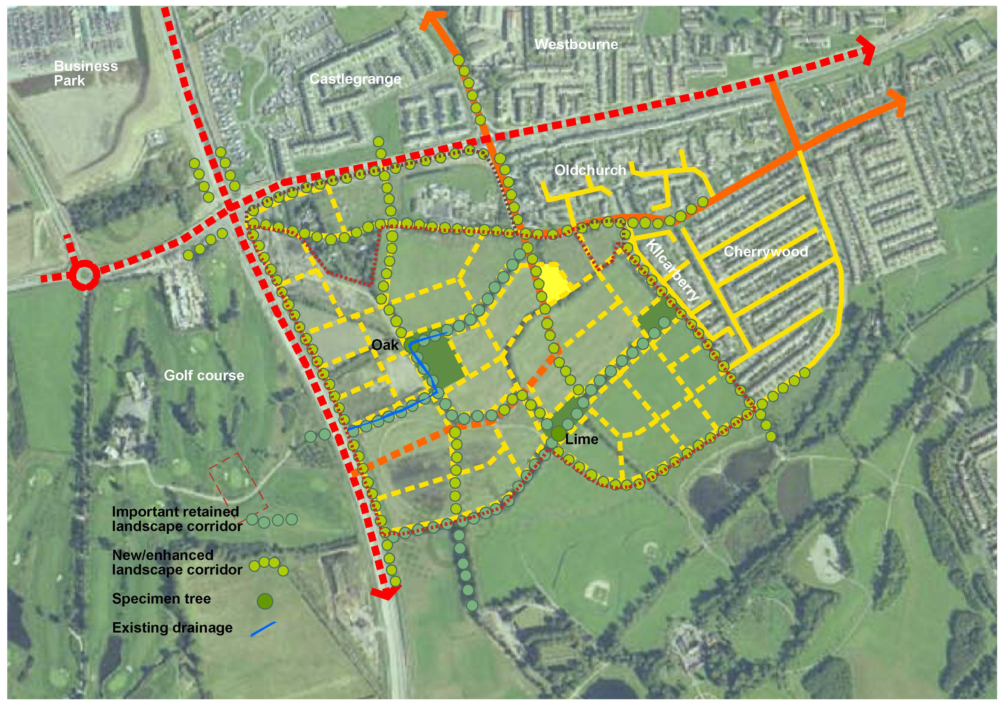
ROUTE & LANDSCAPE

Slide 5
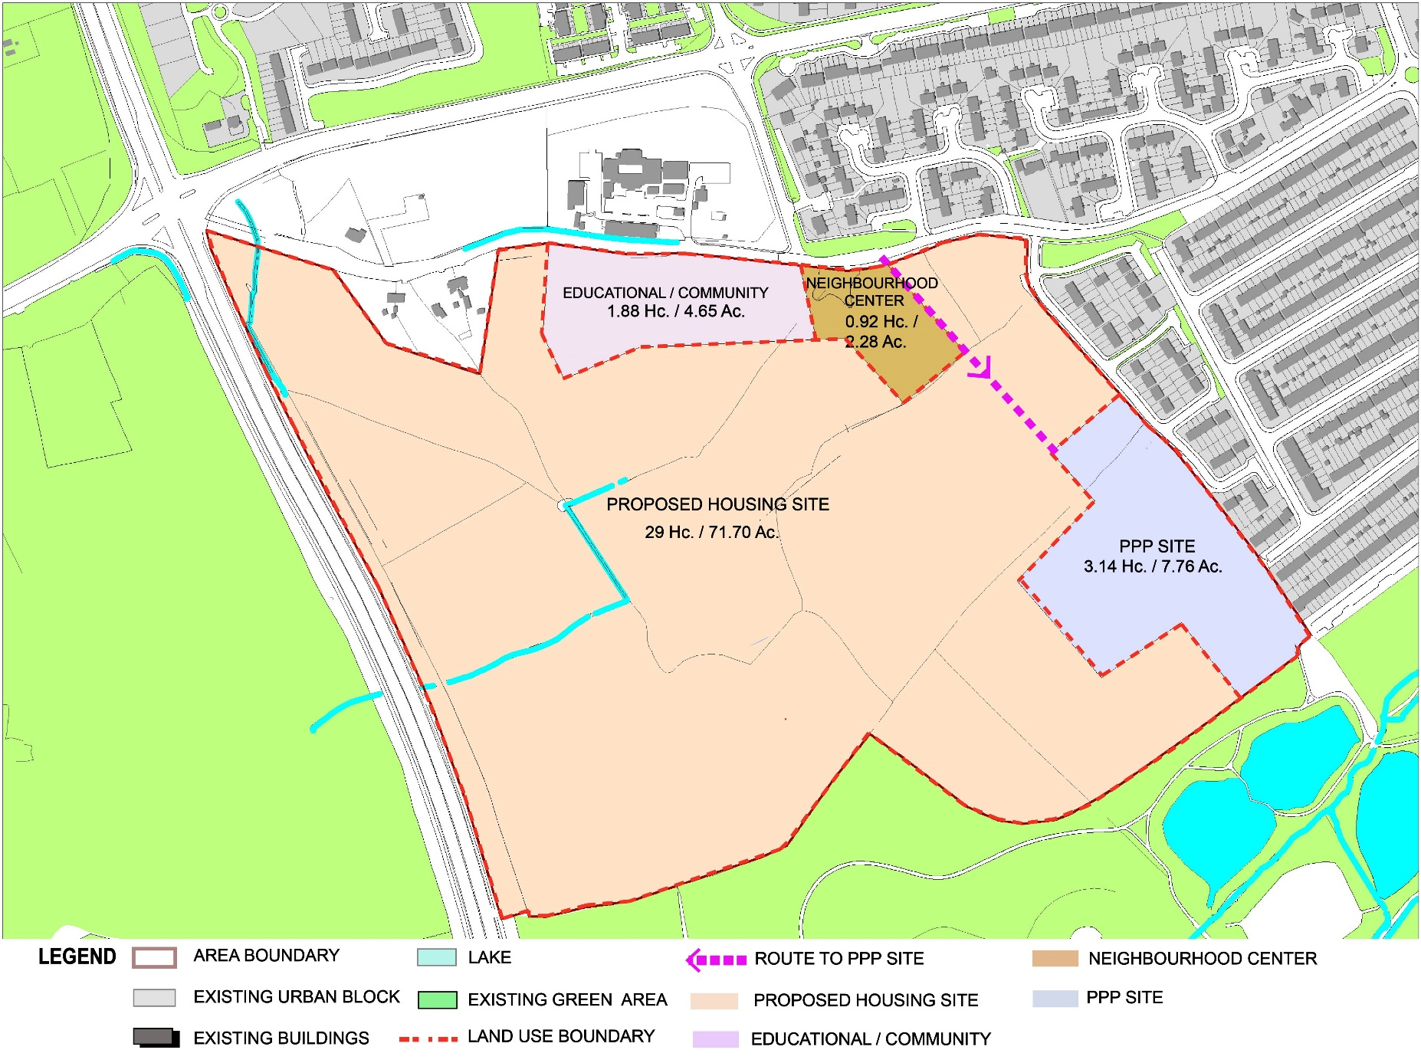
FUNCTION - LAND USE

Slide 6
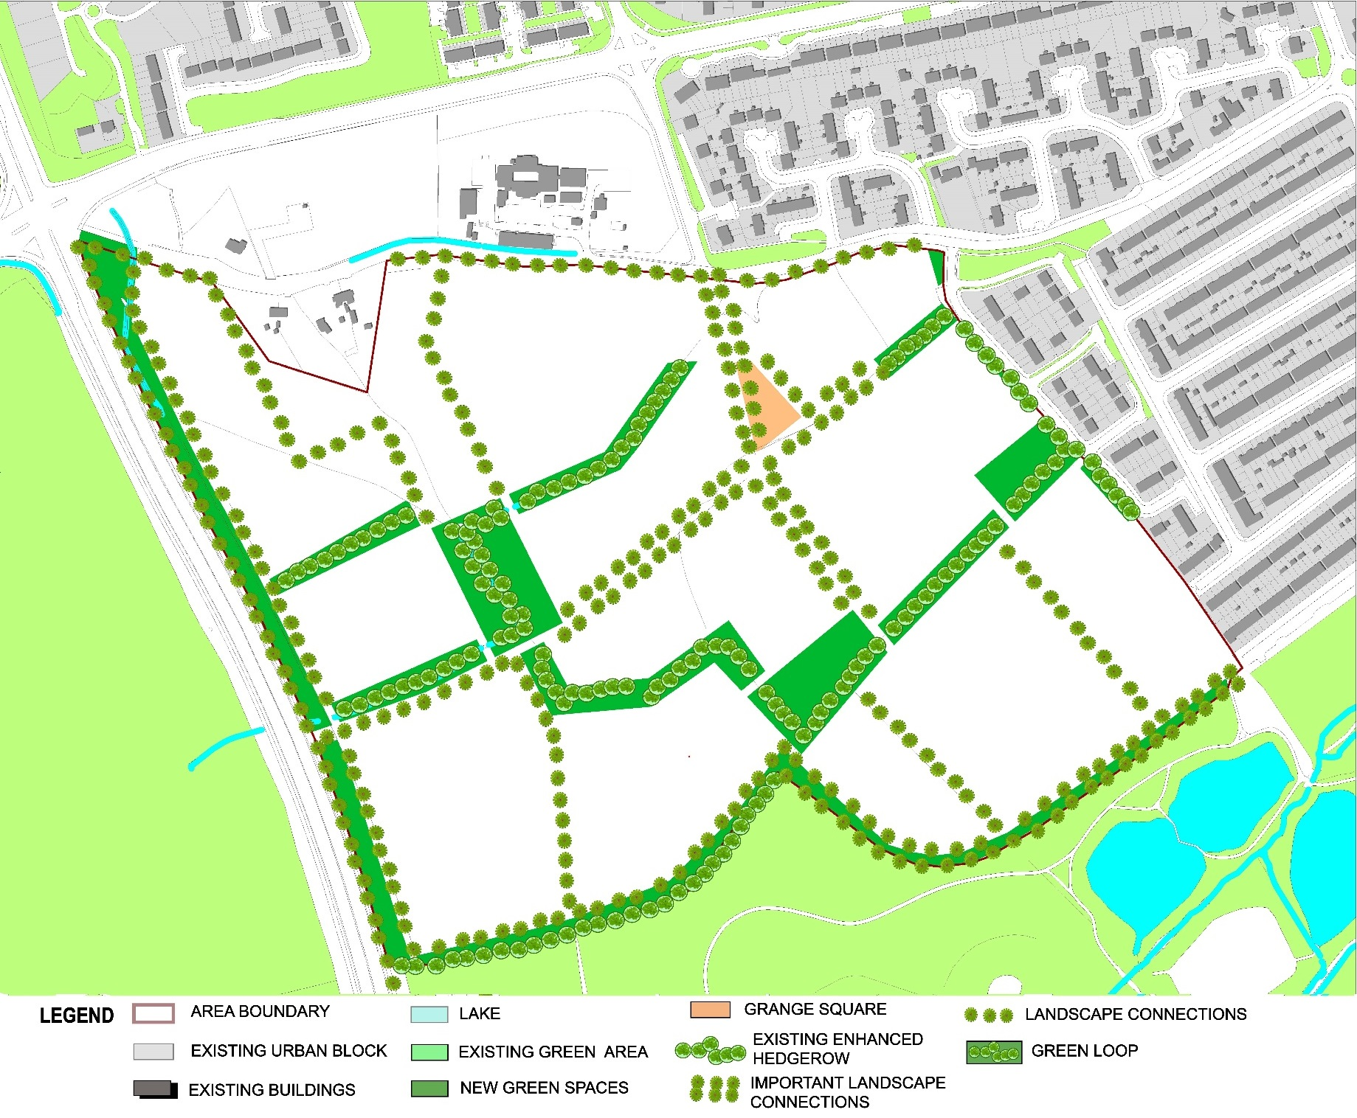
PUBLIC DOMAIN – LANDSCAPE

Slide 7
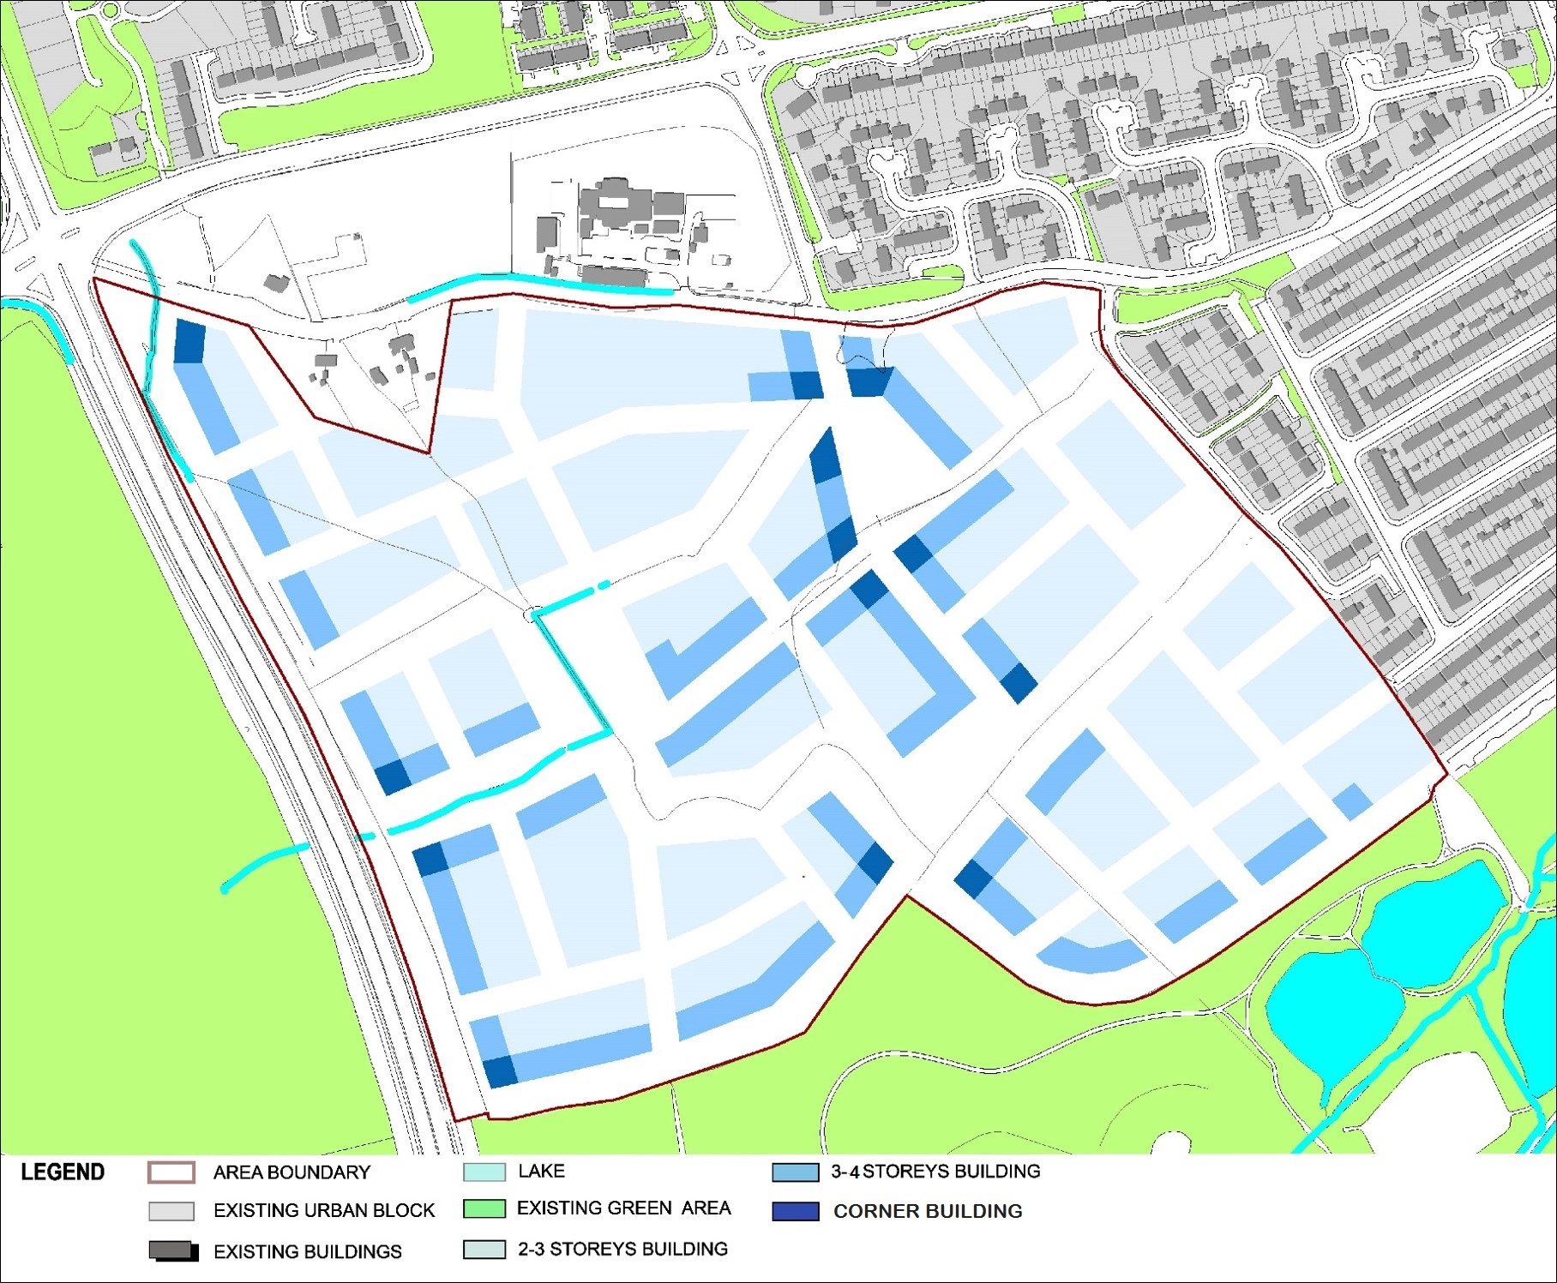
BUILT FORM - BUILDINGS

Slide 8
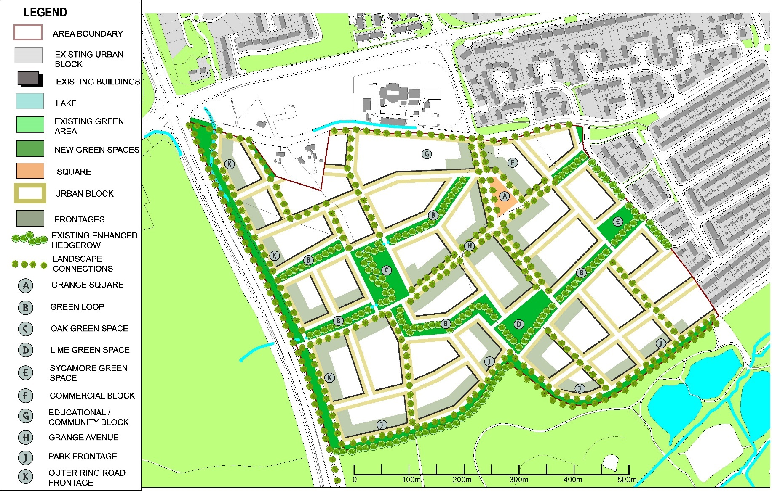
PRELIMINARY MASTERPLAN

Slide 9
Project
Kilcarbery Grange – 87.37 Acres – Entire site
4.65 Acre Site - Department of Education
2.28 Acre Site for retail
7.76 Acre – PPP – 108 Units
TOTAL UNITS – 892 + with SOCIAL 30%
PHASED DELIVERY – 5 year Construction programme
Social Units to be bought by Council with funding from DHPCLG
SOCIAL UNITS MIX - INTEGRATION
Site layout
Tenure mix
Programme of Delivery
Integration
Design Quality
Sustainability
Urban Design
Architecturally Quality
Economic Operator to obtain Planning Permission
Social Employment Clause

Slide 10
Process
PQQ
EVALUATE
SHORTLIST - 4
COMPETITIVE DIALOGUE - Theme Specific
TENDER
PLANNING
DEVELOPMENT AGREEMENT

Slide 11
Indicative Timeframes
Activity | Indicative Start Date
Advertisement on Etenders | 19 April 2017
PQQ Clarification Deadline | 8 May 2017
PQQ Submission Deadline | 9 June 2017
Council issues invitation to participate in dialogue to shortlisted Economic Operators | w/c 10 July 2017
Dialogue Stage(s) | July to October 2017
Council issues invitation to submit final tenders | October 2017
Council issues standstill letters | December 2017
Council and successful Economic Operator sign the Development Agreement | January 2018

Slide 12
Kilcarbery Integrated Housing Project
Accelerated Delivery
Replicable/Scalable
Meeting Housing Needs
Affordable Housing
Social Units

