Slide 1
Council Meeting 10th April 2017
Kilcarbery PPP
Section 85 proposal

Slide 2
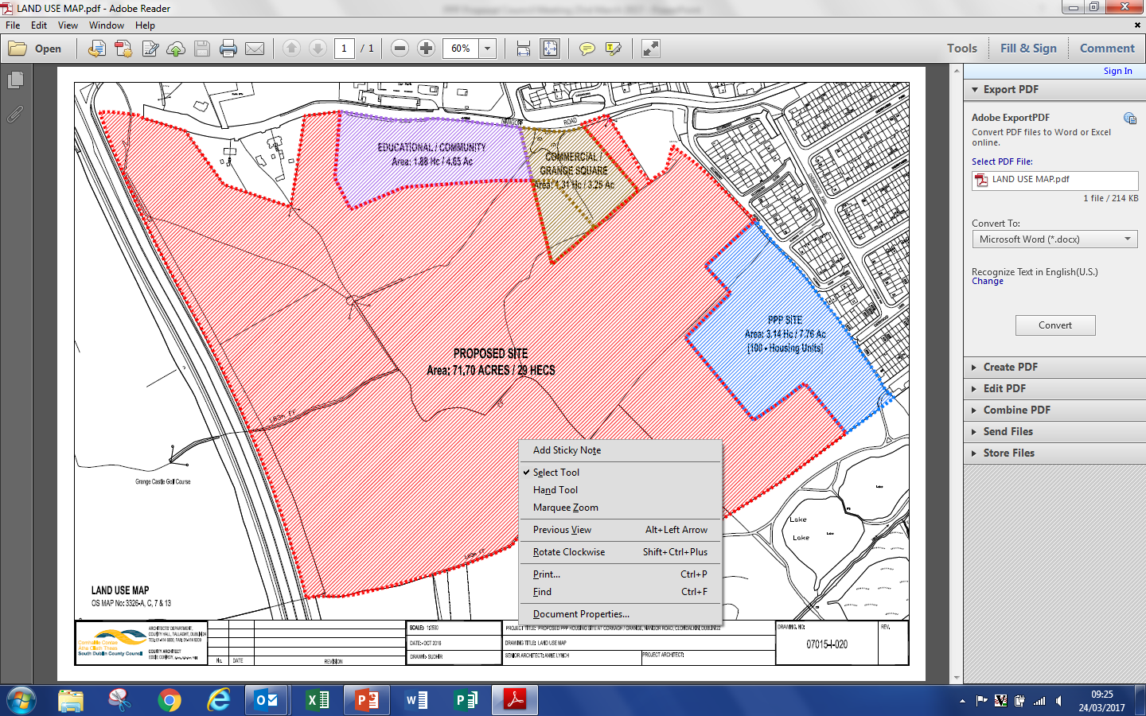
MAPS of Kilcarbery Grange – Highlighting PPP

Slide 3

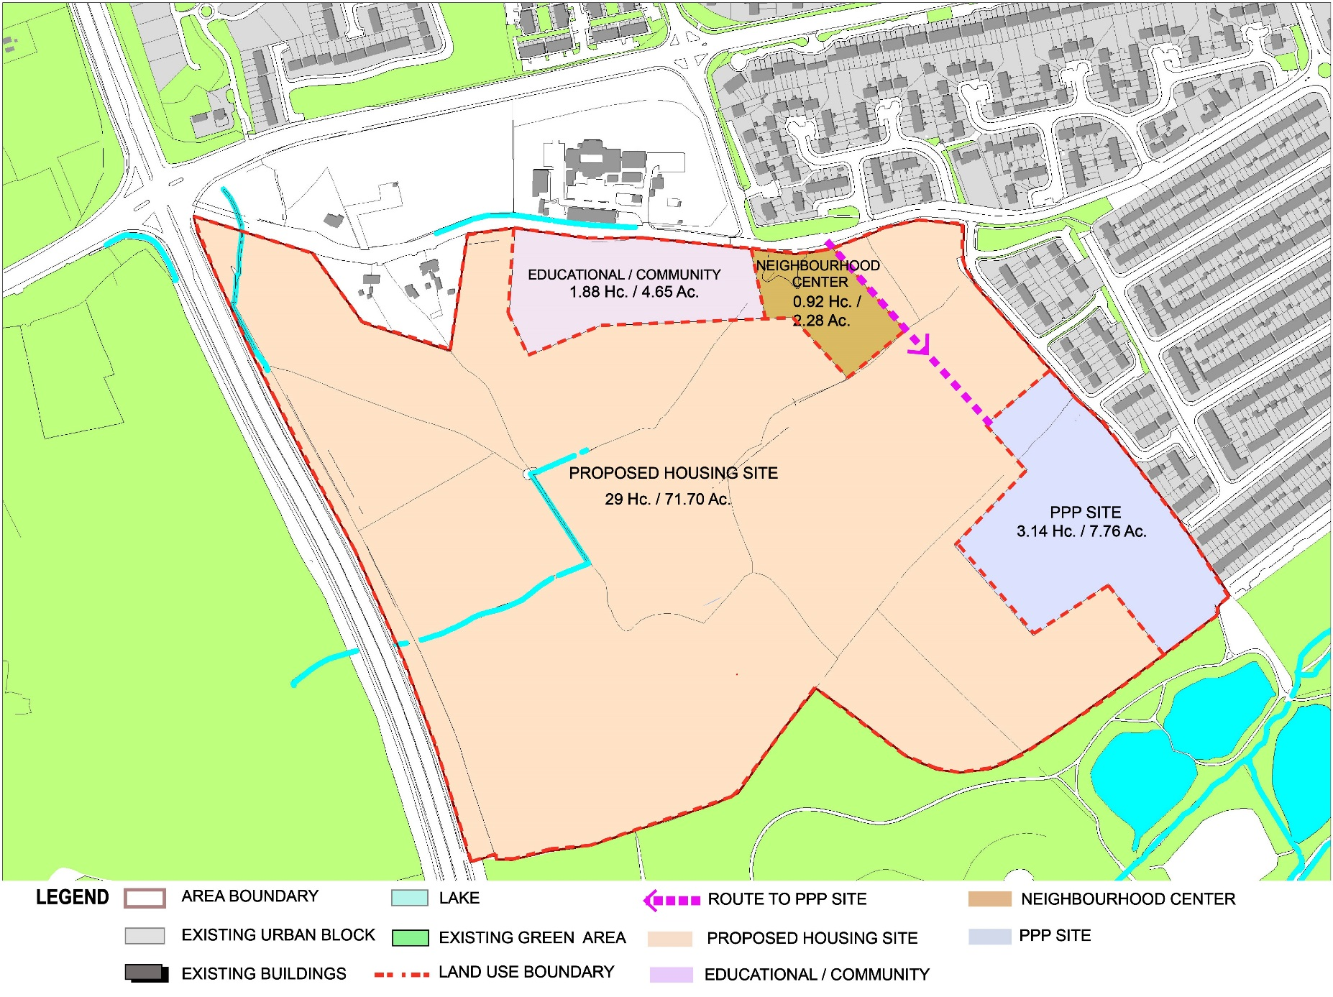
FUNCTION - LAND USE

Slide 4
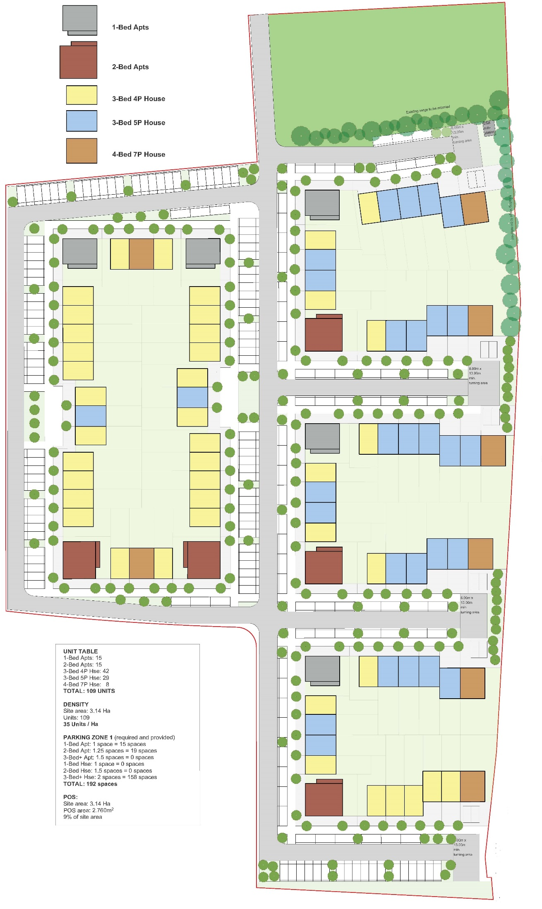
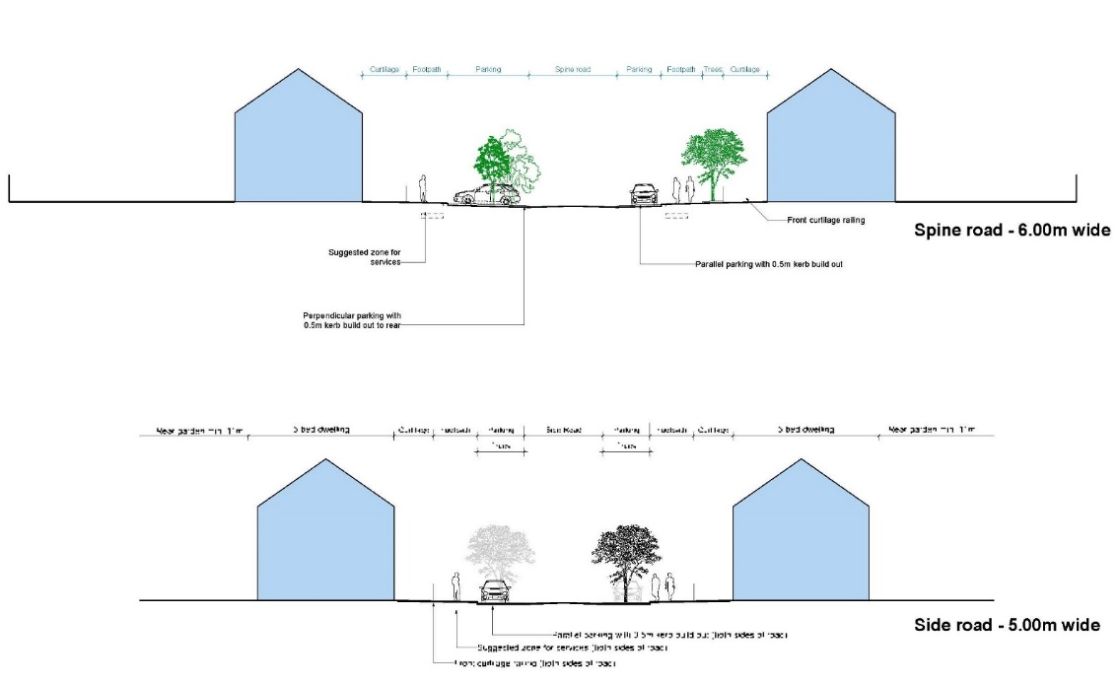
NTMA - PPP (108-UNITS)

Slide 5
PPP MODEL
The Social Housing PPP Programme will be a partnership between the Department of Housing, Planning, Community and Local Government, the Local Authorities and a specially formed project company to deliver 1500 new social housing units. To enable delivery to commence as quickly as possible, the PPP programme is being rolled out in three bundles of circa 500 units each to facilitate greater efficiencies and value for money through economies of scale.
The construction and maintenance of the social housing units is financed by private funds that would not otherwise be available to the State.
This Social Housing PPP Programme will be delivered through the “availability” based model. Under this type of contract the project company designs, builds, finances and maintains public buildings on sites provided by the local authority. Payment is made by the State only once construction of the buildings is complete and the units are ready to house tenants. The payment comprises a monthly ‘availability’ payment (or unitary charge) made over the term of the contract - 25 years. Payment of the full amount of monthly unitary charge is dependent on the building (or parts thereof) meeting both the defined availability criteria and the satisfactory provision of associated services by the project company.
In this PPP model, the project company assumes a large proportion of the risk over the life of the project.
PPP is part of a range of housing options being used by the Government in order to maximise social housing delivery
The SDCC Site is one of 6 Sites – 5 Local Authorities

Slide 6
The upfront construction cost is covered by private funds, which are additional to the Government's social housing capital programme. The State then pays for the construction and management of these homes over 25 years. Ownership reverts to South Dublin County Council after this period
Ownership of the sites is retained by the local authority, as is legal ownership of the units. The project company is granted a license under the contract, by the contracting authority to perform its duties on the sites. The units are not on the State’s balance sheet for the duration of the contract.
The NDFA has incorporated social clauses promoting employment opportunities for new and returning job market participants in all of its recent PPP contracts. It is anticipated that similar provisions will be incorporated for this programme with the exact formulation to be determined on review of the operation of the clauses currently being utilised and in the context of the recovering construction industry.

Slide 7
Key Stages in a Public Private Partnership

Slide 8
VFM/RISK
The PPP model is that the project company is selected via a competitive tender competition and is subject to a number of Value of Money tests.
Ownership of the sites is retained by the local authority, as is legal ownership of the units. The project company is granted a license under the contract, by the contracting authority to perform its duties on the sites. The units are not on the State’s balance sheet for the duration of the contract.
In the previous social housing PPP model, the social units were, in effect, to be paid for through the transfer of State-owned land to the private partner, and therefore were subject to risk associated with changing land values and general property prices. A collapse in the underlying land values directly impacted the delivery of those projects.
Transfer of State land to the project company is not part of the structure. Therefore, this PPP project is not exposed to similar risks.

Slide 9
SDCC ROLE
  South Dublin County Council will be responsible for obtaining the necessary planning approvals by way of Part 8.. and will retain the following functions in respect of the PPP social housing development in its functional area:
  Responsibility for the calculation of the tenant’s rents, in accordance with the local authority’s differential rent scheme.
  100% Nomination rights for the Units.
  The tenant is a local authority tenant. As such, their contractual agreement is with the local authority, just like other local authority tenants.
  The land will remain in the ownership of the local authority in whose functional area the development is constructed.
  South Dublin County Council will be the landlord for the purposes of the tenancy agreements with the tenants of the Units .
  The unit provides the same security of tenure as a social housing unit provided directly by a local authority. The completion of the PPP contract has no effect on the tenancy, as the unit will revert to the control of the local authority at the end of the contract.

Slide 10
TIMELINE
In the case of the Bundle 1 project, it is anticipated that the first units will be ready to move into in mid-2019. Activities completed to date include site selection, establishment of a project structure encompassing each of the participating local authorities and the procurement, by the NDFA, of a design team for the schemes. Design work is well underway and it is expected that the planning process will commence in the second quarter of 2017.
Following this the NDFA will conduct a public competition to select the project company who will then build out the units under the NDFA’s supervision. It is expected that the process to allocate tenants to the units will commence during construction so that the units can become occupied immediately on completion.
The project company will be selected via an advertised tender competition, held by the NDFA in accordance with EU and national procurement regulations. Competitions are typically two-stage with between 2 and 4 qualified parties invited to tender following a publicly advertised, competitive, pre-qualification stage.

Slide 11
RESOLUTION TO COUNCIL
Pursuant to Section 85 of the Local Government Act 2001 as amended South Dublin County Council hereby agrees to enter into an Agreement with Dublin City Council whereby Dublin City Council will carry out such of the functions of South Dublin County Council under the Housing Acts 1966 to 2014 in respect of the Social Housing PPP (Bundle 1) Programme only insofar as is required for the procurement and management of the Programme in respect of 108 social housing units at Kilcarbery The Grange PPP Site.

