Slide 1
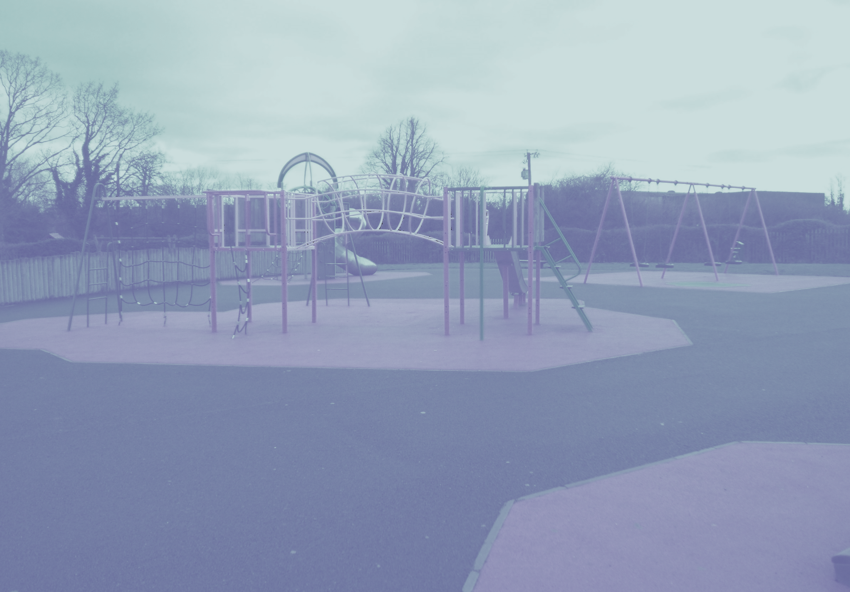

Report on the proposed Redevelopment of
Griffeen Valley Park Playground

Slide 2
Consultation details
Consultation carried out between 29 April- 13th May
Included 5 site visits by Council Officials
Contact with local primary schools and creches
160 completed questionnaires
Many hours of conversation with playground users.

Slide 3
Results of Questionnaires
The highest number of respondents were aged between 6-10 years old followed by children aged 0-5. In total over 80% of respondents were in this age bracket with very few older children currently using the playground.
There was an equally high demand for both an adventure play area and a traditional playground.
Climbing is the most popular activity but the majority of respondents ticked most boxes indicating that all of the play activities listed are equally important and should be included in the new playground
Respondents wanted a wide range of play equipment and natural play.
When asked about what style of play facility was desirable results showed a strong preference for modern wooden equipment in a landscaped setting. Less than 20% of people favoured metallic equipment like what presently exists on site.

Slide 4
From discussions with playground users and comments supplied on questionnaires:
People expect that Griffeen playground will be like Marley Park, Malahide Castle, Cabinteeley Park, Ardgillan Castle and other well-known playgrounds across Dublin.
An open plan layout would be preferable as the current division makes it hard to supervise children of different ages.
Toilet facilities are needed.
Better facilities are needed for disabled children
The playground is not interesting children over 7-8 so this should be addressed.
There needs to be more opportunity for active play- running around and free play.
The current playground is jaded looking and should be replaced with something modern.
The current playground is too small.
People want places to sit and picnic benches so that they can spend more time in the park

Slide 5
Brief for Designers
Increase size of the playground- new fence and entrances
Additional equipment for both Junior and Senior play areas
Additional accessible equipment
Modern open plan design with wooden equipment in a landscaped setting
Reduction in hard surface areas
Repair of existing equipment
More free play and active play areas
Include natural play areas
Include additional equipment for children aged 6-12
More group play opportunities and climbing
Budget €250,000

Slide 6
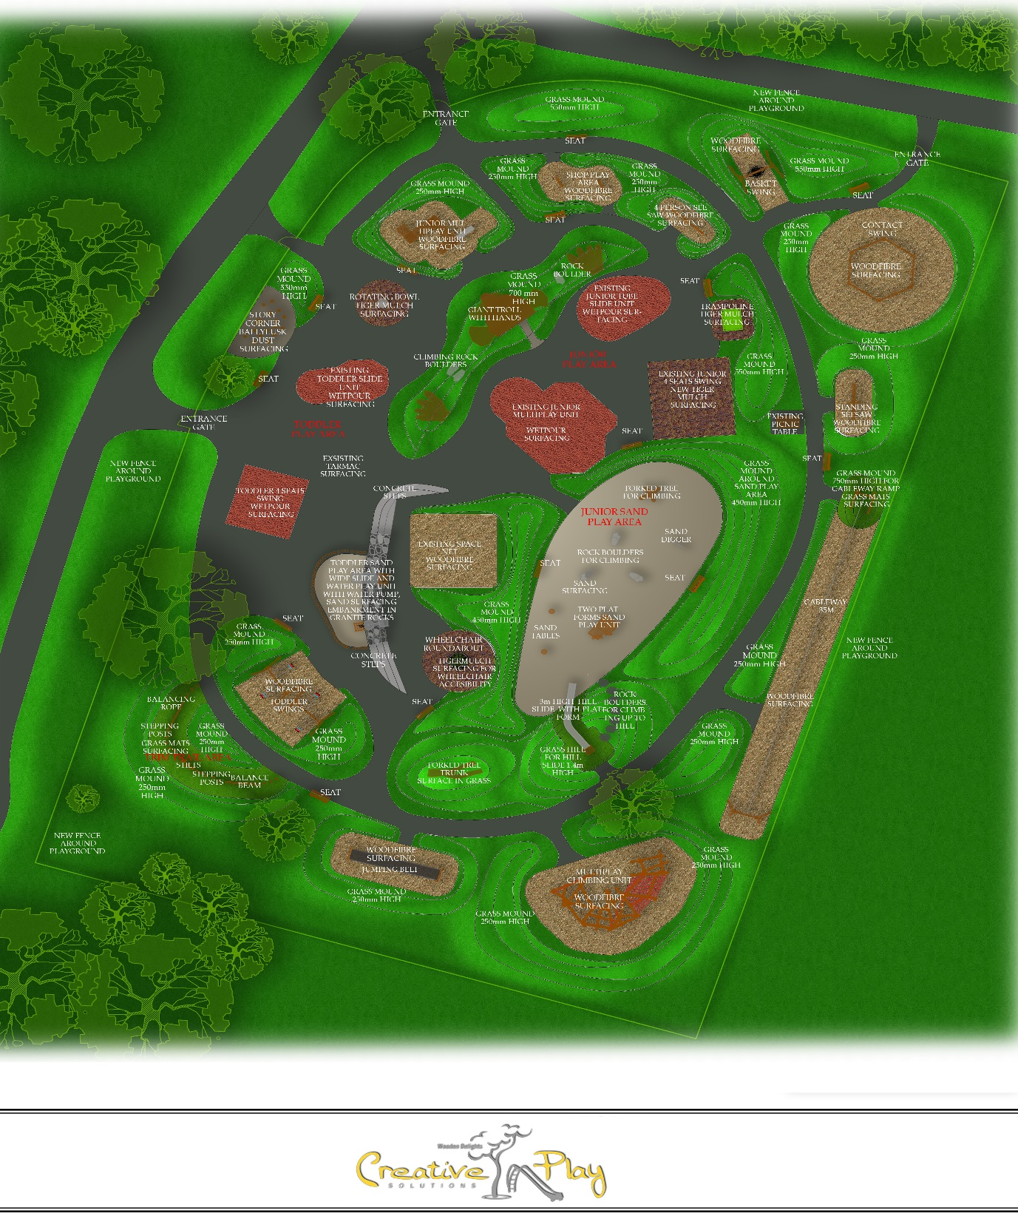
Winning tender by:
Creative Play Solutions
Creative Play Solutions are a very experienced and professional firm who have worked for us previously in Rathcoole Park and Knockmitten Community Centre playgrounds.
The design met all of the criteria in the brief.
Scored very highly in every category including play value, quality of equipment, ease of maintenance and design for children with disabilities.
The design makes really great use of the extended area.
Great free play and natural play features throughout.
Many more group play items and equipment suitable for older children.

Slide 7
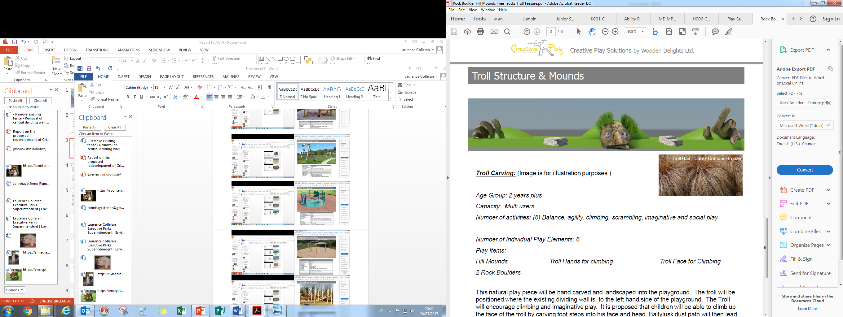
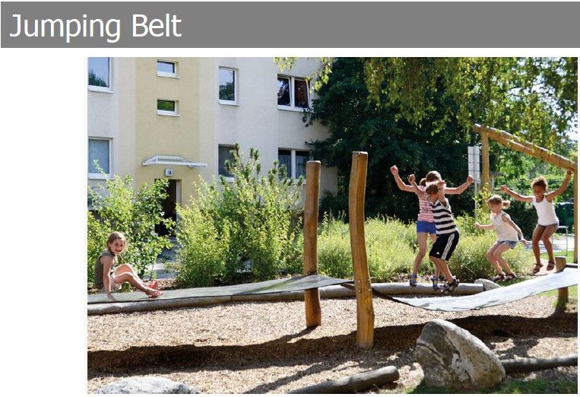
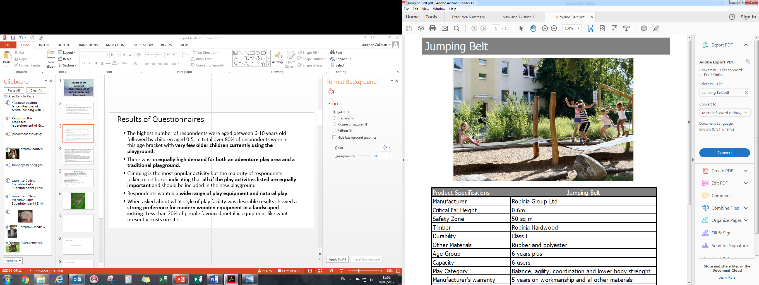
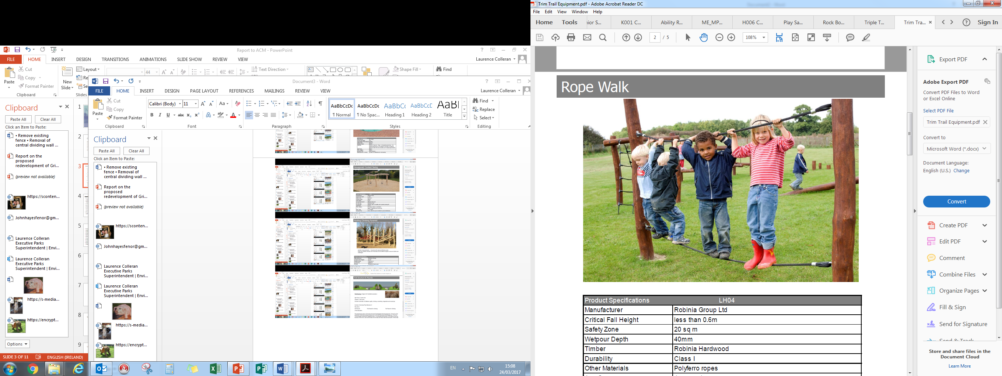
Features of New Design

Slide 8
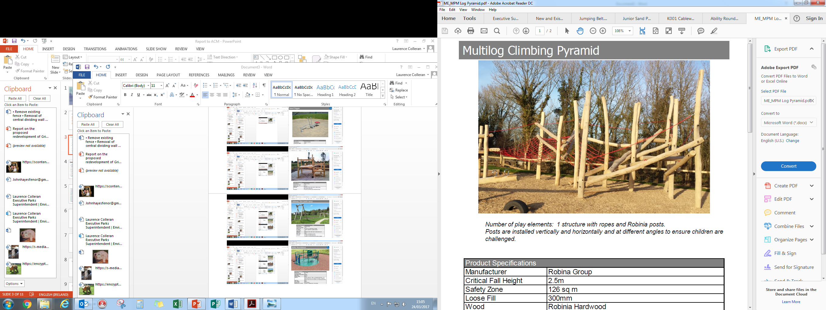
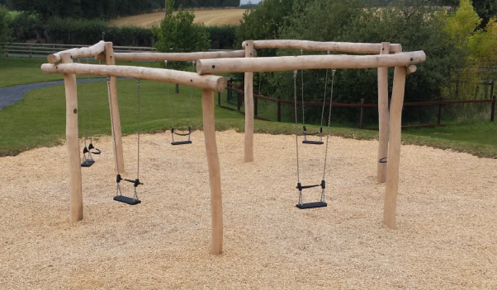
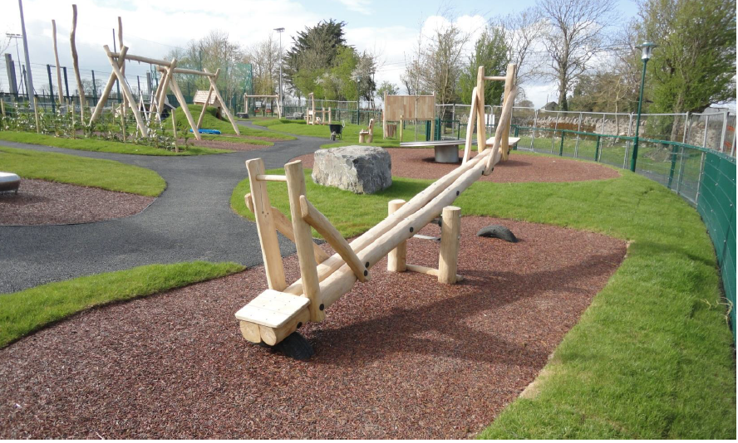
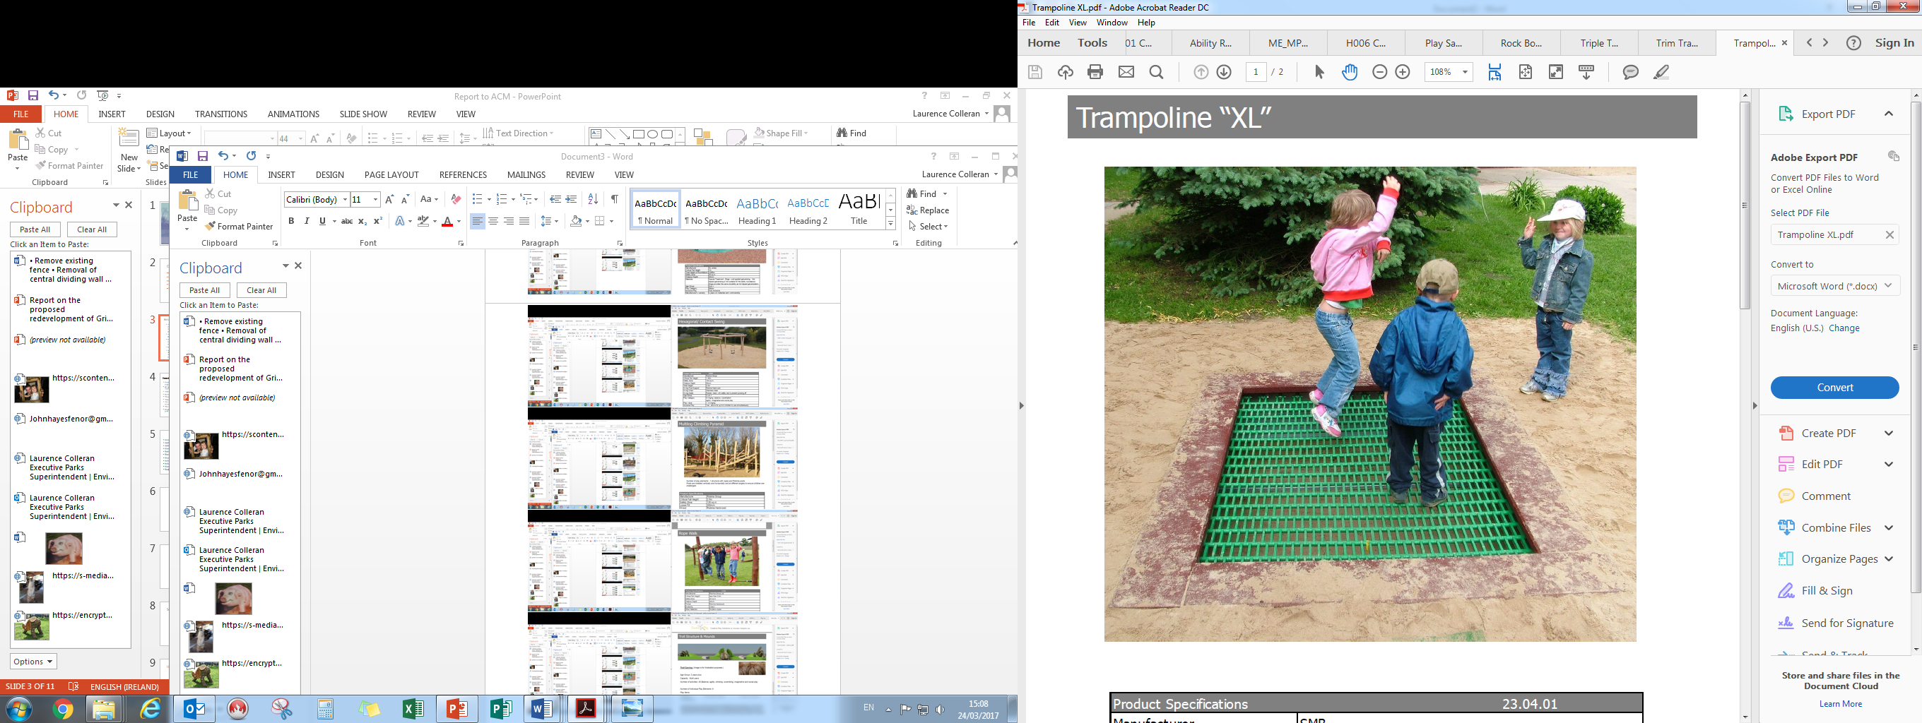

Slide 9
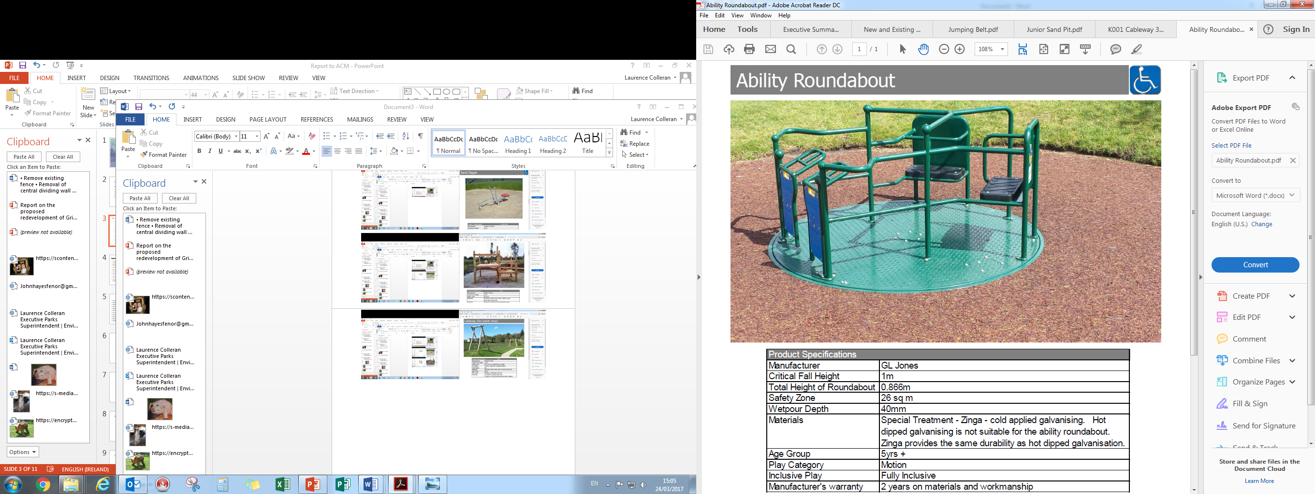
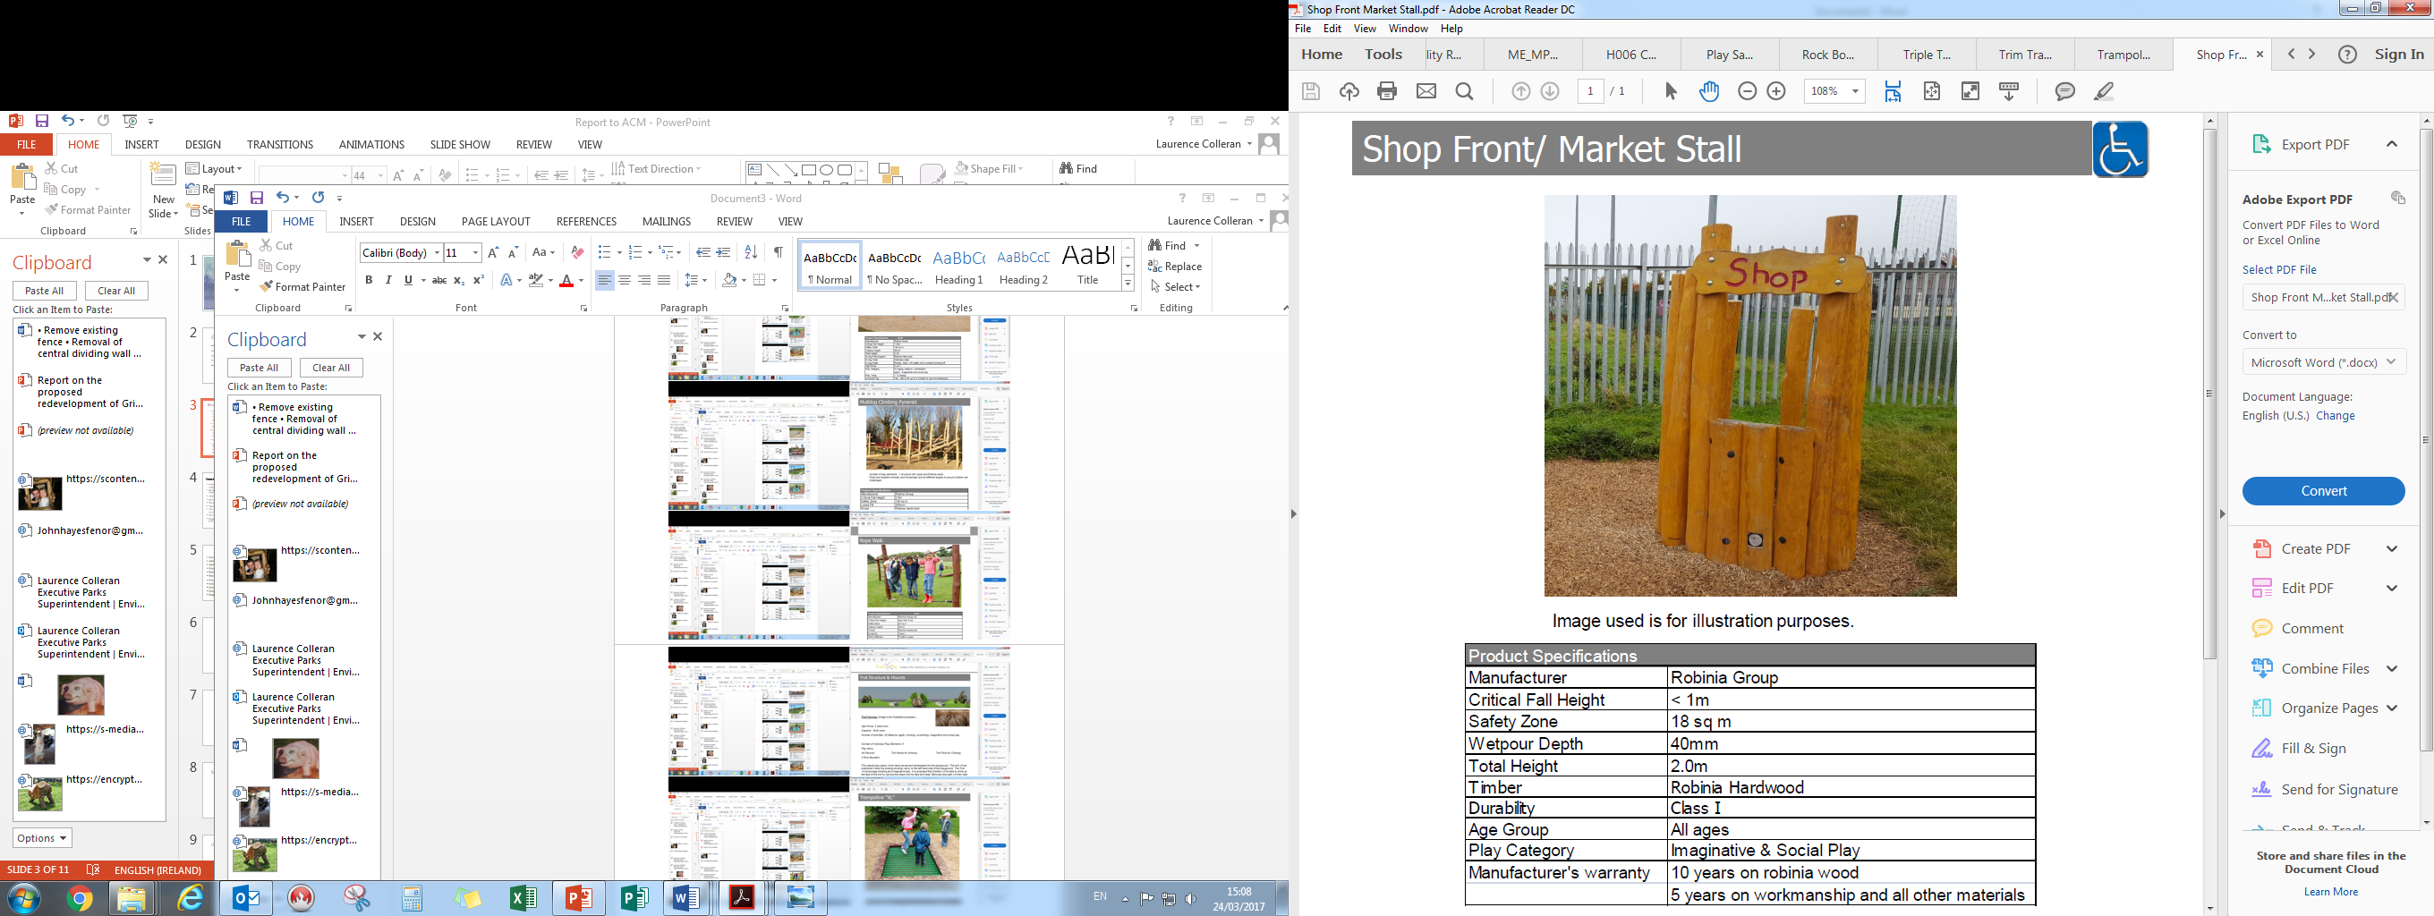
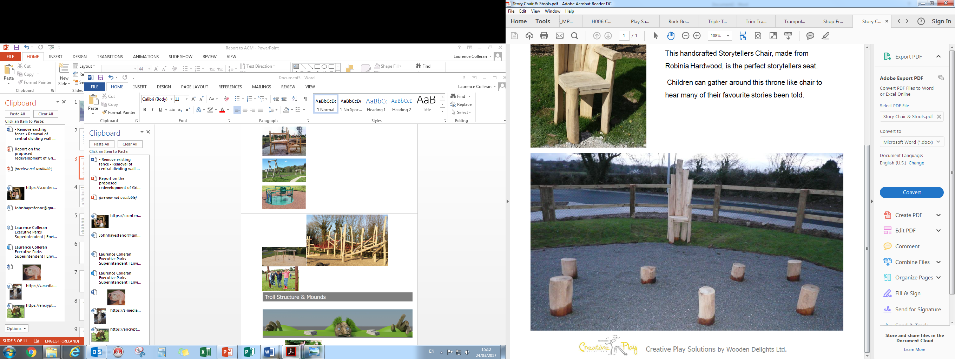

Slide 10
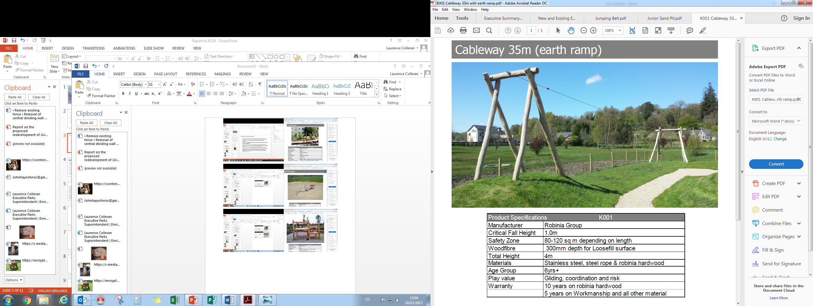
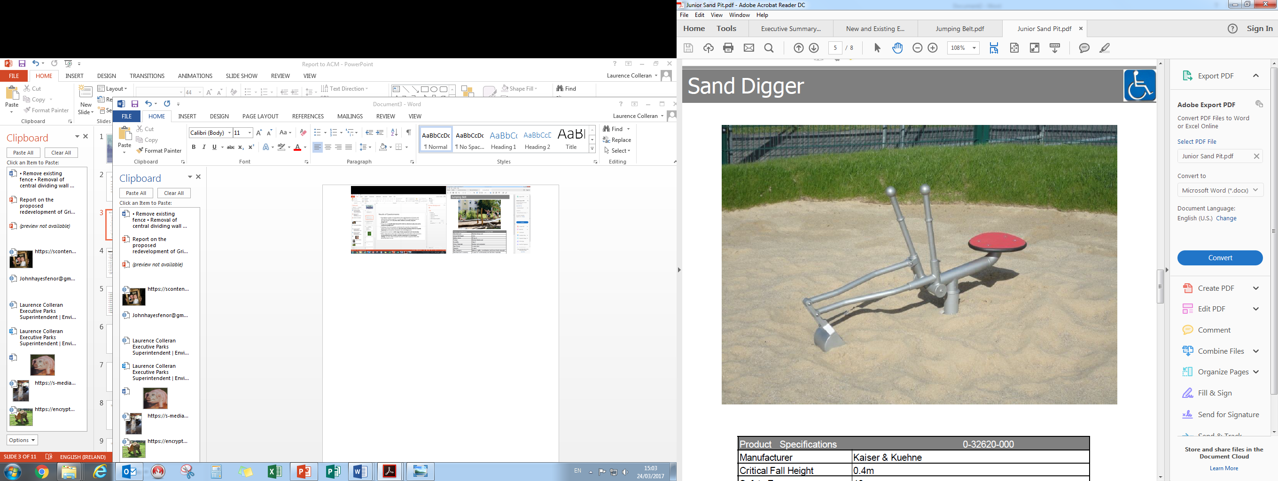
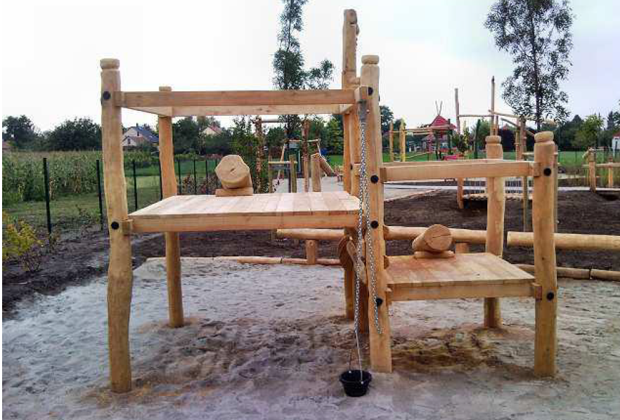

Slide 11
Schedule
Site meetings have already taken place and the equipment is on order.
The site survey work and Health and Safety documentation is currently being undertaken.
We have asked the contractor to complete the works outside of the primary school holidays.
Works are due to commence following the Easter break and are scheduled to be completed prior to the summer break.

