Slide 1
N4 & N7 Corridor Study
Summary
Eoin Gillard
Head of Strategic & transport Planning
Transport Infrastructure Ireland
16th February 2017

Slide 2
Study Area

Slide 3
Objectives
Describe and quantify the existing transport network in the Study Area, and the factors that influence existing behaviour;
Understand the future growth in population, employment, retail, leisure uses and underlying economic activity that will drive future increases in travel demand;
Develop and assess alternative approaches for responding to future demand using a combination of control measures and infrastructure investment on National and Regional/Local Roads to facilitate growth in population and employment, and corresponding increases in economic activity; and
To achieve this in a way that seeks to address on-going capacity issues, provide for short term growth and facilitate the future provision for public transport and other modes.

Slide 4
Study Area Projections TII & SDCC
Future year demand projections based on full build out of SDCC Development Plan 2016 to 2022
A horizon year of 2023 was chosen for the study.
TII | 2011 | 2023 | % growth | 2030 | % growth
Population | 252,009 | 268,449 | +7% | 278,039 | +10%
Jobs | 94,161 | 105,881 | +12% | 112,718 | +20%
SDCC | 2011 | 2023 | % growth | 2030 | % growth
Population | 252,009 | 279,969 | 11% | 299,339 | 19%
Jobs |  | No Data
*Jobs | 94,161 | 115,471 | 23% | 127,902 | 36%
* Assumed Growth in Jobs Based on Ratio of Population to Job Growth NTM
Notes:
National Projections forecast more growth in existing urban areas – therefore, stronger growth in shorter distance travel by car

Slide 5
SDDC Forecast Population 2030 Distribution Process
19%
12%
16%
9%

Slide 6
NTA Do Minimum Scenario Impacts
Consider reduction in highway demand due to committed schemes
Examination of the future year demand profiles in the NTA’s ERM
Scenario | Mode Split | TII Forecast | SDCC Forecast | Difference
2023 DM AM Central Growth | TII | 73,662 | 75,615 | 2.65%
 | NTA | 71,595 | 73,480 | 2.63%
Reduction in Highway Demand NTA Do Min Strategy |  | -2.81% | -2.82%
Notes:
National Projections forecast more growth in existing urban areas – therefore, stronger growth in shorter distance travel by car

Slide 7
SDCC Future Roads Proposals
Western Dublin Orbital Route
Committed Schemes:
Newlands Cross Upgrade
Adamstown Road Improvement
Nangor Road Realignment

Slide 8
Potential Local Improvement Schemes Assessed
A scoping exercise was undertaken with SDCC and TII from which a range of potential schemes within the Study Area were identified and brought through a sifting exercise (modelled in the LAM).
Fonthill / Cloverhill Distributor Road;
Clonburris Special Development Zone (SDZ) Internal Link Roads;
Western Dublin Orbital Route;
Baldonnell Road Upgrades;
Nangor Road Upgrade;
Fonthill Road Upgrade;
Grange Castle Road Upgrade;
Fonthill Road Signals Upgrade;
Grange Castle Road Signals Upgrade;
Rathcoole Bypass;
New Rathcoole Interchange; and
Hillcrest Signal Optimisation.

Slide 9
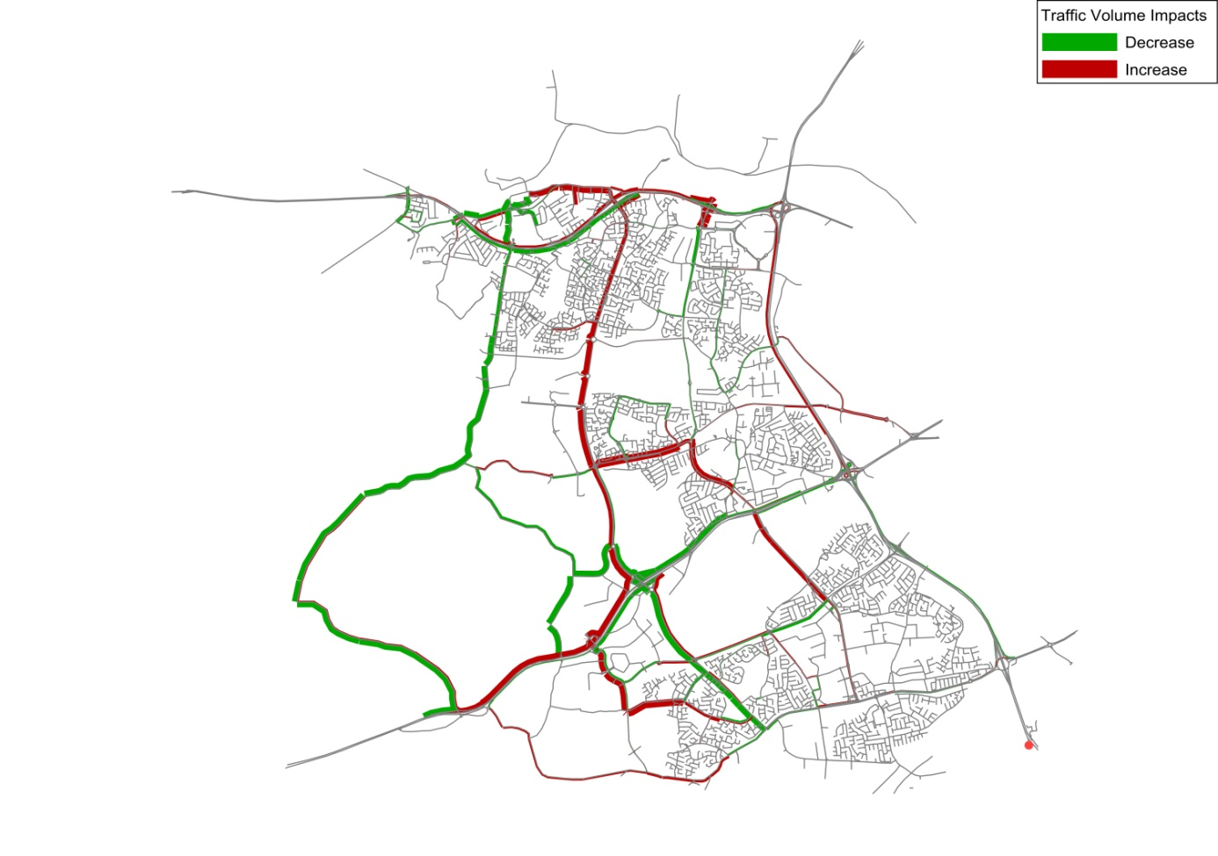
Most Beneficial Scheme Brought forward for a Do-Something Scenario
Fonthill Road Junction Improvements
Scheme: Converting existing roundabout to coordinated signalised junctions
Fonthill Road / N4 Westbound Off Slip;
Fonthill Road / Liffey Valley Shopping Centre;
Fonthill Road / Coldcut Road; and
Fonthill Road / Nangor Road Roundabouts.
Benefits: Congestion relief to Grangecastle Road, Nevinstown Road and Coldcut Road
Grangecastle Road Junction Improvements
Scheme: Additional stacking space for turning traffic at the Grangecastle Road / Lucan Road junction, and the optimisation and co-ordination of existing traffic signals at the following junctions:
Fonthill Road / N4 Westbound Off Slip;
Fonthill Road / Liffey Valley Shopping Centre;
Benefits: Congestion relief to the Newcastle Road, the N4, the local road network in the vicinity of Kingswood Business Park and to the N7 and R136.

Slide 10
Most Beneficial Scheme Brought forward to the Do-Something Scenario
Western Dublin Orbital Route
Scheme: Single carriageway connecting from the existing R120 (Newcastle Road) at Greenogue Business to the existing R403 south of Weston Aerodrome
Benefits: The new link would provide significant relief to the Newcastle Road, Grangecastle Road and sections of the Fonthill Road as well as some relief to the M50.
Clonburris Internal Road Network
Scheme: A series of internal roads linking onto Fonthill Road and Grangecastle Road from the Clonburris Strategic Development Zone (SDZ).
Benefits: Congestion relief benefits to the Nangor Road, the Fonthill Road and to the N7,

Slide 11
Transport Modelling Scenarios
Scenario | Schemes Include | Year
Do Something | Western Dublin Orbital Route; Fonthill Junction Improvements; Grangecastle Junction Improvements; SDCC Road Objectives. | 2023
Do Something Sensitivity A Ongar Link | Ongar Link Road; Western Dublin Orbital Route; Fonthill Junction Improvements; Grangecastle Junction Improvements; SDCC Road Objectives. | 2023
Do Something Sensitivity B Ongar + M50 DM | M50 Demand Management; Ongar Link Road; Western Dublin Orbital Route; Fonthill Junction Improvements; Grangecastle Junction Improvements; SDCC Road Objectives. | 2023

Slide 12
Preferred Strategy (Do-Something vs Do-minimum)

Slide 13
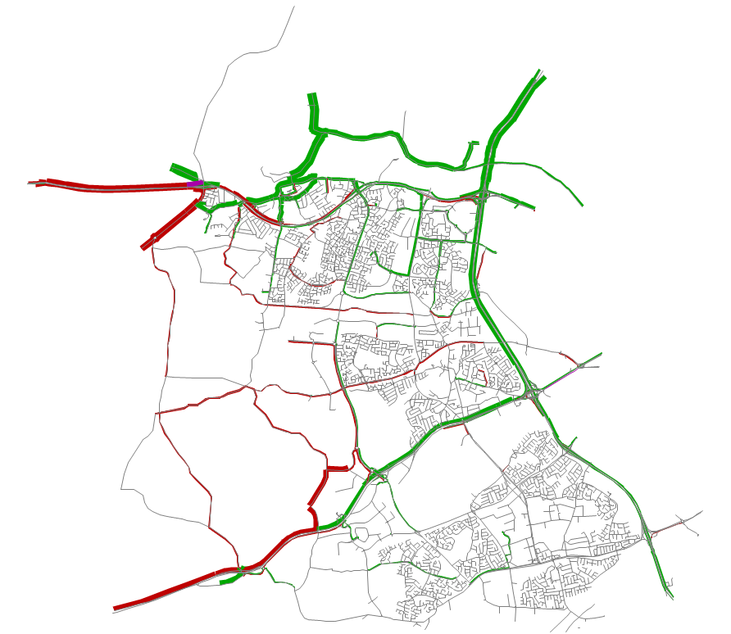
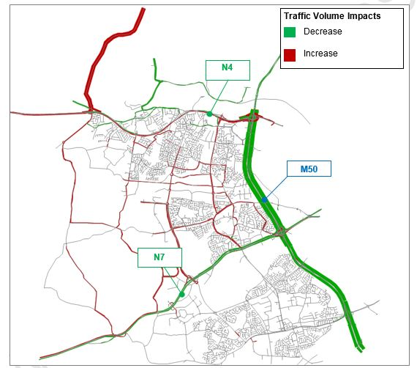
Impact of Ongar Link (N4-N3 Link) and M50 DM
Traffic Volume Impacts
Decrease
Increase
Ongar Link Road
R109
N4
M50
N7
Ongar Link Road Sensitivity
M50 Demand Mgt. Sensitivity

Slide 14
Conclusions
In order for development to continue in line with SDCC projections, improvements to the road network are required
These improvements must be compatible with future public transport provision in the Study Area and support the principles set out in the NTA’s strategy and guidance
Implementation of identified SDCC Road / Traffic Schemes results in improved usage of the local road network and a reduction in demand on strategic links
The provision of the Ongar Link Road and the M50 Demand Management provide clear and significant improvements to the National Road network in 2023
Beyond 2023, the implementation of public transport service improvements contained within the NTA’s Transport Strategy 2016 to 2035 will aid in supporting the sustainable development of the Study Area.
It is recognised that with the exception of the M50 Demand Management Strategy the recommendations outlined in the Study will need to be delivered by the local authorities.

