Slide 1


South Dublin County Council
Vacant Site Register: Update
Presentation to Land Use Planning and Transportation SPC
16th February 2017

Slide 2

Background & Context
Why?
Urban Regeneration & Housing Act 2015
Construction 2020 (Action 23)
Planning Policy Statement 2015
- Active Land Management
Rebuilding Ireland
When?
January 1st 2017

Slide 3

Background & Context
What is a Vacant Site?
(1) Under the legislation, a site (any area of land exceeding 0.05 ha) is considered vacant in the following circumstances, if—
(a) in the case of a site consisting of residential land—
(i) the site is situated in an area in which there is a need for housing,
(ii) the site is suitable for the provision of housing, and
(iii) the site, or the majority of the site, is vacant or idle,
and
(b) in the case of a site consisting of regeneration land—
(i) the site, or the majority of the site, is vacant or idle, and
(ii) the site being vacant or idle has adverse effects on existing amenities or reduces the amenity provided by existing public infrastructure and facilities.

Slide 4

Progress to Date
January 1st 2017:
Information published on SDCC website detailing what the Vacant Site Register/Levy is;
Copy of Register published (unpopulated);
Notifications posted on Councils social media pages and news item on website at 9am on January 1st 2017.
February 2017
Finalising potential sites to be included and identification of those to be notified (information from land registry etc.);
Notification letters/notices prepared;
First phase of letters to issue week of February 20th.
March 2017
Landowners of potential vacant sites have 28 days to respond to letter.
April-May 2017
Planning Authority consider submissions received;
Issue notification to landowners if site to be entered on Register.
June 2017
Sites entered onto Register; any site may be subject of an appeal to An Bord Pleanála.

Slide 5
Vacant Site Register - Summary of Key Stages
1. Assessment of Potential Sites
June – December 2016
Site Assessment on Residential and Regeneration zoned lands
3. Engagement with Landowners
February 2017
SDCC writes to landowners of potential vacant sites
Landowner has 28 days to respond to Planning Authority
Notification from SDCC of entry on Vacant Site Register
Landowner has opportunity to appeal placement on VSR to An Bord Pleanála
4. Vacant Site Levy
June 1st 2018
SDCC writes to landowners of vacant sites
Landowner can appeal the market value to the Valuation Tribunal
January 1st 2019
Planning Authority commences collection of Levies
Levy is paid annually until the site is developed or brought into use
Vacant Site Register
January 1st 2017….
Ongoing Maintenance
2. Establishment of Vacant Site Register
January 1st 2017
Public Notification of the Establishment and Maintenance of a Vacant Site Register
Legend
Current Stage

Slide 6
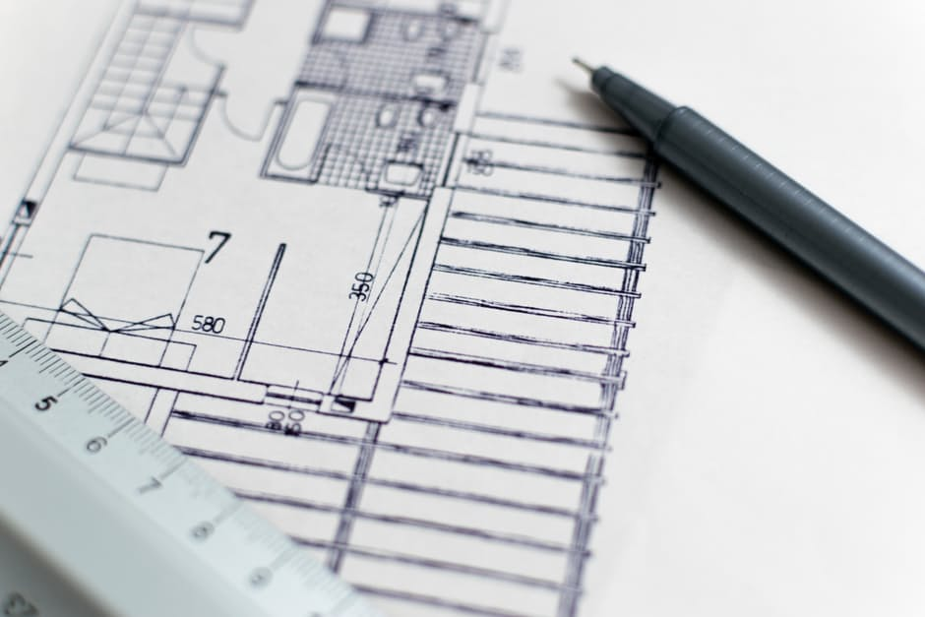
Vacant Site Register Preliminary High Level Figures
Number of potential Vacant Sites: c50 – 75
- Notification letters will be issued on a phased basis
Cumulative area of potential Vacant Sites: c155ha
Total area of potential Vacant Sites subject to further assessment: c70 - 75ha
Cumulative market value of potential Vacant Sites: €180m - €200m
Note: These figures are very much draft as the development of the VSR will be both an iterative and ongoing process.

Slide 7

THANK YOU

