Slide 1

JOINT Land Use Planning and Transportation SPC AND Economic Enterprise & Tourism Development SPC
8th December 2016
Report on Villages Initiative
Caitríona Lambert – Senior Executive Engineer
Roads Department

Slide 2
Since January 2015, there have been 7 projects completed to date under this initiative. Most of the projects included new paving, bollards, parking rearrangement, new street furniture, public lighting and landscaping.
Palmerstown Village
Manor Road
Limekiln
Rathcoole Village
Newcastle Village Phase 1 – Aylmer Road
Tallaght/Lucan Village Paving Repairs
Rathfarnham Village Phase 1 – Gateway Plaza

Slide 3
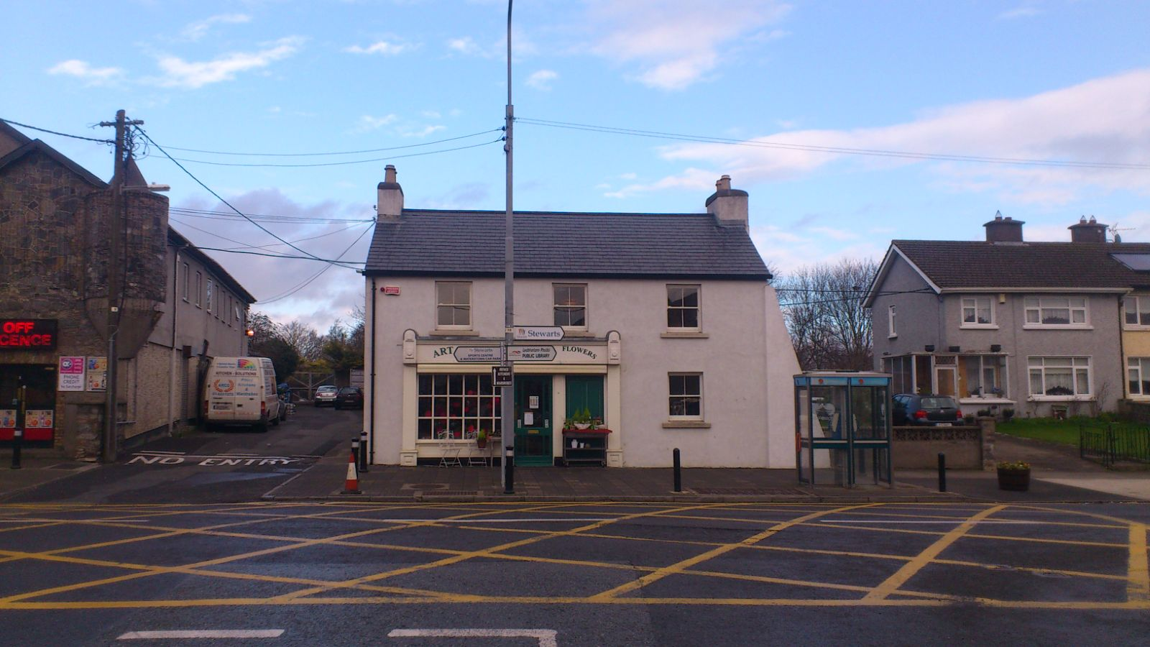
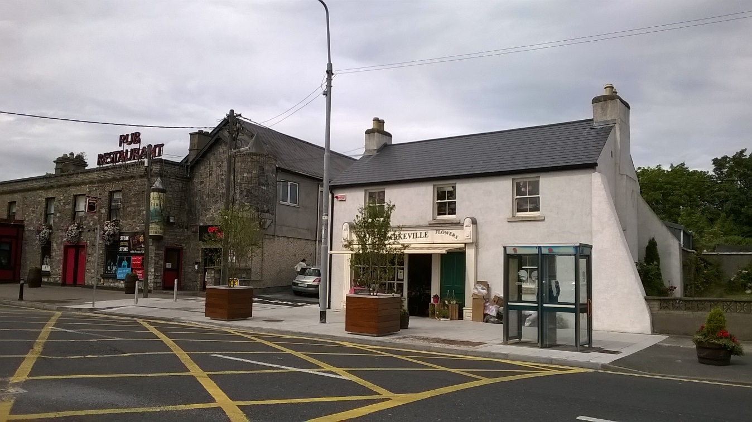
Palmerstown Village
Before
After

Slide 4
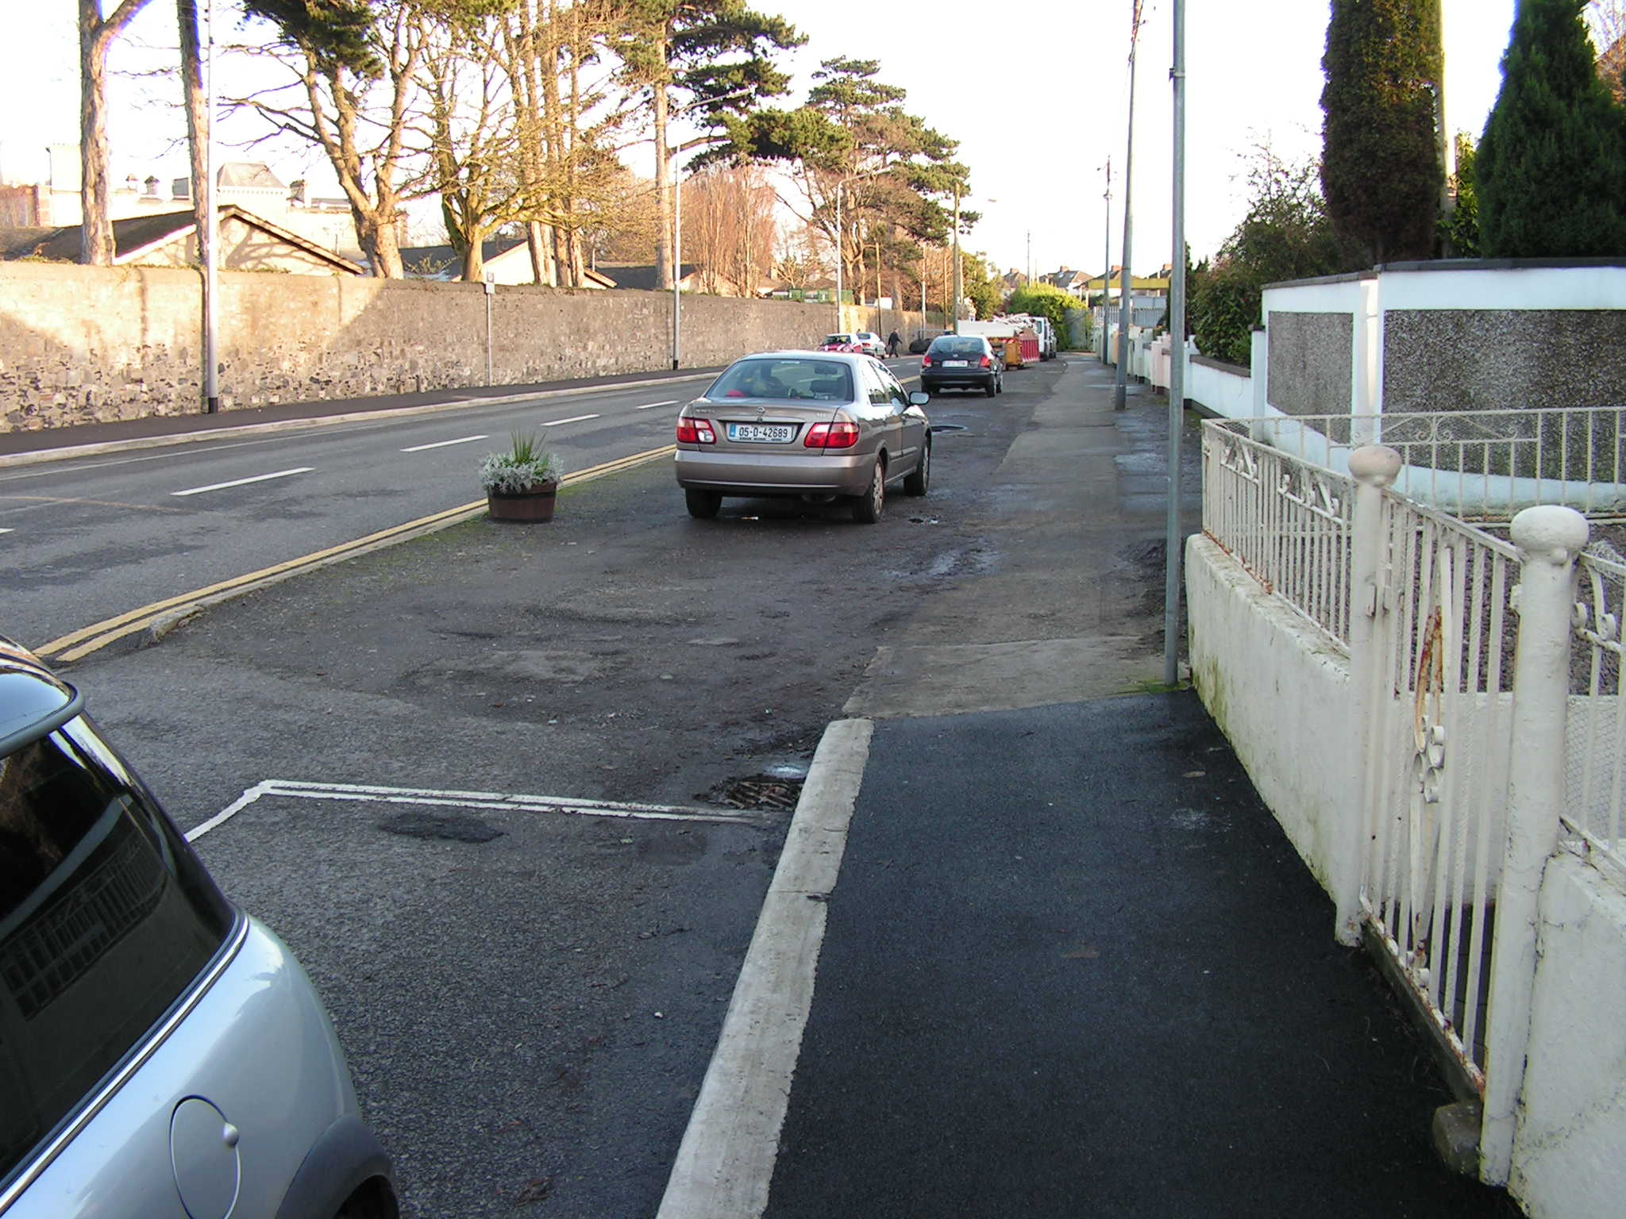
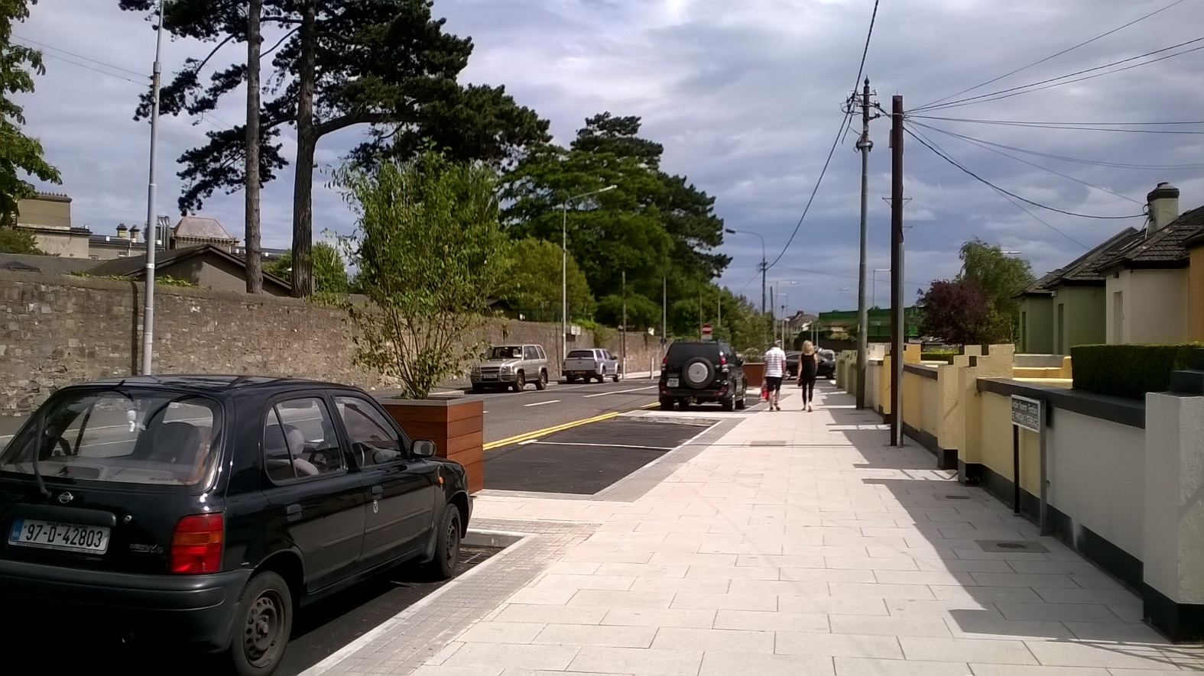
Palmerstown Village
Before
After

Slide 5
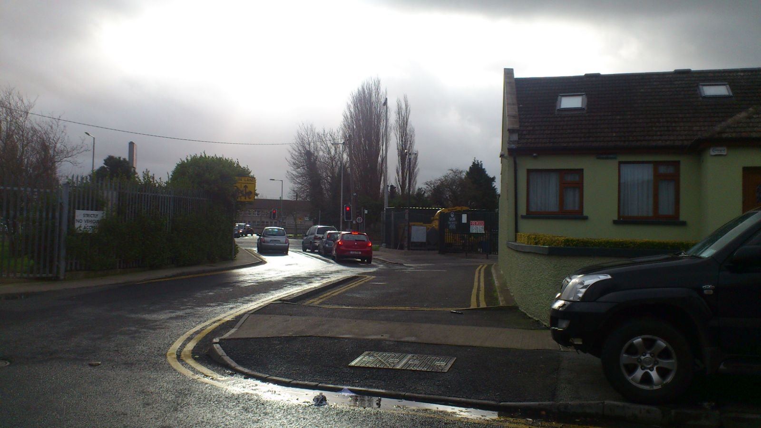
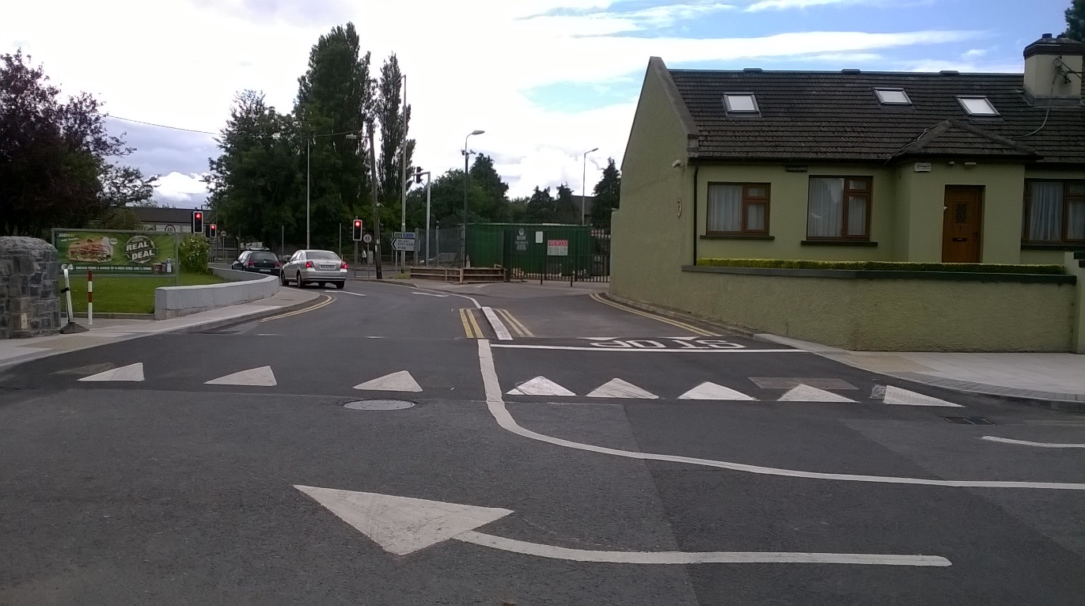
Palmerstown Village
Before
After

Slide 6
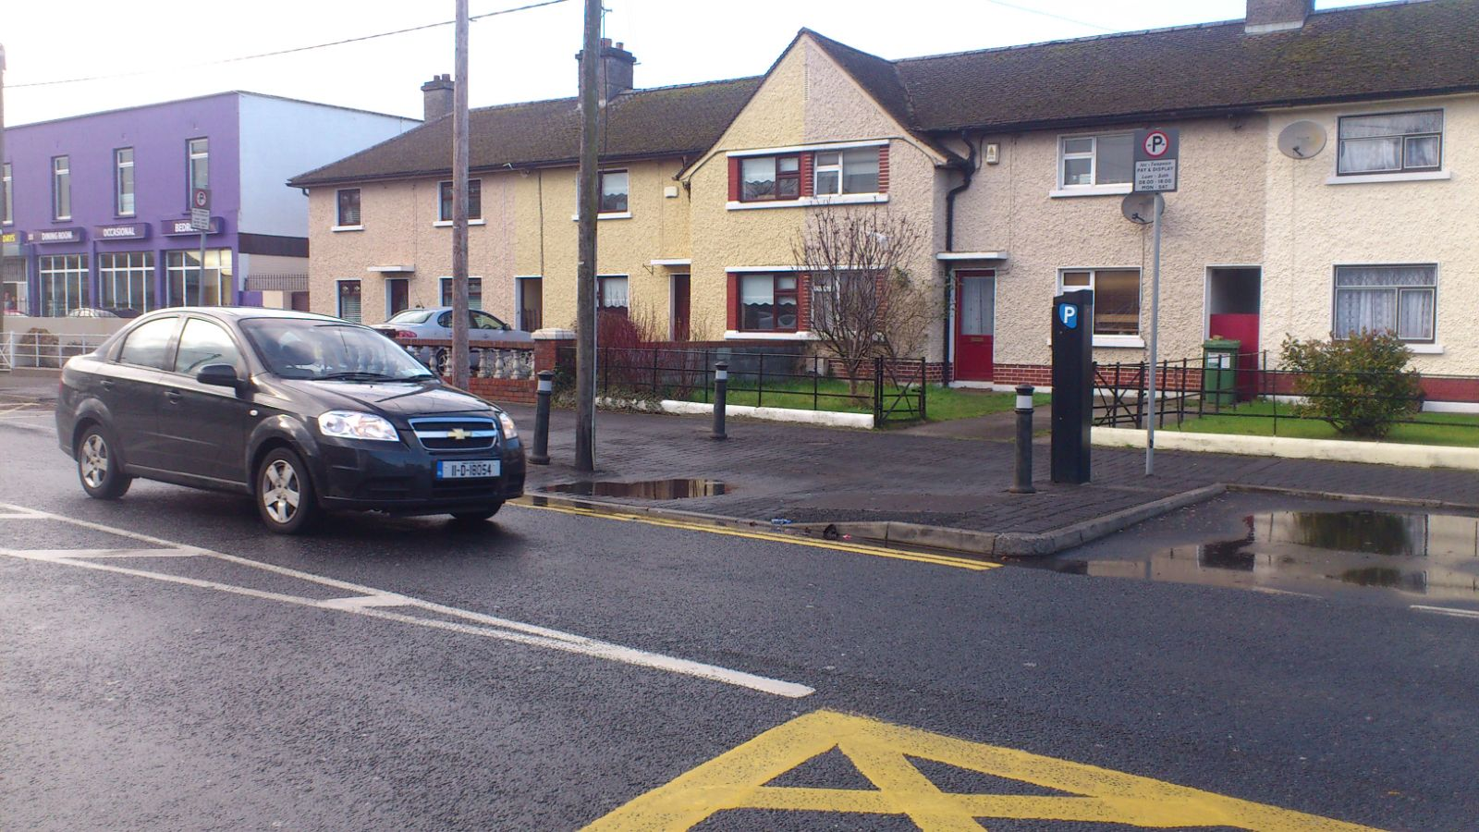
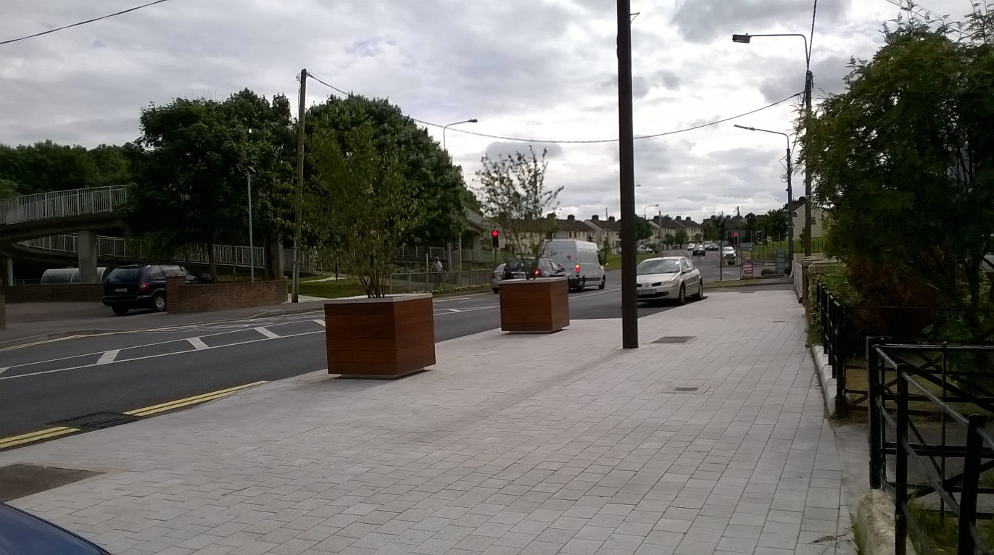
Palmerstown Village
Before
After

Slide 7
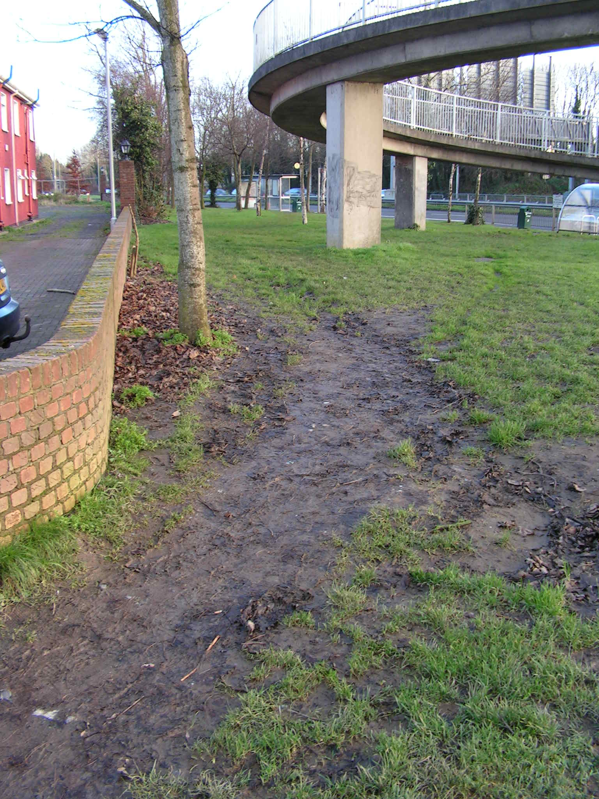
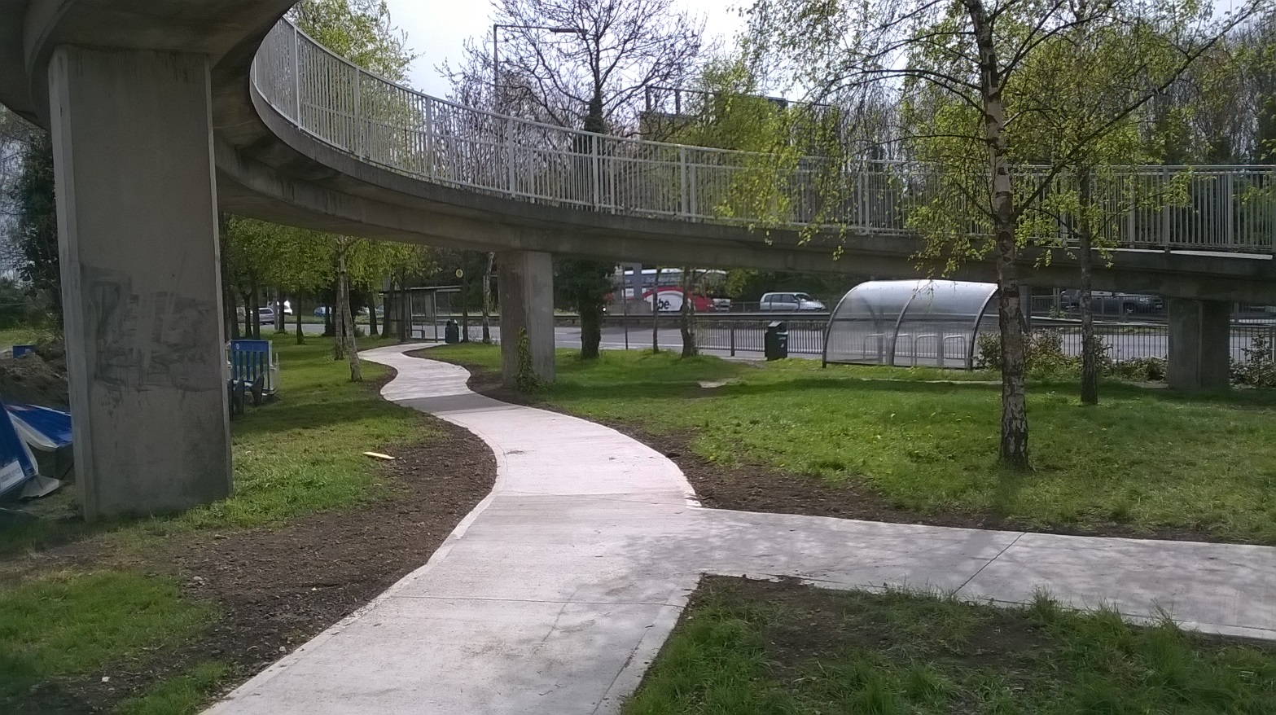
Palmerstown Village
Before
After

Slide 8
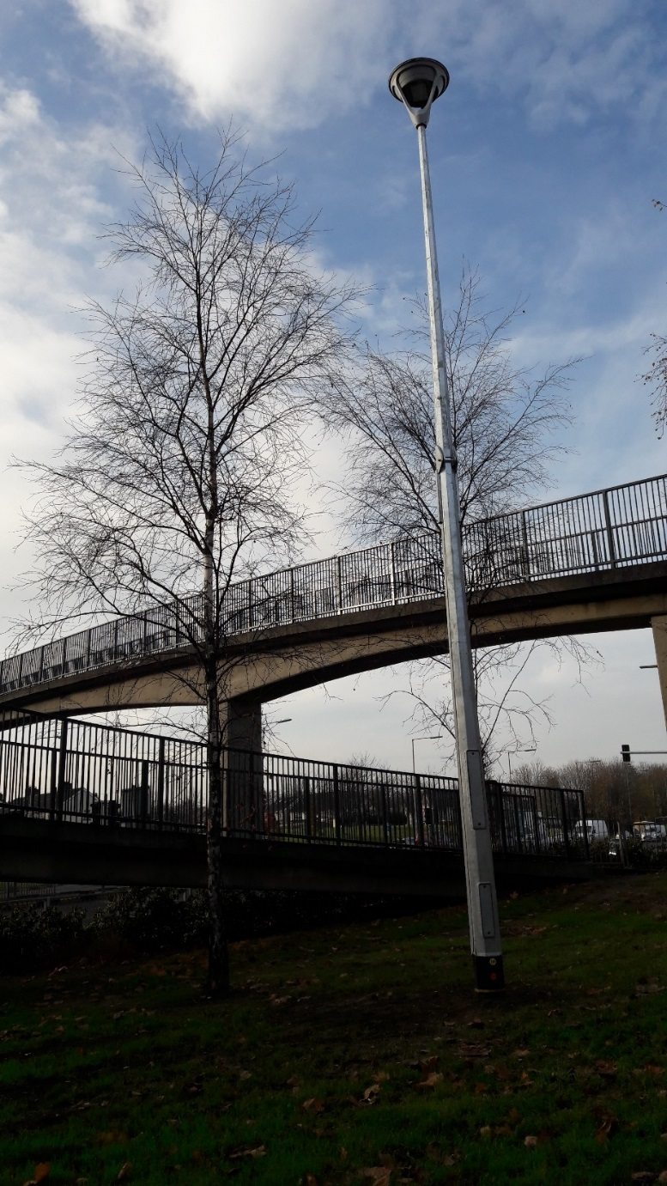
Palmerstown Village

Slide 9
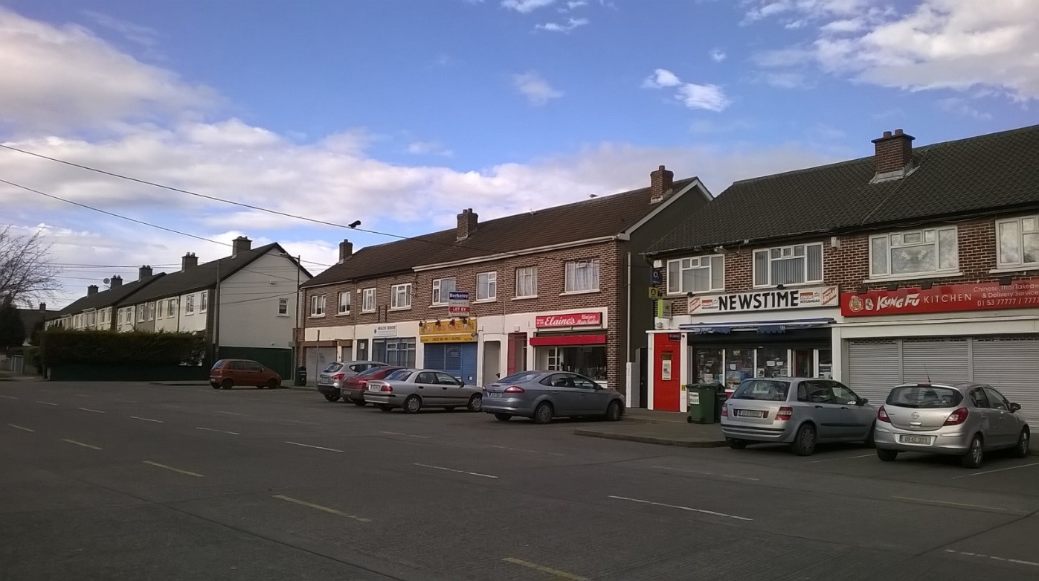
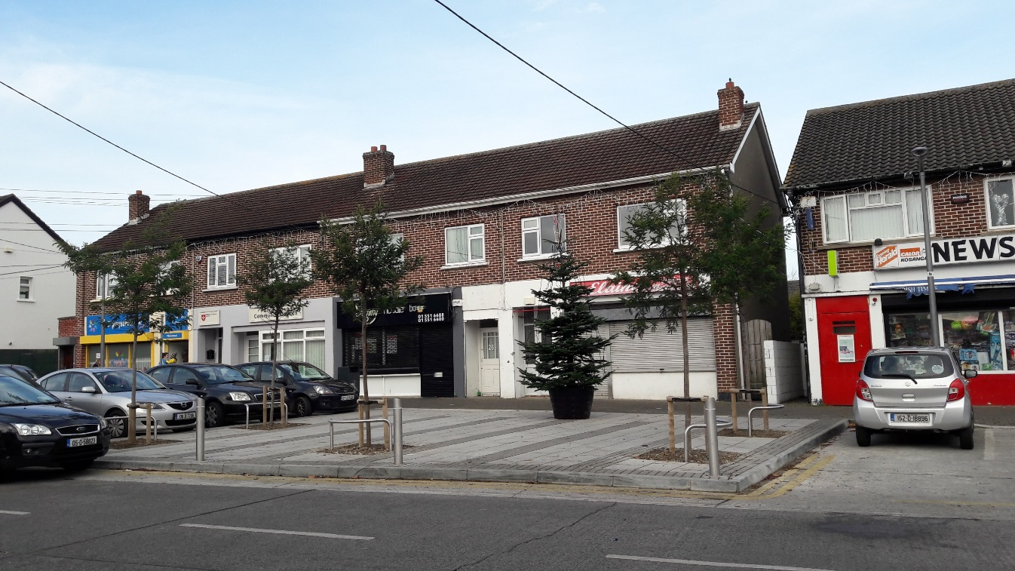
Manor Road
Before
After

Slide 10
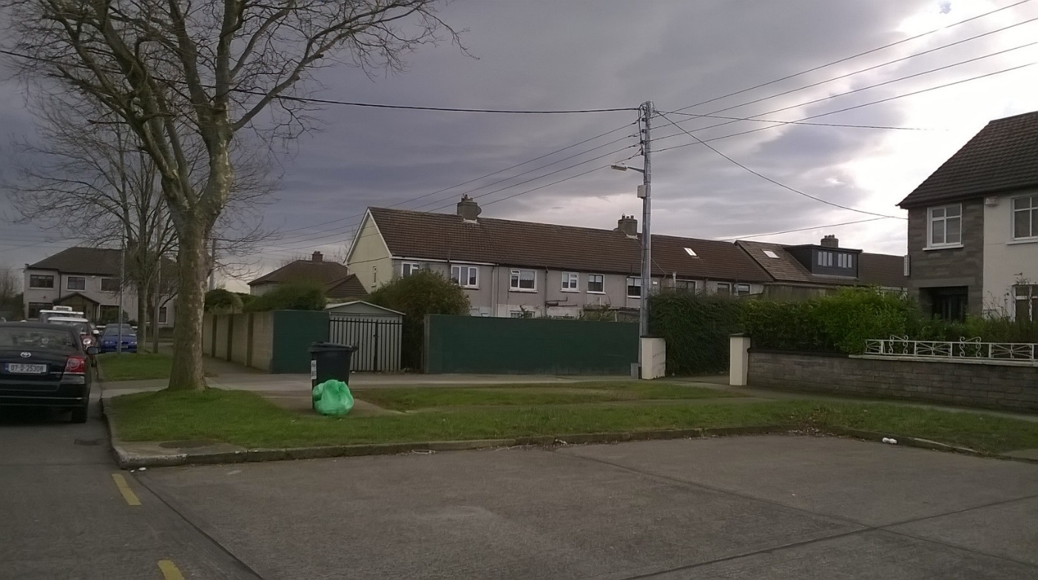
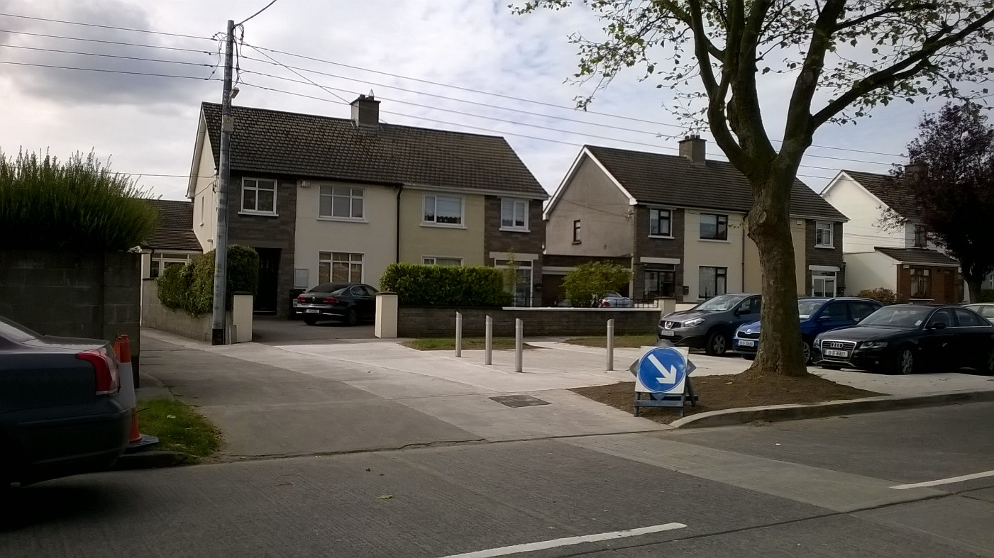
Manor Road
Before
After

Slide 11
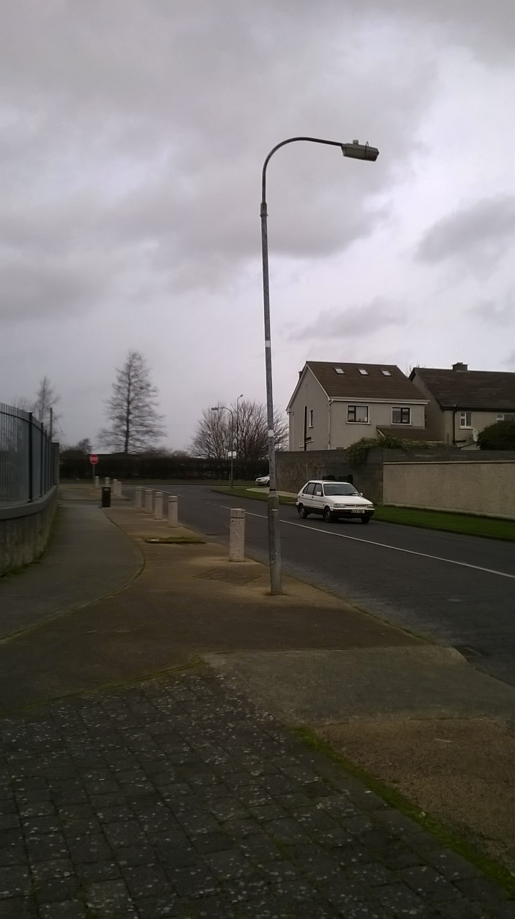
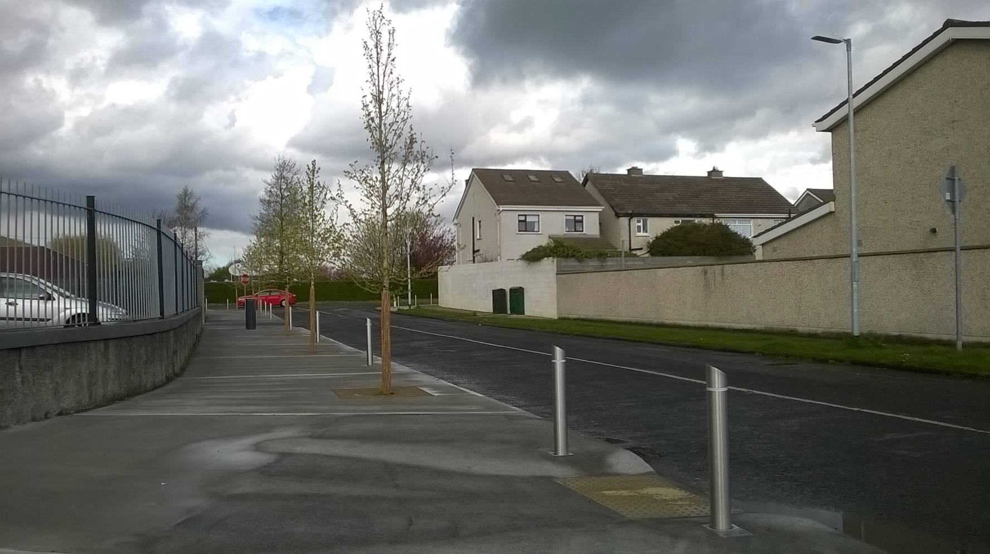
Limekiln
Before
After

Slide 12
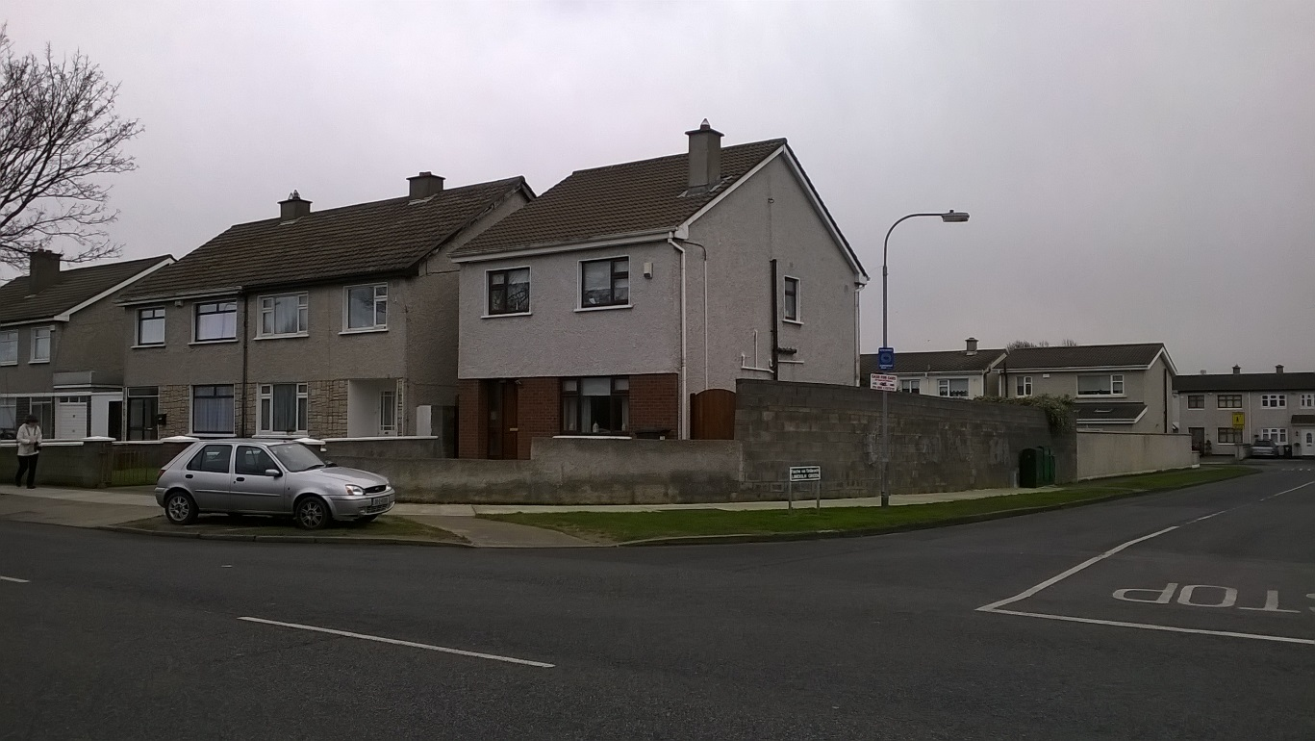
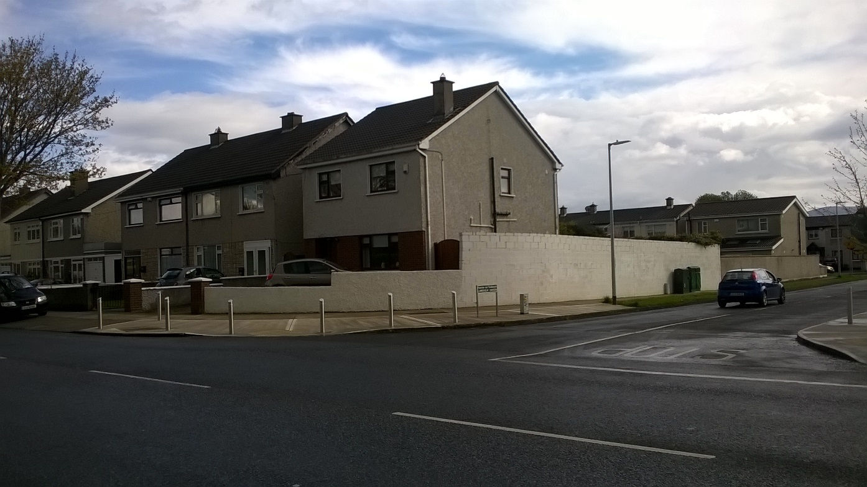
Limekiln
Before
After

Slide 13
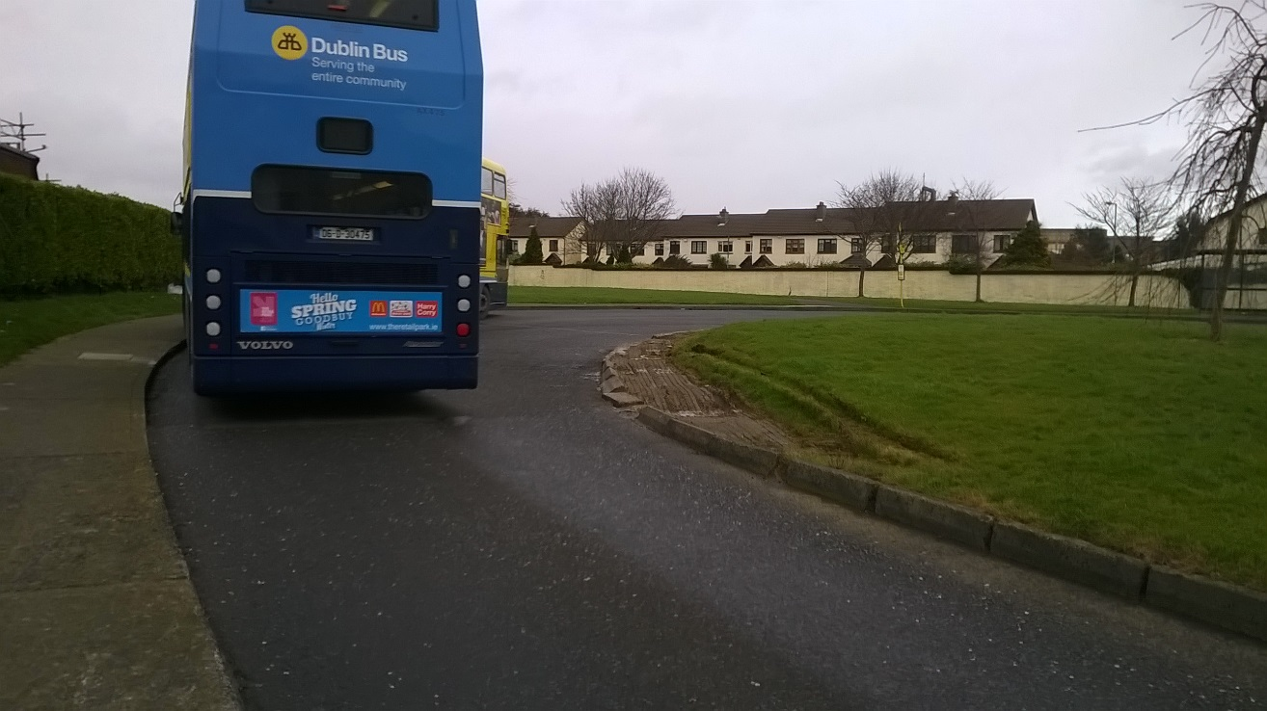
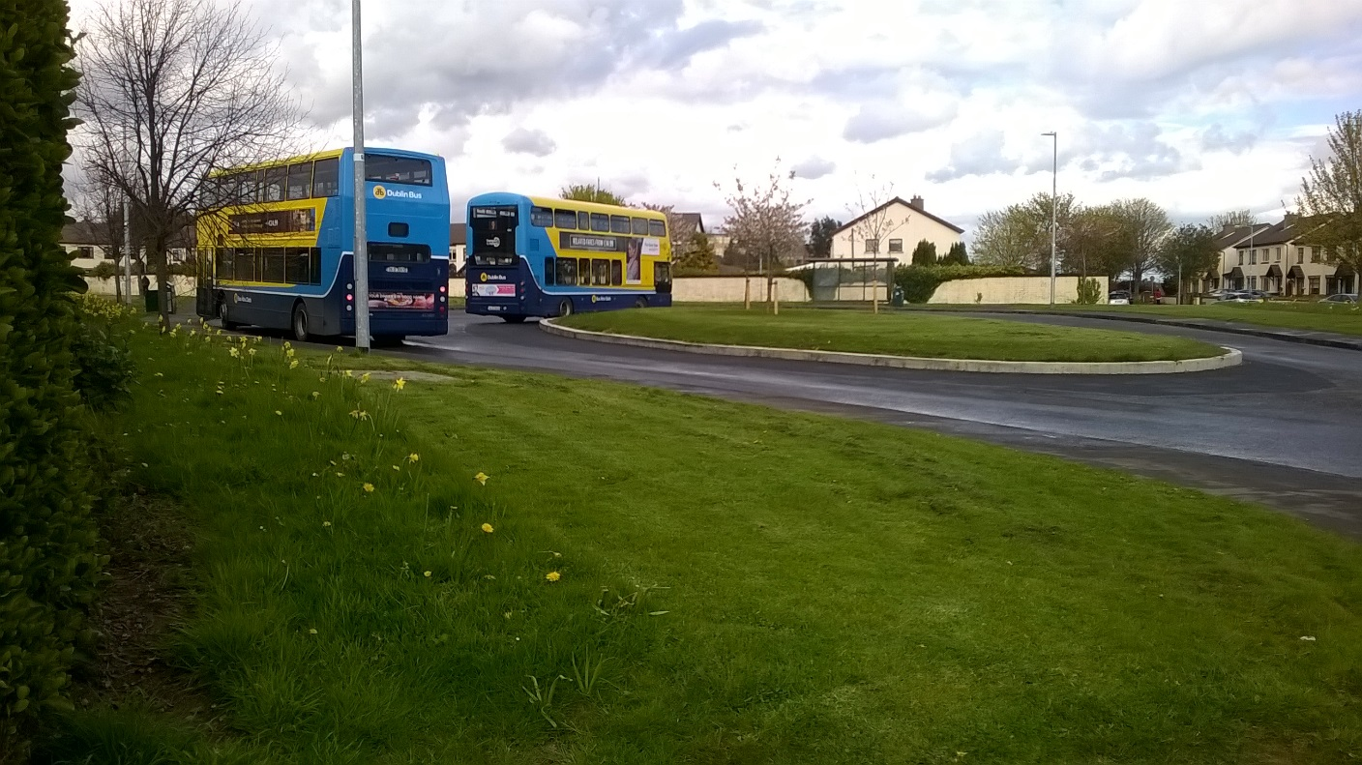
Limekiln
Before
After

Slide 14
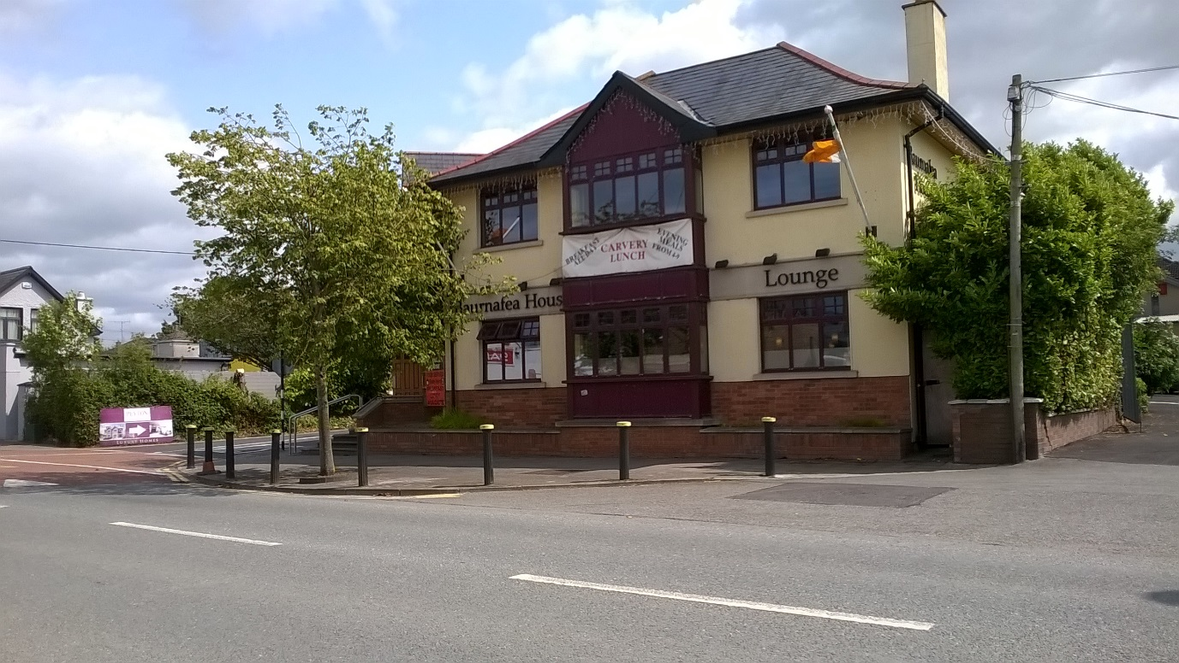
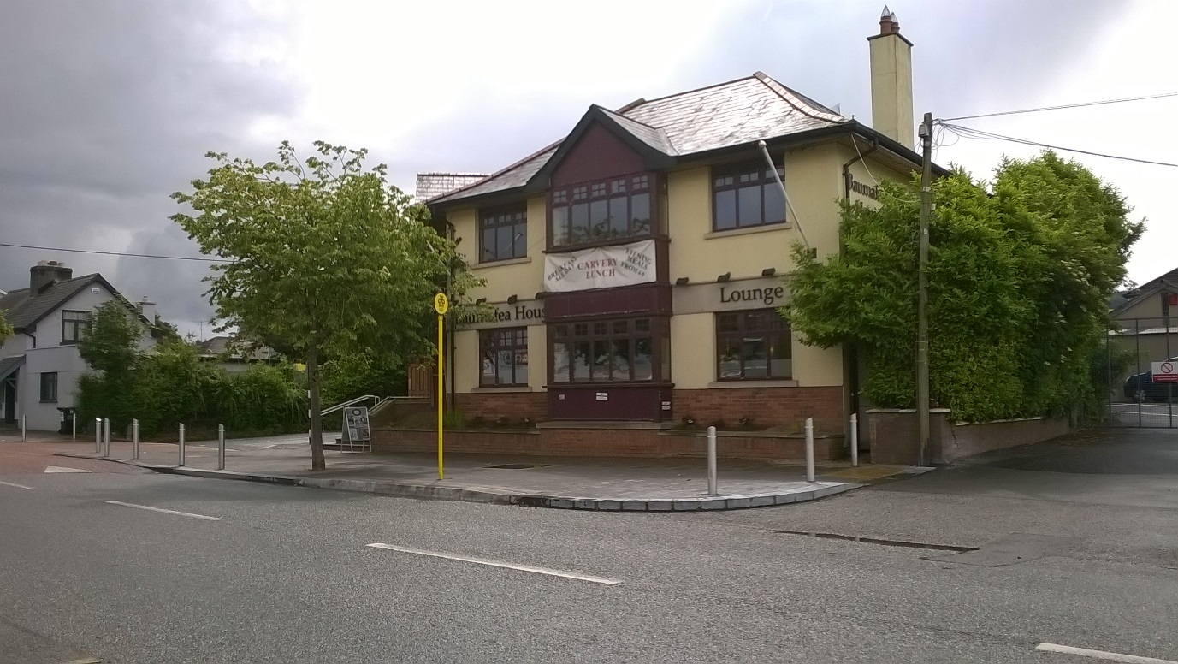
Rathcoole Village
Before
After

Slide 15
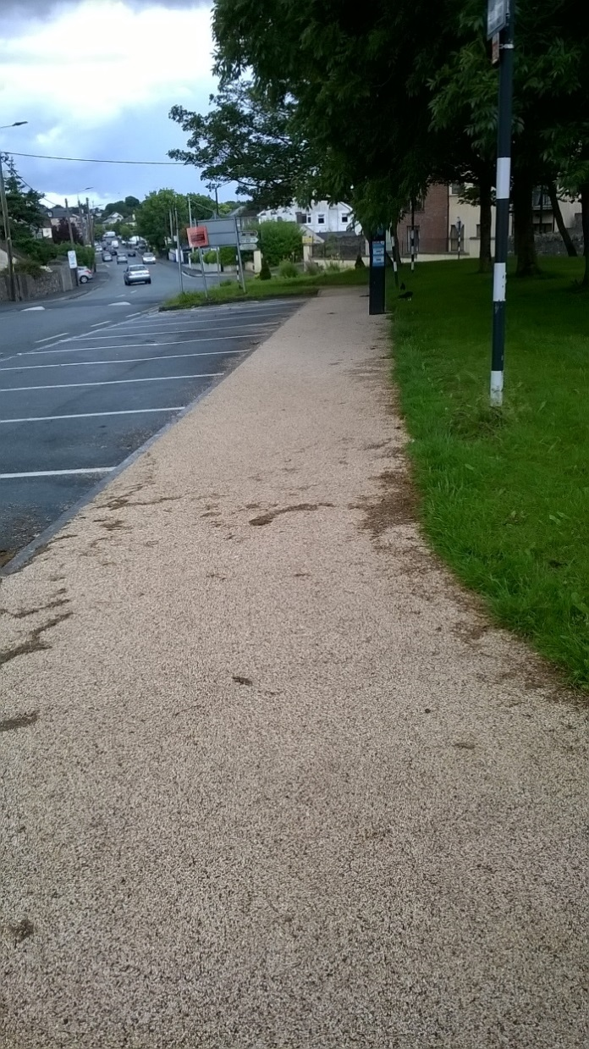
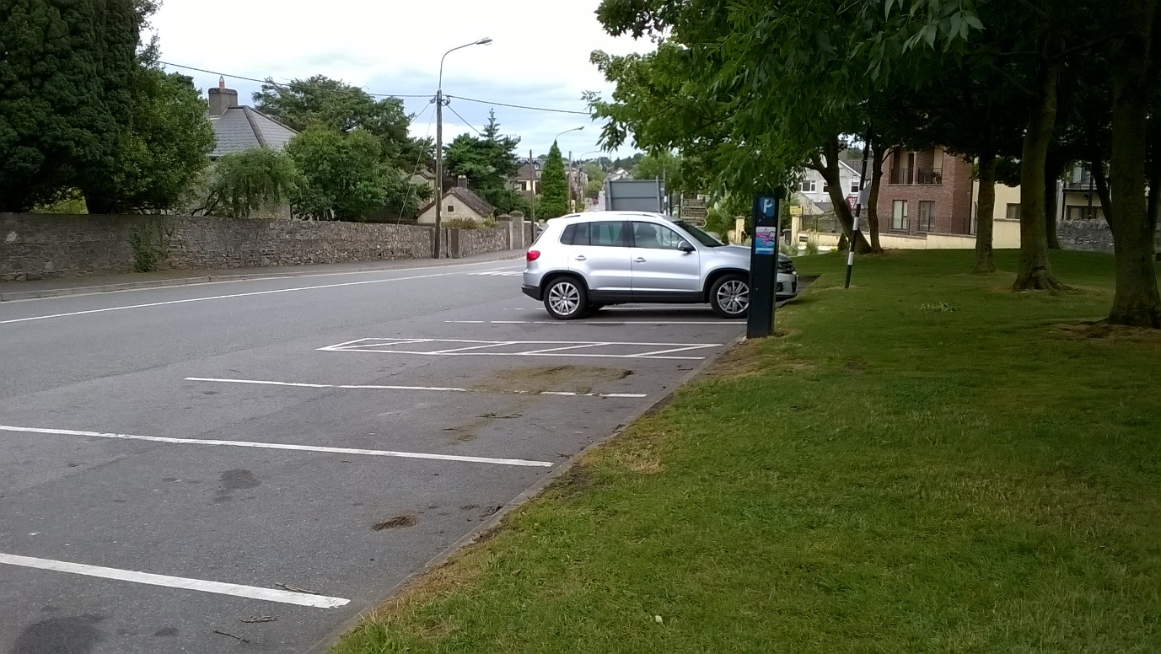
Rathcoole Village
Before
After

Slide 16
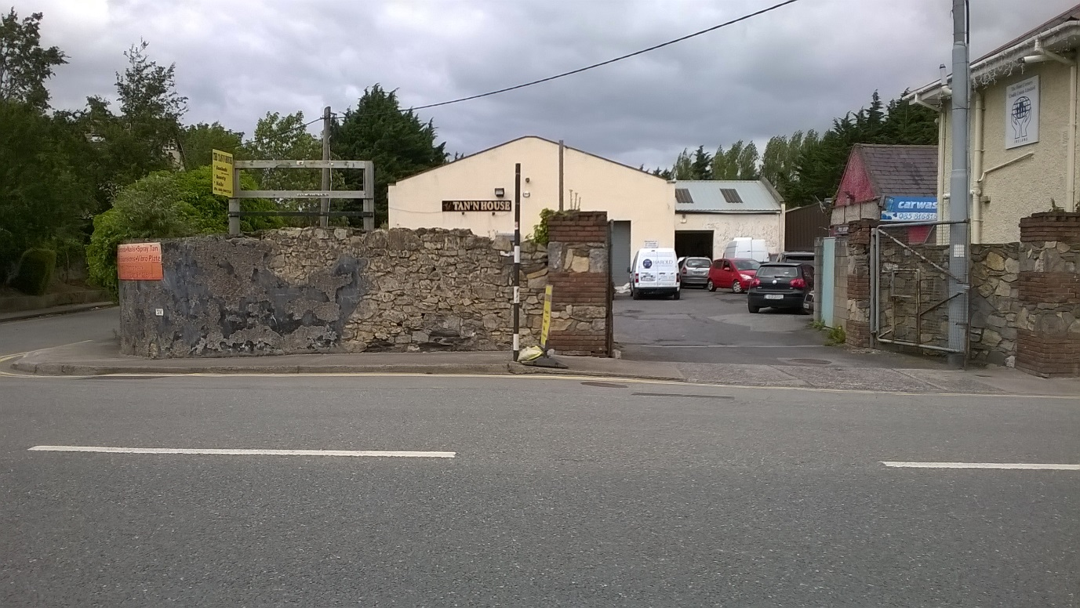
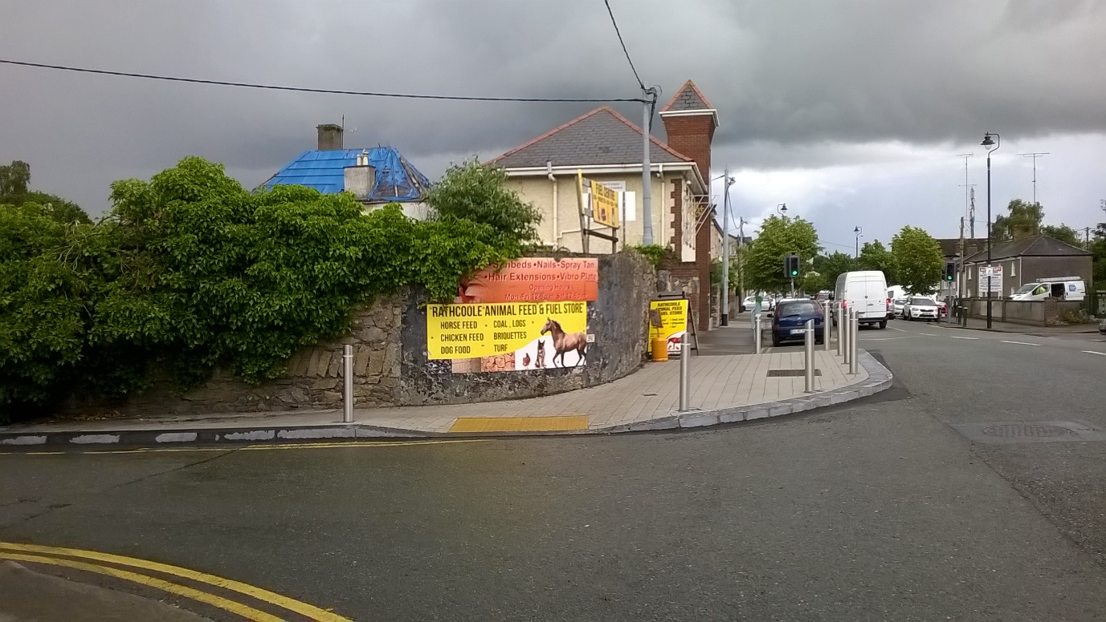
Rathcoole Village
Before
After

Slide 17
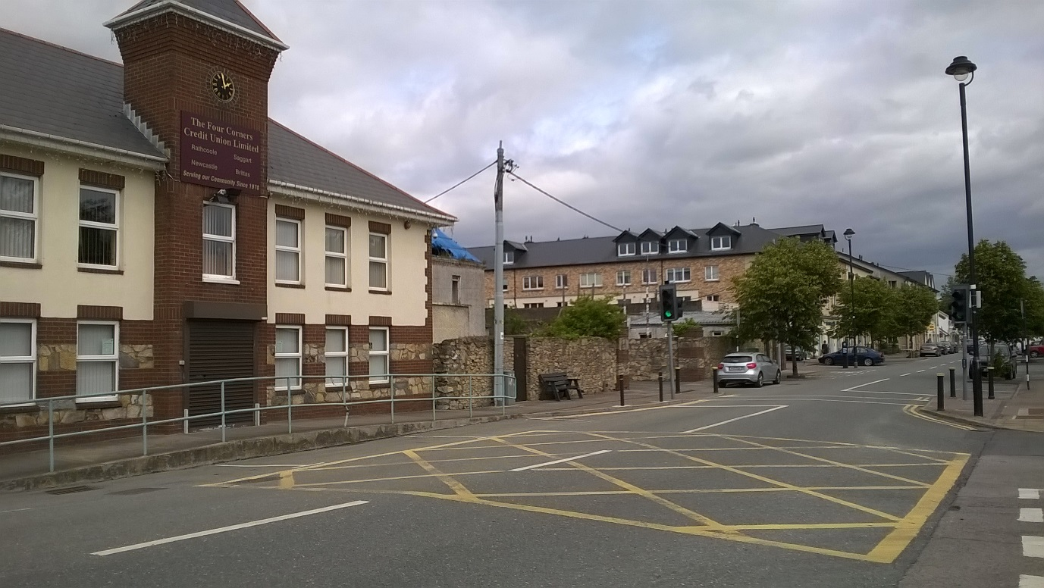
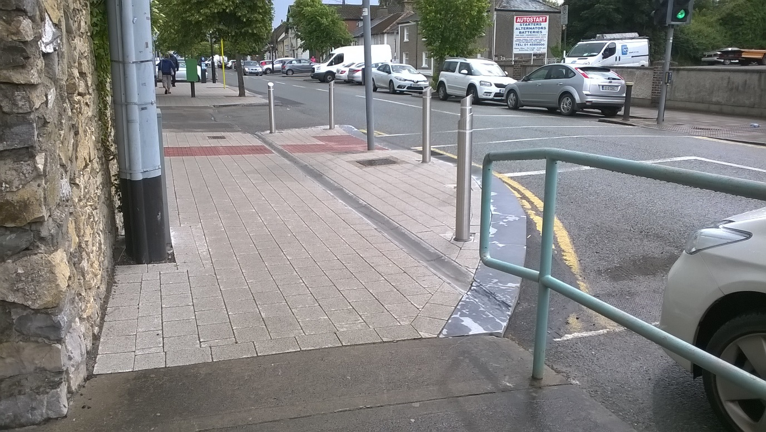
Rathcoole Village
Before
After

Slide 18
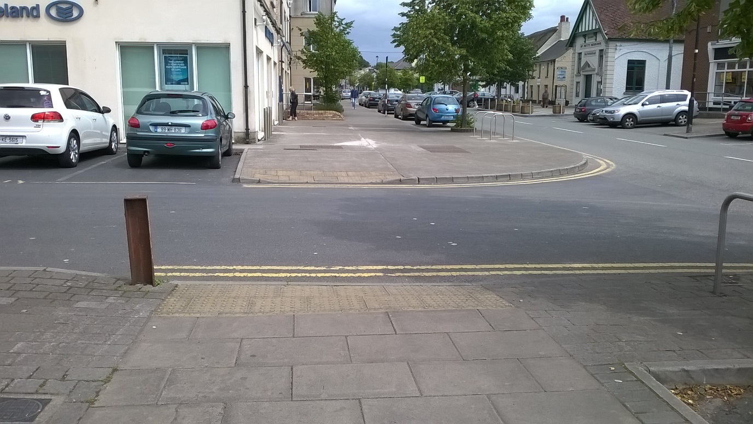
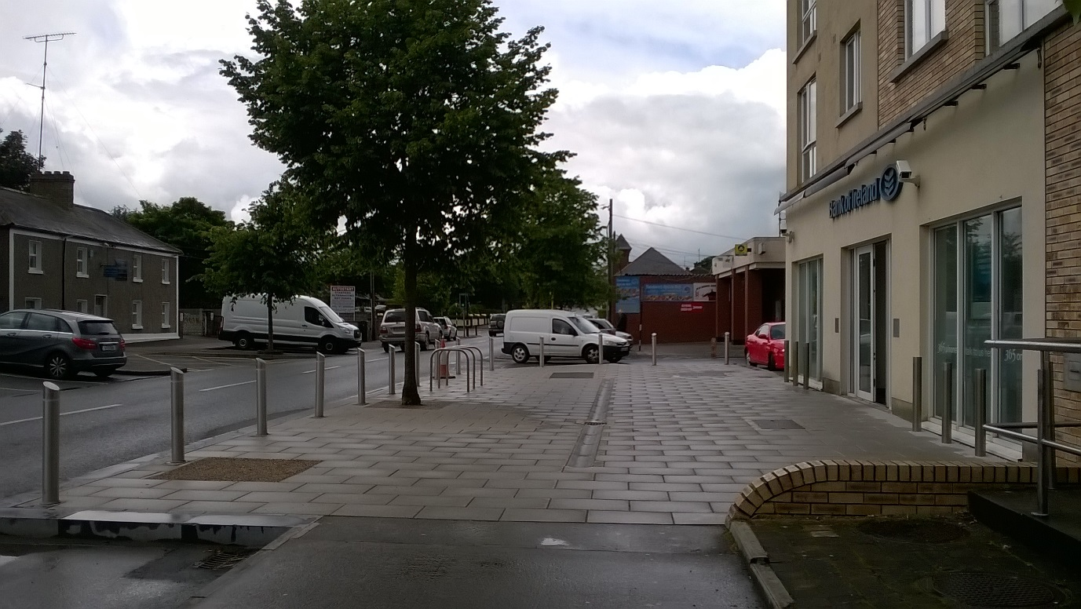
Rathcoole Village
Before
After

Slide 19
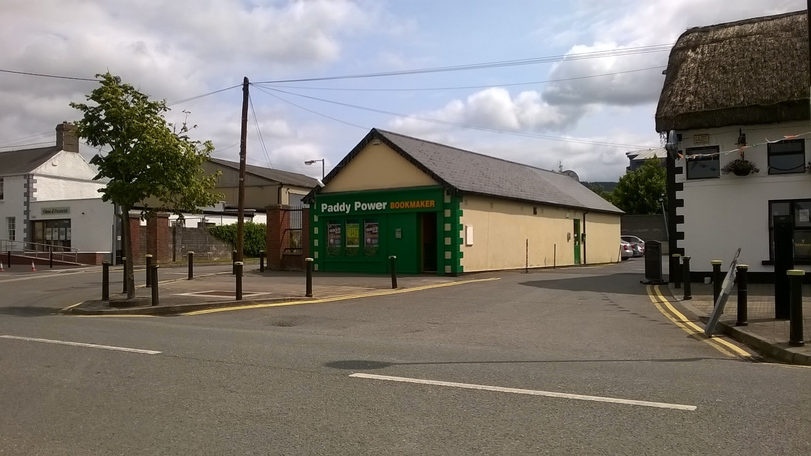
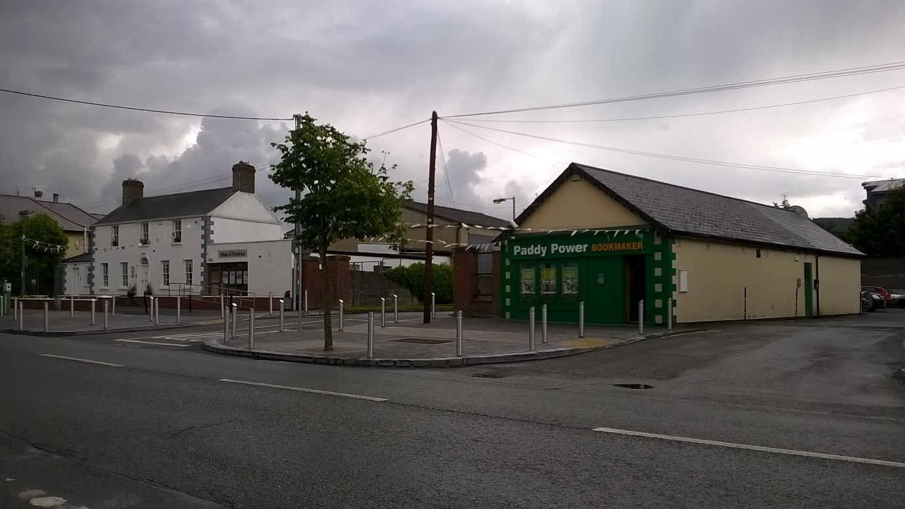
Rathcoole Village
Before
After

Slide 20
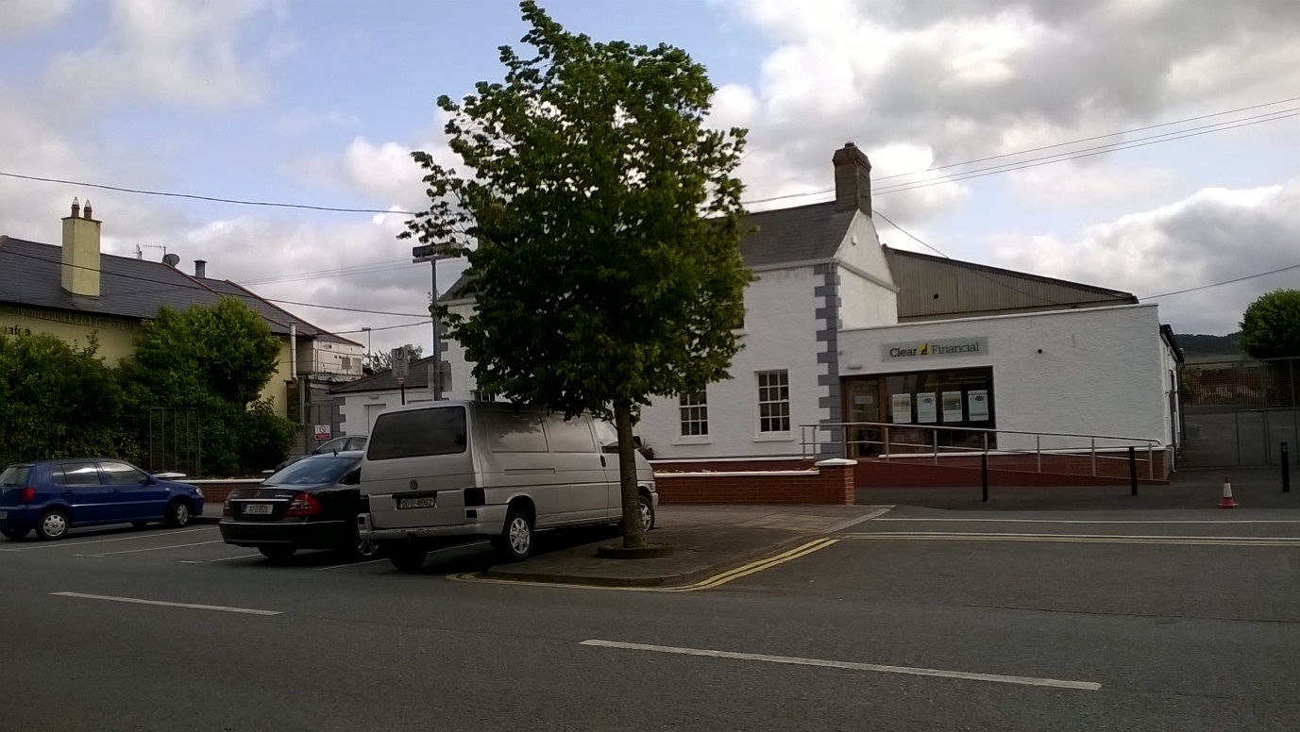
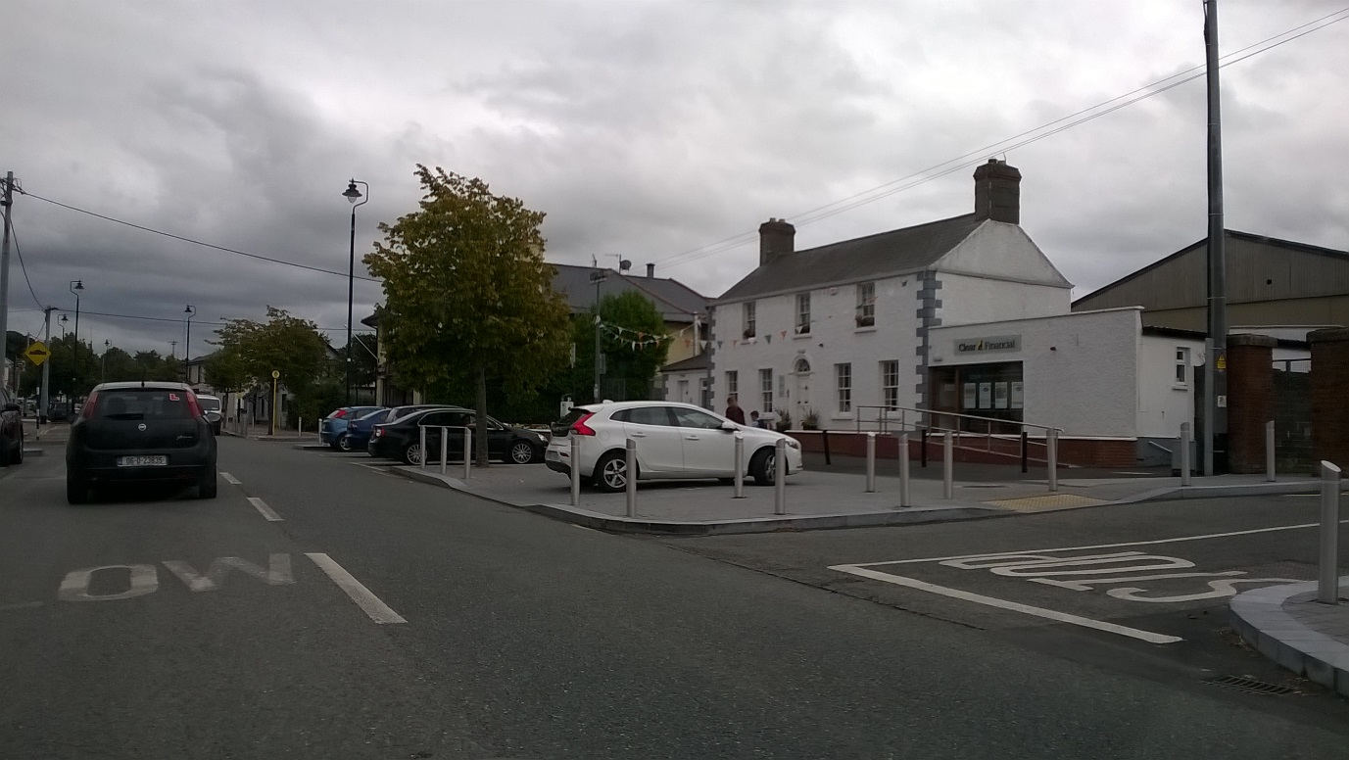
Rathcoole Village
Before
After

Slide 21
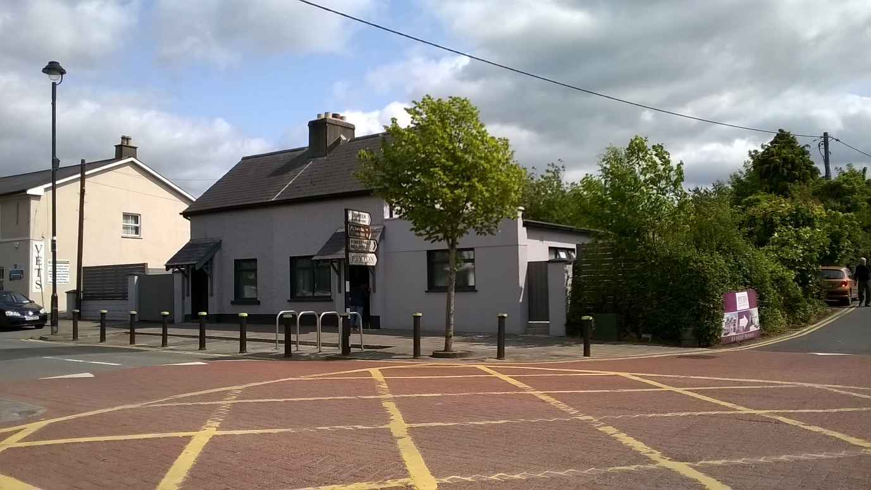
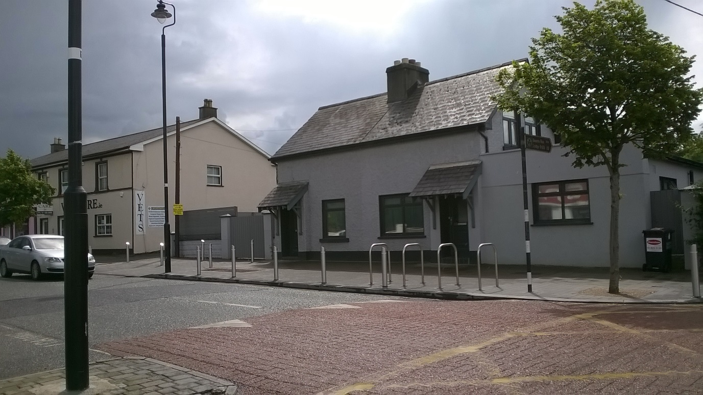
Rathcoole Village
Before
After

Slide 22
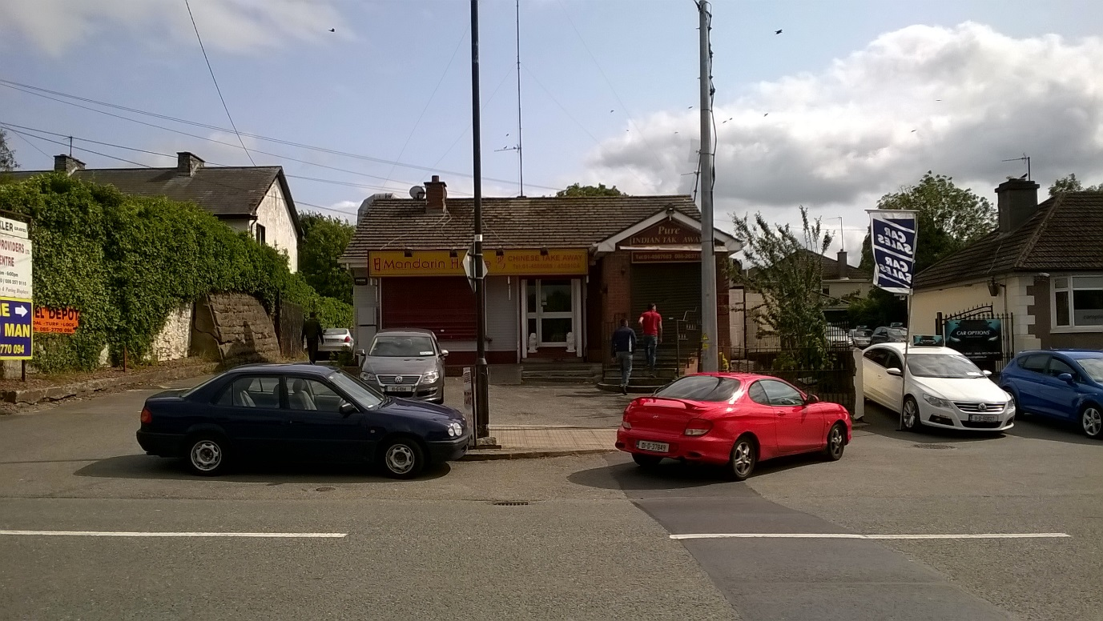
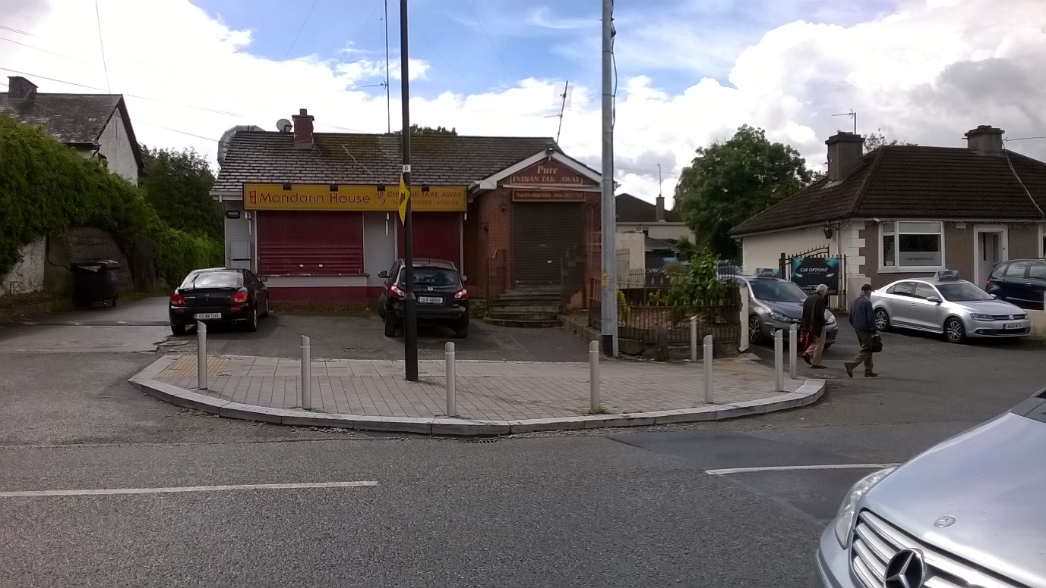
Rathcoole Village
Before
After

Slide 23
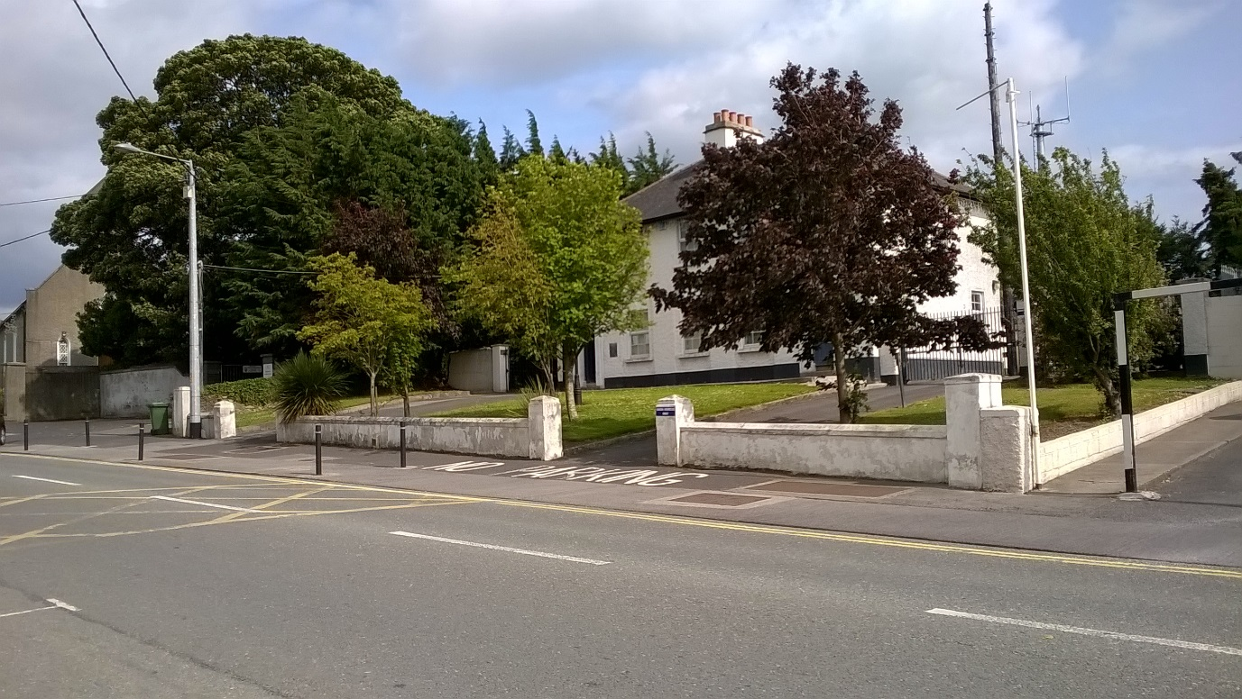
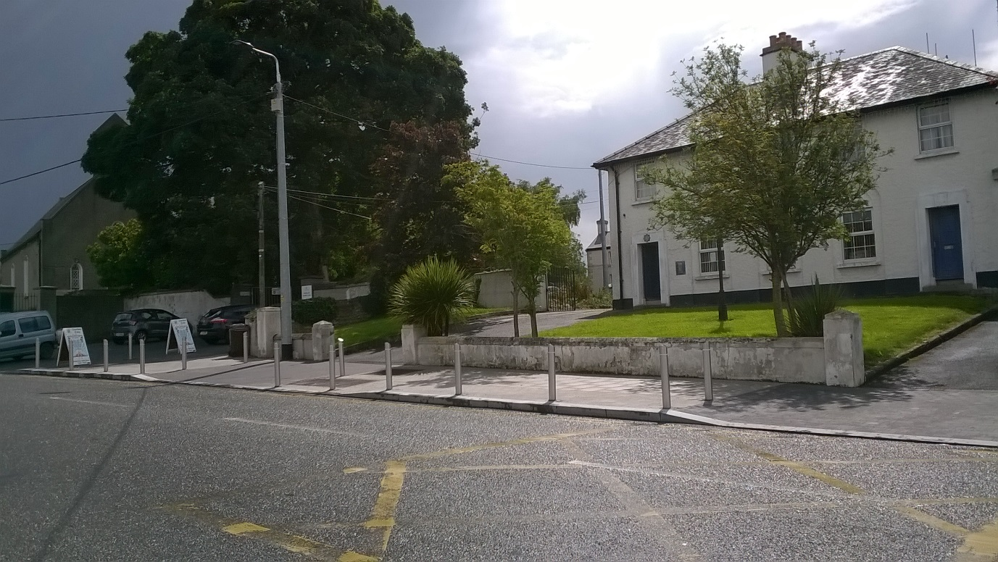
Rathcoole Village
Before
After

Slide 24
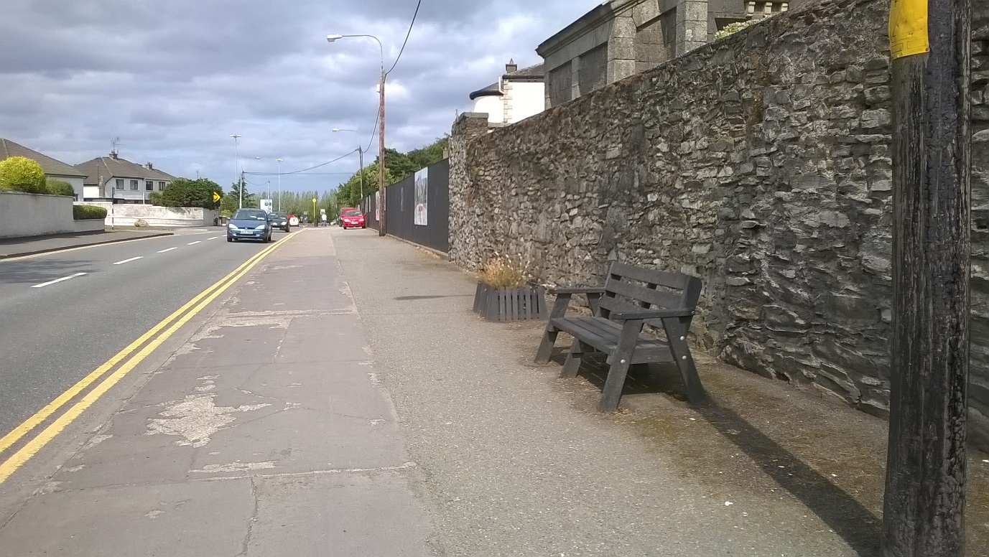
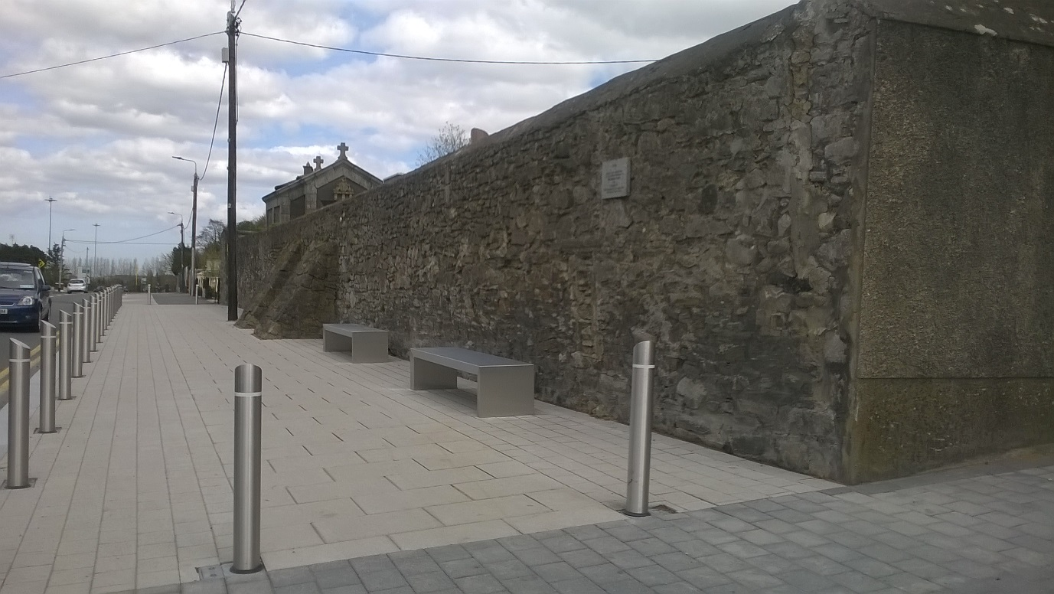
Rathcoole Village
Before
After

Slide 25
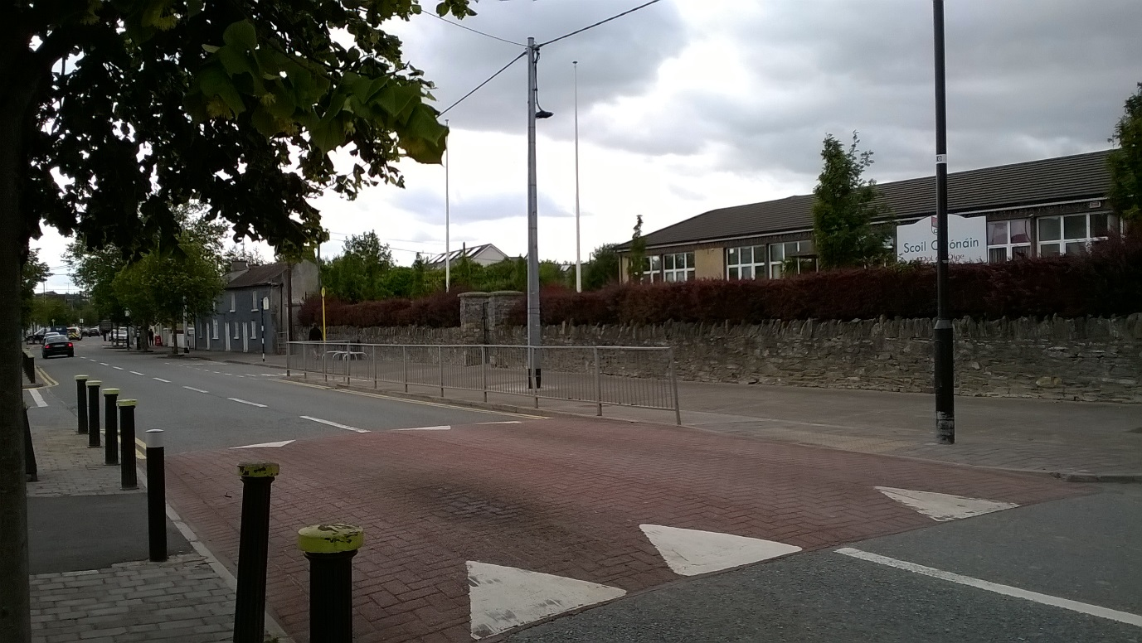
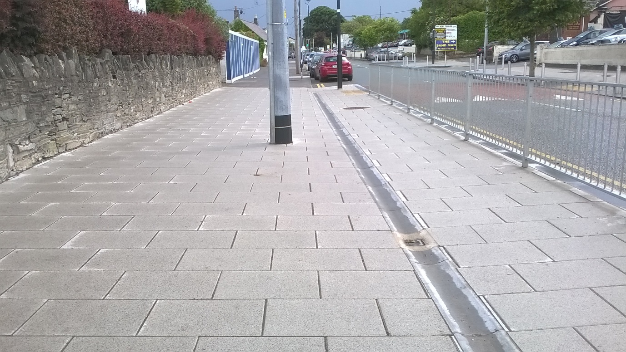
Rathcoole Village
Before
After

Slide 26
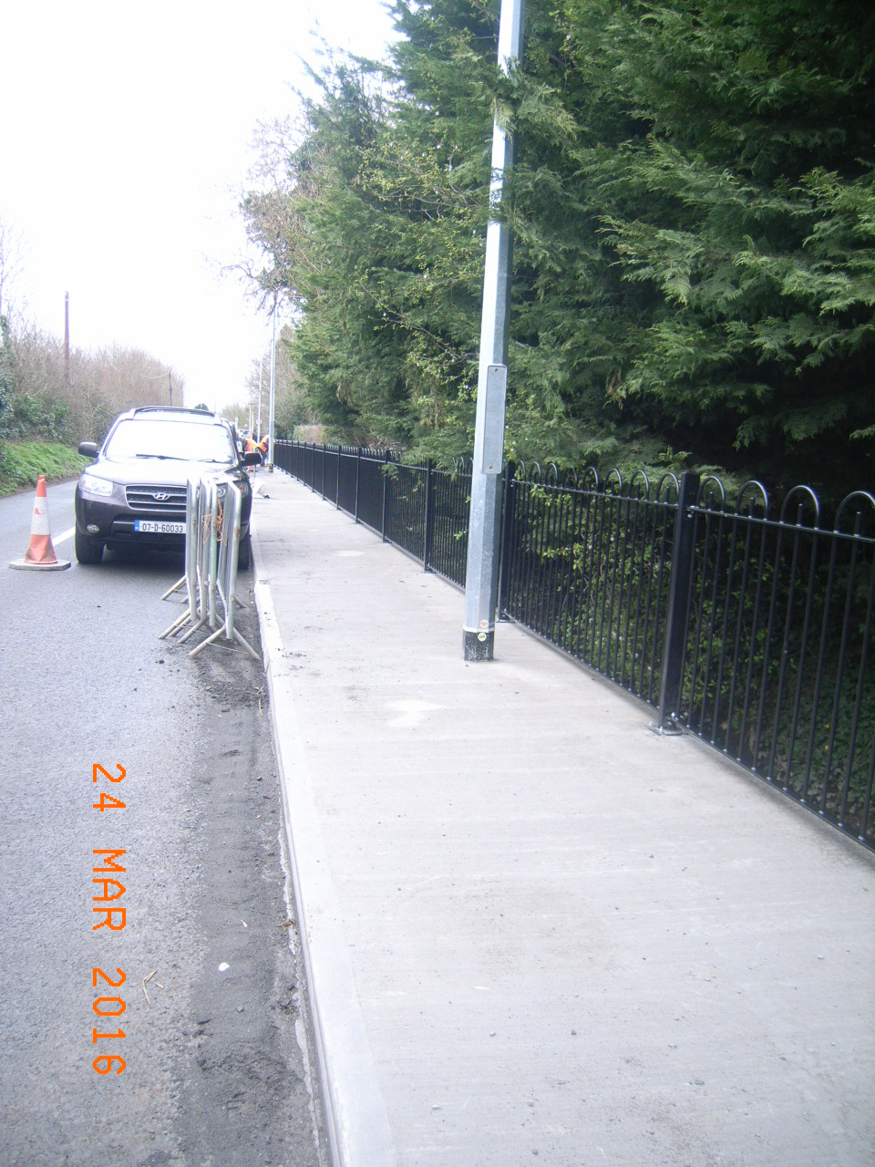
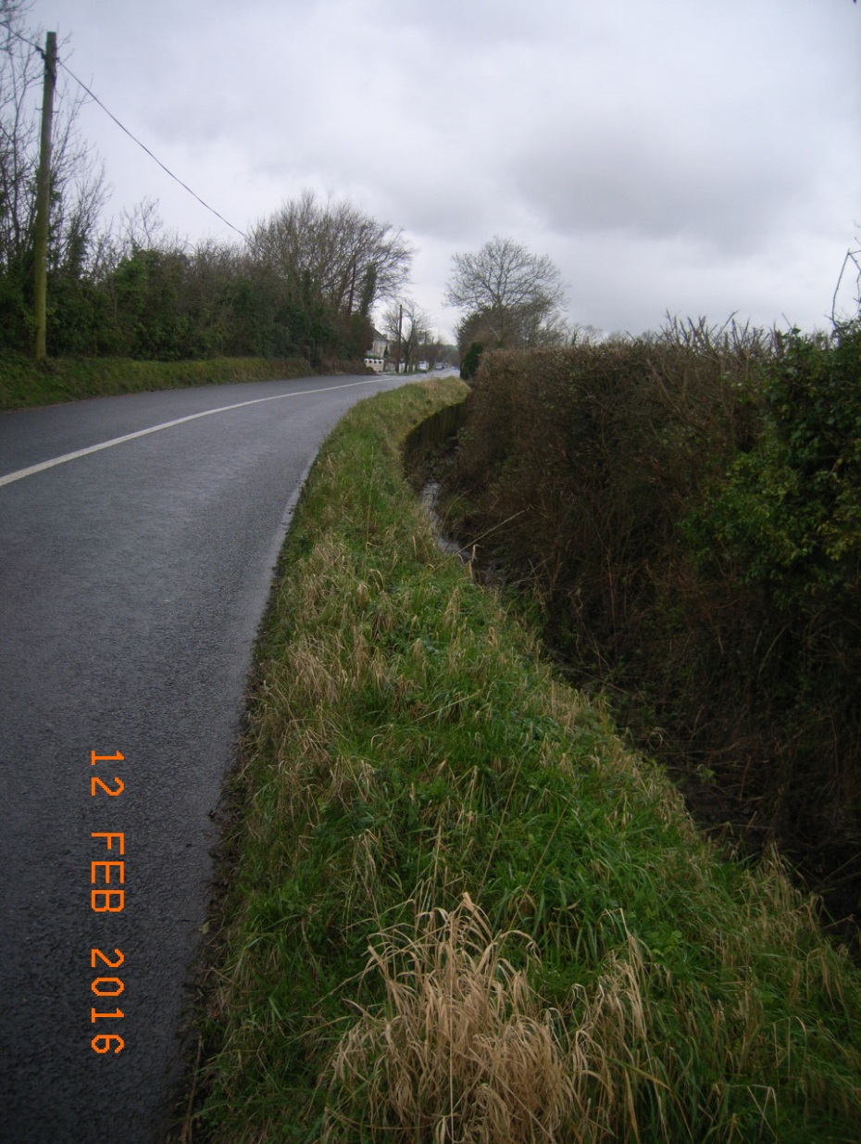
Aylmer Road
Before
After

Slide 27
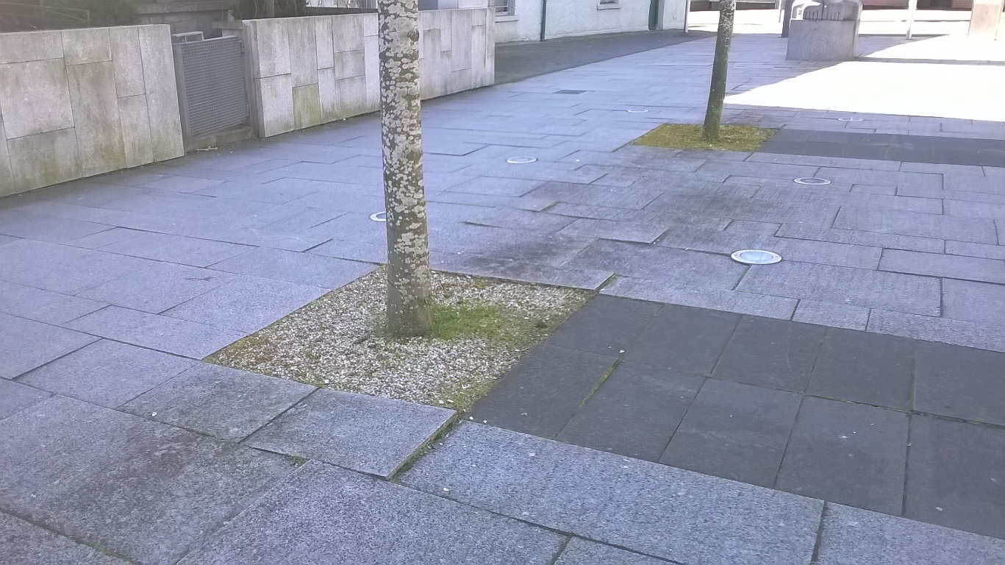
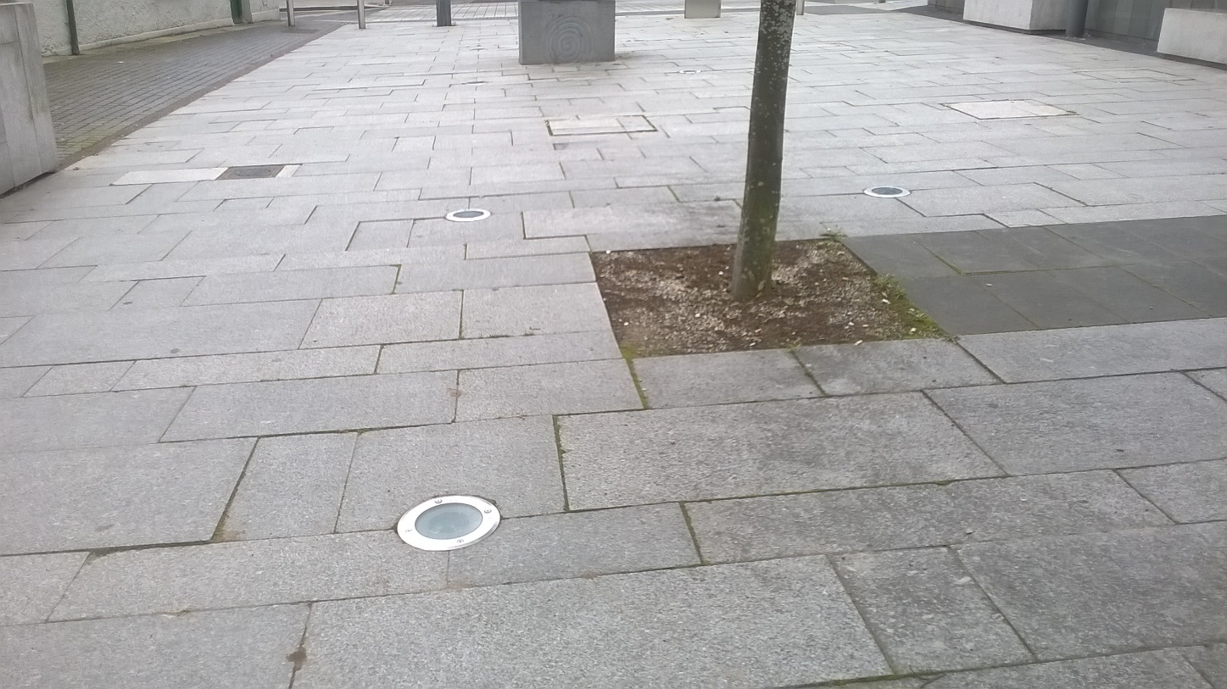
Tallaght Paving Repair Contract
Before
After

Slide 28
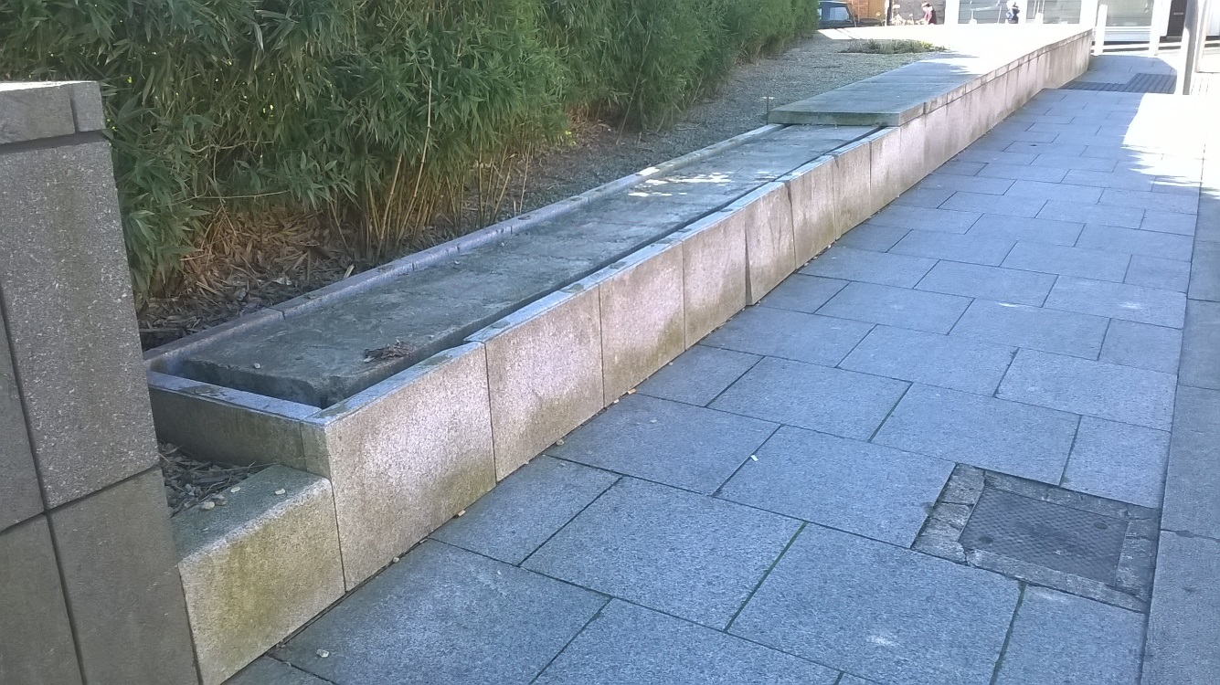

Tallaght Paving Repair Contract
Before
After

Slide 29


Tallaght Paving Repair Contract
Before
After

Slide 30


Lucan Paving Repair Contract
Before
After

Slide 31


Lucan Paving Repair Contract
Before
After

Slide 32


Rathfarnham Phase 1 – Gateway Plaza
Before
After

Slide 33

Rathfarnham Phase 1
Gateway Plaza

Slide 34

Delivery Programme and Spend to Date: 2015/2016
Total spend to date is €1,107,578.21
All figures include VAT.

Slide 35
General Issues Raised During Programme to Date
Limitations on Landscaping Options due to Existing Underground Services
More comprehensive slit trench surveys should be undertaken to establish confirmation of proposed tree
locations. However, the sheer amount of underground utilities are posing serious limitations on where we can
feasibly plant trees or even replace existing unhealthy trees. In addition, the relocation of existing services is
a very costly exercise, but must be taken into consideration if landscaping is to be incorporated into future
schemes.
Issues with Traders during Works
We have always engaged (and will continue) via consultation and letter drop with local traders and stakeholders well in advance of finalising designs and the subsequent issue of tenders. It is clear that we cannot please all the stakeholders for specific schemes. However, we all need to remain cognizant of the fact that these schemes are for the improvement of the Public Realm and are being carried out to enhance the pedestrian experience at the Village in question. The knock on effect of this is to increase economic activity and we must avoid any impediment to this enhancement by vested interests.

Slide 36
There are nine projects planned for implementation
in 2017/2018 and are as follows:
Belgard Walkway
Templeogue Village Part VIII and associated works
Saggart Village
Newcastle Phase 2 – Newcastle Lyons Gateway
Tallaght Village Phase 1 – Old Greenhills Road
Tallaght Village Phase 2 – Main Street Plaza
Lucan Bridge Plaza
Lucan Village Green Part VIII and associated works
Rathfarnham Village Phase 2 at Wolfe Tone Terrace
Part VIII and associated works.

Slide 37

Belgard Square Walkway
Before

Slide 38

Belgard Square Walkway

Slide 39


Templeogue Village
Before

Slide 40
Templeogue Village
Conceptual Images

Slide 41
Templeogue Village
Conceptual Images

Slide 42
Templeogue Village
Conceptual Images

Slide 43


Saggart Village
Conceptual Images
Before
After

Slide 44

Saggart Village

Slide 45


Newcastle Gateway
Before

Slide 46

Newcastle Gateway

Slide 47

Newcastle Gateway

Slide 48


Tallaght Village – Old Greenhills Road
Conceptual Images

Slide 49


Tallaght Village – Main Street Plaza
Conceptual Images

Slide 50


Lucan Village - Steps
Conceptual Images
Before
After

Slide 51

Lucan Village – Village Green
Before

Slide 52
Lucan Village – Village Green
Conceptual Image
After

Slide 53

Planned Delivery Programme for 2017/2018
Projected Spend for 2017/2018 programme is €3.9 million.

Slide 54
Q and A?

