Slide 1

Ballycullen Oldcourt Local Area Plan 2014
Proposed Variation - 2017
1st December 2016

Slide 2
Ballycullen Local Area Plan 2014
Presentation Format
Introduction & Context
Local Area Plan Progress Update
Local Area Plan Phasing Issues
Schools Provision Update
Rebuilding Ireland & LIHAF Proposal
Proposed Phasing Issue Resolution

Slide 3
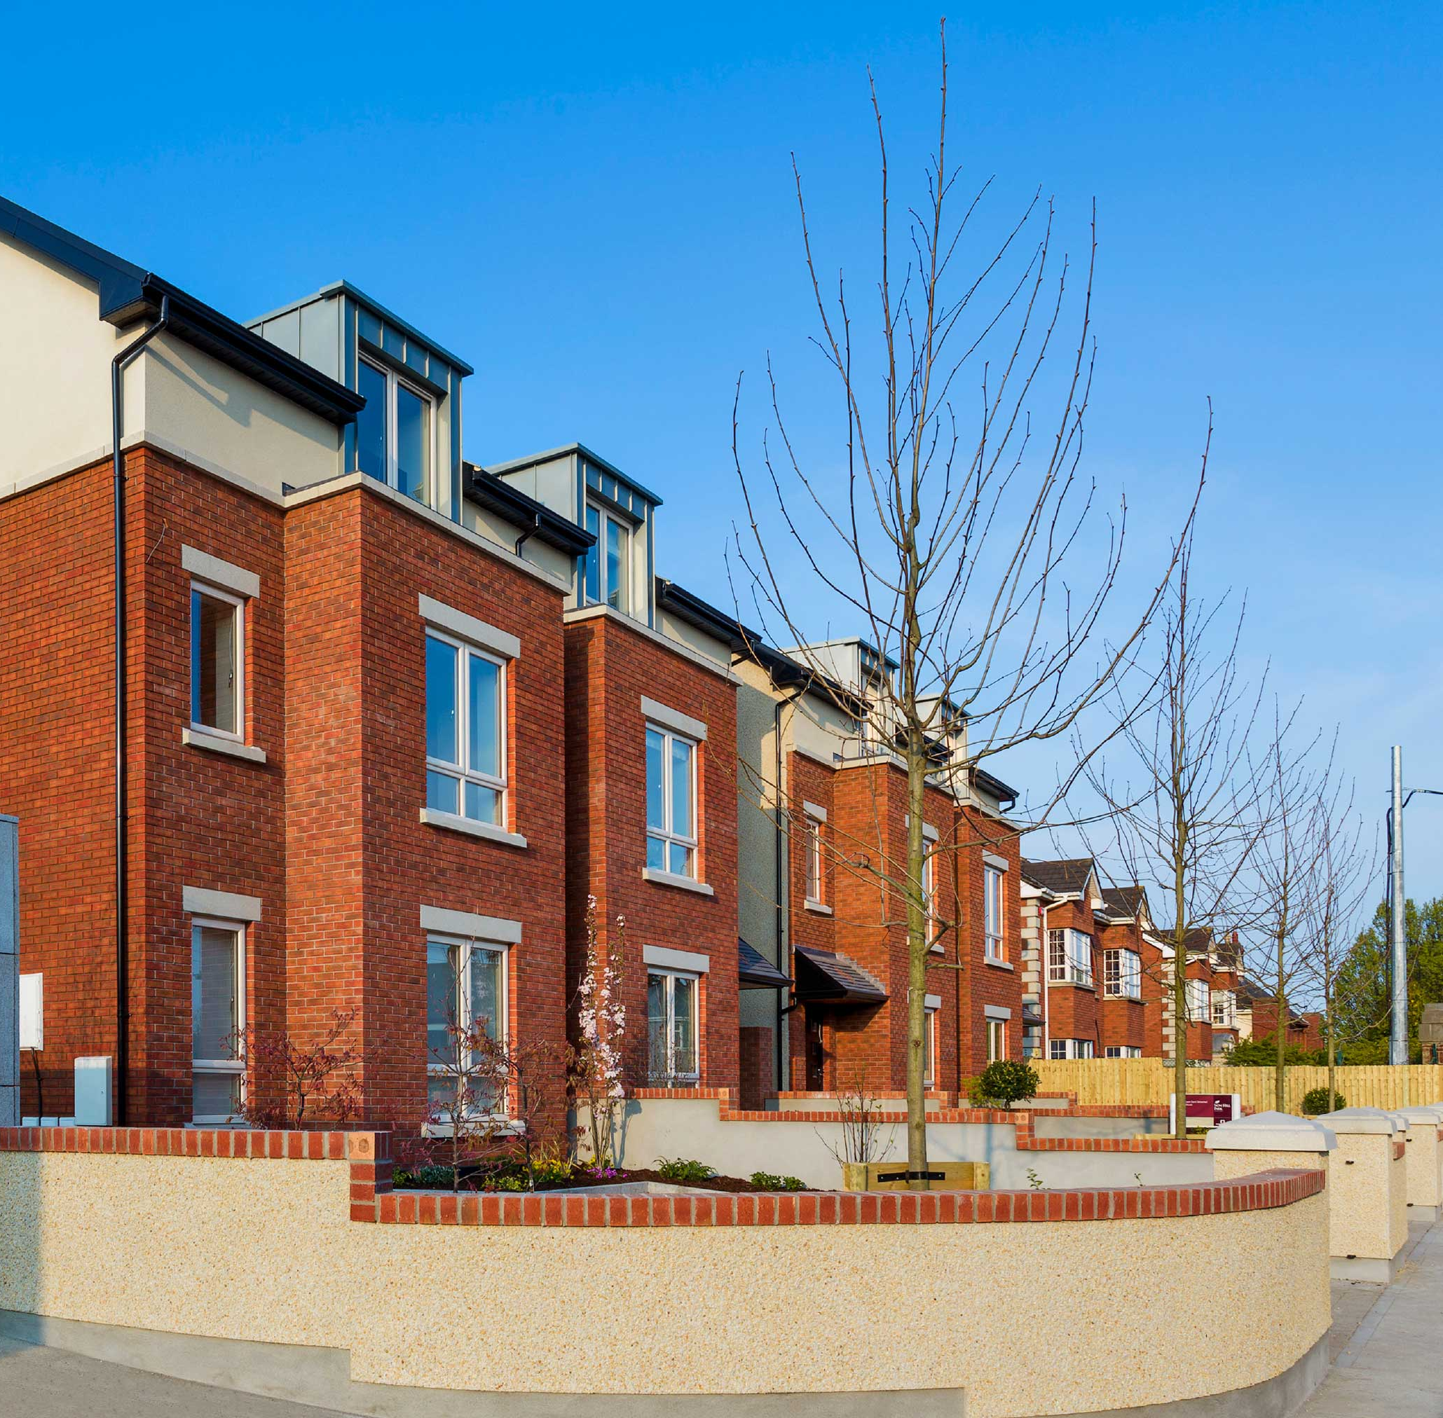
Ballycullen Local Area Plan 2014 Context
Plan Adoption
May 2014
Key Elements:
1,600 Residential Units (excluding extant permissions)
2 Schools
Neighbourhood Parks
Playing Pitches
Phasing Strategy
Eastern Lands: 3 Phases
Western Lands: 3 Phases

Slide 4
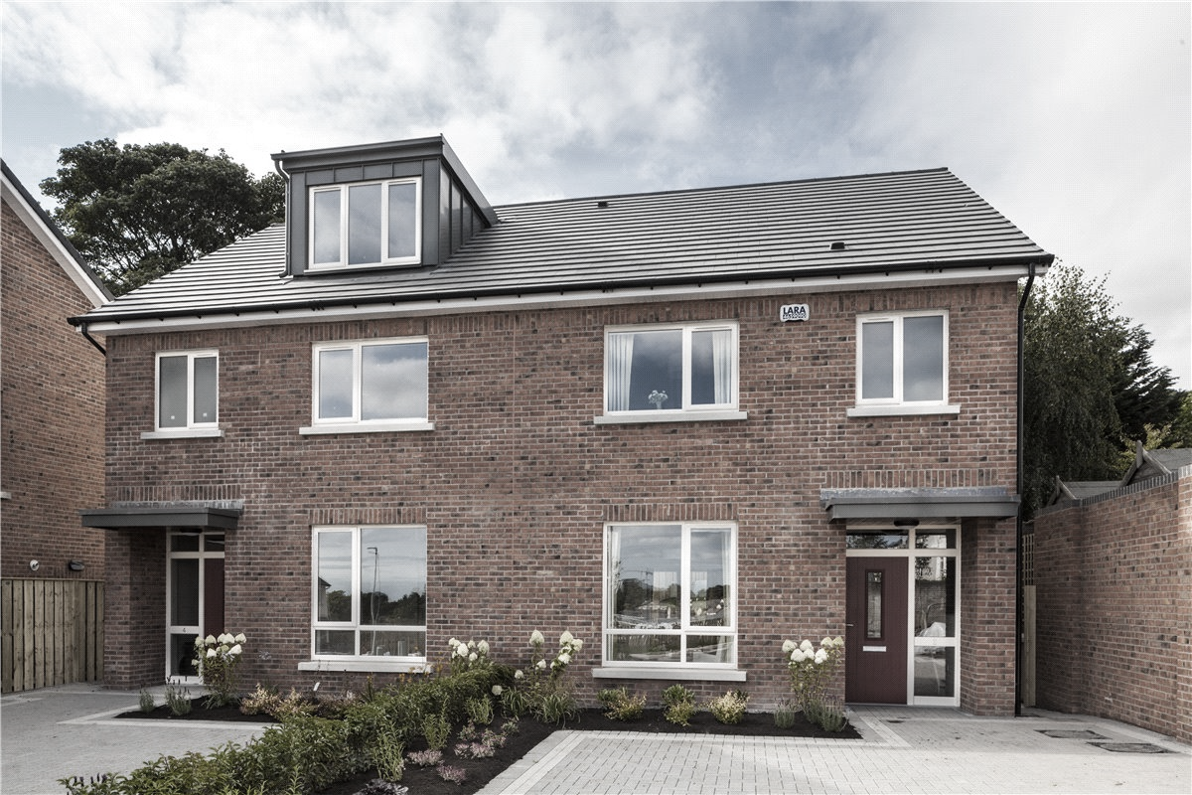
Local Area Plan Delivery Update
Residential Development
Eastern Lands (Pre LAP)
Permitted: 535 Residential Units
Complete: 413 Residential Units
Outstanding: 122 Residential Units
Eastern Lands (Post LAP)
Permitted: 193 Residential Units
Complete: 21 Residential Units
Outstanding: 172 Residential Units
Current Phase
Phase 1 on Eastern LAP Lands
Residential Development
Western Lands (Pre LAP)
Permitted: 0
Western Lands (Post LAP)
Permitted: 211 Residential Units
Complete: 52 Residential Units
Outstanding: 159 Residential Units
Current Phase
Phase 1 on Western LAP Lands

Slide 5
Local Area Plan Development Activity – Spatial Analysis
School Site

Slide 6
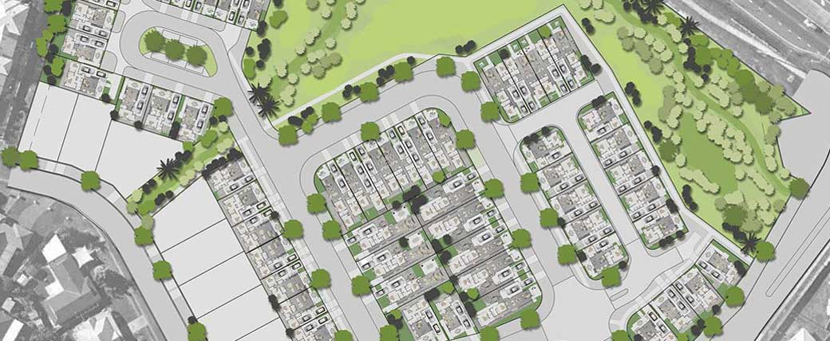
Ballycullen Oldcourt Local Area Plan – Anticipated Future Planning Activity
Key Elements (Western Lands)
Planning Applications:
2018: New Link Road & Relocation of ESB Lines
450 Residential Dwellings
2019: 50 Residential Dwellings
2020 – 2021: 160 Residential Dwellings
Construction of housing delivered on phased basis upon receipt of planning permission – Development expected to be complete in 2022 (subject to planning).

Slide 7
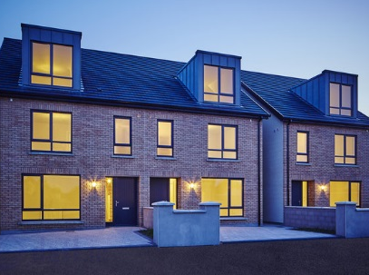
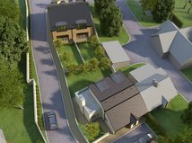
Phasing Issue & Local Authority Response
Phasing Issue
School Provision Premature
Increased Population Requirement to Necessitate School Delivery
Resultant Impact
Restricting Residential Development Planning Applications
Halts all Residential Development
Undermining Compliance with Rebuilding Ireland Commitments
SDCC Issue Analysis
Assessment of Phasing Requirements
Engagement with Key Stakeholders
Recommended LAP Amendment

Slide 8

Department of Education & Skills Analysis
Criteria
Primary School:
Generally 8 classrooms (& multiples of).
Requires a Population of 1,800 & Housing of 620 units (avg. 2.9 person per household).
Based on PTR Ratio 27:1 & 12% of population is of primary school going age.
Assessment
Western Lands:
No. units permitted: 203 houses & 8 duplex’s
Projected population: 580
Projected primary school population: 70
Primary School requirement: 3 Classrooms
Findings & Recommendation
Current level of development ‘‘would not prompt the immediate provision of a new primary school”.

Slide 9
Department of Education & Skills Analysis
Criteria
Primary School:
Generally 8 classrooms (& multiples of).
Requires a Population of 1,800 & Housing of 620 units (avg. 2.9 person per household).
Based on PTR Ratio 27:1 & 12% of population is of primary school going age.
Assessment
Western Lands:
No. units permitted: 203 houses & 8 duplex’s
Projected population: 580
Projected primary school population: 70
Primary School requirement: 3 Classrooms
Findings & Recommendation
Current level of development ‘‘would not prompt the immediate provision of a new primary school”.
Department of Education & Skills are fully committed to delivering the schools as proposed in the Local Area Plan & the lands are both reserved and available.

Slide 10

Ballycullen Oldcourt Local Area Plan – Strategic Importance
Location
High Demand Dublin Location
Planning Framework
LAP Adopted – Zoned & Serviced Land
Housing Output
1,600 Residential Units
Construction Activity
73 Dwellings Complete (Post LAP)
LIHAF Application
New Main Link Road: €6.325 Million
Relocation of ESB Lines: €1.8 Million
Determination
Decision due mid-December 2016

Slide 11
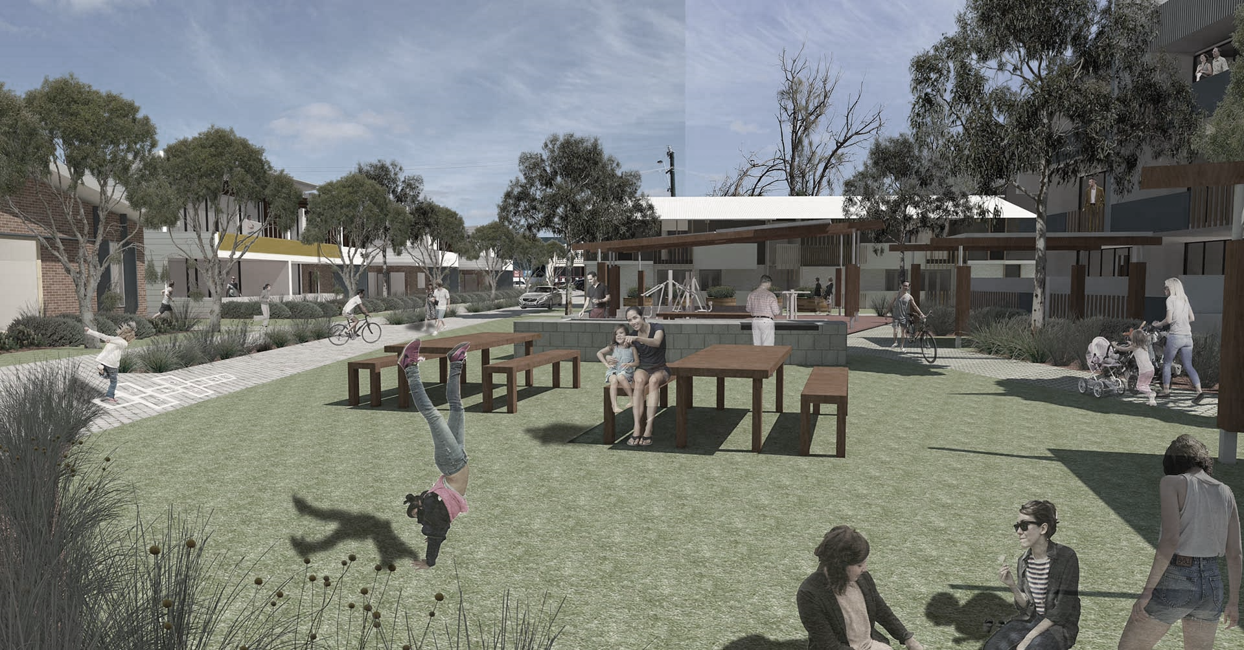
Ballycullen Oldcourt Local Area Plan – Proposed Phasing Amendment
Key Elements
Provides for continued provision of housing in phasing strategy.
Aligns provision of schools with required quantum of housing supply.
Phasing of other community facilities remains the same.
Minor amendments to Eastern LAP Lands.
Amendments primarily relate to Western LAP Lands.

Slide 12
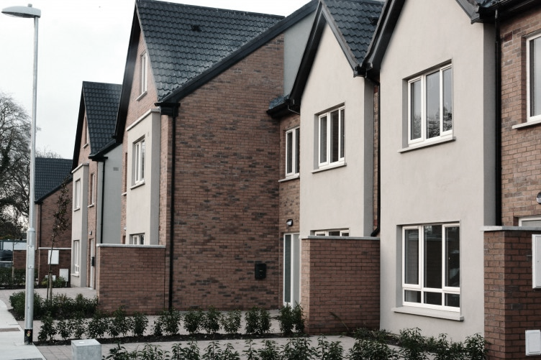
Ballycullen Oldcourt Local Area Plan – Proposed Phasing Amendments
Local Area Plan - Eastern Lands
PHASE ONE
Key Development | 260 dwellings (if all permitted developments are modified in accordance with this Local Area Plan)ª
Key Outcomes Required before Next Phase | Knocklyon Park Extension to include link to existing parkland/playing pitches to the north-east, upgrade of roundabout junction to four arm junction and 1 x NEAP (see Appendix 2 of LAP) Commencement of construction of a school on the designated primary school site on the eastern side of the Plan Lands OR on the designated primary school site on the western side of the Plan Lands^{b} Commencement of construction of Stocking Wood Neighbourhood and Community Centre to include at least 190 sq.m of community floorspace, at least 270 sq.m of childcare floorspace, convenience shopping (not exceeding 1,500 sq.m gross) and a bus lay-by^{c}
Rationale | A substantial number of dwellings have been constructed on the eastern side of the Plan Lands with little or no public open space, local convenience shopping, bus stop facilities, community facilities, childcare facilities or play facilities. To provide primarily for the needs of existing residents, these amenities must be provided prior to or in tandem with the construction of any further housing in the area. A primary school is also required to meet the existing population needs of the Plan Lands and its surrounding suburban hinterland.

Slide 13
Ballycullen Oldcourt Local Area Plan – Proposed Phasing Amendments
Local Area Plan - Eastern Lands
PHASE TWO
Key Development | 150 dwellings
Key Outcomes Required before Next Phase | Completion of Stocking Wood Neighbourhood and Community Centre to include at least 190 sq.m of community floorspace in addition to the minimum quantum set out under Phase One (at least 460 sq.m community floorspace total) plus any additional required childcare floorspace and upgrade of roundabout junction to four arm junction with crossing facilties^{c} Completion and operation of a primary school on the designated primary school site on the eastern side of the Plan Lands OR on the designated primary school site on the western side of the Plan Lands^{b} Commencement of landscaping of Green Buffer with tracks and trails along southern boundary with mountains
Rationale | Further community and neighbourhood facilities will be required to meet the needs of further residents on the eastern side of the Plan Lands as they continue to develop. A school will also need to be in place.

Slide 14
Ballycullen Oldcourt Local Area Plan – Proposed Phasing Amendments
Local Area Plan - Eastern Lands
PHASE THREE
Key Development | 110 dwellings
Key Outcome Required Before Completion of Phase | Site made available for construction of a second primary school on the remaining designated primary school on the eastern or western side of the Plan Lands^{b} Completion of landscaping of Green Buffer with tracks and trails along southern boundary with mountains Commencement of construction of a school on the designated primary school site on the eastern side of the Plan Lands OR on the designated primary school site on the western side of the Plan Lands.
Rationale | Two primary schools will be required to meet the existing and future population needs of the Plan Lands and its surrounding suburban hinterland. Green buffers must be in place before the lands are fully developed particular the partially developed eastern side of the Plan Lands. A primary school is also required to meet the existing and new population needs of the Plan Lands and its surrounding suburban hinterland.
PHASE FOUR
Key Development | Completion of balance of permissible residential development on eastern side of Plan Lands: - approx. 100 dwellings
Key Outcomes Required Before Next Phase | Site made available for construction of the designated second primary school on the eastern and western side of the Plan Lands
Rationale | Two primary schools will be required to meet the existing and new population needs of the Plan Lands and its surrounding suburban hinterland.

Slide 15
Ballycullen Oldcourt Local Area Plan – Proposed Phasing Amendments
Local Area Plan - Western Lands
PHASE ONE
Key Development | Option A (relocation of 220 kV lines) – 200 dwellings Option B (retention of existing 220 kV lines) – 150 dwellings
Key Outcomes Required Before Next Phase | Commencement of works on Gunny Hill playing pitches including access 1 x NEAP on western side of Plan Lands (see Appendix 2 of LAP) Commencement of construction of a school on the designated primary school site on the eastern side of the Plan Lands OR on the designated primary school site on the western side of the Plan Lands^{b} Site made available for construction of a Primary School on the eastern or western side of the Plan Lands
Rationale | Public open space and children’s play facilities will be required to serve new housing development on the western side of the Plan Lands. A primary school is also required to meet the existing population needs of the Plan Lands and its surrounding suburban hinterland.
PHASE TWO
Key Development | Option A (relocation of 220 kV lines) – 300 dwellings Option B (retention of existing 220 kV lines) – 220 dwellings
Key Outcomes Required Before Next Phase | Completion of Gunny Hill playing pitches including access Completion and operation of a primary school on either of the two designated primary school sites within the Plan Lands^{b} Site made available for construction of a Primary School on the eastern or western side of the Plan Lands Commencement of landscaping of Oldcourt Park with access and 1 additional NEAP for western side of Plan Lands The provision of a minimum of 300 sq.m. of community floorspace
Rationale | Public open space and children’s play facilities will be required to serve new housing development on the western side of the Plan Lands.

Slide 16
Ballycullen Oldcourt Local Area Plan – Proposed Phasing Amendments
Local Area Plan - Western Lands
PHASE THREE
Key Development | Completion of balance of permissible residential development on western side of Plan Lands: Option A (relocation of 220 kV lines) – approx. 460 dwellings 350 dwellings Option B (retention of existing 220 kV lines) – approx. 460 dwellings 350 dwellings
Key Outcomes Required Before Next Phase | Site made available for construction of a second primary school on the remaining designated primary school on the eastern and western side of the Plan Lands Completion of Oldcourt Park Commencement of planning process for the provision of a school on the designated primary school site on the eastern side of the Plan Lands OR on the designated primary school site on the western side of the Plan Lands.
Rationale | Two primary schools and parkland facilities will be required to meet the existing and future population needs of the Plan Lands and its surrounding suburban hinterland. Parkland facilities will be required to meet the existing and future population needs of the Plan Lands and its surrounding suburban hinterland. A Primary School is also required to meet the existing and new population needs of the Plan Lands and its surrounding suburban hinterland.
PHASE FOUR
Key Development | Completion of balance of permissible residential development on western side of Plan Lands: Option A (relocation of 220 kV lines) – approx. 110 dwellings Option B (retention of existing 220 kV lines) – approx. 110 dwellings
Key Outcomes Required Before Next Phase | Commencement of construction of the designated Primary Schools on the eastern and western side of the Plan Lands
Rationale | Two Primary Schools will be required to meet the existing and new population needs of the Plan Lands and its surrounding suburban hinterland.

Slide 17
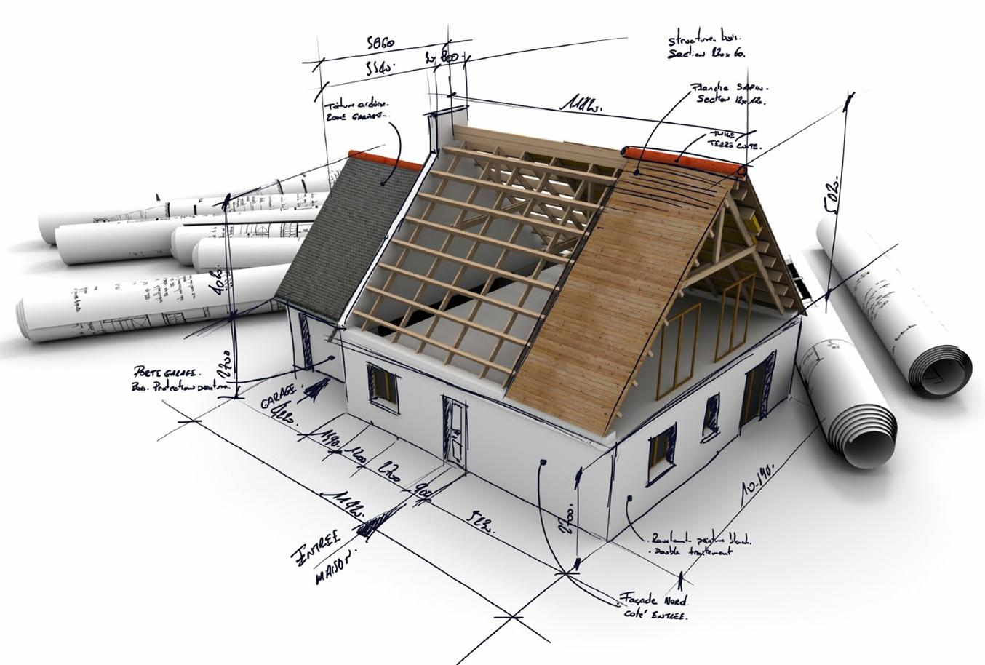

Ballycullen Oldcourt Local Area Plan Proposed Amendment – Next Steps
Next Steps
Finalisation of Draft Amendment
Public Display & Consultation
Preparation of Report
Elected Representatives Consideration of Amendment
Plan Implementation

Slide 18
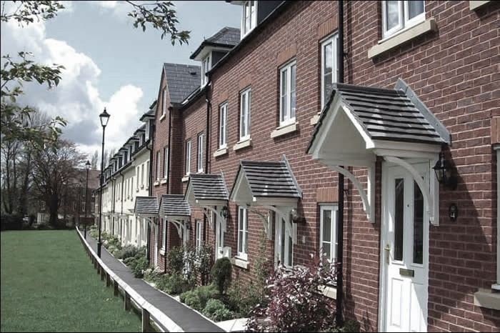
THANK YOU!

