Slide 1


Dublin Regional enterprise Strategy:
2017-2019
South Dublin County Council
Strategic Policy Committee for Economic Development, Enterprise and Tourism
9th November 2016

Slide 2
Summary of presentation
Establishing the Context
Policy Framework
Enterprise Landscape – Regionally
Strategic Pathway to develop Strategy
Vision to Actions

Slide 3
Establishing the Context
Joint strategy for Enterprise for the four Dublin local authorities.
Three year strategy to guide enterprise growth and development.
Clear benefits to a combined strategy at a regional level:
  Joint initiatives;
  Complementarities and synergies;
  Enhanced sharing of best practices;
  Consistent voice for the Dublin Region.

Slide 4
Policy Framework
A ‘systems’ approach:
  Creating networks;
  Cluster development;
  Addressing coordination issues;
  Aligning strategic priorities;
  Dialogue with enterprise.
Underlying Themes:
  Technological change;
  Skills and talent;
  Local enterprise reform;
  Entrepreneurship and Innovation;
  Place-making;
  Smart specialisation;
  Change and adaptation.

Slide 5
Enterprise Landscape

Slide 6
Enterprise Landscape
Dublin Region:
  43% of national GVA;
  30% of employment.
Many Strengths:
  Including Pharma, ICT, Financial Services;
  Educated, diverse, open to new ideas;
  Connected nationally and internationally.
Key Identified Issues:
  Affordable housing;
  Quality of Life;
  Collaboration across agencies;
  Start-up growth;
  Third level collaborations;
  Skills needs and potential shortages;
  Responsive education and training.

Slide 7
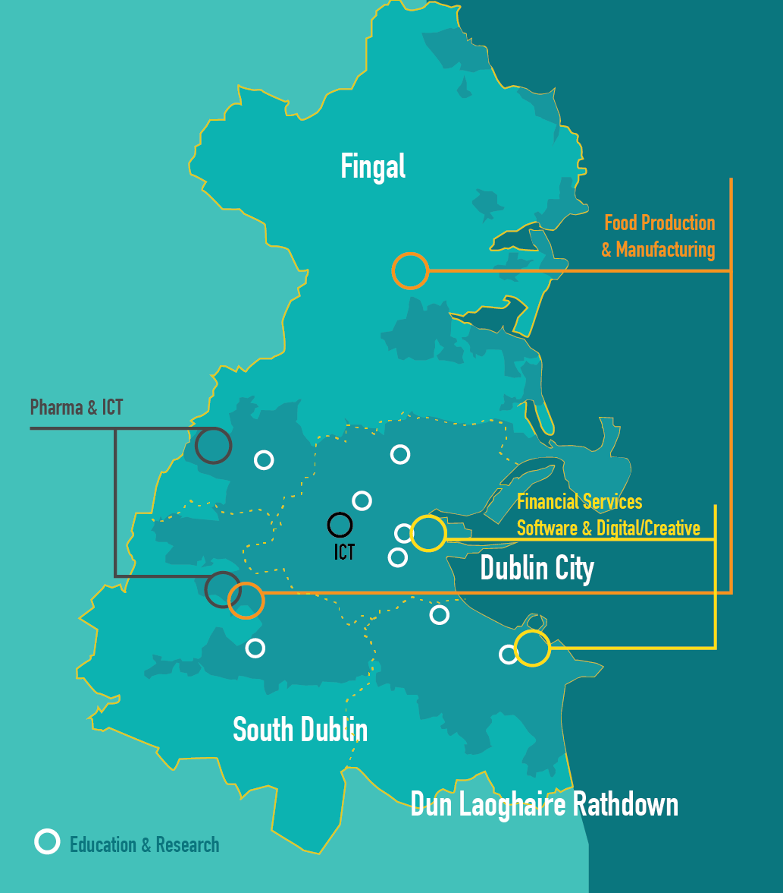
Enterprise Landscape
Regional Potential
“Opportunity Growth
Areas”:
  Design and Creative Industries;
  Food Industry;
  Green Economy;
  International Financial Services;
  Pharma/BioPharma;
  Software and Digital;
  Tourism;
  Education.

Slide 8
‘Strategic Pathway’ to develop

Slide 9
Vision for enterprise development
“…for the creation of a sustainable, globally competitive and innovative enterprise and living environment”.

Slide 10
‘Enterprise Drivers’
  City Region Positioning.
  Meeting the needs of Entrepreneurs and Enterprises.
  Potential ‘Growth Opportunity Areas’.
  Skills, Education and Training.
  Culture of Entrepreneurship and Innovation.

Slide 11
Key ‘Objectives’ associated with each Driver
  A unified, integrated vision for the Dublin Region.
  High-quality, efficient, responsive and supportive enterprise environment.
  Build on emerging sectoral advantages.
  Targeted educational and training initiatives.
  Culture of entrepreneurship and innovation.

Slide 12
‘Recommendations’ and ‘Actions’
‘Recommendations’ to ensure the delivery of the ‘Objectives’.
‘Actions’ to secure the ‘Recommendations’.
  12 Recommendations in total.
  1-4 Recommendations per Objective.

Slide 13
‘Actions’
Actions:
    Defined by the review of policy and the enterprise landscape, consultation and collaboration with the Steering Committee.
    19 Actions in total.
    1-6 Actions per Recommendation.
    Time-specific:
      Short-term (1-12 months);
      Medium-term (12-36 months);
      Long-term (36 months +).
    At regional level and at local authority level.
    Given a measure/monitoring mechanism.
    Allocated partners.

Slide 14
Action 1
Objective: City Region Positioning.
Recommendation: Develop a ‘Dublin Regional Enterprise Brand’ and proposition for national and international promotion.
Action: Using the dublin.ie website as a medium, create and develop an agreed 'enterprise brand' for the Dublin Region to be promoted nationally and internationally.
Local Authority: Regional Action.
Term: Short-term Action.
Monitor/Measure: Brand created and representative appointed.

Slide 15
Action 3
Objective: High-quality, efficient, responsive and supportive enterprise environment.
Recommendation: Develop a coordinated approach to promoting and supporting models of enterprise space across the Region.
Action: Create an Action Plan to promote, facilitate and incentivise the uptake of vacant and underutilised enterprise space (retail, commercial, industrial, etc.), and to identify and address key infrastructural barriers and increase progression from supported enterprise space. Example: consider use and expansion of SDCC's 'Business Support Grants'.
Local Authority: Regional Action.
Term: Medium-term Action.
Monitor/Measure: Action Plan prepared and enacted.

Slide 16
Action 11
Objective: Potential ‘Growth Opportunity Areas’.
Recommendation: Facilitate the synergistic clustering of enterprises.
Action: Explore collaborative 'Mountains to the Sea' tourism opportunities in the context of the 'A Breath of Fresh Air' tourism marketing campaign to promote the Region's marine and mountain amenities.
Local Authority: Regional Action.
Term: Short-term Action.
Monitor/Measure: Opportunities identified and plans implemented.
Partner: Fáilte Ireland.

Slide 17
questions
Many thanks for your time.
We are now happy to take questions.

Slide 18
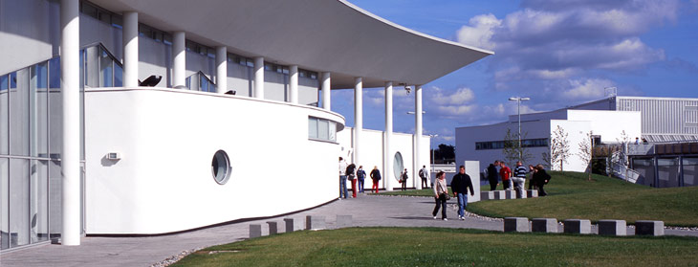



Thank you
Dublin Regional Enterprise Strategy 2017-2019

